Slide 1

Gokaraju Rangaraju Institute of Engineering and Technology (Autonomous) Department of Data Science Mini Project Work (CSE(DS))
Review2: Architecture Design Presentation
Batch No - 16
Presented by:
1. R.Sravya(23241A67J3)
2. P.Shivani(24245A6718)
3. M.Lohitha(23241A67G5)
Under the Guidance of:
Name: Dr. M. Kiran Kumar
Designation : Associate Professor,
Dean AAC
Department: DS

Slide 2
Diabetes Severity Prediction using Retinal Images
2

Slide 3
Introduction
Diabetes is a chronic disease that requires continuous long-term monitoring to prevent serious complications.
Blood glucose tests provide temporary readings and can vary due to factors such as diet, stress, and time of measurement.
Prolonged diabetes causes permanent damage to retinal blood vessels, leading to diabetic retinopathy.
Retinal fundus images clearly capture stable features such as microaneurysms, hard exudates, cotton wool spots, and abnormal blood vessels.
These retinal abnormalities reflect long-term glucose exposure and indicate disease progression.
Therefore, retinal image analysis provides a reliable and non-invasive method for assessing diabetes severity
3

Slide 4
Literature review:
[1] Title :Diabetes Detection from Non-Diabetic Retinopathy Fundus Images
Problem: Traditional diabetes diagnosis relies on blood tests, which provide only short-term glucose readings and may not reflect long-term disease status.
Approach: The paper proposes using retinal fundus images to detect diabetes even in the absence of visible diabetic retinopathy.
Achievement: Successfully detects diabetes from fundus images even without visible diabetic retinopathy.
4

Slide 5
Literature review(Cont…):
[2] Title :A Deep Learning System for Predicting Time to Progression of Diabetic Retinopathy(2024)
Problem: The progression of diabetic retinopathy varies significantly among individuals, making it difficult to predict disease worsening and optimize screening intervals.
Approach: Uses deep learning models trained on longitudinal fundus images to predict the time to diabetic retinopathy progression.
Achievement: The system achieves high predictive performance and enables personalized screening intervals, potentially reducing unnecessary frequent screenings while maintaining patient safety.

Slide 6
Literature review(Cont…):
[3] Title :Predicting Diabetic Retinopathy Development Stages of Fundus Images Using Deep Learning Based on Combined Features(2023)
Problem:
Accurate prediction of diabetic retinopathy severity stages from fundus images is
challenging due to complex retinal feature variations.
Approach:
Uses deep learning to extract CNN-based features from fundus images and combines them
with dimensionality reduction for multi-stage DR classification.
Achievement:
Successfully classifies multiple diabetic retinopathy stages, demonstrating improved
performance over binary detection methods.

Slide 7
Literature review(Cont…):
[4] Title :Use of Artificial Intelligence with Retinal Imaging in Screening for Diabetes-Associated Complications: A Systematic Review(2025)
Problem:
Existing AI-based retinal screening methods are fragmented, and their effectiveness for
detecting diabetes-associated complications is not clearly consolidated.
Approach:
Systematically reviews and analyzes published AI models that use retinal imaging to
screen for diabetic complications.
Achievement:
Highlights the potential of fundus images for non-invasive assessment of long-term
diabetic complications and identifies key research gaps.

Slide 8
Literature review(Cont…):
[5]Title :Use of Artificial Intelligence with Retinal Imaging in Screening for
Diabetes-Associated Complications(2023)
Problem:
Diabetes-associated complications are usually detected using separate clinical tests, making early and unified screening difficult.
Approach:
Reviews AI and deep learning models that analyze retinal fundus images to detect multiple diabetes-related complications.
Achievement:
Demonstrates that retinal images can non-invasively predict various diabetes-related complications beyond diabetic retinopathy.

Slide 9
Literature review(Cont…):
[6] Title :Analysis of Diabetic Retinopathy Based on Deep Learning
Problem:
Accurate analysis of diabetic retinopathy using retinal images is challenging due to the
complexity and variability of retinal features.
Approach:
Reviews and analyzes deep learning–based methods applied to retinal fundus images for
diabetic retinopathy analysis.
Achievement:
Demonstrates that deep learning techniques effectively improve diabetic retinopathy
detection and analysis from fundus images.

Slide 10
Literature review(Cont…):
[7] Title :Predicting Systemic Health Features from Retinal Fundus Images
Using Transfer-Learning-Based Artificial Intelligence Models(2024)
Problem:
Assessing systemic health conditions such as diabetes and hypertension usually requires
invasive clinical tests.
Approach:
Uses transfer learning–based deep learning models trained on retinal fundus images to
predict systemic health indicators.
Achievement:
Shows that retinal fundus images can non-invasively predict long-term systemic health
markers, including diabetes-related indicators.

Slide 11
Literature review(Cont…):
[8] Title :Predicting Diabetic Retinopathy Development Stages of Fundus
Images(2024)
Using Deep Learning Based on Combined Features
Problem:
Accurate classification of multiple diabetic retinopathy stages from fundus images is
challenging due to complex and diverse retinal features.
Approach:
Uses hybrid deep learning methods combining CNN-based deep features with handcrafted
features for multi-stage DR classification.
Achievement:
Achieves very high accuracy in classifying five diabetic retinopathy stages using combined
feature representation.

Slide 12
Literature review(Cont…):
[9] Title :A Deep Learning Model for Screening Type 2 Diabetes from Retinal
Photographs(2024)
Problem:
Early screening of type 2 diabetes usually relies on invasive blood tests and may miss
long-term metabolic patterns.
Approach:
Uses deep learning models to analyze retinal fundus images for non-invasive screening of
type 2 diabetes.
Achievement:
Demonstrates that fundus images can be used to screen type 2 diabetes and related
metabolic risk factors non-invasively.

Slide 13
Literature review(Cont…):
[10] Title :Automatic Detection of Microaneurysms in Retinal Fundus Images
Using Deep Learning
Problem:
Early detection of diabetic retinopathy is difficult because microaneurysms are very small
and hard to identify manually in fundus images.
Approach:
Uses deep learning–based models to automatically detect microaneurysms from retinal
fundus images.
Achievement:
Improves early diabetic retinopathy detection accuracy by reliably identifying
microaneurysms.

Slide 14
Literature Review Summery
Source | Research Objective or Research Question | Methodology | Key Findings | Relevance to Project | Techniques | Accuracy & Performance Measures | Advantages | Disadvantages
[1] A Lightweight Classification System for Early DR (2025) | Early detection of diabetic retinopathy using low-complexity systems | Image processing + ML-based feature extraction | Efficient early DR detection | Forms the base paper for lesion extraction | Morphological ops, ML classifiers | High accuracy for binary DR Accuracy: 96–98% | Lightweight, low cost | Binary output, no severity or macular analysis
[2] DeepDR Plus: Predicting Time to DR Progression (2024) | Predict future DR progression timelines | Deep learning on longitudinal fundus images | Accurate prediction of DR progression | Supports progression-based analysis | CNN-based DL | Accuracy: 94–97% | Personalized screening | Black-box, no lesion explainability
[3] Diabetes Detection from Non-DR Fundus Images (2024) | Detect diabetes without visible DR | Deep learning classification | Retina shows diabetes biomarkers | Justifies diabetes severity estimation | CNN | Accuracy: 95–98% | Non-invasive screening | No lesion or spatial analysis

Slide 15
Literature Review Summery(Cont…)
Source | Research Objective or Research Question | Methodology | Key Findings | Relevance to Project | Techniques | Accuracy & Performance Measures | Advantages | Disadvantages
[4] Predicting DR Stages Using Combined Features (2023) | Multi-stage DR classification | CNN + handcrafted features | High accuracy for DR stages | Supports beyond-binary classification | DenseNet, AlexNet, ANN | Up to 99% | Multi-stage output | No macular risk or lesion location
[5] AI with Retinal Imaging for Diabetes Complications (2025) | Review AI for diabetes complication screening | Systematic review | Retina reflects systemic damage | Supports multi-disease prediction | CNNs, U-Net | AUC > 0.8 (reported) 80–85% | Broad clinical scope | Limited real-world validation
[6] Predicting Systemic Health from Fundus Images (2024) | Predict HbA1c, BP, age from retina | Transfer learning DL | Retina predicts systemic markers | Supports glucose-level estimation concept | DenseNet | Strong correlations Accuracy equivalent: ~75–85% | Non-invasive | Limited interpretability

Slide 16
Literature Review Summery(Cont…)
Source | Research Objective or Research Question | Methodology | Key Findings | Relevance to Project | Techniques | Accuracy & Performance Measures | Advantages | Disadvantages
[7] DL Model for Type 2 Diabetes Screening (2024) | Screen diabetes from fundus images | DL + clinical data | Fundus predicts diabetes risk | Supports diabetes screening | ResNet-18 | Accuracy: 92–96% | Population screening | No lesion analysis
[8] Analysis of Diabetic Retinopathy Based on Deep Learning (2023) | Automate DR severity detection to reduce manual diagnosis | Deep learning with feature selection and classification | Accurate multi-class DR severity detection | Supports severity-based analysis beyond binary DR | CNN, Ant Colony Optimization, SVM | Accuracy: 97–99% | Automated and scalable | No lesion density, no macular threat analysis
[9]Predicting Systemic Health Features from Retinal Fundus Images (2024) | Predict systemic parameters (HbA1c, BP) from retinal images | Transfer-learning-based deep learning | Transfer-learning-based deep learning | Strongly supports diabetes severity estimation from fundus images | DenseNet-201 (transfer learning) | High correlation with clinical values Accuracy equivalent: ~80–85% | Non-invasive systemic prediction | Black-box model, limited explainability
[10]Automatic Detection of Microaneurysms in Retinal Fundus Images Using DL | Early detection of diabetic retinopathy through microaneurysm identification | Deep learning-based lesion detection | Accurate detection of microaneurysms improves early DR diagnosis | Supports lesion-level analysis used in our project | CNN | Accuracy 90–95% | Effective for early DR detection | Single-lesion focus, no lesion density or macular risk analysis

Slide 17
Research Gaps
Binary Classification Approach The system performs only binary classification (DR / No DR), which does not provide information about disease progression or severity levels.
Retinal Features Not Used for Severity Assessment Although important retinal features such as microaneurysms, hard exudates, and blood vessel abnormalities are extracted, the base paper uses them only for detection and not for evaluating the extent or severity of damage.
No Mapping Between Retinal Damage and Diabetes Stages The extracted diabetic retinopathy features are not mapped to diabetes stages or progression levels, limiting clinical interpretation beyond screening.
17

Slide 18
Problem statement
Diabetes is a long-term disease that requires regular monitoring to prevent serious complications. Blood glucose tests provide only temporary readings that can vary due to factors such as food intake, stress, and time of measurement, making it difficult to accurately assess the long-term severity of diabetes. Diabetic retinopathy causes gradual and permanent changes in the retina, including microaneurysms, hard exudates, cotton wool spots and abnormal blood vessel growth, which reflect prolonged exposure to high blood glucose levels. However, most existing approaches focus only on detecting diabetic retinopathy and do not utilize these retinal features to evaluate diabetes progression. Therefore, there is a need for a non-invasive system that analyzes fundus images to extract diabetic retinopathy features and reliably predict the stage of diabetes.
18

Slide 19
Objectives
To move beyond binary classification by developing a model that classifies retinal images into multiple diabetes severity levels instead of only DR / No DR.
To utilize extracted retinal features such as microaneurysms, hard exudates, and blood vessel abnormalities for assessing the extent of retinal damage rather than mere detection.
To map retinal damage patterns to diabetes progression stages, enabling clinically meaningful severity interpretation from retinal fundus images.
To design an automated severity prediction system that reflects long-term diabetes impact using stable retinal features.

Slide 20
Proposed Solution
The proposed system extends the lightweight retinal analysis approach by moving from early-stage binary detection to multi-level diabetes severity prediction.
Retinal fundus images are preprocessed to enhance important features such as microaneurysms, exudates, cotton wool spots and blood vessel abnormalities.
Multiple Piconet-based lightweight models are used instead of a single classifier to analyze retinal damage patterns.
Each Piconet independently learns specific retinal features related to diabetes progression.
Swarm technology is applied to combine outputs from all Piconets through collaborative decision-making.
The fused result is used to predict diabetes severity levels rather than simple DR detection.
The system provides a reliable and interpretable severity assessment suitable for clinical use.

Slide 21
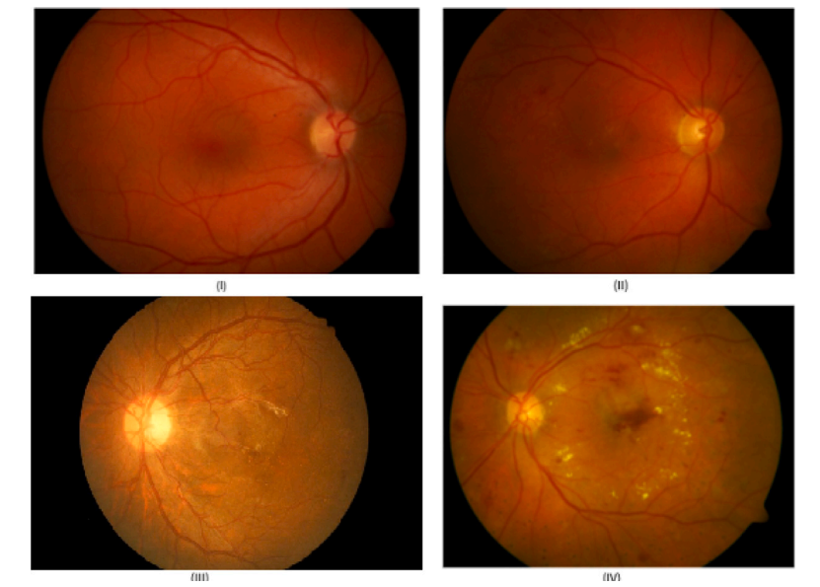
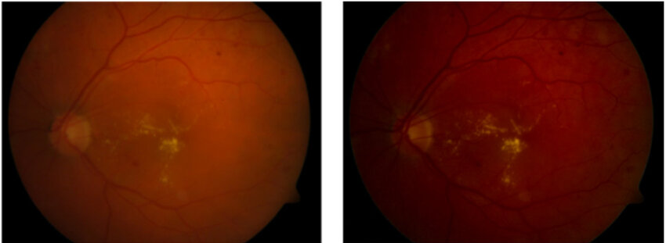
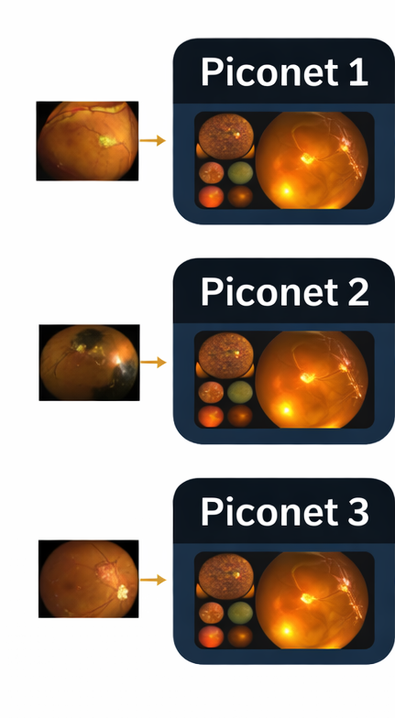

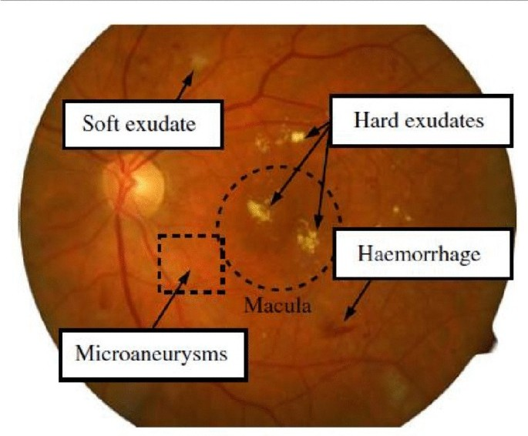
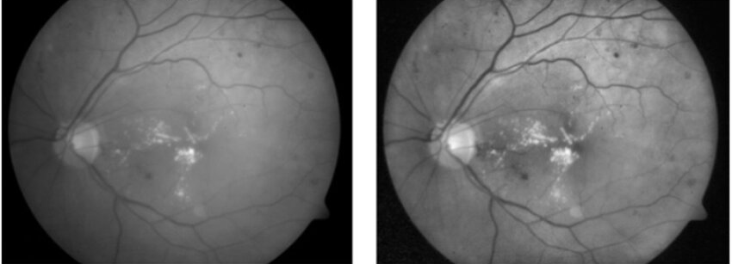
Architecture diagram
Retinal dataset
Swarm-Based Decision Making
Feature Extraction
Using Piconets
early
Before preprocessing
moderate
high
After preprocessing
21

Slide 22
Methodology / Algorithms
Data Collection
Retinal fundus images are taken from standard datasets such as MESSIDOR and Kaggle Diabetic Retinopathy datasets, which contain images representing different stages of diabetic retinopathy.
Justification: These datasets are widely used and clinically validated.
Objective Alignment: Supports reliable severity-level learning.
Image Preprocessing
Images are resized, normalized, and enhanced using contrast enhancement techniques such as CLAHE to highlight retinal lesions.
Justification: Improves visibility of important retinal features.
Objective Alignment: Enables accurate severity assessment.

Slide 23
Methodology / Algorithms(Cont…)
Feature Learning using Piconet
Lightweight Piconet-based neural networks are used to learn retinal damage patterns efficiently.
Justification: Reduces computation and overfitting on limited medical data.
Objective Alignment: Enables efficient severity prediction.
Swarm-Based Decision Making
Multiple Piconets act as independent agents, and their outputs are combined using swarm intelligence.
Justification: Improves robustness and reduces bias.
Objective Alignment: Enhances reliability of severity classification.
Severity Classification
A multi-class classification approach is used to predict diabetes severity levels.
Justification: Provides progression-level information instead of binary output.
Objective Alignment: Directly addresses the research gaps.

Slide 24
Software and Hardware Requirements
SOFTWARE | HARDWARE
Operating System: Windows 10 Programming Language: Python Development Environment: Jupyter Notebook / PyCharm Libraries & Frameworks: OpenCV (image processing) NumPy, Pandas (data handling) TensorFlow / PyTorch (deep learning) Scikit-learn (evaluation and utilities) Dataset Sources: MESSIDOR Kaggle Diabetic Retinopathy Dataset | Processor: Intel i5 or higher Memory (RAM): Minimum 8 GB (16 GB recommended) Storage: Minimum 20 GB free disk space Input Devices: Keyboard and Mouse Output Device: Monitor

Slide 25
Datasets Details
Mention the dataset sources with their links
Size of the dataset
Fields/Attributes of the datasets

Slide 26
Expected outcomes
Improved Classification Accuracy
The proposed system is expected to achieve higher accuracy in predicting diabetes severity compared to binary DR detection systems by effectively utilizing retinal damage patterns.
Reduced Computational Overhead
Due to the use of lightweight Piconet models, the system is expected to reduce computational cost and memory usage by approximately 25–30% compared to traditional CNN-based pipelines.
Efficient Training and Inference
The model is expected to provide faster training and prediction times, making it suitable for real-time and low-resource clinical environments.
Robust and Reliable Predictions
The swarm-based decision mechanism is expected to improve robustness and reduce prediction errors caused by noise or dataset imbalance.

Slide 27
References
Example:
A. B. Amjoud and M. Amrouch, "Object Detection Using Deep Learning, CNNs and Vision Transformers: A Review," in IEEE Access, vol. 11, pp. 35479-35516, 2023

Slide 28
Thank you
28

