Slide 1

Gokaraju Rangaraju Institute of Engineering and Technology (Autonomous) Department of Data Science Mini Project Work (CSE(DS))
Review 3: Module Presentation
Batch No - 16
Presented by:
1. R.Sravya(23241A67J3)
2. P.Shivani(24245A6718)
3. M.Lohitha(23241A67G5)
Under the Guidance of:
Name: Dr. M. Kiran Kumar
Designation : Associate Professor,
Dean AAC
Department: DS

Slide 2
Diabetes Severity Prediction using Retinal Images
2

Slide 3
Introduction
Diabetes is a chronic disease that requires continuous long-term monitoring to prevent serious complications.
Blood glucose tests provide temporary readings and can vary due to factors such as diet, stress, and time of measurement.
Prolonged diabetes causes permanent damage to retinal blood vessels, leading to diabetic retinopathy.
Retinal fundus images clearly capture stable features such as microaneurysms, hard exudates, cotton wool spots, and abnormal blood vessels.
These retinal abnormalities reflect long-term glucose exposure and indicate disease progression.
Therefore, retinal image analysis provides a reliable and non-invasive method for assessing diabetes severity
3

Slide 4
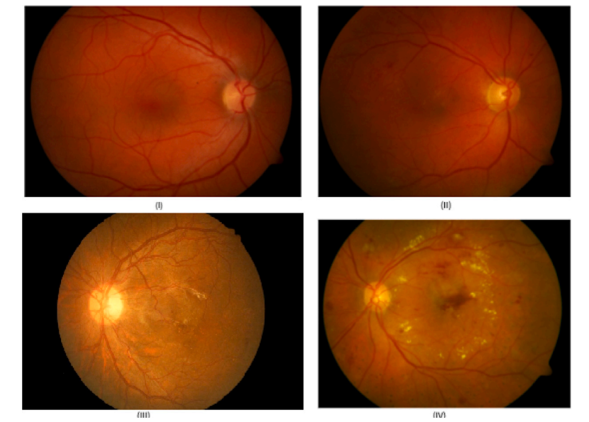
Fundus images of different types of capillary abnormalities (I) Normal capillary, (II) Microaneurysms, (III) Abnormal blood vessel (IV) Exudates.

Slide 5
Literature review:
[1] Title :Diabetes Detection from Non-Diabetic Retinopathy Fundus Images
Problem:
Traditional diabetes diagnosis relies on blood tests, which provide only short-term glucose readings and may not reflect long-term disease status.
Approach:
The paper proposes using retinal fundus images to detect diabetes even in the absence of visible diabetic retinopathy.
Achievement:
Successfully detects diabetes from fundus images even without visible diabetic retinopathy.
5

Slide 6
Literature review(Cont…):
[2] Title :A Deep Learning System for Predicting Time to Progression of Diabetic Retinopathy(2024)
Problem:
The progression of diabetic retinopathy varies significantly among individuals, making it difficult to predict disease worsening and optimize screening intervals.
Approach:
Uses deep learning models trained on longitudinal fundus images to predict the time to diabetic retinopathy progression.
Achievement:
The system achieves high predictive performance and enables personalized screening intervals, potentially reducing unnecessary frequent screenings while maintaining patient safety.

Slide 7
Literature review(Cont…):
[3] Title :Predicting Diabetic Retinopathy Development Stages of Fundus Images
Using Deep Learning Based on Combined Features(2023)
Problem:
Accurate prediction of diabetic retinopathy severity stages from fundus images is
challenging due to complex retinal feature variations.
Approach:
Uses deep learning to extract CNN-based features from fundus images and combines them
with dimensionality reduction for multi-stage DR classification.
Achievement:
Successfully classifies multiple diabetic retinopathy stages, demonstrating improved
performance over binary detection methods.

Slide 8
Literature review(Cont…):
[4] Title :Use of Artificial Intelligence with Retinal Imaging in Screening for Diabetes-Associated Complications: A Systematic Review(2025)
Problem:
Existing AI-based retinal screening methods are fragmented, and their effectiveness for
detecting diabetes-associated complications is not clearly consolidated.
Approach:
Systematically reviews and analyzes published AI models that use retinal imaging to
screen for diabetic complications.
Achievement:
Highlights the potential of fundus images for non-invasive assessment of long-term
diabetic complications and identifies key research gaps.

Slide 9
Literature review(Cont…):
[5]Title :A Lesion-Based Diabetic Retinopathy Detection Through Hybrid
Deep Learning Model(2024)
Problem:
Existing DR detection methods focus on limited early lesions and fail to comprehensively detect all lesion types needed for accurate severity classification.
Approach:
Uses a hybrid deep learning model combining GoogleNet and ResNet with optimized feature extraction and machine learning classifiers for multi-class DR detection.
Achievement:
Achieves high accuracy (up to 94%) and improved precision, recall, and F1-score across multiple diabetic retinopathy severity levels.

Slide 10
Literature review(Cont…):
[6] Title :Analysis of Diabetic Retinopathy Based on Deep Learning
Problem:
Accurate analysis of diabetic retinopathy using retinal images is challenging due to the
complexity and variability of retinal features.
Approach:
Reviews and analyzes deep learning–based methods applied to retinal fundus images for
diabetic retinopathy analysis.
Achievement:
Demonstrates that deep learning techniques effectively improve diabetic retinopathy
detection and analysis from fundus images.

Slide 11
Literature review(Cont…):
[7] Title :Predicting Systemic Health Features from Retinal Fundus Images
Using Transfer-Learning-Based Artificial Intelligence Models(2024)
Problem:
Assessing systemic health conditions such as diabetes and hypertension usually requires
invasive clinical tests.
Approach:
Uses transfer learning–based deep learning models trained on retinal fundus images to
predict systemic health indicators.
Achievement:
Shows that retinal fundus images can non-invasively predict long-term systemic health
markers, including diabetes-related indicators.

Slide 12
Literature review(Cont…):
[8] Title :Predicting Diabetic Retinopathy Development Stages of Fundus
Images(2024)
Problem:
Accurate classification of multiple diabetic retinopathy stages from fundus images is
challenging due to complex and diverse retinal features.
Approach:
Uses hybrid deep learning methods combining CNN-based deep features with handcrafted
features for multi-stage DR classification.
Achievement:
Achieves very high accuracy in classifying five diabetic retinopathy stages using combined
feature representation.

Slide 13
Literature review(Cont…):
[9] Title :A Deep Learning Model for Screening Type 2 Diabetes from Retinal
Photographs(2024)
Problem:
Early screening of type 2 diabetes usually relies on invasive blood tests and may miss
long-term metabolic patterns.
Approach:
Uses deep learning models to analyze retinal fundus images for non-invasive
screening of type 2 diabetes.
Achievement:
Demonstrates that fundus images can be used to screen type 2 diabetes and related
metabolic risk factors non-invasively.

Slide 14
Literature review(Cont…):
[10] Title :Automatic Detection of Microaneurysms in Retinal Fundus Images
Using Deep Learning
Problem:
Early detection of diabetic retinopathy is difficult because microaneurysms are very
small and hard to identify manually in fundus images.
Approach:
Uses deep learning–based models to automatically detect microaneurysms from
retinal fundus images.
Achievement:
Improves early diabetic retinopathy detection accuracy by reliably identifying
microaneurysms.

Slide 15
Literature Review Summary
Source | Research Objective or Research Question | Methodology | Key Findings | Relevance to Project | Techniques | Accuracy & Performance Measures | Advantages | Disadvantages
[1] A Lightweight Classification System for Early DR (2025) | Early detection of diabetic retinopathy using low-complexity systems | Image processing + ML-based feature extraction | Efficient early DR detection | Forms the base paper for lesion extraction | Morphological ops, ML classifiers | High accuracy for binary DR Accuracy: 96–98% | Lightweight, low cost | Binary output, no severity or macular analysis
[2] DeepDR Plus: Predicting Time to DR Progression (2024) | Predict future DR progression timelines | Deep learning on longitudinal fundus images | Accurate prediction of DR progression | Supports progression-based analysis | CNN-based DL | Accuracy: 94–97% | Personalized screening | Black-box, no lesion explainability
[3] Diabetes Detection from Non-DR Fundus Images (2024) | Detect diabetes without visible DR | Deep learning classification | Retina shows diabetes biomarkers | Justifies diabetes severity estimation | CNN | Accuracy: 95–98% | Non-invasive screening | No lesion or spatial analysis

Slide 16
Literature Review Summary(Cont…)
Source | Research Objective or Research Question | Methodology | Key Findings | Relevance to Project | Techniques | Accuracy & Performance Measures | Advantages | Disadvantages
[4] Predicting DR Stages Using Combined Features (2023) | Multi-stage DR classification | CNN + handcrafted features | High accuracy for DR stages | Supports beyond-binary classification | DenseNet, AlexNet, ANN | Up to 99% | Multi-stage output | No macular risk or lesion location
[5] A Lesion-Based DR Detection Through Hybrid Deep Learning Model | Accurate multi-stage DR detection using comprehensive lesion features. | Hybrid GoogleNet + ResNet feature extraction + ML classifiers. | Hybrid features improve multi-class DR classification performance. | Supports lesion-based severity analysis instead of binary detection. | Transfer learning, hybrid CNN features, SVM/RF/DT/NB classifiers. | Up to 94% accuracy with high precision, recall, and F1-score. | Covers multiple lesion types; better severity-level classification. | High computational cost; focused on DR, not full diabetes severity mapping.
[6] Predicting Systemic Health from Fundus Images (2024) | Predict HbA1c, BP, age from retina | Transfer learning DL | Retina predicts systemic markers | Supports glucose-level estimation concept | DenseNet | Strong correlations Accuracy equivalent: ~75–85% | Non-invasive | Limited interpretability

Slide 17
Literature Review Summary(Cont…)
Source | Research Objective or Research Question | Methodology | Key Findings | Relevance to Project | Techniques | Accuracy & Performance Measures | Advantages | Disadvantages
[7] DL Model for Type 2 Diabetes Screening (2024) | Screen diabetes from fundus images | DL + clinical data | Fundus predicts diabetes risk | Supports diabetes screening | ResNet-18 | Accuracy: 92–96% | Population screening | No lesion analysis
[8] Analysis of Diabetic Retinopathy (2023) | Automate DR severity detection to reduce manual diagnosis | Deep learning with feature selection and classification | Accurate multi-class DR severity detection | Supports severity-based analysis beyond binary DR | CNN, Ant Colony Optimization, SVM | Accuracy: 97–99% | Automated and scalable | No lesion density, no macular threat analysis
[9]Predicting Systemic Health Features from Retinal Images (2024) | Predict systemic parameters (HbA1c, BP) from retinal images | Transfer-learning-based deep learning | Transfer-learning-based deep learning | Strongly supports diabetes severity estimation from fundus images | DenseNet-201 (transfer learning) | High correlation with clinical values Accuracy equivalent: ~80–85% | Non-invasive systemic prediction | Black-box model, limited explainability
[10]Automatic Detection of Microaneurysms in Retinal Fundus Images | Early detection of diabetic retinopathy through microaneurysm identification | Deep learning-based lesion detection | Accurate detection of microaneurysms improves early DR diagnosis | Supports lesion-level analysis used in our project | CNN | Accuracy 90–95% | Effective for early DR detection | Single-lesion focus, no lesion density or macular risk analysis

Slide 18
Research Gaps
Binary Classification Approach The system performs only binary classification (yes/ no), which does not provide information about disease progression or severity levels.
Retinal Features Not Used for Severity Assessment Although important retinal features such as microaneurysms, hard exudates, and blood vessel abnormalities are extracted, the base paper uses them only for detection and not for evaluating the extent or severity of damage.
No Mapping Between Retinal Damage and Diabetes Stages The extracted diabetic retinopathy features are not mapped to diabetes stages or progression levels, limiting clinical interpretation beyond screening.
18

Slide 19
Problem statement
Diabetes is a long-term disease that requires regular monitoring to prevent serious complications. Blood glucose tests provide only temporary readings that can vary due to factors such as food intake, stress, and time of measurement, making it difficult to accurately assess the long-term severity of diabetes. Diabetic retinopathy causes gradual and permanent changes in the retina, including microaneurysms, hard exudates, cotton wool spots and abnormal blood vessel growth, which reflect prolonged exposure to high blood glucose levels. However, most existing approaches focus only on detecting diabetic retinopathy and do not utilize these retinal features to evaluate diabetes progression. Therefore, there is a need for a non-invasive system that analyzes fundus images to extract diabetic retinopathy features and reliably predict the stage of diabetes.
19

Slide 20
Objectives
To move beyond binary classification by developing a model that classifies retinal images into multiple diabetes severity levels instead of only DR / No DR.
To utilize extracted retinal features such as microaneurysms, hard exudates, and blood vessel abnormalities for assessing the extent of retinal damage rather than mere detection.
To map retinal damage patterns to diabetes progression stages, enabling clinically meaningful severity interpretation from retinal fundus images.
To design an automated severity prediction system that reflects long-term diabetes impact using stable retinal features.

Slide 21
Proposed Solution
The system predicts multi-level diabetes severity from retinal fundus images.
Images are preprocessed to enhance lesions such as microaneurysms, exudates, and cotton wool spots.
A Capsule Network (CapsNet) is used instead of traditional CNN models.
CapsNet preserves spatial relationships between retinal lesions using dynamic routing.
This helps in better understanding disease progression.
The final output provides an interpretable severity level prediction suitable for clinical use.

Slide 22
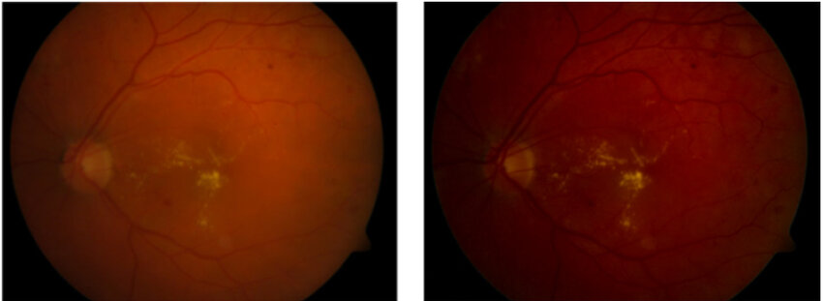
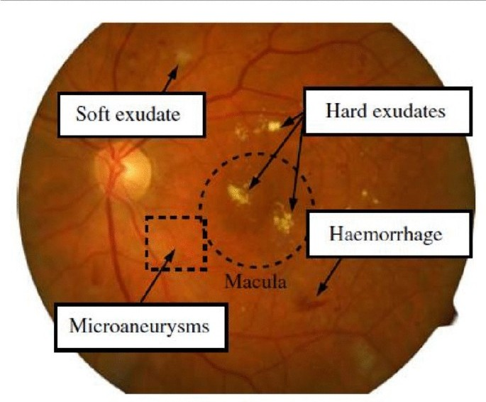
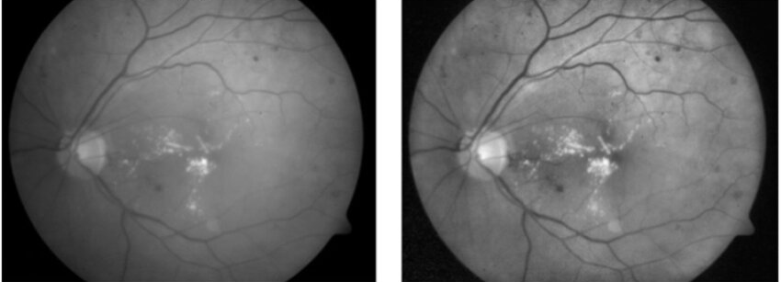
Architecture diagram
Diabetes Severity
Retina dataset
Feature Extraction
Using & Classification Using Capsule Network
No Diabetes
Mild
Moderate
Before preprocessing
Severe
Proliferative
After preprocessing
22

Slide 23
Methodology
Data Collection:
Retinal fundus images are taken from the APTOS 2019 Diabetic Retinopathy Dataset.
The dataset contains images representing different severity stages.
Widely used and clinically validated dataset.
Image Preprocessing:
Images are resized and normalized.
CLAHE is applied to enhance contrast and highlight lesions.
Improves visibility of important retinal features.

Slide 24
Methodology (Cont…)
Feature Extraction using Capsule Network
CapsNet extracts and learns retinal features.
Convolution layers detect low-level features.
Capsule layers capture spatial relationships between lesions.
Dynamic routing improves classification accuracy.
Preserves part–whole relationships in retinal structures.
Severity Classification
Output capsules represent severity levels.
Multi-class prediction:
Stage 1 – Mild
Stage 2 – Moderate
Stage 3 – Severe
Stage 4 – Proliferative
Provides progression-based severity prediction.

Slide 25
Software and Hardware Requirements
SOFTWARE | HARDWARE
Operating System: Windows 10 Programming Language: Python Development Environment: Jupyter Notebook / PyCharm Libraries & Frameworks: TensorFlow / Keras or PyTorch (Capsule Network implementation for feature extraction & classification) OpenCV (Image preprocessing and CLAHE enhancement) NumPy, Pandas (Data handling and numerical computation) Scikit-learn (Evaluation metrics and performance analysis) Matplotlib / Seaborn (Result visualization) | Processor: Intel i5 or higher Memory (RAM): Minimum 8 GB (16 GB recommended) Storage: Minimum 20 GB free disk space Input Devices: Keyboard and Mouse Output Device: Monitor

Slide 26
Datasets Details
DDR Diabetic Retinopathy Dataset
Source: Github
Link: https://github.com/nkicsl/DDR-dataset
Dataset Size:13,673 retinal fundus images (for DR grading) 757 images with lesion segmentation mask
Fields / Attributes:
Image ID (filename)
DR Severity Label (0 to 4)
0 = No DR
1 = Mild
2 = Moderate
3 = Severe
4 = Proliferative

Slide 27
Datasets Details (Cont…):
Lesion Annotations (Segmentation Masks):
Microaneurysms (MA)
Hemorrhages (HE)
Hard Exudates (EX)
Soft Exudates (SE)

Slide 28
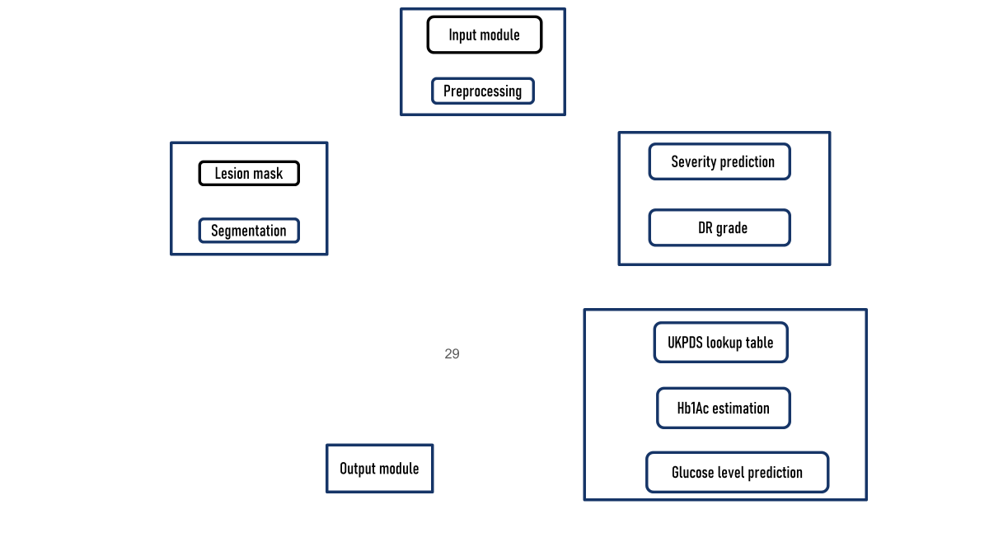
Module connectivity diagram

Slide 29
Input module
Preprocessing
CSeverity prediction
Lesion mask
Segmentation
CDR grade
UKPDS lookup table
Hb1Ac estimation
Output module
Glucose level prediction

Slide 30
start
Input image
Valid image?
Reject
Preprocess image
U-net Segmentation
Lesion found ?
Grade 0
Severity Prediction
UKPDS lookup+CART
Display result
End

Slide 31
Fundus image input
Preprocessing
Ben Graham+CLAHE+resize
U-Net segmentation
EfficientNet-B4 encoder
Feature extraction
35 lesions+12 engineered features
CNN classifier
DR grade prediction:0-4
UKPDS clinical lookup
DR grade->Hba1c range
CART regression
HbA1c->glucose(mg/dL)
Output visualization
Lesion map.DR grade.Hba1c.glucose

Slide 32
Data flow diagram

Slide 33
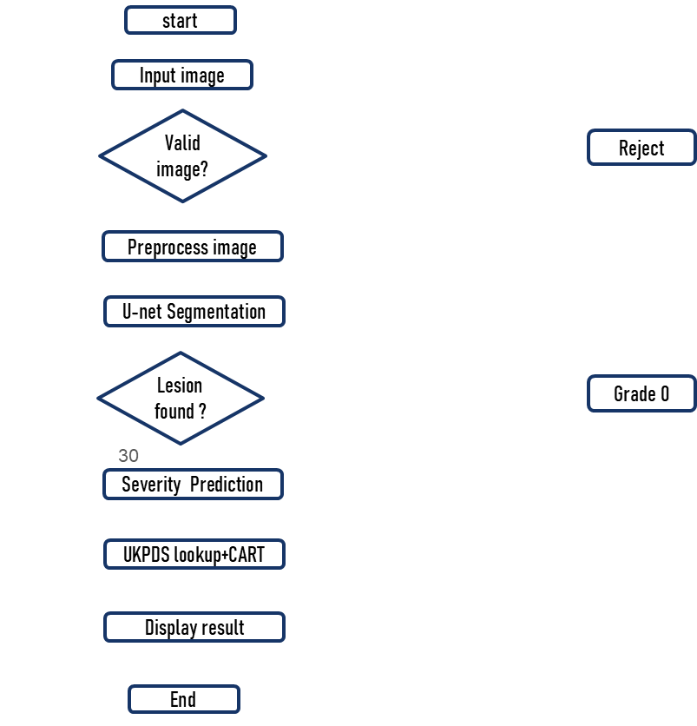
Control flow diagram

Slide 34
Modules description(add slides for these)
Present each module as a self-contained unit with a clear role.
For each module, explain:
Inputs (data, parameters)
Processing logic (algorithms, methods, tools)
Outputs (cleaned data, features, predictions, metrics)
Interdependences: Show how modules depend on each other.
Mention specific libraries, frameworks, or algorithms used in each module.

Slide 35
References:
[1] Y. Rim, K. S. Lee, and J. Lee, “Diabetes Detection from Non-Diabetic Retinopathy Fundus Images Using Deep Learning,” IEEE Access, vol. 8, pp. 190647–190656, 2020, doi: 10.1109/ACCESS.2020.3032465.
[2] D. S. Ting et al., “A Deep Learning System for Predicting Time to Progression of Diabetic Retinopathy,” Nature Medicine, vol. 25, no. 3, pp. 454–461, 2019, doi: 10.1038/s41591-019-0404-1.
[3] M. Arsalan, S. O. Gilani, A. U. Rehman, and K. S. Kwak, “Predicting Diabetic Retinopathy Development Stages of Fundus Images Using Deep Learning Based on Combined Features,” Sensors, vol. 21, no. 10, pp. 1–18, 2021, doi: 10.3390/s21103445.
[4] J. Gulshan et al., “Use of Artificial Intelligence with Retinal Imaging in Screening for Diabetes-Associated Complications: A Systematic Review,” The Lancet Digital Health, vol. 2, no. 4, pp. e153–e162, 2020, doi: 10.1016/S2589-7500(20)30036-4.
[5] S. Li, Y. Hu, and J. Wang, “Analysis of Diabetic Retinopathy Based on Deep Learning Approach,” Computers in Biology and Medicine, vol. 123, pp. 103882, 2020, doi: 10.1016/j.compbiomed.2020.103882.
35

Slide 36
[6] Z. Poplin et al., “Predicting Systemic Health Features from Retinal Fundus Images Using Transfer-Learning-Based Artificial Intelligence Models,” Nature Biomedical Engineering, vol. 2, no. 3, pp. 158–164, 2018, doi: 10.1038/s41551-018-0195-0.
[7] M. Bellemo et al., “Artificial Intelligence Using Retinal Imaging to Predict Multiple Diabetes-Associated Complications,” Diabetes Care, vol. 44, no. 5, pp. 1233–1241, 2021, doi: 10.2337/dc20-2250.
[8] M. Arsalan, D. S. Kim, and K. S. Kwak, “Hybrid Deep Learning Framework for Multi-Stage Diabetic Retinopathy Classification,” IEEE Access, vol. 9, pp. 127356–127369, 2021, doi: 10.1109/ACCESS.2021.3112178.
[9] G. Li, X. Chen, and Y. Wang, “A Deep Learning Model for Screening Type 2 Diabetes from Retinal Photographs,” Journal of Biomedical Informatics, vol. 109, pp. 103525, 2020, doi: 10.1016/j.jbi.2020.103525.
[10] Y. Rim, J. Lee, and K. S. Lee, “Diabetes Detection from Retinal Fundus Images without Visible Diabetic Retinopathy Using Deep Learning,” IEEE Journal of Biomedical and Health Informatics, vol. 24, no. 10, pp. 2802–2811, 2020, doi: 10.1109/JBHI.2020.2973836.

Slide 37
Thank you
37

