Slide 1


AtliQ Hardware Sales & Finance
Presented By Shivani

Slide 2
About AtliQ Hardware and Problem Statement
AtliQ hardware(imaginary Company) is a leading company which specializes in PCs, printers, mouse and other accessories across the globe.
Due to increased size of excel files in company led to performance problems that results in inefficiency and loss of data. Business owners decided to assemble a team of data analysts where they decided to built database. They used MYSQL as their database management systems because its free and robust. These insights from data will help company in taking data-driven decision and optimize the overall business problems.

Slide 3
Project Overview
This project focuses to analyze and extract meaningful insights from database. The database contains information abouts sales, product, customer, market and regions for AtliQ hardware. I aimed to addressed the questions from business owner related to sales report, market analysis, consumer preferences, revenue and supply chain forecasting.

Slide 4
AtliQ Hardware Business Model
Customers
Customer Platforms
Customer Channels
Retailer
CROMA
Brick & Mortar
E - Commerce
BestBuy
Amazon
Croma
CROMA
Amazon
Staples
Direct
BEST BUY
Flipkart
Flipkart
AtliQ hardware E-store
AtliQ hardware Exclusive
Neptune

Slide 5
Database
dim_customer
dim_product
dim_date
Dimension
Database
gdb0041
fact_forecast_monthly
fact_sales_monthly
fact_freight_cost
fact_manufacturing_cost
fact_post_invoice_deductions
fact_pre_invoice_deductions
Fact

Slide 6

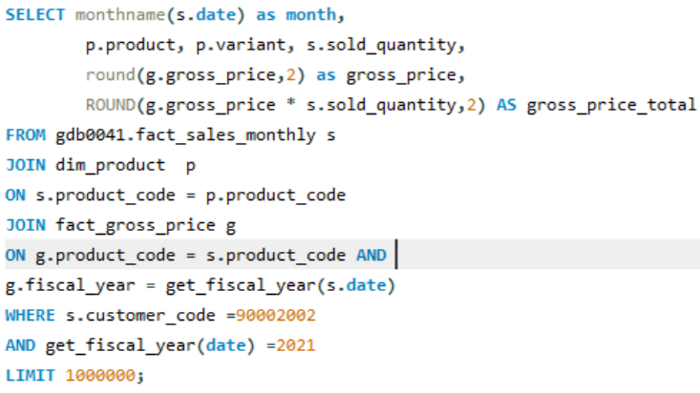
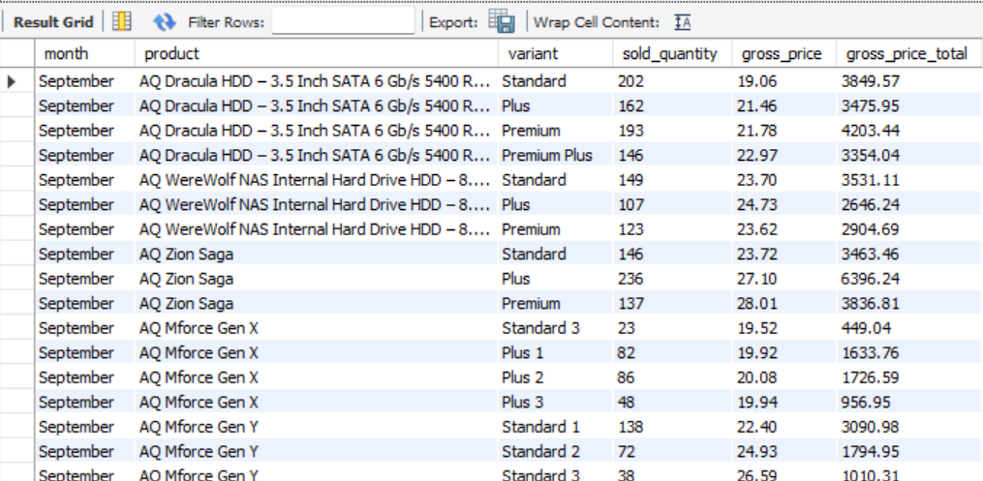
Croma India product wise sales report for fiscal year 2021

Slide 7
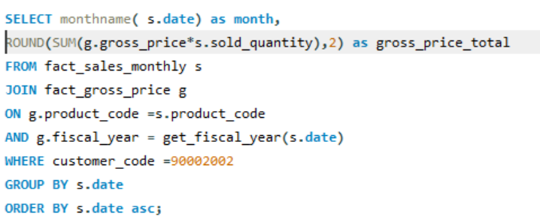
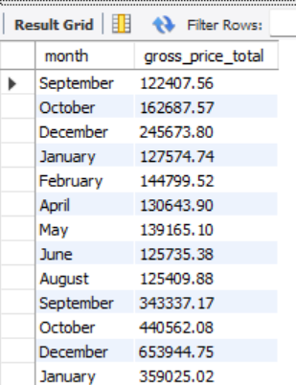
Gross Monthly Total sales for Croma

Slide 8
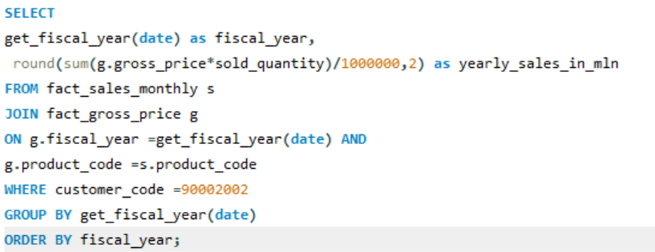
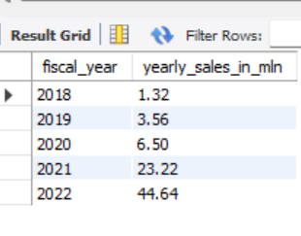
Yearly sales report for Croma India

Slide 9
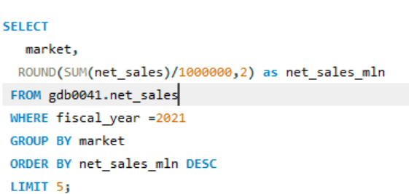
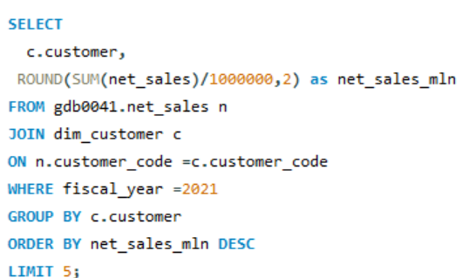
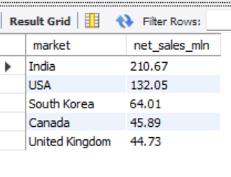
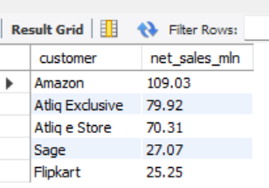
Top Market & customer for financial year 2021
Market
Customer

Slide 10
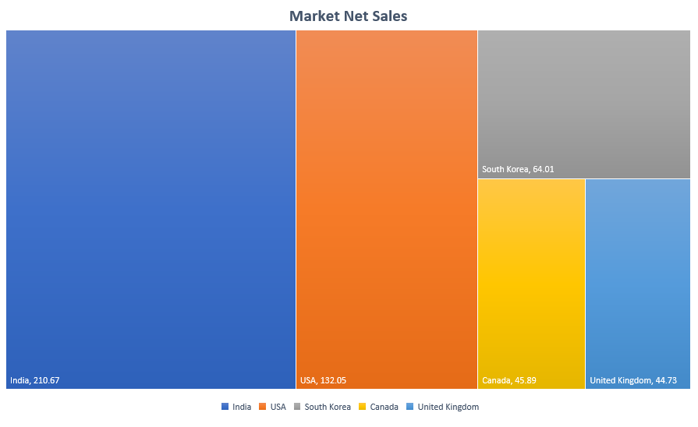
Top 5 Market Net sales(in millions) for FY 2021

Slide 11
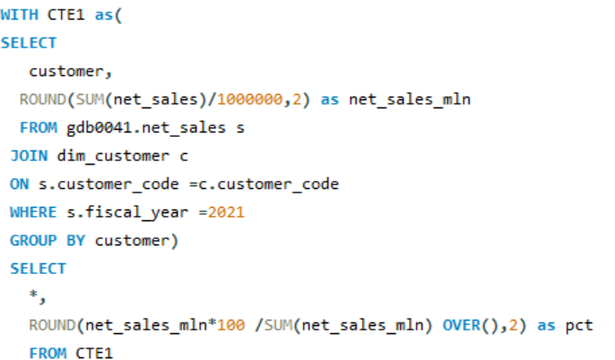
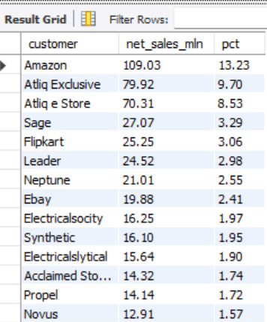
Net Sales % share by Customers

Slide 12
Top 5 Customer Net Sales for FY 2021

Slide 13
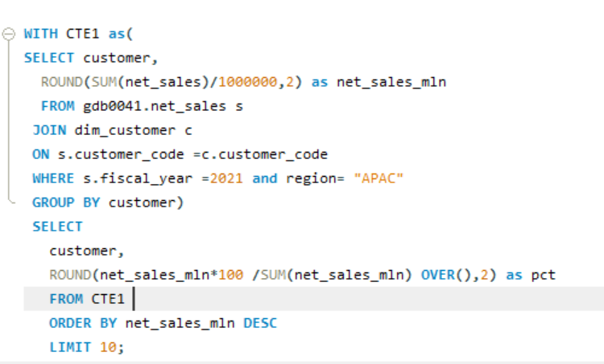
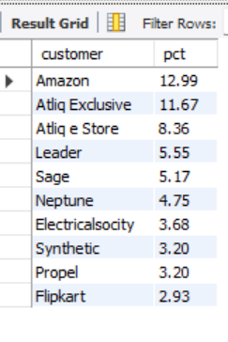
Net Sales % share by Region -APAC

