Slide 1
Air canvas using computer vision
Presented By:
B.SHIVANI
V.MANYA

Slide 2
Abstract
This abstract introduces "Air Canvas," which transforms the physical space into a digital canvas where users can paint and draw simply by moving their hands or any other object in the air. With the occurrence of unexpected circumstances and pandemics, there has been a need for virtual reading and learning, our project is a medium through which that need can be fulfilled in an interesting and exploring manner. The project uses the concept of computer vision which is a branch of Artificial Intelligence (AI) that uses various processing techniques, machine learning, and deep learning methods to replicate and automate tasks that require human visual perception. This includes object detection, recognition, tracking, scene understanding, image segmentation, and more. This includes the use of various algorithms such as Convolutional Neural Networks (CNNs) which are commonly used for detecting and localizing objects within images, including hands or specific objects in the camera's field of view These algorithms can be implemented using various Machine learning libraries and frameworks in Python, such as OpenCV. By integrating these algorithms into the Air Canvas project, the application can offer a more immersive and intuitive painting experience for users, enhancing creativity, learning, and interaction

Slide 3
Existing System
An existing system similar to this project is the Google Jamboard application , which is a paid version of a virtual collaboration by google. As a member of the G Suite software family, Google created Google Jamboard, an interactive digital whiteboard. It is intended to support group ideation, group presentations, and group instruction.
Jamboard is a digital interactive whiteboard developed by Google to work with Google Workspace, formerly known as G Suite. It was officially announced on 25 October 2016. It has a 55" 4K touchscreen display and can be used for online collaboration using Google Workspace. The display can also be mounted onto a wall or be configured into a stand.
Google jamboard is paid application that requires user verification and log in along with a required fee to setup and fully use this application and utilize its functionality.
Google announced on September 28, 2023, that Jamboard would shut down on December 31, 2024.

Slide 4
Proposed System
our proposed system is a an open source application can be used free of cost and doesn’t require complicated steps or digital equipments for its working and functioning.Although Google Jamboard is an effective tool for teamwork, there are a number of special benefits to the Air Canvas project, especially when it comes to its creative approach to painting and interaction.Which includes Free hands interaction , Open source environment , compatibility and portable.

Slide 5
Algorithm and Technologies used in the project
The MediaPipe Library consists of Hands model which uses Deep learning algorithm such as convolutional neural network (CNN) for hand landmarks detection .
The CNN model helps in feature extraction and classification with the help of the pre-trained datasets available in the module.
The Open Source Computer Vision Library (OpenCV) is used for video capturing and Image processing. It uses various internally build Machine learning and Image processing algorithms.

Slide 6
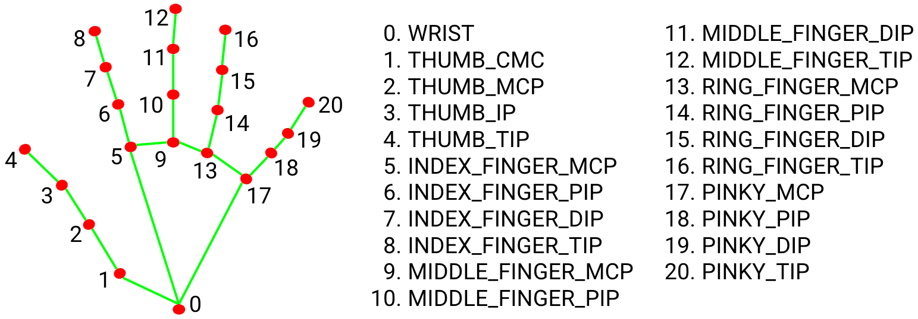
Mediapipe HandTracking Model

Slide 7


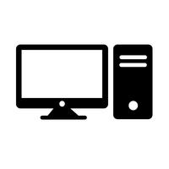

System Architecture
Importing libraries
mp.solutions.hands
Code Execution
mp.solutions.drawing_utils
IDE
RUN
Trained Dataset
Launch
Web camera
Hand tracking
mechanism
CMD
(system requirement and installation)
User Interface

Slide 8
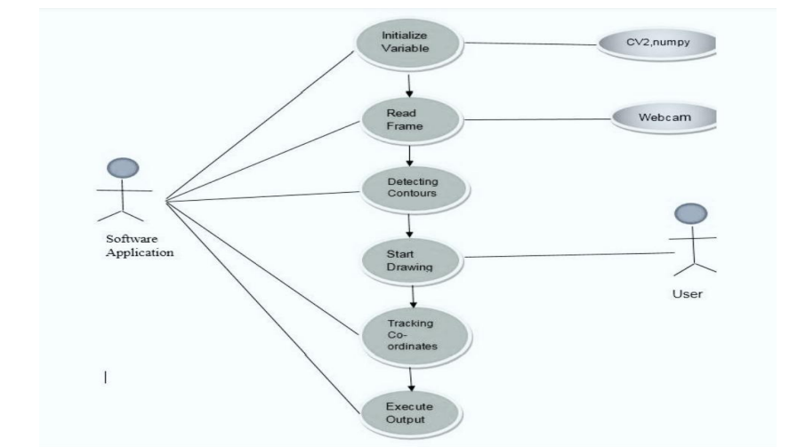
USE-CASE DIAGRAM

Slide 9
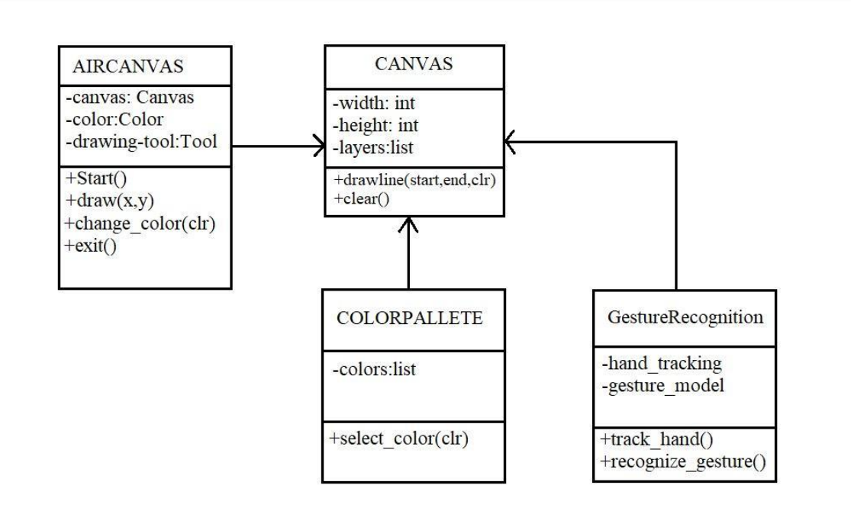
CLASS DIAGRAM

Slide 10
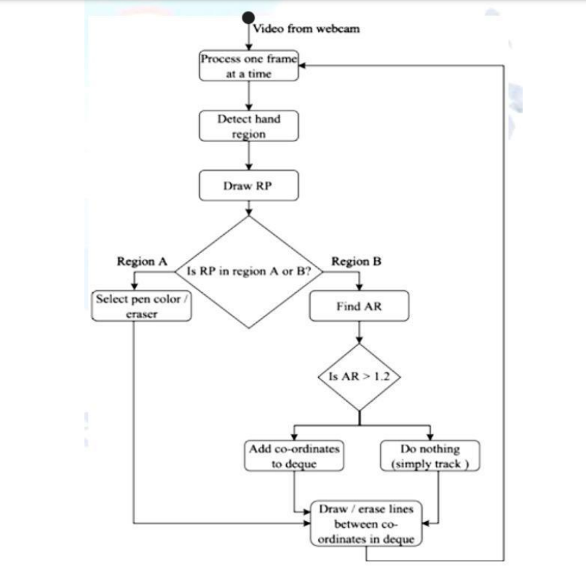
ACTIVITY DIAGRAM

Slide 11
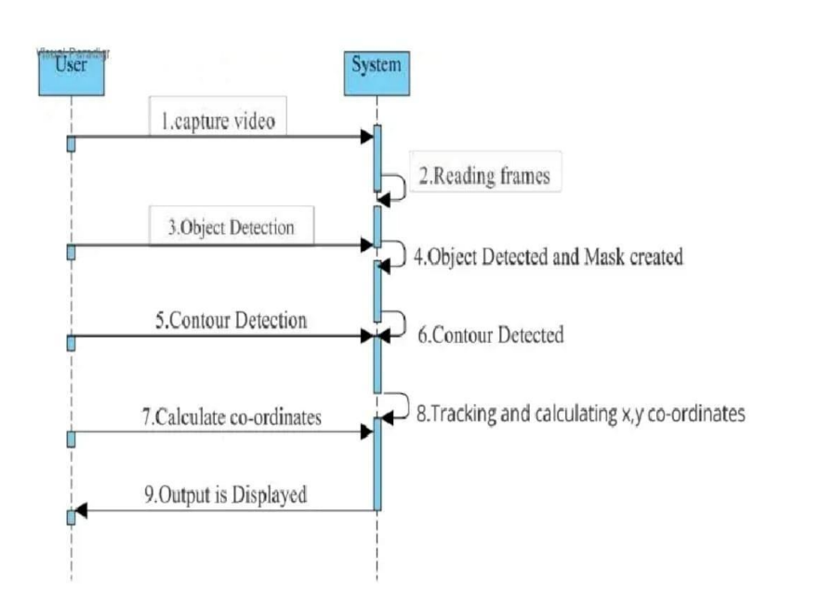
SEQUENCE DIAGRAM

Slide 12
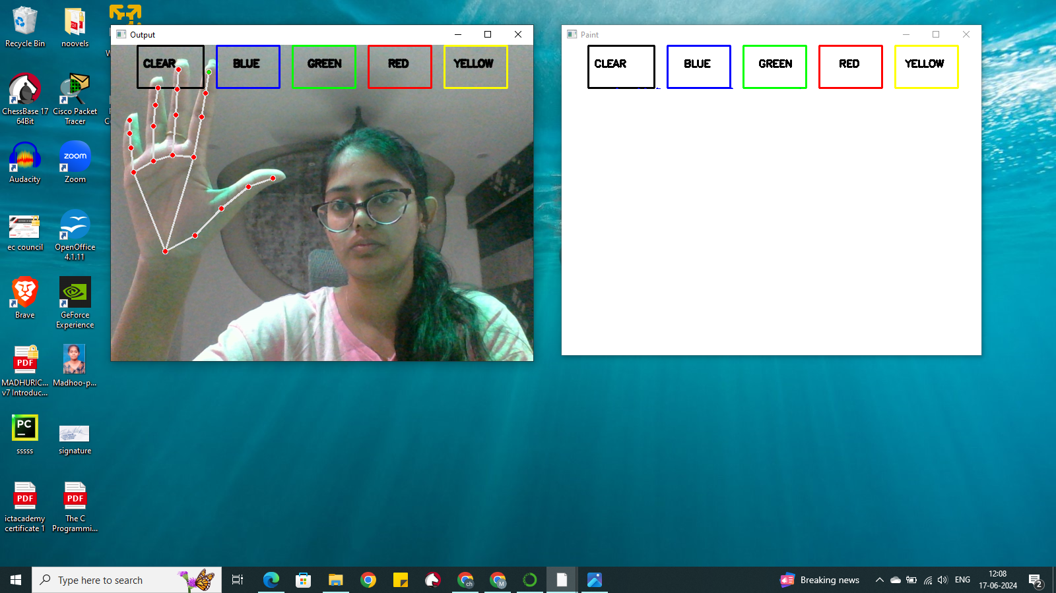
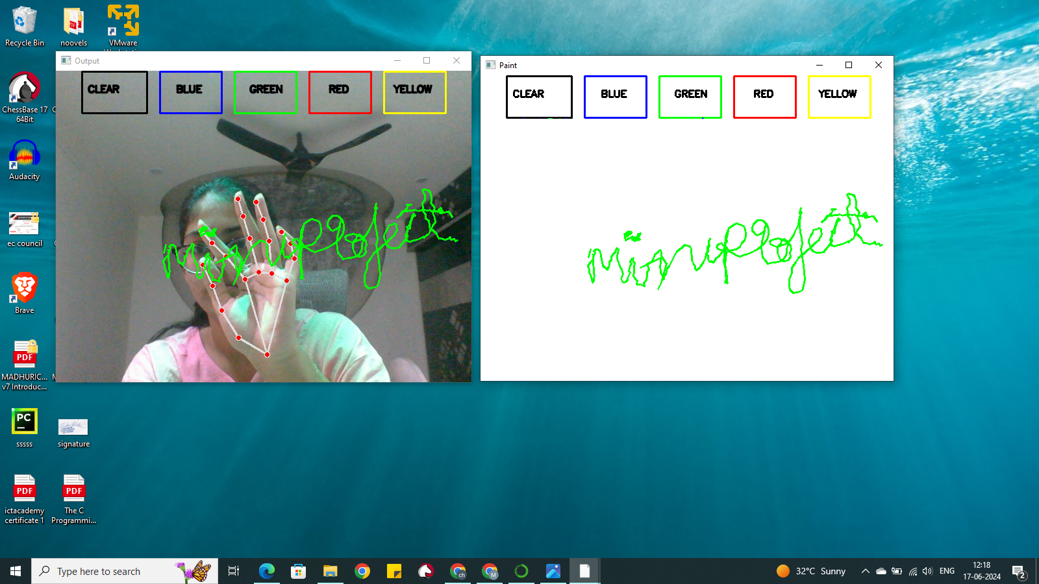
RESULTS

Slide 13
Conclusion and Further scope
The project focuses on making online teaching more interesting and enabling users to be able to draw things in air without the need of any other external devices and hardware implementation.
The application can work in collaboration with various online meeting apps and enable a collab type atmosphere without the need for an individual platform.
Introduction of more features such as shapes , lines , graphs can make it useful among various visualizations of data in air.

Slide 14
REFERENCES
https://www.youtube.com/watch?v=zggNw2D3SC8
https://medium.com/@jinisuga2001/air-canvas-a392041b99b9
https://www.kaggle.com/code/tuynlc/air-canvas-machine-learning-model
https://journal.inence.org/index.php/ijfiahm/article/view/258?articlesBySimilarityPage=5
https://www.csharp.com/article/how-to-build-air-canvas/
https://www.researchgate.net/publication/354142408_AIR_CANVAS_APPLICATION_USING_OPENCV_AND_NUMPY_IN_PYTHON
https://www.geeksforgeeks.org/create-air-canvas-using-python-opencv/

Slide 15
Thank You!

