Slide 1

Research Project: Spatial Analysis of Air Pollution and Respiratory Illnesses in DFW Area
The University of Texas at Dallas (UTD)
School of Economic, Political & Policy Sciences (EPPS)
2024
Shivani Chowdhry
Notes:
x̄

Slide 2

Research Question and Problem Definition
Clearly outline the primary questions your research aims to answer.
What is the spatial distribution of air pollution in DFW area
How does the exposure PM2.5 correlate with the prevalence of respiratory illnesses like asthma, Chronic obstructive pulmonary disease (COPD), etc. health conditions
Which specific neighborhoods are significantly more affected by both air pollution and respiratory illnesses?
What is the spatial relationship between socio-economic factors, and air pollution-related health risks?

Slide 3
Methodology
Explain your methodology
Regression Modeling:
1. Ordinary Least Squares (OLS) Regression – Global model to study the relationship between PM2.5 and health outcomes -- using a single set of coefficients for the entire study area.
Baseline model to understand the relationship
2. Geographically Weighted Regression (GWR) – Local model; Enhancement of OLS: Calculates a separate regression equation for every location (Census Tract) in study area, allowing the relationships between variables to vary across space.
More nuanced understanding of how effects of PM2.5 on health outcomes differ across various CTs in DFW

Slide 4

Study Area
Define the geographic scope of your study
The Dallas-Fort Worth (DFW) metropolitan area in Texas is one of the fastest-growing regions in the United States
However, this growth has brought several environmental and public health challenges, particularly related to air quality.
High levels of ground-level ozone and particulate matter (PM2.5) are prevalent, particularly during the summer months.
Additionally, heavy traffic congestion and substantial presence of highways
Elevated risks of respiratory health issues among the local population, especially in socioeconomically disadvantaged communities

Slide 5
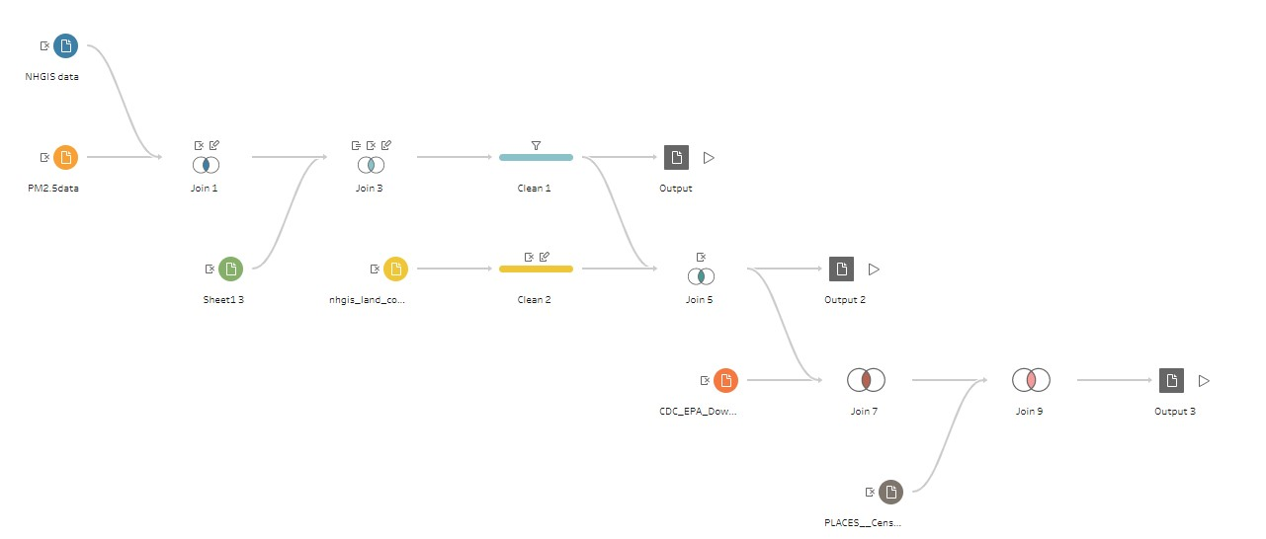
Data Sources
Explain Data Collection & Limitations
Air Quality Data: PM2.5 estimates for 2020 at Census Tracts level from EPA Downscaler Model (Yearly Average Value)
Health Data: CDC Places dataset
Demographic Data: Socioeconomic indicators from Census Bureau datasets and ACS from NHGIS for 2020.
Land Use Data: National Land Cover Dataset summaries from NHGIS
Merged and cleaned all datasets in Tableau Prep

Slide 6
Tools and Applications
List the software you have used.
Excel and Tableau Prep for Data Cleaning and Engineering
ArcGIS Pro for Regression Models

Slide 7
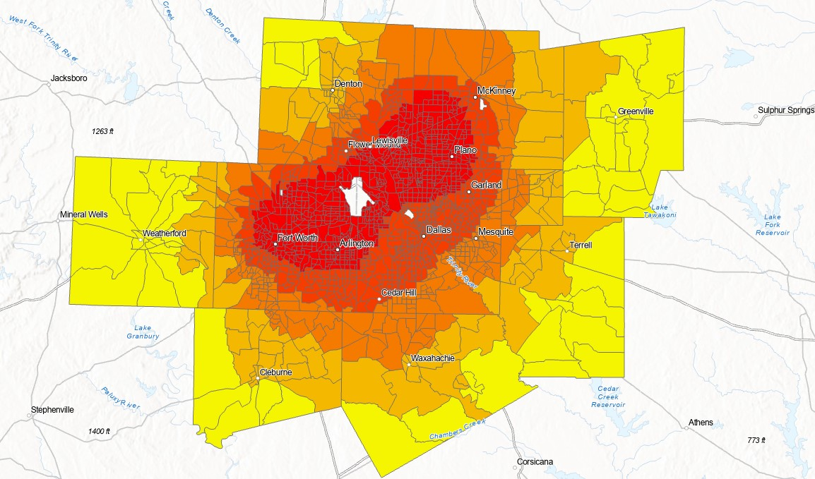
Outcomes and Impact
Visualization – PM2.5 distribution over census tracts

Slide 8
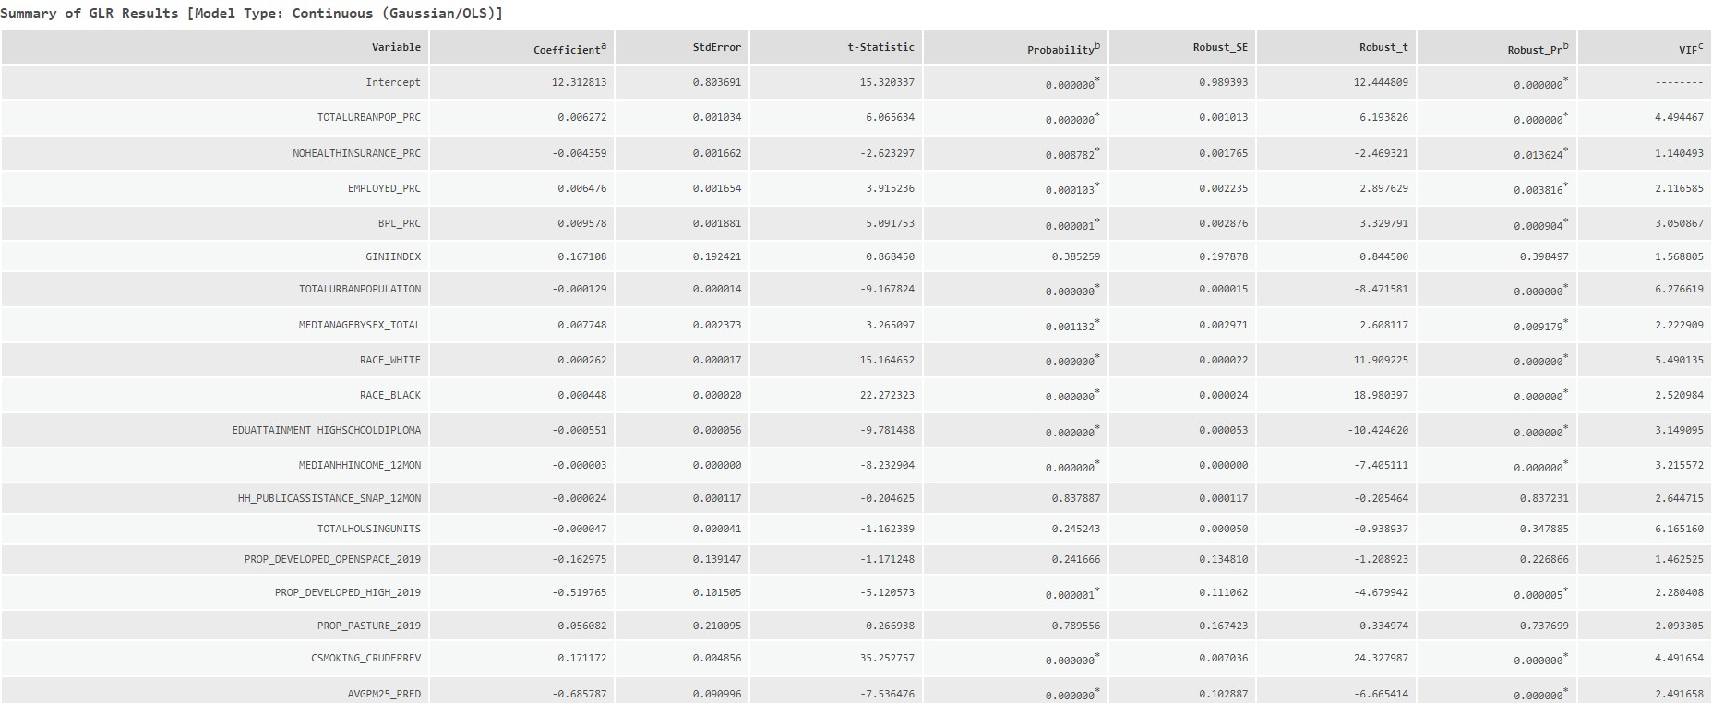

Outcomes and Impact
1. OLS Model Results: Outcome -- Asthma prevalence

Slide 9
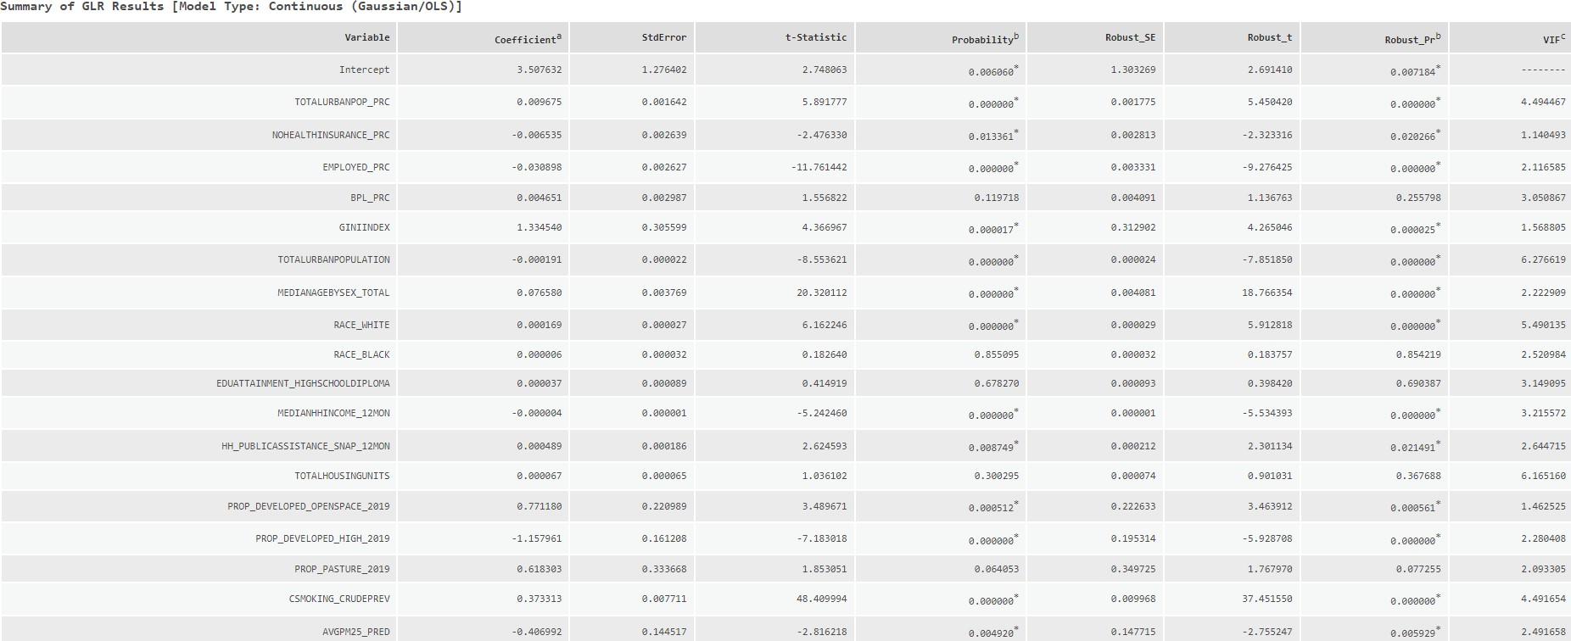
Outcomes and Impact
2. OLS Model Results: Outcome -- COPD prevalence

Slide 10
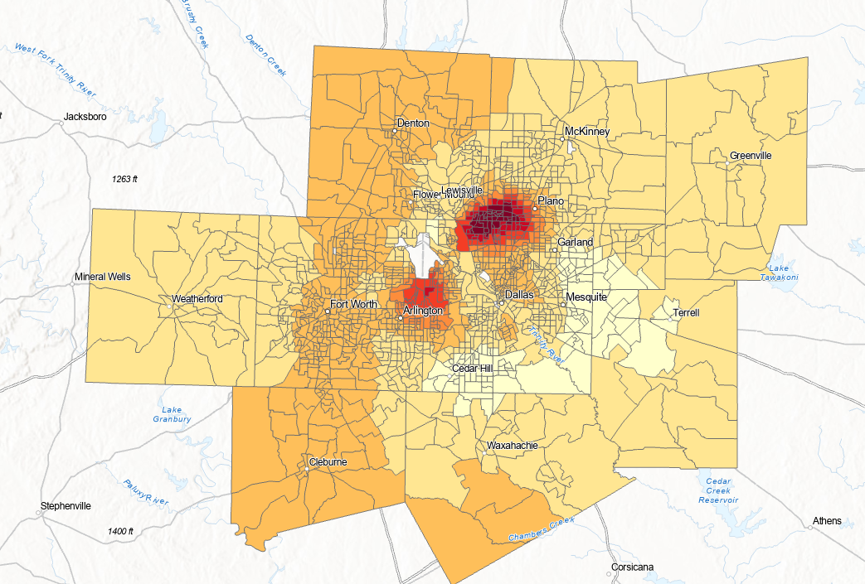
Outcomes and Impact
3. GWR Map of PM2.5 Coefficients: Outcome - Asthma prevalence
CTs in Yellow : -ve coefficient on PM2.5 => Increase in PM2.5 levels leads to decrease in Asthma prevalence rates
CTs in Red: +ve coefficient on PM2.5 => Increase in PM2.5 leads to an increase in Asthma prevalence

Slide 11
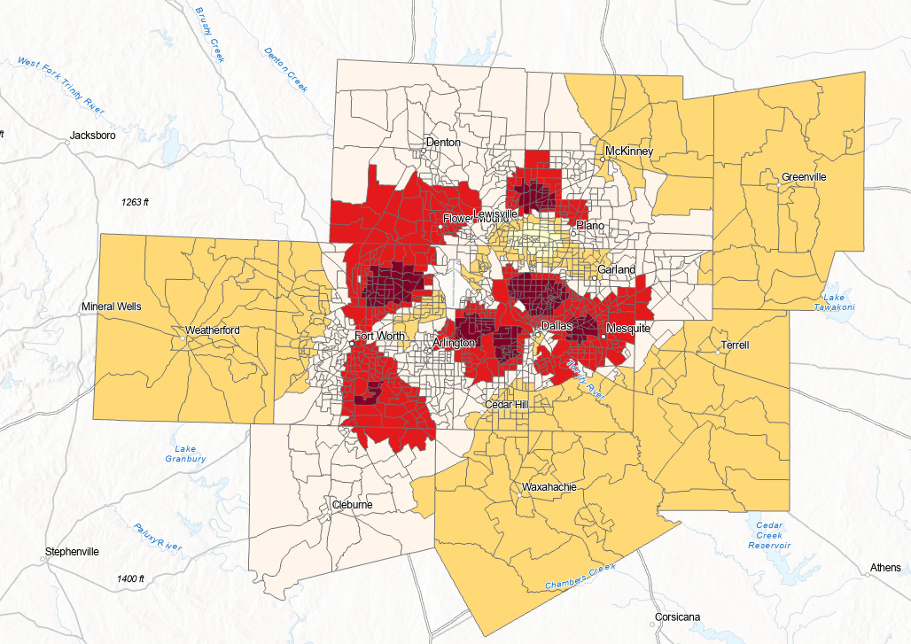
Outcomes and Impact
4. GWR Map of PM2.5 Coefficients: Outcome - COPD prevalence
CTs in Light Yellow-Yellow: -ve coefficient on PM2.5 => Increase in PM2.5 levels leads to decrease in COPD prevalence rates
CTs in Red-Dark Red: +ve coefficient on PM2.5 => Increase in PM2.5 leads to an increase in COPD prevalence

Slide 12





