Slide 1


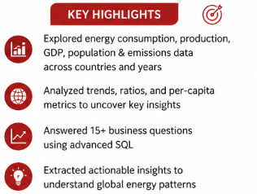




World Wide Energy Consumption Analysis Using MySQL
SQL Project
Shivani Gundla
https://www.linkedin.com/in/shivanigundla29/
https://github.com/ShivaniGundla

Slide 2

World Wide Energy Consumption Analysis Using MySQL
Shivani Gundla

Slide 3


Slide 4

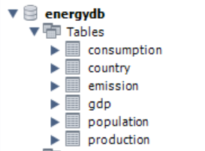
Database

Slide 5
Objective
The main objective is to analyse how energy consumption, production and emission vary across countries and over time.
It aims to understand the relationship between energy usage, economic growth (GDP), and population dynamics.
The project focuses on identifying key trends, such as changes in emissions over time and the contribution of different energy types to overall emissions.

Slide 6
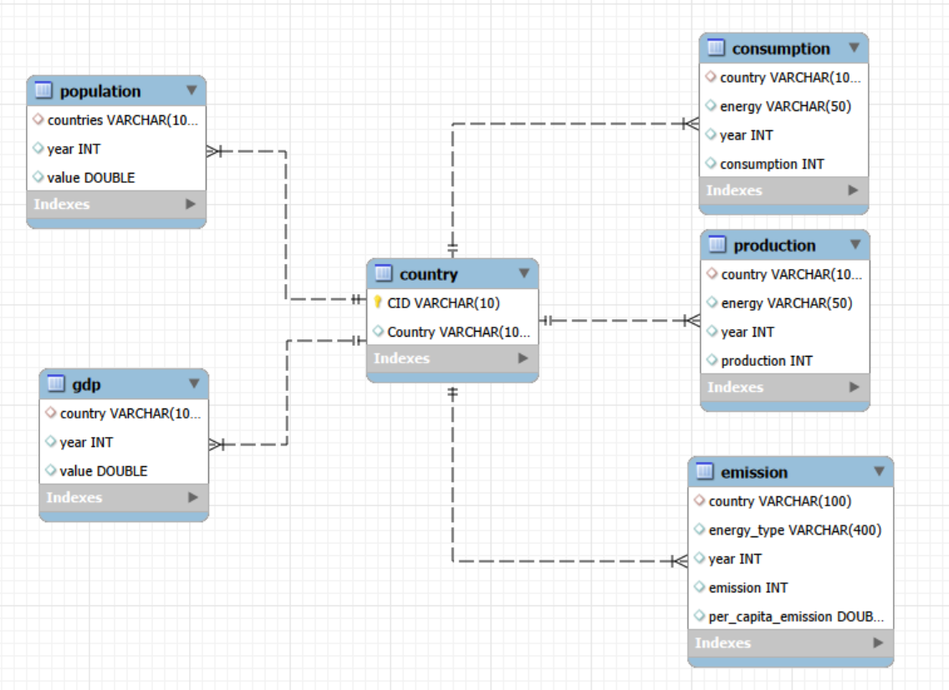
ER Diagram

Slide 7
KEY ANALYSIS QUESTIONS
General Analysis
Total emission per country for recent year
Top 5 countries by GDP
Production vs consumption
Major energy type emission contributors
Trend Analysis
Emission trends over years
GDP trends for each country
Population vs emissions
Energy consumption trends
Ratio Analysis
Emission-to-GDP ratio
Production per capita
Energy Consumption relative to GDP
Consumption per capita
Global Comparisons
Top 10 countries by population and emissions
Global share (%) of emissions by country
Global average GDP, emissions, and population by year

Slide 8
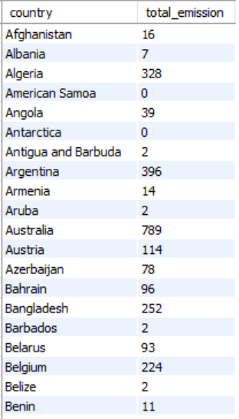
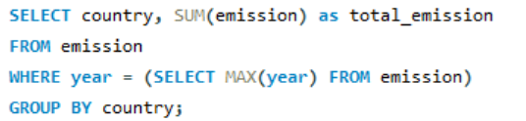
PART 1: General & Comparative Analysis
Q1: What is the total emission per country for the most recent year available?
Insight:
The results show the total emissions recorded for each country in the latest available year, allowing comparison of emission levels across countries and providing a basis for further environmental and economic analysis.
.

Slide 9
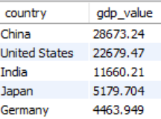

Q2: What are the top 5 countries by GDP in the most recent year?
Insight:
China and the United States are among the highest GDP, followed by other major global economies.
Economic growth often correlates with increased energy demand and infrastructure development.

Slide 10
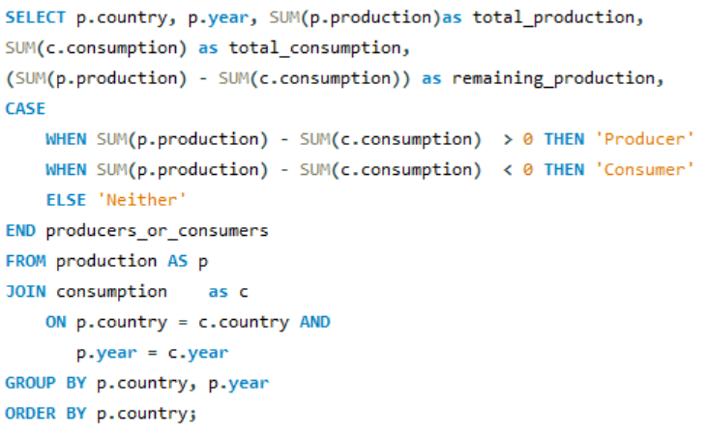
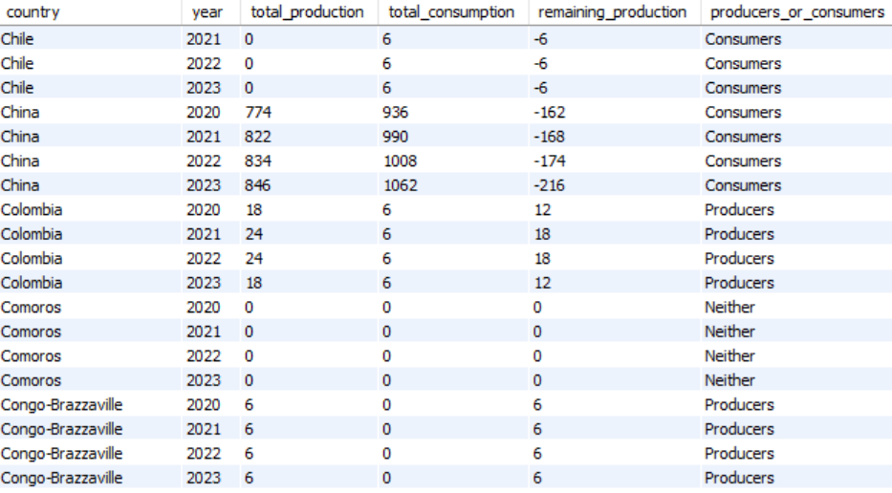
Q3:Compare energy production and consumption by country and year.
Insight:
The gap between production and consumption highlights a country's role as either an energy exporter or importer.
Highly industrialized nations often consume more energy to support manufacturing, transportation, and economic activities.

Slide 11
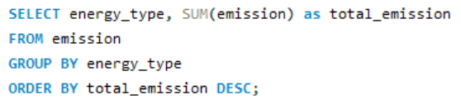
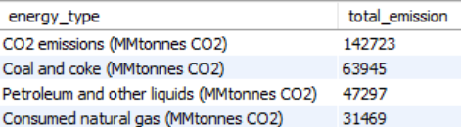
Q4: Which energy types contribute most to emissions across all countries?
Insight:
CO₂ emissions are the largest contributor, accounting for 142,723 MMtonnes CO₂, significantly higher than emissions from coal and coke, petroleum, and natural gas.
The results highlight the dominant role of CO₂ emissions in the overall emissions profile and emphasize the environmental impact associated with energy production and consumption.

Slide 12
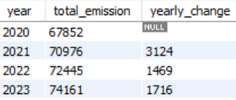
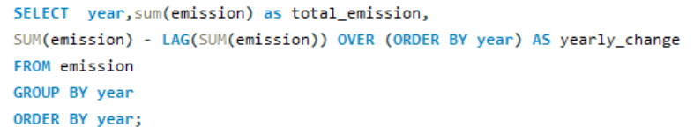
PART 2: Trend Analysis Over Time
Q5:How have global emissions changed year over year?
Insight:
Global emissions show an overall increasing trend over the years.
Economic expansion, industrialization, and population growth continue to drive higher emission levels.

Slide 13
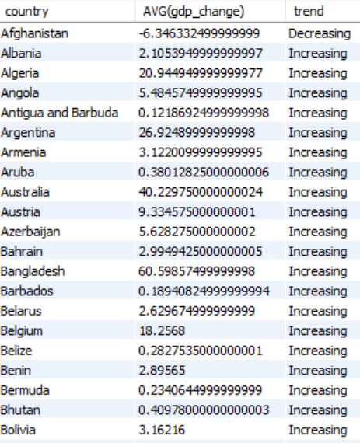
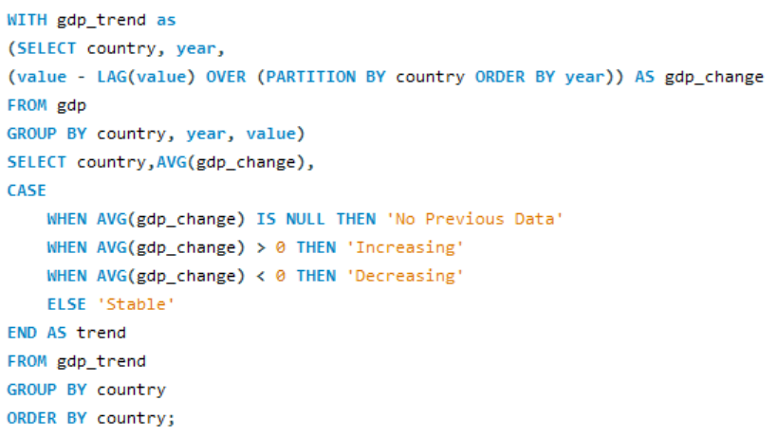
Q6: What is the trend in GDP for each country over the given years?
Insight:
Most countries demonstrate a positive GDP growth trend over time.
Developed economies show steady growth, while emerging economies often experience faster growth rates.

Slide 14
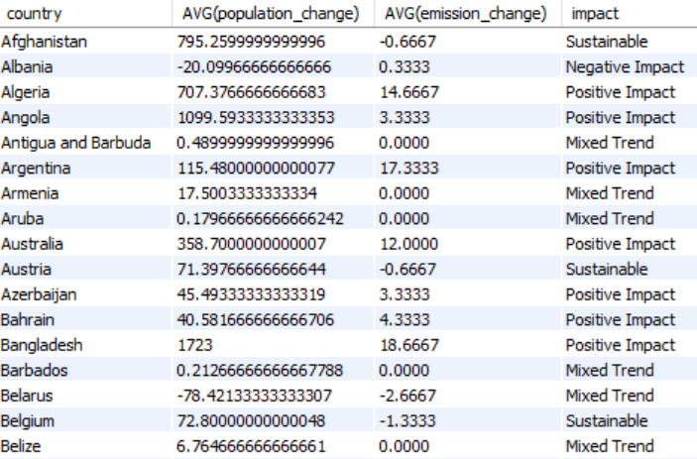
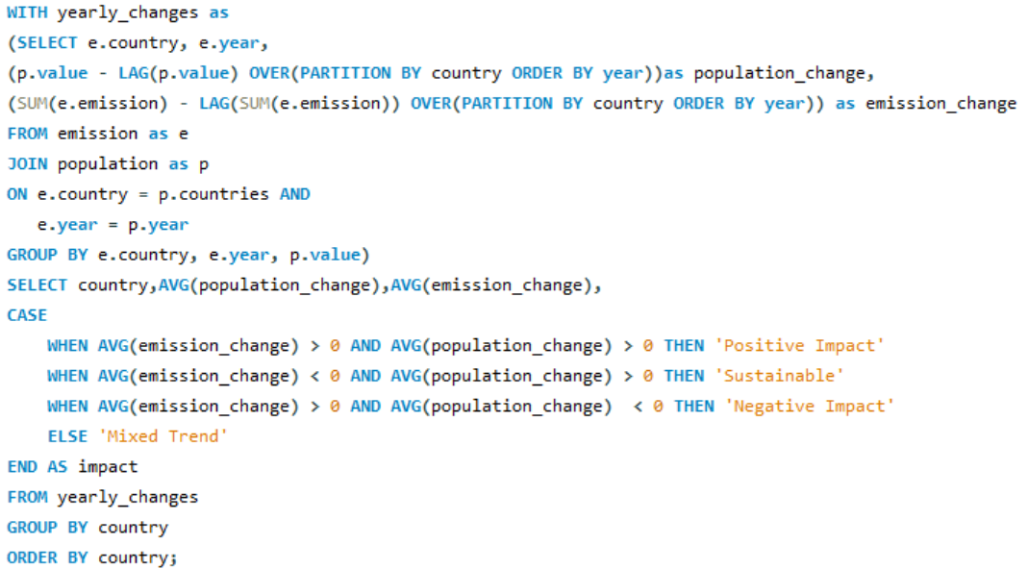
Q7: How has population growth affected total emissions in each country?
Insight:
Countries with growing populations tend to experience higher emissions due to increased energy requirements.
Population growth is a key driver of long-term energy demand and environmental pressure.

Slide 15
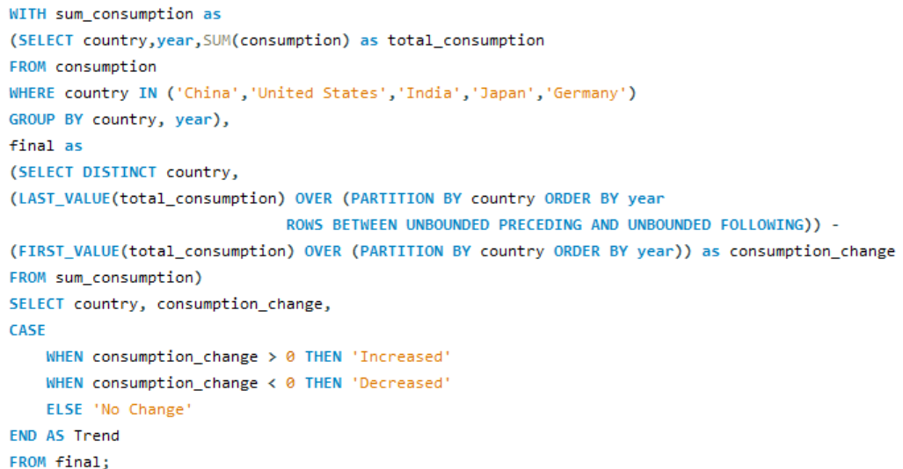
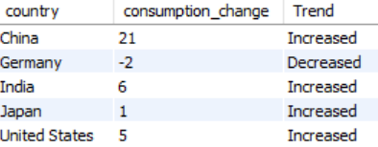
Q8 : Has energy consumption increased or decreased over the years for major economies?
Insight:
It has increased for other top 4 countries except for Germany.

Slide 16
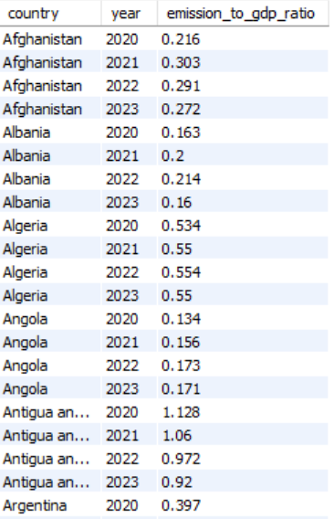
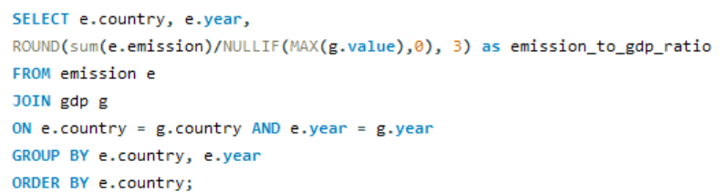
PART 3:Ratio & Per Capita Analysis
Q9: What is the emission-to-GDP ratio for each country by year?
Insight:
The emissions-to-GDP ratio measures the amount of emissions generated per unit of economic output

Slide 17
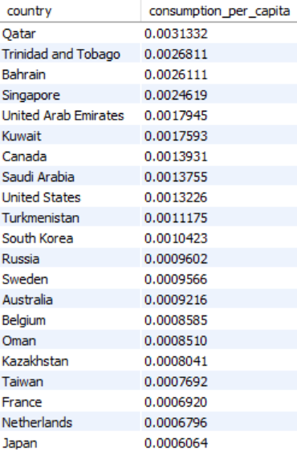
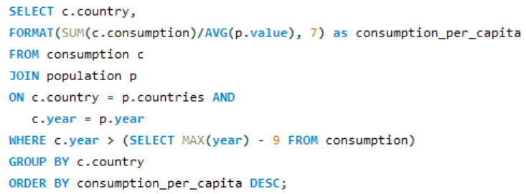
Q10 :What is the energy consumption per capita for each country over the last decade?
Insight:
Oil and Gas rich countries dominate the top position as average energy consumed per person is more.

Slide 18
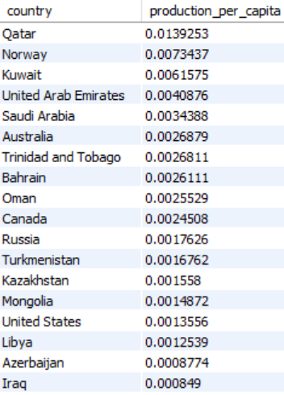
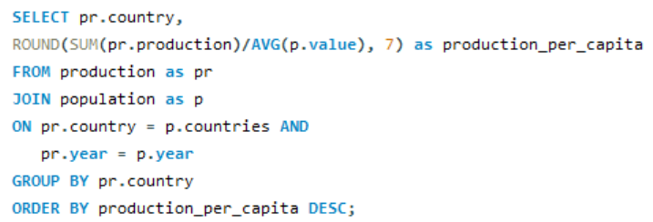
Q11: How does energy production per capita vary across countries?
Insight:
Qatar, Norway, Kuwait, UAE are energy exporting/ producing countries.

Slide 19
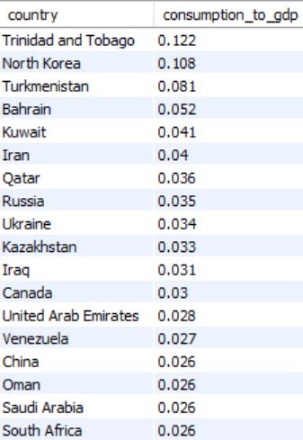
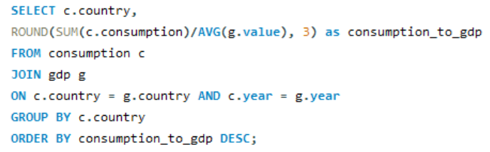
Q12 :Which countries have the highest energy consumption relative to GDP?
Insight:
The countries with high consumption to gdp ratio indicates that they consume much energy to produce unit of economic output.

Slide 20
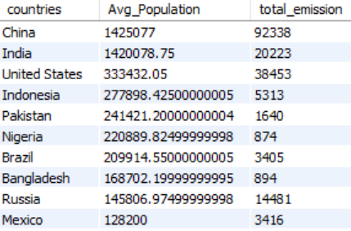
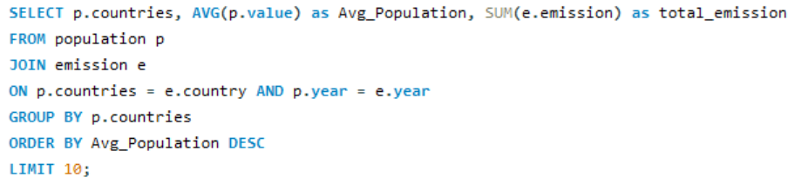
PART 4:Global Comparisons
Q13 :What are the top 10 countries by population and how do their emissions compare?
Insight:
Countries with high average population are producing much emissions.

Slide 21
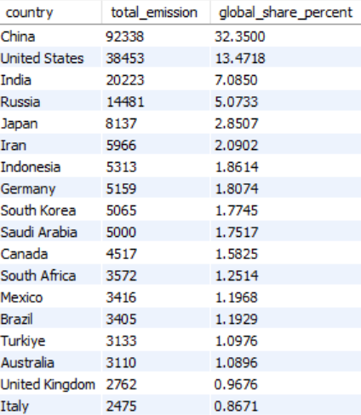
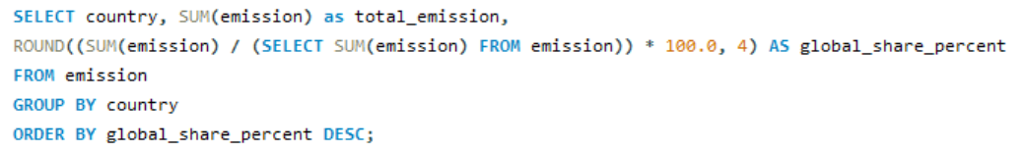
Q14: What is the global share (%) of emissions by country?
Insight:
China is the top most contributor in the world as it accounts to 32.3% to total global emissions.

Slide 22
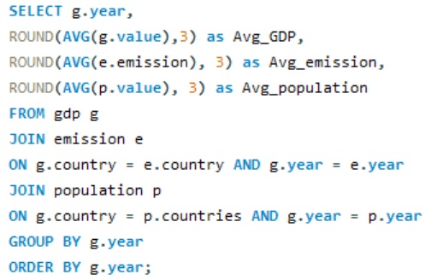
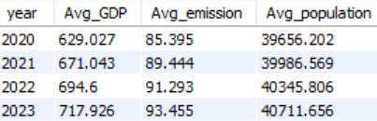
Q15 : What is the global average GDP, emission, and population by year?
Insight:
Population Growth → Economic Growth (GDP)→Higher Energy Consumption →Higher Emissions

Slide 23
Conclusion
The study highlights the strong relationship between economic growth, energy use, and emissions.
Fossil-fuel-rich countries dominated energy production per capita, indicating strong dependence on oil and gas industries.
Developed and industrialized countries showed the highest energy consumption per capita, reflecting energy-intensive lifestyles and infrastructure
Population growth contributes significantly to rising energy demand, urbanization, and environmental pressure.
Countries with higher economic activity generally exhibited higher energy consumption and greenhouse gas emissions
Global GDP, population, and emissions showed an increasing trend over recent years especially in 2023, highlighting continued economic and industrial expansion.

Slide 24

THANK YOU

