Slide 1
Flight Reservation system

Slide 2
Contents
Objective
Modules
Future Scope

Slide 3
Objective
Flight reservation system contains the details about the flight schedules and its fare tariffs, passenger reservations and ticket records
(FRS) is a computerized system used to store and retrieve information and conduct transactions related to air travel
ER Diagram helps to conceptualize the database and reduces complexity and allows to build databases quickly.

Slide 4
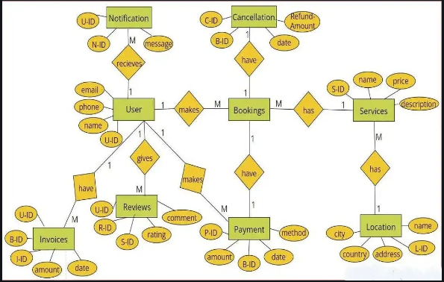
ER Diagram

Slide 5
Modules
Registration Module : To book tickets, firstly system asks for details to Login
Administrative Module : To manage the site and update the details at regular intervals including view passenger list, cancel tickets, check available seats in flight
Passenger Module : This module includes operations like view all airline schedules, timings, fares and dates, book tickets, view and cancelling tickets, and providing feedback.

Slide 6
Future scope
The purpose of Flight Reservation System project is to build an application program which Airlines can use to manage the reservations of airlines ticket
IT makes the customer easy to get ticket online instead of queue up to buy tickets

Slide 7
Thank you
Shivani Jadhav
www.bookyourown.com

