Slide 1


Analyzing Car Sales Metrics for Revenue Growth
Presenter: Shivani Jadhav

Slide 2


Content
Understanding Sales metrics
Leveraging customer feedback and Ship Mode
Revenue Growth Strategy
SWOT Analysis

Slide 3
Understanding Sales Metrics includes:
Customer Feedback : It significantly impacts car prices, with higher prices linked to better feedback
Average Car Price : Higher counts and prices are associated with better feedback.
Vehicle Type Analysis : The sum of sales and discounts varies by vehicle type, with passenger cars showing a notable sum of discounts and sales.
Shipping Influence : The average car price by ship mode and shipping reveals that the 'Air' mode commands a higher average price than other shipping.
Impact of Ship Mode : The 'First Class ' ship mode has the highest average car price and sum of sales, followed by 'Same Day,' 'Second Class,' and 'Standard Class'.

Slide 4
Leveraging Customer Feedback and Ship Mode
Actionable Insights
Revenue Enhancement
Competitive Advantage

Slide 5
Revenue Growth Strategy
Customer Feedback Optimization : Improving customer feedback can directly impact car prices and sales, presenting an opportunity for revenue growth.
Premium Ship mode Utilization : Utilizing premium ship modes such as 'First Class' can potentially increase average car prices and boost sales revenue.
Supplier ID and Vehicle type : Leveraging the positive correlation between supplier ID count, vehicle type, and sales metrics can further contribute to revenue growth.
Product ID : Evaluate the number of products based on customer feedback.

Slide 6
SWOT Analysis
Strengths
Clear correlation between customer feedback, ship mode, and sales metrics provides actionable insights for revenue growth.
Weaknesses
Overlooking the influence of customer feedback and ship mode may lead to missed revenue opportunities.
Opportunities
Leveraging customer feedback optimization and premium ship mode utilization can drive revenue growth.
Threats
Failure to adapt sales strategies based on the analyzed metrics may result in competitive disadvantage.

Slide 7
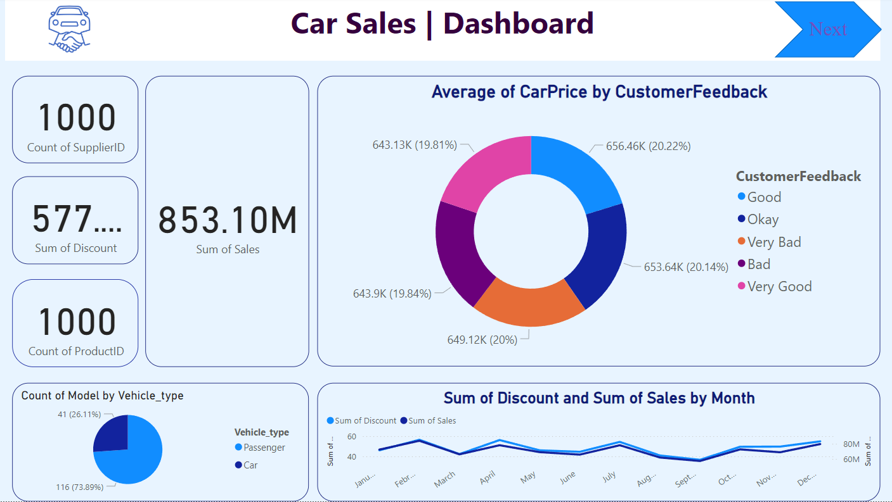
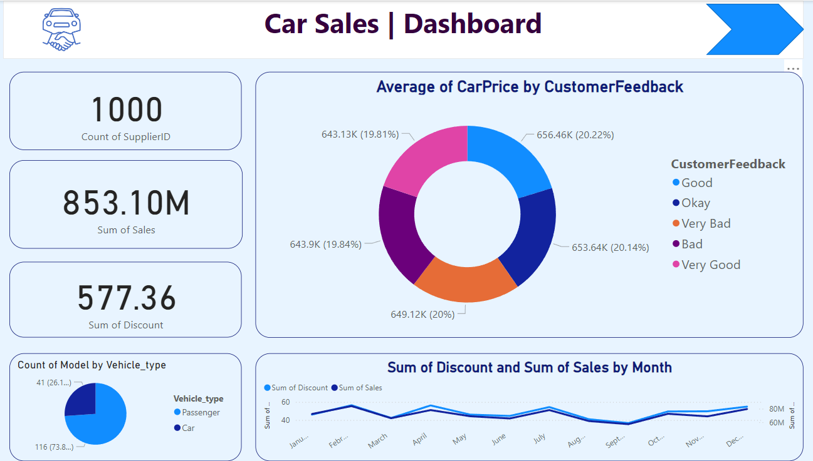

Slide 8
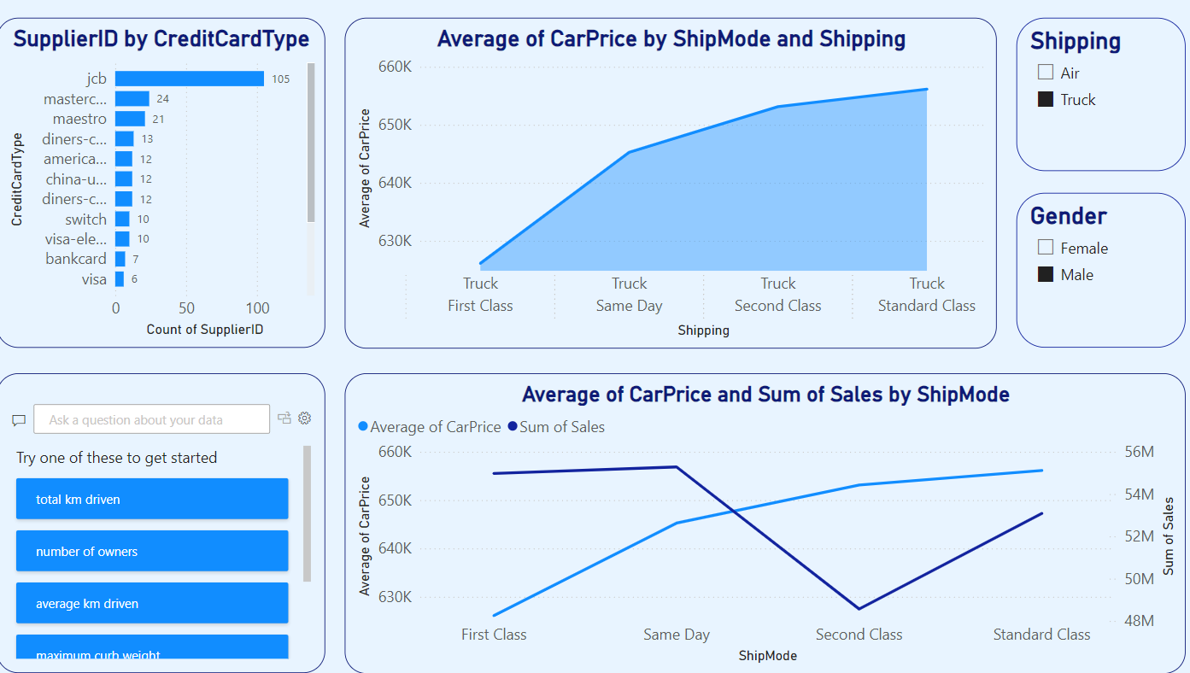
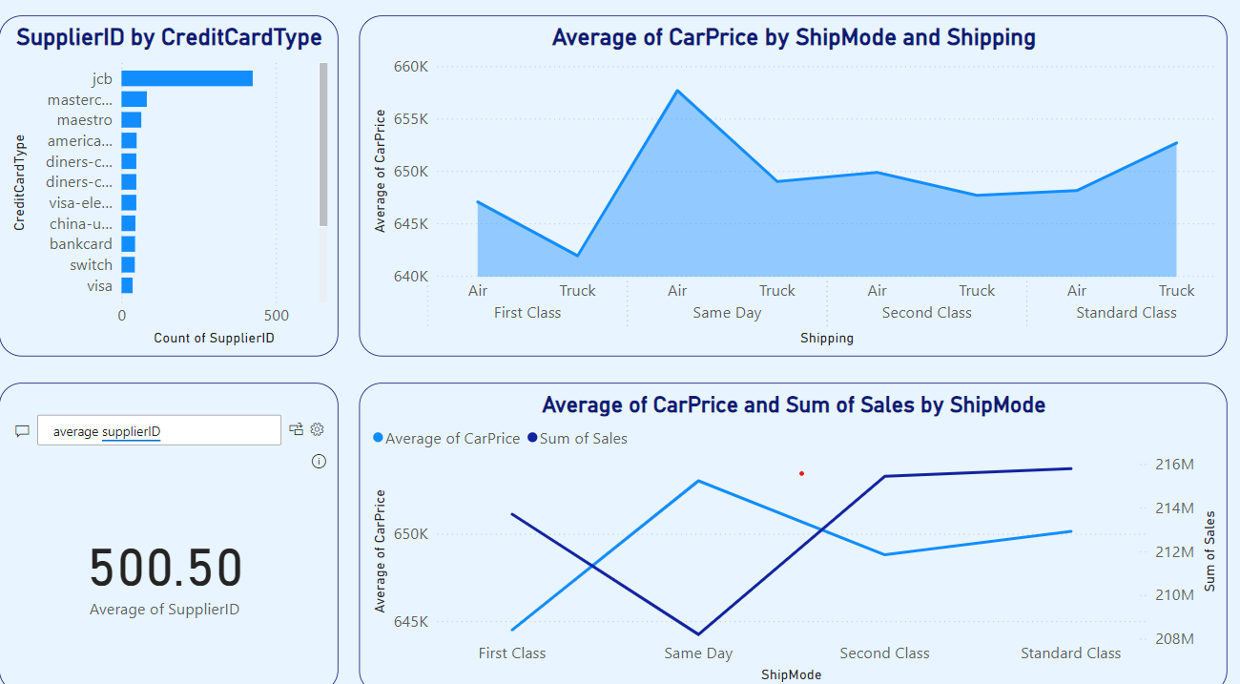

Slide 9
Thank you
Contact : car.sales@analytics.com

