Slide 1
S
SmartHire AI
HACKATHON ROUND 1 · 2026
AI-Powered Placement
Preparation Platform
"Prepare. Perform. Get Placed."
Transform placement preparation from scattered guesswork to AI-driven,
structured, personalized career readiness for every student.
Team TwinTech | Yashvant & Shivani
80%
Students feel
unprepared
75%
Resumes rejected
by ATS
5-10
Platforms juggled
for prep
$2.1B
Ed-tech placement
market

Slide 2
PROBLEM STATEMENT
Placement Preparation Faces a Multi-Dimensional Crisis
Students are trapped in a cycle of scattered preparation. Without unified AI tools, they face compounding challenges from fragmented resources, interview anxiety, and missed opportunities.
1
Resource
Fragmentation
2
Interview
Anxiety
3
ATS Resume
Rejection
4
Zero
Visibility
• 5-10 different platforms
• No unified progress tracking
• Context-switching overhead
• Inconsistent quality
• 78% report high stress
• Coaching costs ₹10K-50K+
• No realistic practice access
• No feedback on performance
• 75% never reach recruiters
• Wrong keywords & format
• No professional feedback
• Generic templates fail
• 20-50+ applications untracked
• Missed deadlines & follow-ups
• No analytics on success rate
• Lost opportunities
₹50,000+ Crore
Annual productivity lost by Indian students due to poor placement prep, scattered resources, and lack of affordable coaching.
SmartHire AI · AI-Powered Placement Preparation Platform
2 / 15

Slide 3
EXISTING SYSTEM
Current Solutions Are Fragmented & Ineffective
Students today rely on a patchwork of disconnected tools, none of which provide end-to-end placement preparation. Each tool solves only one piece of the puzzle.
Solution Category | Examples | Strengths | Limitations
Coaching Centers | T.I.M.E., Career Launcher | Personalized mentorship | ₹10K-50K cost, location-bound
Interview Apps | InterviewBit, Pramp | Practice problems, mock | No resume analysis or tracking
Resume Tools | Canva, Resume.io | Templates & formatting | No ATS scoring or AI feedback
Job Portals | Naukri, LinkedIn, Indeed | Job listings & networking | No prep, no AI guidance
Spreadsheets | Excel, Google Sheets | Free, customizable | Manual, no automation/insights
💡 The Gap: No single platform unifies AI mock interviews + ATS resume scoring + smart job tracking with personalized career guidance — until SmartHire AI.
SmartHire AI · AI-Powered Placement Preparation Platform
3 / 15

Slide 4
PROPOSED SOLUTION
SmartHire AI — Complete Placement Ecosystem
An integrated AI platform that transforms scattered preparation into a structured, personalized, and intelligent placement readiness journey for every student.
🤖 MOCK INTERVIEW
📝 RESUME ANALYZER
📋 JOB TRACKER
AI-powered chatbot conducts realistic technical & HR interviews with adaptive difficulty & scoring
ATS scoring engine with keyword optimization, format validation & actionable recommendations
Kanban dashboard to manage applications, deadlines, interviews with analytics & calendar sync
⚡ AI FEEDBACK
📊 ANALYTICS
🎙️ VOICE MODE
Personalized improvement plans based on interview performance & resume quality analysis
Progress tracking, success rates, weakness identification & skill gap analysis over time
Speech-to-text interview practice with pronunciation feedback & confidence scoring
SmartHire AI · AI-Powered Placement Preparation Platform
4 / 15

Slide 5
OBJECTIVES
Our Goals & Mission
SmartHire AI is built with clear, measurable objectives to revolutionize placement preparation for every Indian student.
01
Democratize Quality Prep
02
Unify Fragmented Tools
03
Improve Interview Skills
Make AI-powered placement preparation accessible to every student regardless of college tier or financial background.
Replace 5-10 disconnected platforms with one cohesive AI ecosystem that handles every aspect of placement prep.
Provide unlimited realistic mock interviews with adaptive difficulty, instant NLP-based feedback, and progress tracking.
04
Boost Resume Quality
05
Track Career Progress
06
Deliver Career Guidance
Help students build ATS-compliant resumes with 85%+ compatibility scores using AI-powered optimization & keyword analysis.
Centralize all job applications, deadlines, and interviews with smart analytics and AI-driven insights.
Offer personalized career path recommendations with skill gap analysis, learning resources, and market trends.
SmartHire AI · AI-Powered Placement Preparation Platform
5 / 15

Slide 6
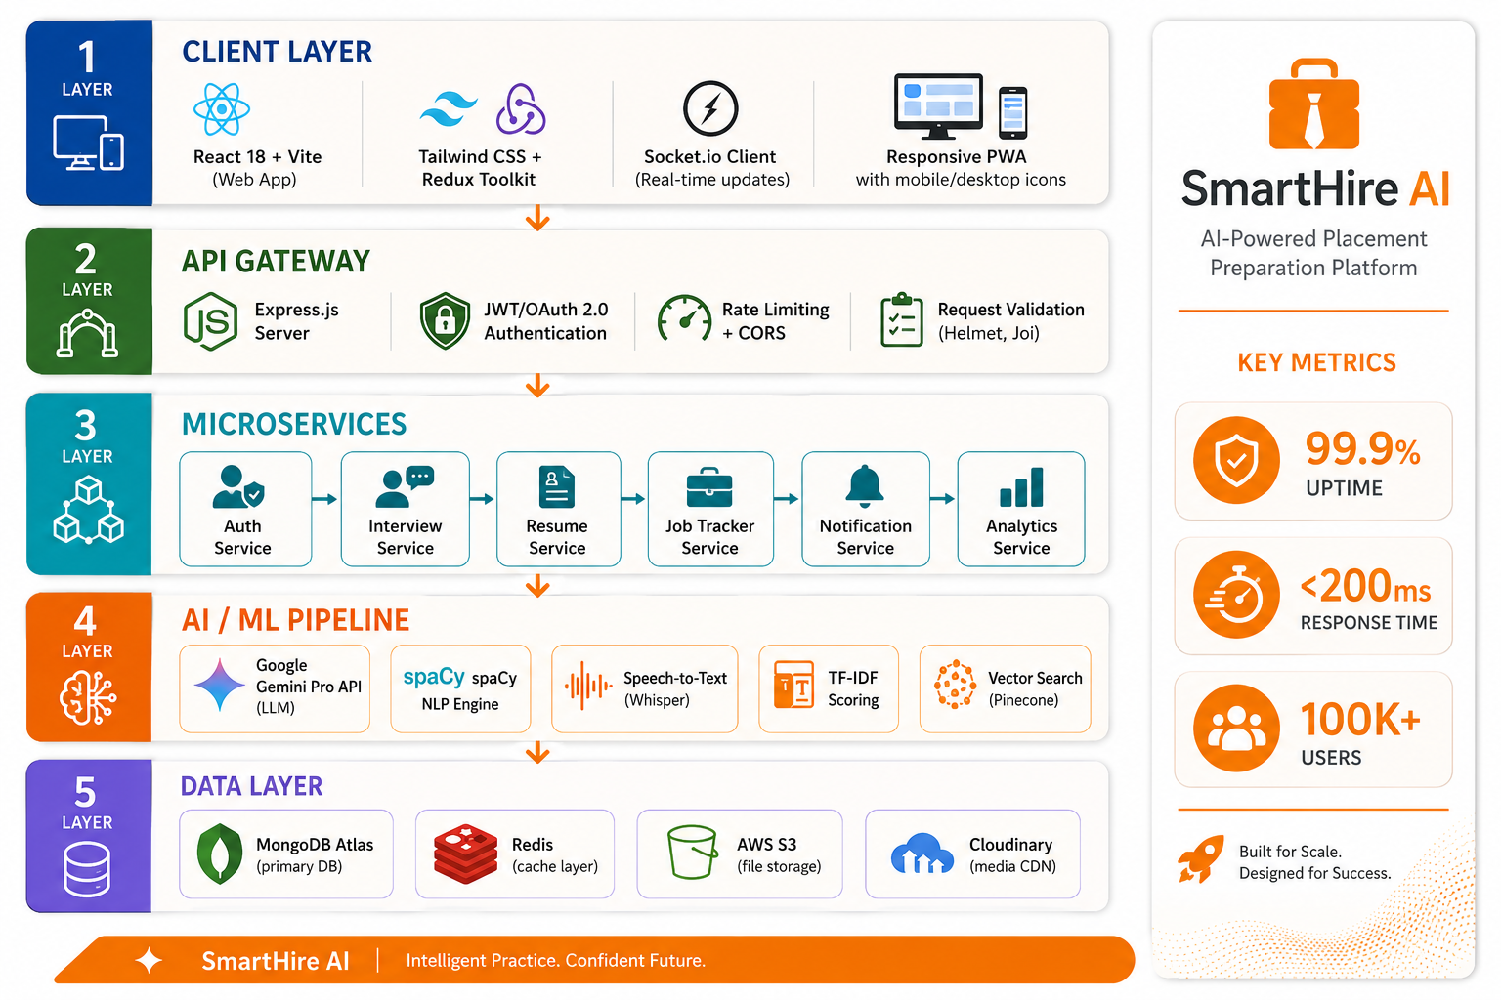
ARCHITECTURE DIAGRAM
System Design — Scalable, Modular, Cloud-Native
Layered microservices architecture designed for 100K+ concurrent users with 99.9% uptime.
Client Layer (Frontend)
React 18 + Vite + Tailwind CSS + Redux Toolkit • Responsive UI • Real-time updates via Socket.io
API Gateway
▼
Express.js • JWT/OAuth Auth • Rate Limiting • CORS • Request Validation • Helmet Security
Microservices Layer
▼
Auth Service | Interview Service | Resume Service | Tracker Service | Notification Service
AI/ML Pipeline
▼
Google Gemini Pro API | spaCy NLP | Speech-to-Text | Scoring Models | Vector Search
Data Layer
▼
MongoDB Atlas • Redis Cache • AWS S3 Storage • Cloudinary CDN • Pinecone Vector DB
99.9%
<200ms
100K+
Auto-Scale
Uptime
API Response
Concurrent Users
Cloud Native
SmartHire AI · AI-Powered Placement Preparation Platform
6 / 15

Slide 7
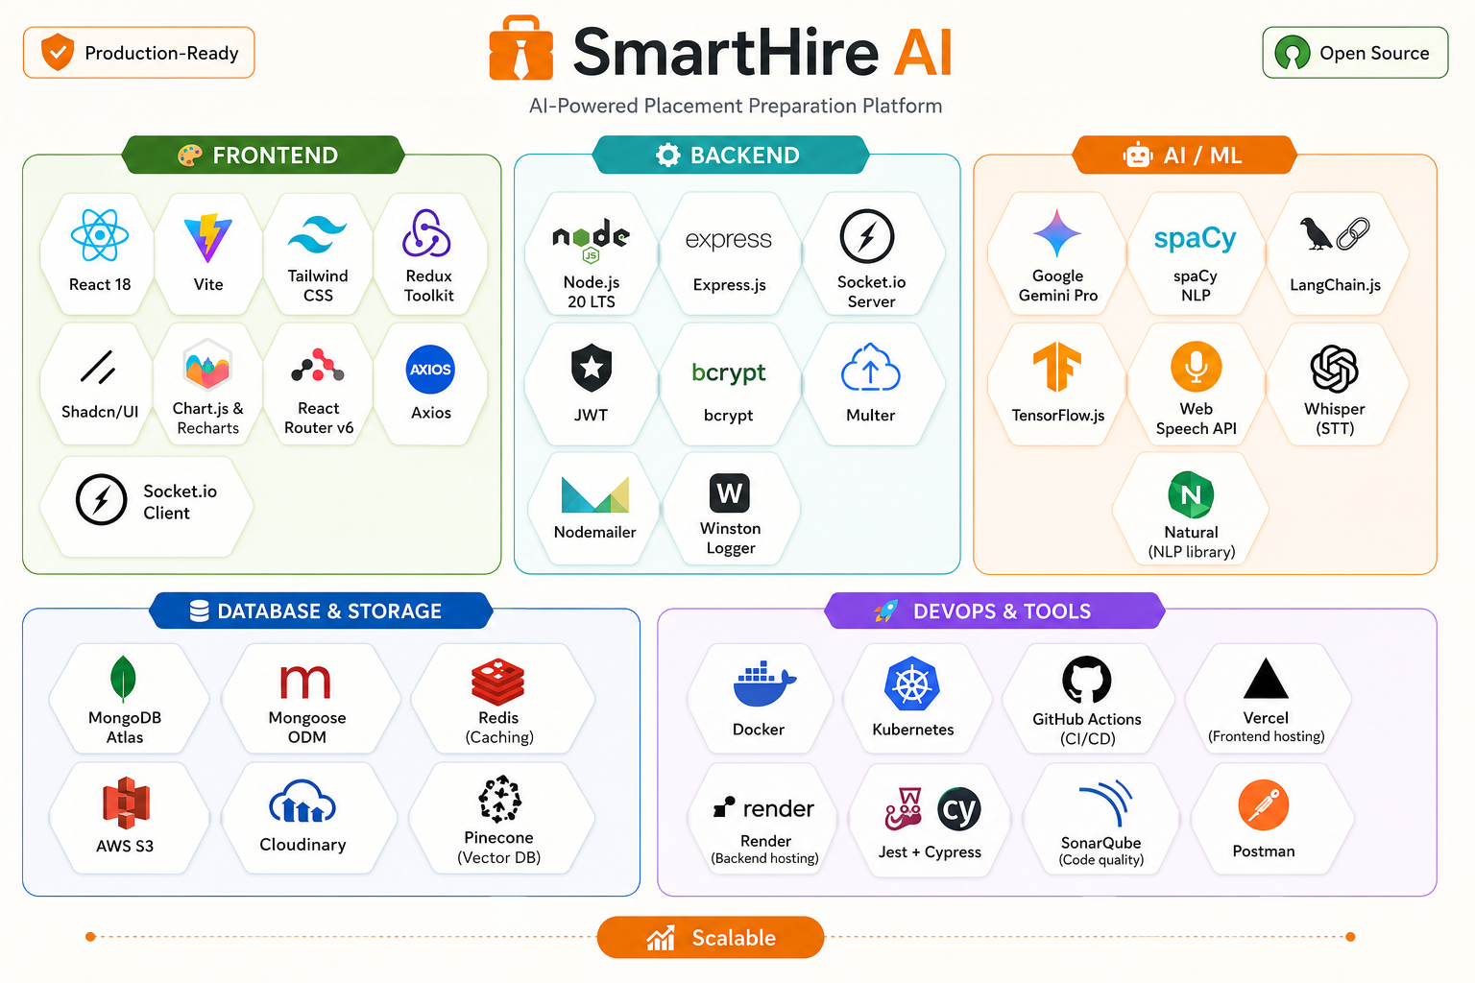
TECHNOLOGY STACK
Enterprise-Grade, Modern & Scalable Infrastructure
FRONTEND
BACKEND
AI / ML
DATABASE
DEVOPS
• React 18 + Vite
• Tailwind CSS
• Shadcn/UI
• Redux Toolkit
• Chart.js / Recharts
• Node.js 20 LTS
• Express.js
• Socket.io
• JWT + OAuth 2.0
• REST APIs
• Google Gemini Pro
• spaCy (NLP)
• TensorFlow.js
• Web Speech API
• LangChain.js
• MongoDB Atlas
• Redis (Caching)
• AWS S3 (Storage)
• Cloudinary
• Pinecone (Vector)
• Docker + K8s
• GitHub Actions
• Vercel + Render
• Jest + Cypress
• SonarQube
99.9%
<200ms
100K+
Auto-scale
Platform uptime
API response
Concurrent users
Cloud infra
SmartHire AI · AI-Powered Placement Preparation Platform
7 / 15

Slide 8
KEY FEATURES
AI Innovations That Set SmartHire Apart
🤖
🏢
📊
🔔
🔗
AI Interview Copilot
Company-Specific Prep
Peer Benchmarking
Smart Notifications
LinkedIn Integration
Real-time hints & coaching during live mock sessions
Curated banks for TCS, Infosys, Google, Amazon
Compare progress with anonymous cohort data
AI-prioritized alerts for deadlines & opportunities
Auto-optimize LinkedIn profile from resume analysis
🎥
🗺️
👥
🌐
🏫
Video Interview Mode
Skill Gap Roadmap
Group Mock Sessions
Portfolio Generator
TPO Dashboards
Camera practice with body language scoring
Personalized learning path with resources
Collaborative practice with peer feedback
Auto-generate portfolio website from resume
College-level analytics with cohort insights
SmartHire AI · AI-Powered Placement Preparation Platform
8 / 15

Slide 9
SCREENSHOTS / DEMO
Glimpse Into the SmartHire AI Experience
A walkthrough of our key user-facing modules — from dashboard to interview to resume analysis.
🏠
Dashboard
🎤
Mock Interview
📄
Resume Analyzer
Welcome banner, stats cards, Career Recommendations, Quick Actions, Recent Activity, Resume Score Trend & Placement Readiness gauge
Domain selection (DSA, WebDev, DBMS, OS, HR), 3 difficulty levels, real-time AI scoring with metrics, adaptive difficulty, full interview report
PDF/DOCX upload, ATS score (0-100), keyword analysis, AI suggestions by priority, JD matching, live resume builder with PDF export
💼
Job Tracker
🎯
Career Guide
👤
Profile
Add applications with company, role, salary, mode. Kanban view + Table view, stage filters, search, analytics dashboard
18+ career paths with match scores, skill gaps, learning roadmap, market trends, company insights, salary projections
Picture upload, edit personal info, education, skills, projects, certifications with PDF upload, career goals — fully editable
SmartHire AI · AI-Powered Placement Preparation Platform
9 / 15

Slide 10
INNOVATION & IMPACT
Why SmartHire AI Stands Out
Others solve one piece of the puzzle. SmartHire AI is the only platform that fuses mock interviews, resume intelligence, and job tracking into a single, student-friendly AI experience.
Feature | Generic Platforms | Interview Apps | Resume Tools | SmartHire AI
AI Mock Interviews | ❌ | ⚠️ | ❌ | ✅
ATS Resume Scoring | ❌ | ❌ | ⚠️ | ✅
Job Application Tracker | ⚠️ | ❌ | ❌ | ✅
Adaptive AI Difficulty | ❌ | ❌ | ❌ | ✅
Voice Interview Mode | ❌ | ❌ | ❌ | ✅
Career Recommendations | ❌ | ❌ | ❌ | ✅
Free for Students | ❌ | ⚠️ | ❌ | ✅
🏆 Our Moat: Unified AI ecosystem where interview performance informs resume improvements, and job tracking drives preparation priorities — creating a continuous feedback loop.
SmartHire AI · AI-Powered Placement Preparation Platform
10 / 15

Slide 11
SCALABILITY
Built for National Scale — 1M+ Users Ready
From day one, SmartHire AI's architecture is designed to scale horizontally with growing demand, ensuring sub-200ms response times even at peak load.
🏗️
Microservices Architecture
🗄️
MongoDB Atlas + Sharding
⚡
Redis Caching Layer
Each module (Auth, Interview, Resume, Tracker) scales independently based on load. No bottleneck.
Auto-scaling clusters with sharding strategies for millions of resume documents and user records.
Hot data (sessions, AI responses) cached in Redis for <50ms access. CDN for static assets.
🐳
Docker + Kubernetes
🔄
Event-Driven Pipeline
🌍
Multi-Region Deployment
Containerized deployment with K8s orchestration. Auto-scaling pods based on CPU/memory metrics.
Async processing with message queues (RabbitMQ) for AI tasks, notifications & background jobs.
Active-active deployment across AWS regions for low latency, fault tolerance & disaster recovery.
1M+ — Users supported
<200ms — p95 response
99.9% — Uptime SLA
Auto-scale — Horizontal
SmartHire AI · AI-Powered Placement Preparation Platform
11 / 15

Slide 12
BUSINESS & SOCIAL IMPACT
Empowering Students, Strengthening Institutions
Student Impact
Institutional Impact
Industry Impact
60%
Reduction in preparation time
40%
Higher placement success rate
50%
Reduced screening time
3x
Higher interview confidence
Digital
Data-driven analytics
Higher
Quality of candidates
85%+
ATS-compatible resumes created
Better
Institutional reputation
Wider
Talent pipeline access
10+ hrs
Saved per week
Equitable
Tier 2-3 college support
Lower
Cost-per-hire
ALIGNED WITH UN SUSTAINABLE DEVELOPMENT GOALS
SDG 4
SDG 5
SDG 8
SDG 9
SDG 10
Quality Education
Gender Equality
Decent Work
Innovation
Reduced Inequality
SmartHire AI · AI-Powered Placement Preparation Platform
12 / 15

Slide 13
FUTURE SCOPE
Roadmap — From Prototype to National Scale
PHASE 1
0-3 Months
PHASE 2
3-6 Months
PHASE 3
6-12 Months
PHASE 4
1-3 Years
Prototype
Beta Launch
Scale
National
• Requirements & system design
• Core API development
• Mock interview MVP
• Resume parser v1
• Auth & user management
• Full feature development
• AI model fine-tuning
• 5 college pilot testing
• User feedback iteration
• LinkedIn integration
• 25+ college deployment
• Voice + vernacular support
• Mobile app (React Native)
• B2B API launch
• Video interview mode
• 1L+ students served
• Pan-India coverage
• Full AI ecosystem
• Marketplace launch
• Government partnerships
VISION 2030
SmartHire AI becomes India's most trusted AI placement platform — 1 Million+ students across 1000+ colleges, transforming campus hiring forever.
SmartHire AI · AI-Powered Placement Preparation Platform
13 / 15

Slide 14
TEAM DETAILS
Meet Team TwinTech
Two minds, one mission — making placement preparation smarter for every Indian student.
Y
S
Yashvant
Shivani Kapase
Full Stack Developer & AI Engineer
Frontend Developer & UX Designer
• Backend Architecture
• Node.js / Express
• React.js & Redux
• UI/UX Design
• MongoDB / Database Design
• Google Gemini AI Integration
• Tailwind CSS
• Data Visualization
• NLP & ML Algorithms
• DevOps & Cloud (AWS)
• User Research & Testing
• Frontend Architecture
"Twin minds, one mission — making placement prep smarter for every student."
SmartHire AI · AI-Powered Placement Preparation Platform
14 / 15

Slide 15
S
SmartHire AI
Thank You!
"Prepare. Perform. Get Placed."
🤖 AI Mock Interview — NLP + Voice + Adaptive Difficulty
📝 Resume Analyzer — ATS Scoring + ML Optimization
📋 Job Tracker — Kanban + Analytics + Calendar Sync
⚙️ MERN Stack + Gemini AI + Microservices + DevOps
🌟 Freemium Model | 1L+ Users Target | College Partnerships
Team TwinTech
Yashvant • Shivani • Hackathon Round 1 | June 2026
15 / 15

