Slide 1
Community Detection based on Distance Dynamics
Group 6 - 3 Vertices
Shivani Kolanu
Bhavya Penumarthi
Sreekar Alakanti

Slide 2
Motivation:
Our team always wanted to know about the hidden relations among the nodes in a network.
As the data in the world is getting increased day by day, we always wondered on how can this data/network can be grouped or clustered.
Then comes community detection in rescue.

Slide 3
Introduction:
What is a Community in a graph?
A community is a subset of nodes that are closely connected to one another and distantly connected to the nodes in the other communities.
What is Community Detection?
The concept of community detection has emerged in network science as a method for finding groups within complex systems through representing on a graph.

Slide 4
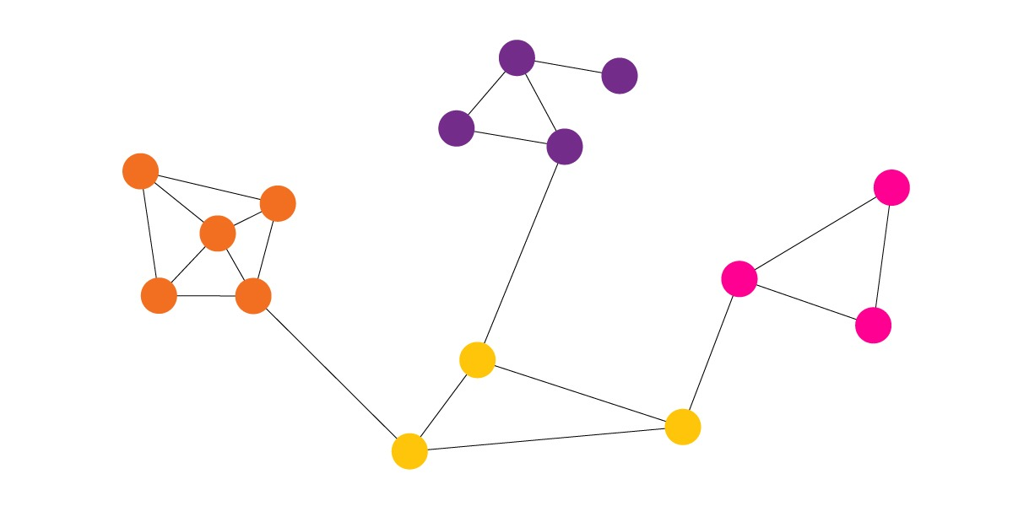
Problem Statement:
How do we identify the natural communities in a real-world network that give us information about its underlying composition and possible mechanisms?
How to identify the community structure in large scale networks effectively and efficiently?

Slide 5
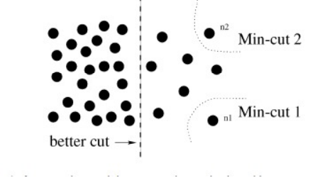
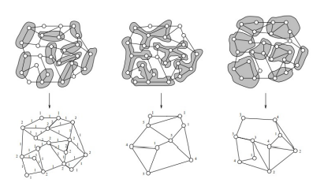
Related work:
Cut criteria-based community detection
Minimum cut criterion
Normalized cut
Expected cut
Large scale Network Handling

Slide 6
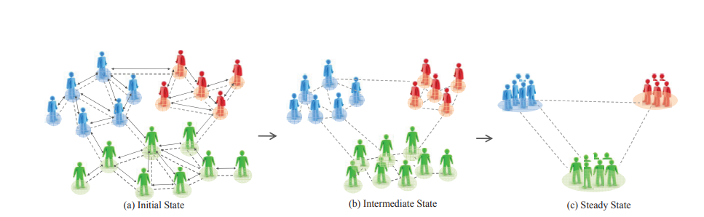
Proposed Method:
The basic idea is to consider the network as an adaptive dynamic system, and to investigate the distances between adjacent nodes dynamically in order to uncover its community structure.
Here we use an algorithm called attractor, which provides an intuitive way to analyze the community structure and captures the natural communities .

Slide 7
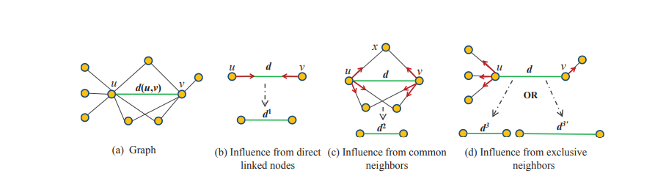
Implementation:
For the purpose of community detection some necessary definitions are introduced.
To uncover the community structure in networks based on the distance dynamics, we should build a suitable interaction model.
Therefore, the interaction range and interaction patterns need to be considered.

Slide 8
Attractor Distance Definition

Slide 9
Attractor Directed Linked Nodes Influence

Slide 10
Attractor Common Neighbor Influence

Slide 11
Attractor Exclusive Neighbor Influence
Notes: The dash line between u and h is called virtual edge.

Slide 12
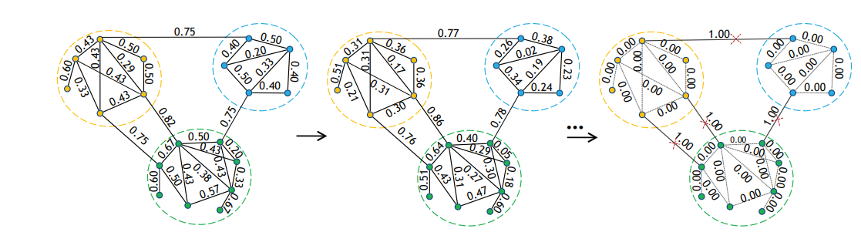

Slide 13
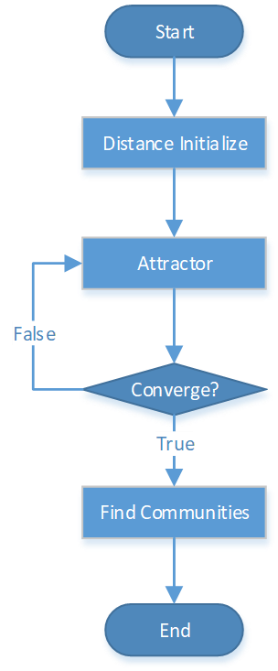
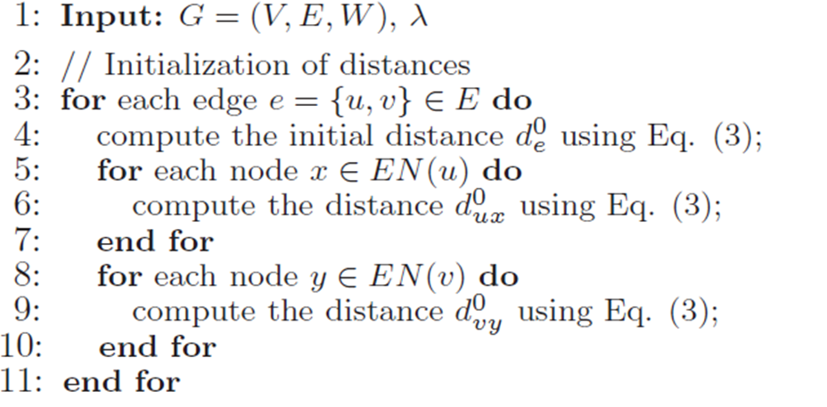
Attractor Model Initialization

Slide 14
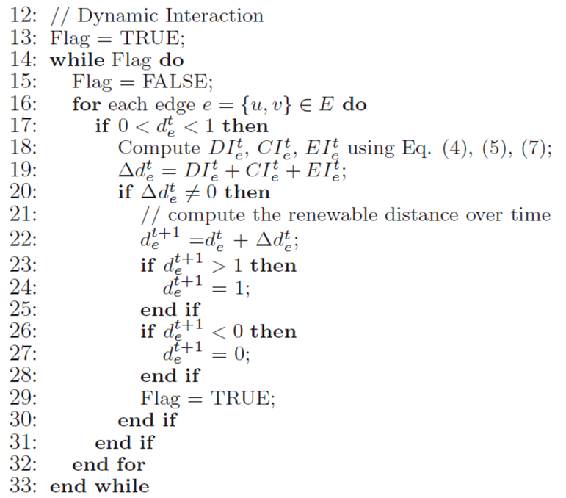
Attractor Model Dynamic Iteration

Slide 15
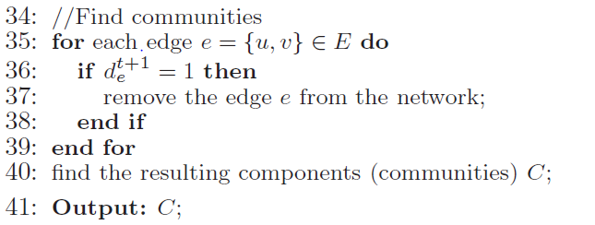
Attractor Model Finding communities

Slide 16
Advantages:
Intuitive Community Detection: Instead of optimizing user specified measures, Attractor investigates network community structure from a novel perspective: distance dynamics.
Small Community and Anomaly Detection: Small communities or anomalies that typically exist in large-scale networks can be well identified by relying on local topology-driven dynamic interactions, as Attractor allows discovering arbitrary size communities .
Scalability: Since the local interaction model, Attractor only needs to investigate the distances between linked nodes over time, resulting in a time complexity of O(|E|).

Slide 17
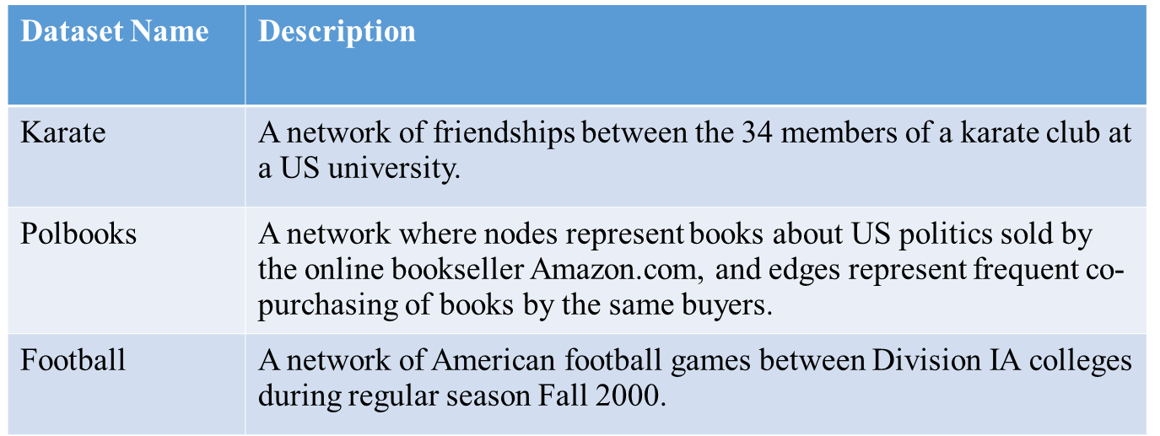
Experimental Evaluation:

Slide 18
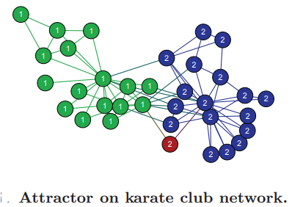
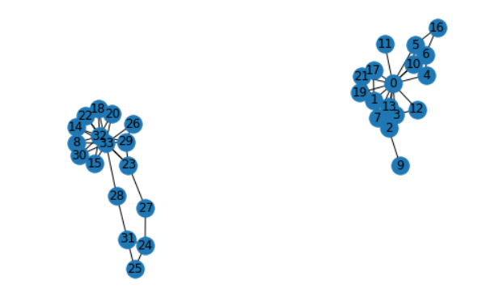
Experimental Evaluation:
Karate club graph
Expected Output
Actual output

Slide 19
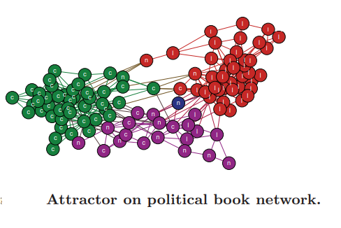
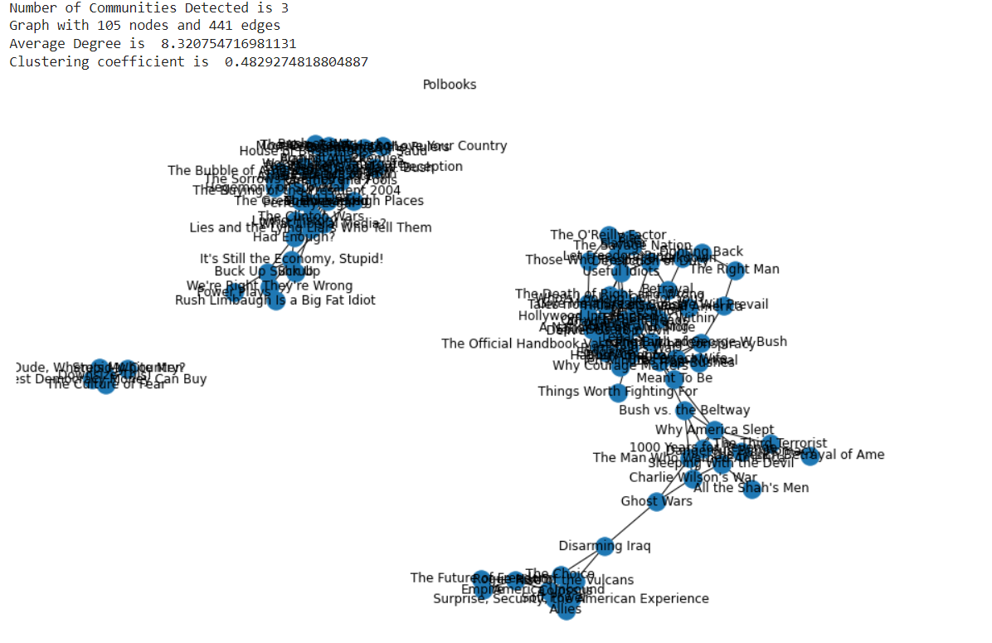
Experimental Evaluation:
Polbooks
Expected Output
Actual output

Slide 20
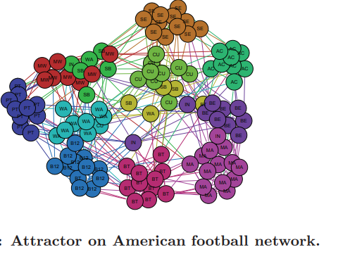
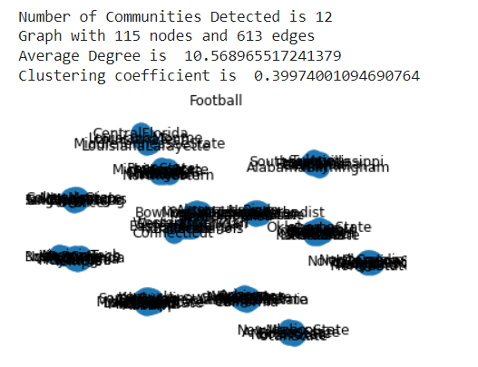
Experimental Evaluation:
Football Network
Expected Output
Actual output

Slide 21
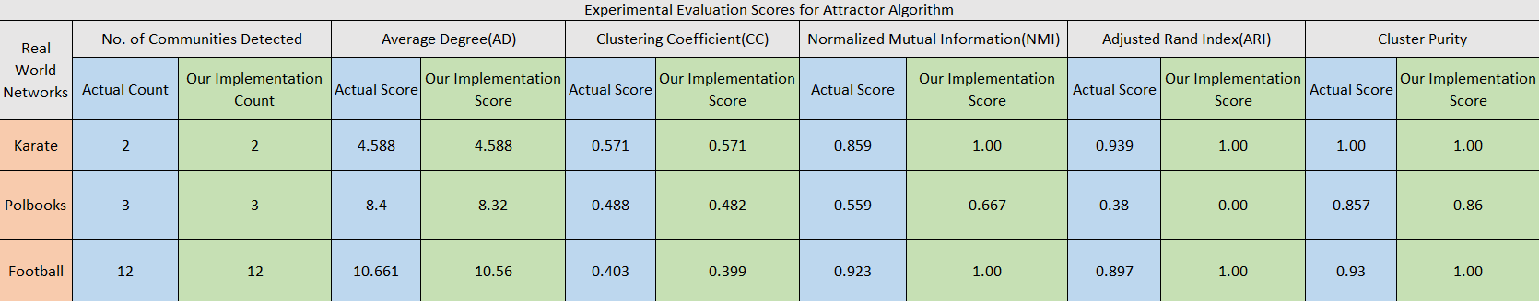
Experimental Evaluation

Slide 22
Conclusion:
In this project, we present Attractor, a novel community recognition technique that uses distance dynamics to automatically identify community structure in networks. Extensive trials further reveal that Attractor allows locating communities in small to large size networks with great quality and also offers favorable benefits compared to several state-of-heart approaches. We intend to concentrate on investigating massive network abstraction and visualization based on the understandable dynamic interaction model in future work.

Slide 23


