Slide 1
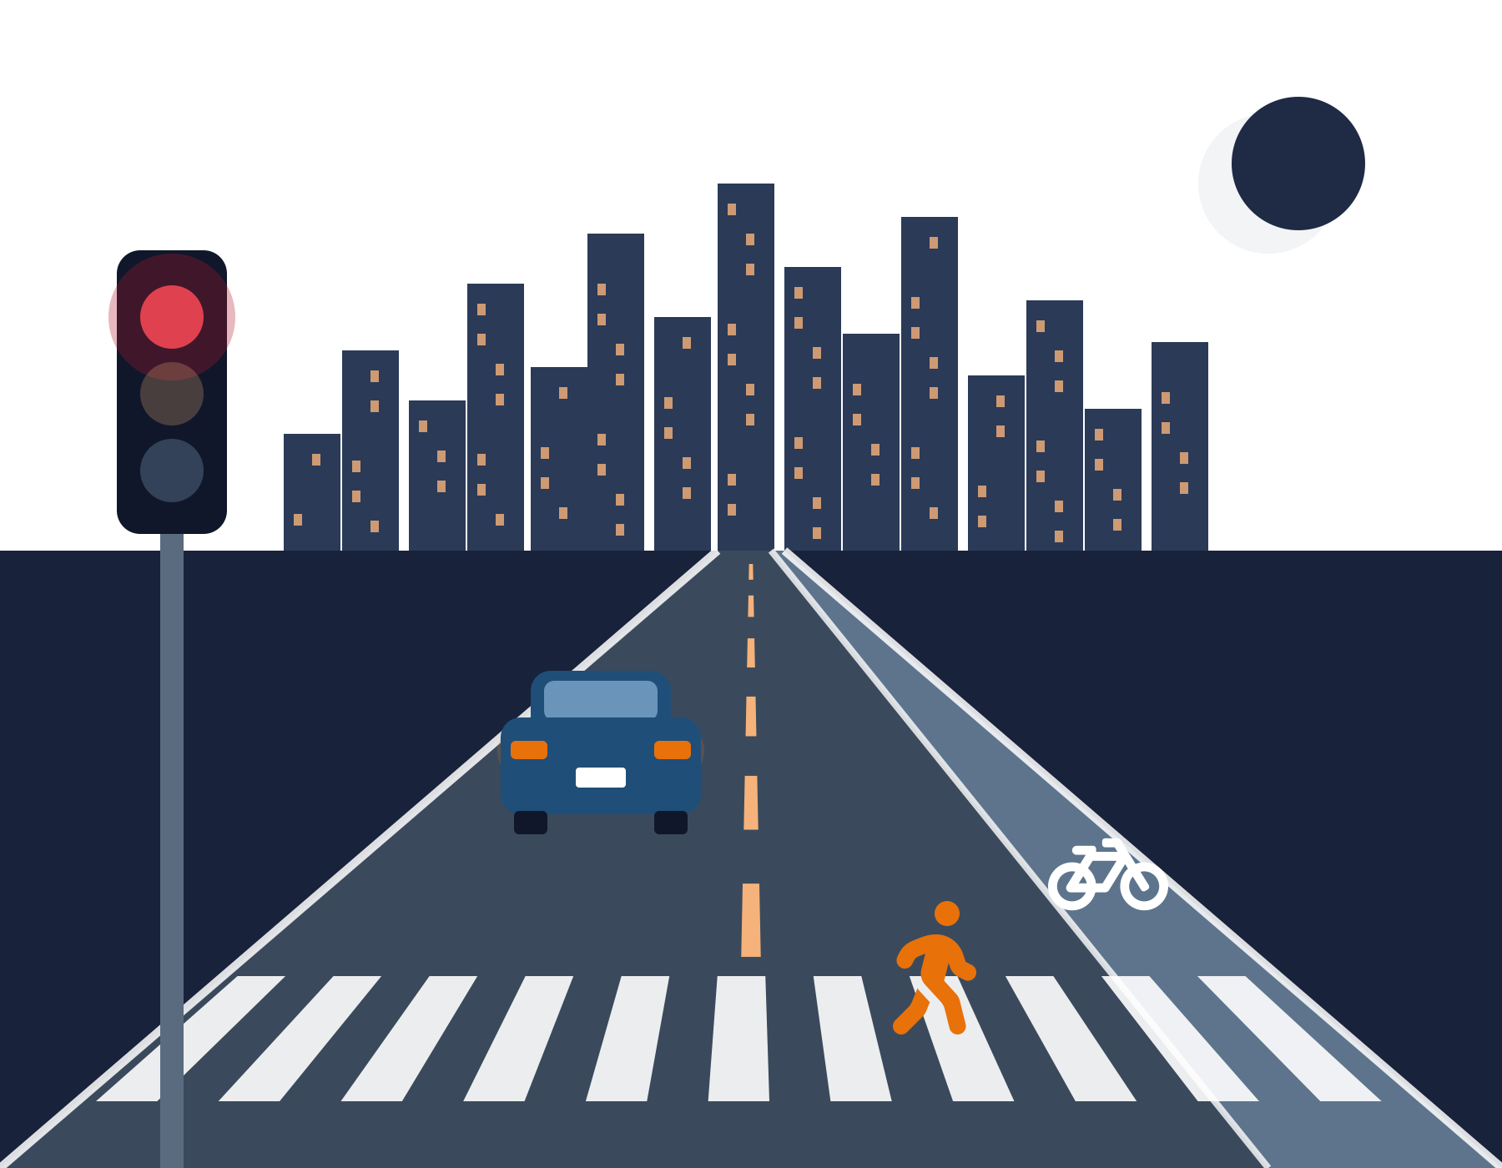
Fewer Crashes, Deadlier Roads
IE 6600 | DATA STORY
Where Seattle should act to reach Vision Zero
Shivani Mohan | 30-October-2026
Notes:
Hi everyone, I’m Shivani. Today I’m presenting my data story on traffic safety in Seattle, titled Fewer Crashes, Deadlier Roads. I analyzed the city’s traffic collision data from the perspective of the Seattle Department of Transportation’s Vision Zero team, the group responsible for making Seattle’s streets safer. My goal is to show where the city should focus to prevent the most serious crashes.

Slide 2
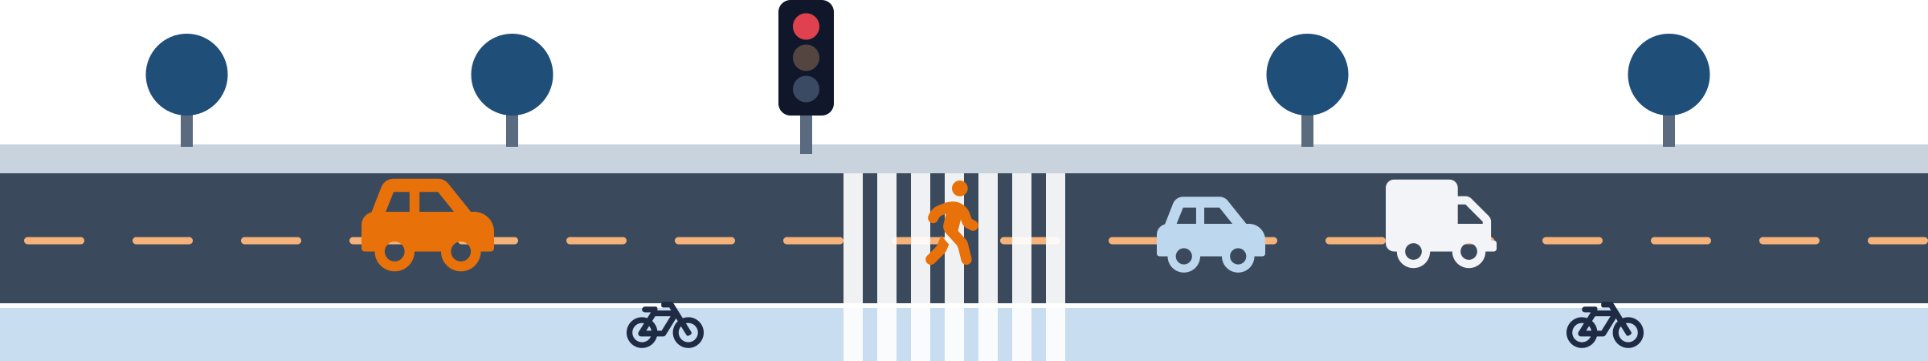
Seattle wants zero traffic deaths by 2030, but severe crashes are rising
2030
283
+34%
Vision Zero goal: no traffic deaths or serious injuries
people killed on Seattle streets since Vision Zero began (2015–2025)
more severe crashes per year in 2021–25 than in 2010–14
If SDOT could act on only a few things, which should they be? We look at why, when, and where severe crashes happen.
Notes:
In 2015, Seattle set a bold goal called Vision Zero: no traffic deaths or serious injuries on city streets by 2030. That's now just a few years away.. Since Vision Zero began, 283 people have been killed on Seattle's streets, about 26 every year. And it's getting worse, not better: in the last five years, severe crashes, the ones that kill or seriously injure someone, have been 34% higher than in the five years before Vision Zero started. SDOT also has a limited budget. It can't redesign every street or patrol every corner. So the question we asked is simple: if SDOT could act on only a few things, which should they be? To answer that, we'll walk you through why severe crashes happen, when they happen, and where they happen.

Slide 3
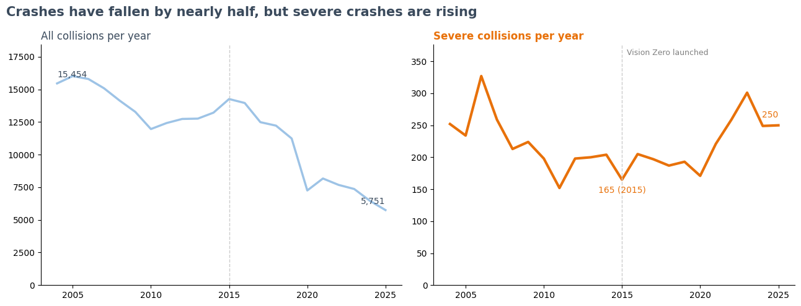
.
Paste Python chart here: Trend (all vs severe collisions)
From Colab: right-click the chart > Save image, then Insert > Pictures in PowerPoint
Severe = serious injury or fatal. Vision Zero launched in 2015. 5-year averages: all crashes −44%, severe crashes +34% (2021–25 vs 2010–14). Source: SDOT Collisions, 2004–2025.
Notes:
Let's start with the big picture. On the left are all collisions in Seattle, every reported crash from a dented bumper to a fatal crash. Since 2004, they've dropped from about 15,500 a year to about 5,800. On its own, that looks like great news. But on the right are severe collisions, where someone was seriously injured or killed. They reached their lowest point in 2015, the very year Vision Zero launched, and have been climbing ever since, reaching about 250 a year. To make a fair comparison, we used five-year averages instead of single years. Compared with the five years before Vision Zero, total crashes are down about 44%, but severe crashes are up about 34%. So Seattle has fewer crashes than ever, but the ones that do happen are far more likely to kill or seriously injure someone. That's the problem the rest of our story explains.

Slide 4
Speeding and failing to stop for pedestrians dominate severe crashes
64%
of severe crashes with a recorded factor involve speeding or not stopping for a pedestrian, up from 22% of all crashes
54%
of fatal crashes with a recorded factor involve speeding
Speeding
Didn't stop for pedestrian
Under the influence
Multiple factors
Inattention
Hit parked car
Complete police reports, 2016–2025, where at least one factor was recorded. 'Multiple factors' = two or more in the same crash. Source: SDOT Collisions.
Notes:
First, why are crashes becoming so dangerous? Police reports record contributing factors, like speeding or impairment. To make sure missing data didn't skew our results, we used only complete police reports. Each donut shows the mix of recorded factors. On the left are all crashes. The biggest slices are inattention, about 35%, and hitting a parked car, about 27%. These are everyday, mostly low-speed crashes. On the right are severe crashes, and the picture flips. Speeding jumps to 34%, and drivers not stopping for pedestrians jumps to 30%. Together, these two behaviors account for nearly two-thirds of severe crashes where a factor was recorded. And among fatal crashes, speeding alone is involved in more than half. Notice that distracted driving, the most common factor overall, shrinks in severe crashes. It causes a lot of fender-benders, but speed is what turns a crash deadly

Slide 5
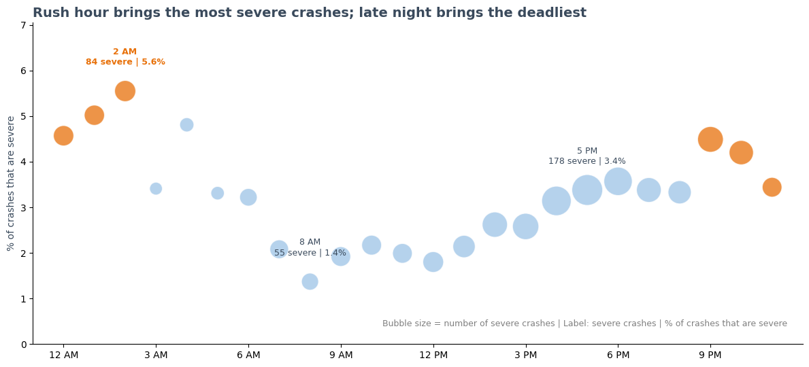
.
178
severe crashes at 5 PM, the most of any hour (crowded roads)
Paste Python chart here: Bubble chart (time of day)
From Colab: right-click the chart > Save image, then Insert > Pictures in PowerPoint
4x
a crash at 2 AM (5.6% severe) vs 8 AM (1.4%) is four times as likely to be severe
Bubble size = number of severe crashes. Crashes with a recorded time, 2016–2025. Source: SDOT Collisions.
Notes:
Next, when do severe crashes happen?
In this chart, each bubble is one hour of the day.
The size of the bubble shows how many severe crashes happened in that hour, and the height shows the share of crashes in that hour that were severe, in other words, how dangerous a crash is at that time. The biggest bubbles are during the evening rush. 5 PM alone had 178 severe crashes, the most of any hour, simply because the roads are full. But look at the late-night hours. Those bubbles are smaller, because there are fewer crashes, but they sit much higher. A crash at 2 AM is about four times as likely to be severe as a crash at 8 AM. So there are really two danger windows: rush hour, where the volume is, and late night, where the risk is highest.

Slide 6
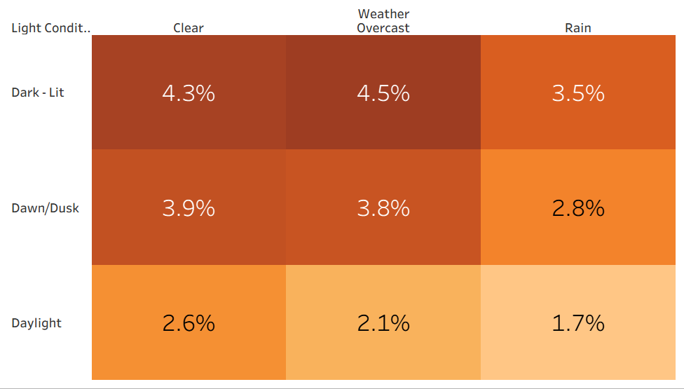


A crash on a clear night is 2.5x as likely to be severe as one on a rainy day
4.3%
severe on clear nights
1.7%
severe on rainy days
Paste Tableau chart here: Conditions highlight table
In Tableau: Worksheet > Export > Image, then Insert > Pictures in PowerPoint
In every light condition, rain has the lowest severity. Drivers slow down in the rain; on dry, open roads at night, they speed.
% of crashes that are severe by light and weather condition, 2016–2025. Cells with fewer than 100 crashes excluded. Source: SDOT Collisions.
Notes:
Now, living in Seattle, you might expect rain to be the biggest danger. We expected that too. It isn't. This table shows the share of crashes that were severe for each combination of light and weather. Darker orange means more dangerous. Look at the bottom-right corner: rainy days are actually the safest, with just 1.7% of crashes being severe. The darkest cells are at night, when skies are clear or overcast, at around 4.3 to 4.5%. That makes a crash on a clear night about two and a half times as likely to be severe as one on a rainy day. The most likely explanation is driver behavior. People slow down and take care in the rain, but on dry, open roads at night, they speed. That connects directly back to our speeding finding.

Slide 7
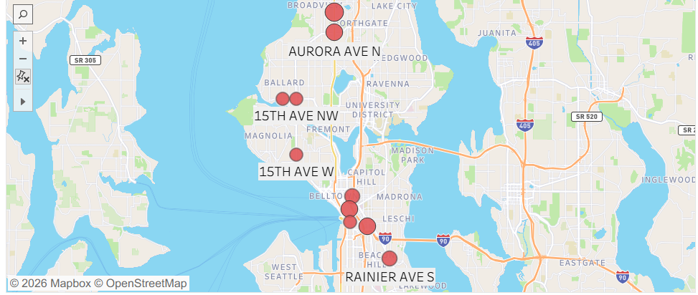


Where pedestrians and cyclists are most often seriously hurt, led by Aurora Ave N
Nearly half of severe crashes (1,089 of 2,233) involve someone walking or biking
Paste Tableau chart here: Pedestrian & Cyclist Map
In Tableau: Worksheet > Export > Image, then Insert > Pictures in PowerPoint
Top locations | Severe
Aurora Ave N (N 117th Pl–N 125th St) | 6
Aurora Ave N (near N Northgate Way) | 5
5th Ave & Spring St | 5
12th Ave S & S Weller St | 5
Boren Ave & Pine St | 4
Rainier Ave S | 4
Severe crashes (serious injury or fatal) involving a pedestrian or cyclist, 2016–2025. Source: SDOT Collisions.
Notes:
Finally, where, and who gets hurt most. People walking or biking are involved in fewer than 8% of all crashes, but in nearly half of all severe crashes: 1,089 out of 2,233 in the last ten years. When a car hits a pedestrian, the crash is about 14 times as likely to be severe as a crash between vehicles. This map shows the places in Seattle where pedestrians and cyclists were most often seriously hurt or killed. The worst single location is Aurora Avenue North between 117th and 125th Street, and Aurora holds another spot in the top four near Northgate. Downtown intersections like 5th Avenue and Spring Street and Boren and Pine, along with 12th Avenue South and Rainier Avenue South, also stand out. These are the places where safety upgrades would protect the most vulnerable people on the road.

Slide 8

Slow the speeds, own the nights, protect people walking and biking
Slow the speeds
Own the nights
Protect people outside cars
Speeding is the top recorded factor in severe and fatal crashes.
Late-night and clear-night crashes are the most likely to be severe.
Pedestrians and cyclists: under 8% of crashes, nearly half of severe ones.
Reaching Vision Zero by 2030 means putting SDOT's limited budget where severe crashes concentrate.
Notes:
So, if Seattle wants to reverse the rise in severe crashes, our data points to three priorities: slow the speeds, own the nights, and protect people walking and biking. Reaching Vision Zero by 2030 means putting SDOT's limited budget where severe crashes are concentrated. Now let me walk through the structure of our project.

Slide 9




1. Business Understanding
Stakeholder
Business problem
Seattle Department of Transportation (SDOT), Vision Zero team. We act as data consultants.
Severe crashes are rising ahead of the 2030 goal, and SDOT's safety budget can't fix every street.
Objective
How SDOT uses it
Identify where, when, and why severe crashes (serious injury or fatal) happen.
Prioritize street redesigns, time enforcement, and target safety campaigns.
Notes:
Our stakeholder is SDOT's Vision Zero team, and we took the role of data consultants. The business problem is that severe crashes are rising as the 2030 deadline approaches, and SDOT's safety budget can't fix every street. Our objective was to identify where, when, and why severe crashes happen, meaning crashes with a serious injury or death. SDOT can use these insights to prioritize street redesigns, schedule enforcement, and target its safety campaigns.

Slide 10

2. Data Description & Summary
262,615
Source: SDOT Collisions (City of Seattle open data), late 2003 to Oct 2026
collisions after cleaning (from 262,998 rows, 64 → 43 columns)
Cleaning
Limitations
5,022
Removed 3 duplicates and 380 rows with no severity
Parsed dates and times; added year, hour, weekday
Grouped weather, road, and light values
Converted map coordinates to latitude/longitude
23% of crashes have no time recorded
~20% have unknown conditions (mostly citizen reports)
Behavior factors recorded only when an officer notes them
Some minor crashes go unreported
severe collisions (1.9%): serious injury or fatal
2004–2025
full years analyzed; 2016–2025 used for detailed charts
Notes:
Our data comes from SDOT's official collision records, published on the City of Seattle's open data portal. Each row is one reported crash, with details on when and where it happened, how severe it was, the road and light conditions, and contributing factors like speeding. After cleaning, we have about 263,000 collisions, of which 5,022, or just under 2%, were severe. We used full years from 2004 to 2025 for the long-term trend, and the most recent ten years, 2016 to 2025, for our detailed analysis. For cleaning, we removed duplicate reports and rows without a severity, converted the date text into a proper date-time format to create year and hour columns, simplified the weather, road, and light categories, and converted the city's map coordinates into latitude and longitude for mapping. We also want to be transparent about limitations. About 23% of crashes have no time recorded, so they're excluded only from the time-of-day chart. About 20% have unknown conditions, mostly from citizen-filed reports. And contributing factors are only recorded when an officer notes them, so behaviors like speeding are likely undercounted, which makes our estimates conservative.

Slide 11



3. Identifying Business Questions
1
Is Seattle on track to meet its Vision Zero goal?
2
Which driver behaviors should SDOT target with enforcement and campaigns?
3
When should SDOT focus enforcement and safety campaigns?
4
Should campaigns focus on bad-weather days or clear nights?
5
Which locations are pedestrians and cyclists most often seriously hurt?
Notes:
These are the five business questions we set out to answer, each tied to a decision SDOT controls: whether Seattle is on track, which behaviors to target, when to focus enforcement, whether to focus on rain or clear nights, and where pedestrians and cyclists need protection most.

Slide 12
4. Answering Business Questions
Business question | Answer
On track for Vision Zero? | No. Total crashes fell ~44%, but severe crashes rose ~34% (5-year averages).
Which behaviors? | Speeding and not stopping for pedestrians: 64% of severe crashes with a recorded factor.
When? | Evening rush (3–9 PM) has the most severe crashes; late night (9 PM–3 AM) the highest risk.
Rain or clear nights? | Clear nights: 4.3% severe vs 1.7% on rainy days, about 2.5x.
Where for pedestrians and cyclists? | Aurora Ave N (two of the top four spots), downtown, 12th Ave S, Rainier Ave S.
Notes:
In short: no, Seattle is not on track, since severe crashes are up about a third. The behaviors to target are speeding and failing to stop for pedestrians. Enforcement should focus on the evening rush and late night. Campaigns should focus on clear nights, not rain. And pedestrian and cyclist upgrades should start on Aurora Avenue North.

Slide 13


5. Business Recommendations
Target speeding
Speed cameras, lower limits, and street designs that slow traffic, especially at night
Protect people walking and biking
Safer crosswalks, leading pedestrian signals, lighting, and protected bike lanes, starting on Aurora Ave N
Time enforcement to two windows
Evening rush for volume, late night for risk
Shift campaign messaging
From "drive carefully in the rain" to "slow down on clear nights"
Track severe crashes, not totals
Falling total crashes hide the real problem; measure progress by severe crashes
Notes:
Our recommendations: first, target speeding with cameras, lower limits, and street designs that slow traffic. Second, protect people walking and biking with safer crosswalks, leading pedestrian signals, lighting, and protected bike lanes, starting on Aurora. Third, time enforcement to the evening rush and late night. Fourth, shift campaign messaging from rain to clear nights. And fifth, measure progress by severe crashes, not total crashes, because falling totals hide the real problem.

Slide 14
References
[1] City of Seattle, “Vision Zero: Seattle’s plan to end traffic deaths and serious injuries by 2030,” Seattle, WA, USA, 2015. [Online]. Available: https://www.seattle.gov/Documents/Departments/beSuperSafe/VisionZeroPlan.pdf
[2] Seattle Department of Transportation, “SDOT collisions - All years,” Data.gov, dataset. [Online]. Available: https://catalog.data.gov/dataset/sdot-collisions-all-years. Accessed: Oct. 26, 2026.
[3] Seattle Department of Transportation, “Collisions: Open data metadata,” City of Seattle, data dictionary. [Online]. Available: https://www.seattle.gov/Documents/Departments/SDOT/GIS/Collisions_OD.pdf. Accessed: Oct. 26, 2026.
[4] A. Chen, “Lessons in storytelling; Clutter is your enemy; Focus on the audience’s attention,” lecture slides, IE 6600, Northeastern Univ., Seattle, WA, USA, 2026.
Tools: Python (pandas, matplotlib) in Google Colab; Tableau Public.
Notes:
Our analysis uses the City of Seattle’s SDOT collision data [2], with field definitions from its metadata [3]. The Vision Zero goal comes from the city’s plan [1], and our chart design follows the course storytelling principles [4]. No need to read this slide aloud; leave it up briefly before the Thank You slide.

Slide 15
Thank you
Questions?
Severe crashes in Seattle are concentrated, predictable, and preventable.
Notes:
To sum up: severe crashes in Seattle are concentrated, predictable, and preventable. Thank you, and we're happy to take questions.

