Slide 1

Supplier Evaluation Dashboard
Framework for scoring hardware suppliers (Microsoft example)

Slide 2
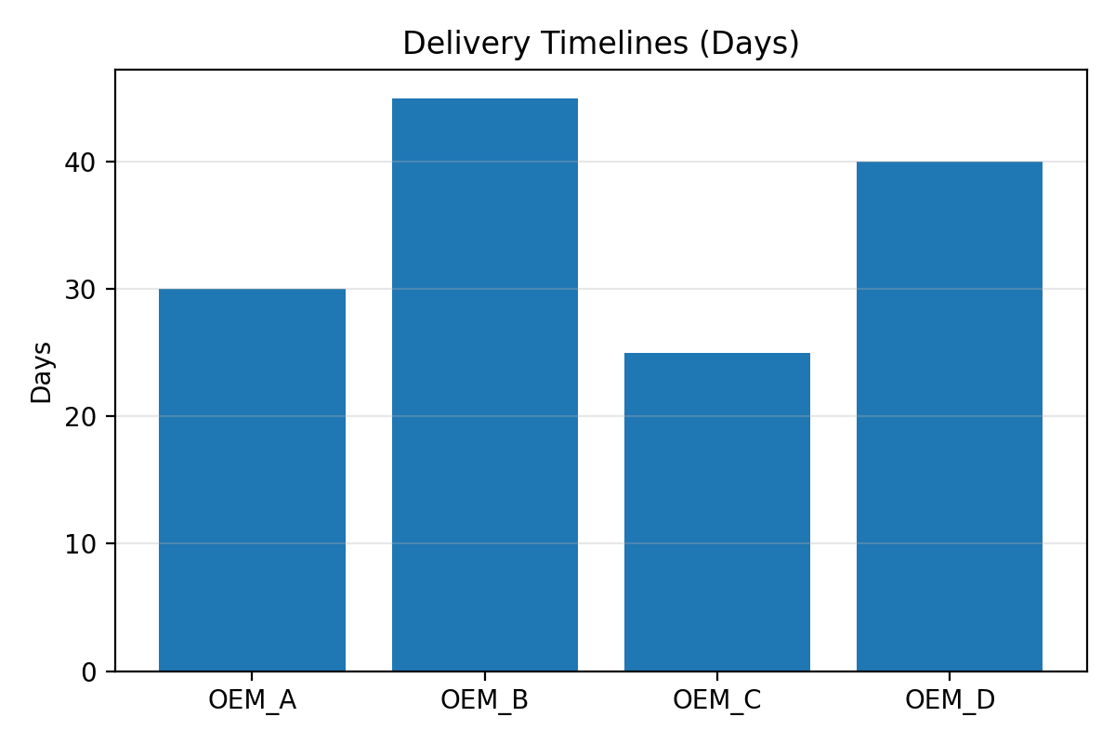
Delivery Timelines

Slide 3
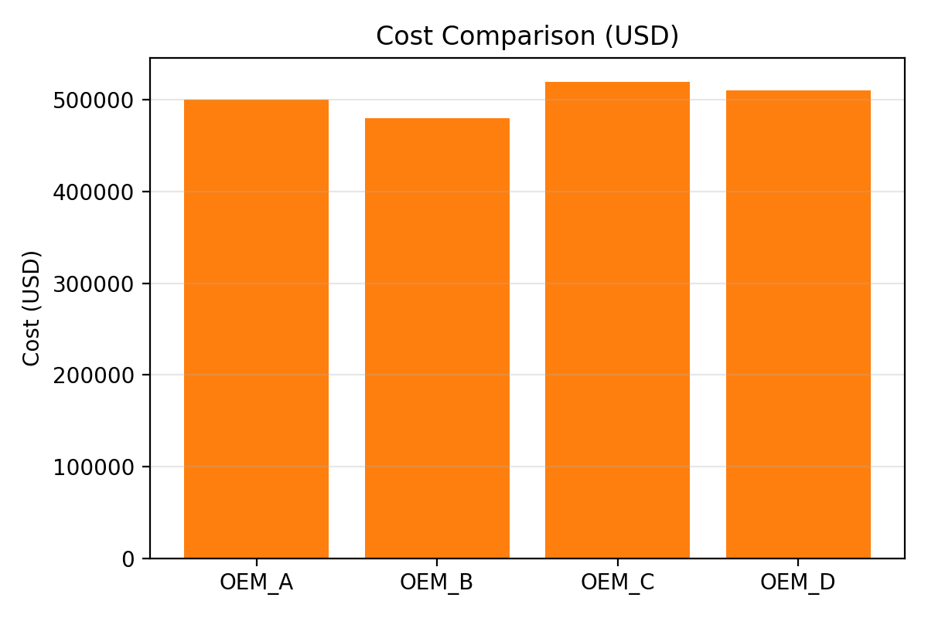
Cost Comparison

Slide 4
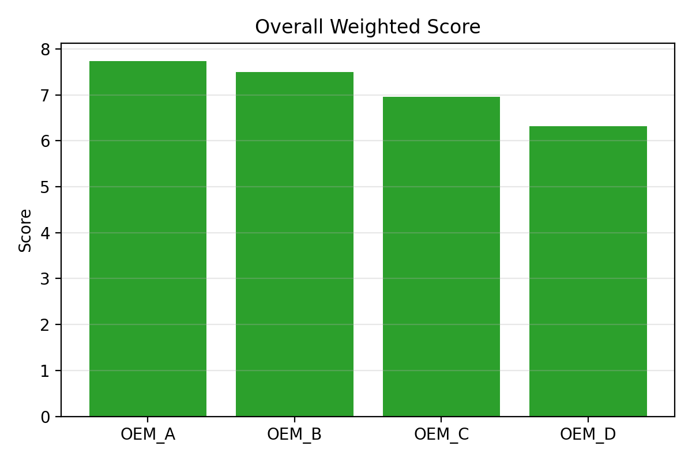
Overall Weighted Score

Slide 5
Criteria and Weightage for Quality Scoring
Criteria | Weightage
Quality | 0.4
Cost | 0.2
Delivery | 0.2
Reliability | 0.2

Slide 6
Vendor Reliability Index
Reliability Index (0-100):
  OEM_A: 92
  OEM_B: 95
  OEM_C: 88
  OEM_D: 90

