Slide 1
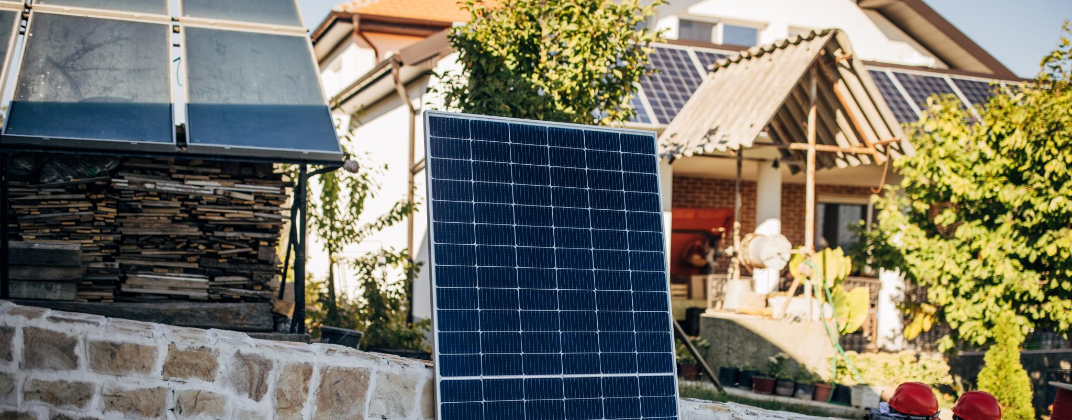
Solar Inverters – Global Market & Technology Brief
Overview of innovations and market trends worldwide
Notes:
---

Slide 2
Executive Summary

Slide 3
Key Insights & Trends
Global solar inverter market poised for steady growth; hybrid and smart inverter adoption accelerating.
  • Market size: $12.9B (2025) → $21.6B (2035), CAGR ~5.3%.
  • Huawei & Sungrow dominate globally; India led by Sungrow (29%).
  • Trends: Hybrid/storage integration, AI-driven MPPT, SiC/GaN semiconductors.
  • Regulations: Net billing (US), rooftop mandates (EU), ALMM expansion (India).

Slide 4
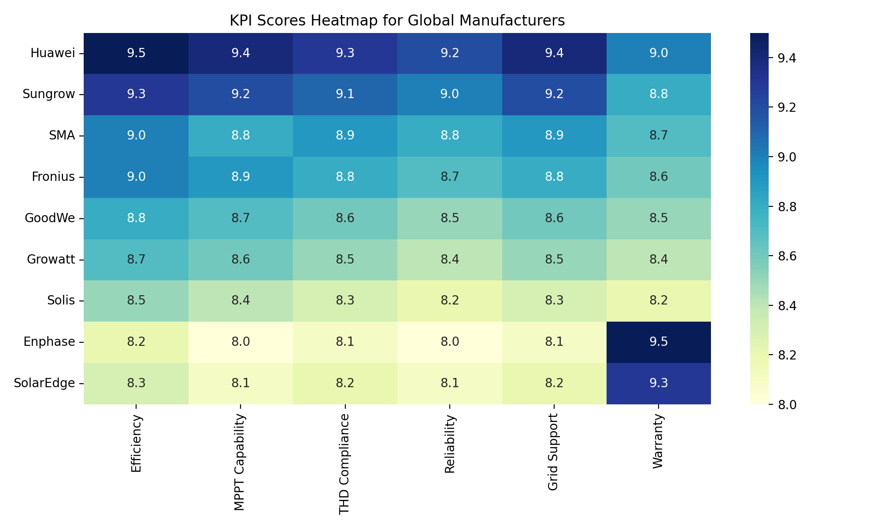
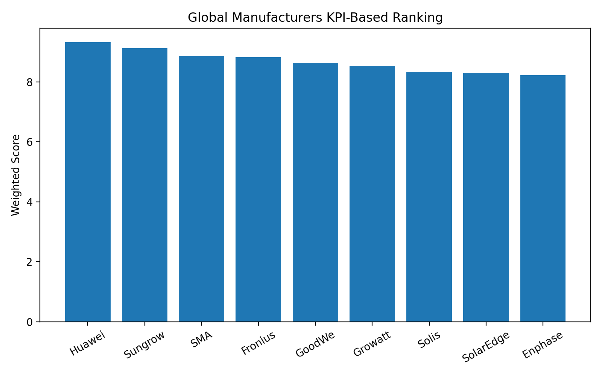
KPI Scores Heatmap and Rankings – Global Manufacturers
Notes:
---
This slide references information from the following file: https://www.futuremarketinsights.com/reports/solar-inverter-market,https://www.gminsights.com/industry-analysis/pv-inverter-market,https://www.globalmarketstatistics.com/market-reports/solar-inverter-market-11975,https://www.wiseguyreports.com/reports/solar-pv-inverter-market
The global solar inverter market is experiencing robust growth driven by the accelerating adoption of renewable energy and supportive government policies. According to multiple analyst sources, the market size in 2024 ranged between USD 15.9 billion and USD 34.6 billion, reflecting variations in methodology and scope. Forecasts indicate that by 2033–2035, the market could reach between USD 20.5 billion and USD 90 billion, depending on the scenario considered. This expansion corresponds to compound annual growth rates (CAGRs) between 5.3% and 9.5%, highlighting a strong upward trajectory. Key drivers include declining costs of photovoltaic systems, technological advancements in inverter design, and the integration of smart features such as grid support and energy storage compatibility. Additionally, the modernization of power grids and the rise of decentralized generation models are fueling demand for advanced inverter solutions. These trends underscore the strategic importance of solar inverters in global energy transition plans, making them a critical component for residential, commercial, and utility-scale projects.

Slide 5
Global Market Overview
Notes:
---
This slide references information from the following file: https://www.futuremarketinsights.com/reports/solar-inverter-market,https://www.gminsights.com/industry-analysis/pv-inverter-market,https://www.globalmarketstatistics.com/market-reports/solar-inverter-market-11975,https://www.wiseguyreports.com/reports/solar-pv-inverter-market
Market Size and Growth Forecast, Regional Shipment Distribution

Slide 6
Market Size and Growth Forecast
Source | Base Year | Market Size (Base) | Forecast Year | Market Size (Forecast) | CAGR %
Global Market Statistics | 2024 | USD 15.9B | 2033 | USD 20.5B | 8.9%
Global Market Insights | 2024 | USD 34.6B | 2034 | USD 90B | 9.5%
Future Market Insights | 2025 | USD 12.9B | 2035 | USD 21.6B | 5.3%
Notes:
---
This slide references information from the following file: https://www.futuremarketinsights.com/reports/solar-inverter-market,https://www.gminsights.com/industry-analysis/pv-inverter-market,https://www.globalmarketstatistics.com/market-reports/solar-inverter-market-11975,https://www.wiseguyreports.com/reports/solar-pv-inverter-market
The global solar inverter market is experiencing robust growth driven by the accelerating adoption of renewable energy and supportive government policies. According to multiple analyst sources, the market size in 2024 ranged between USD 15.9 billion and USD 34.6 billion, reflecting variations in methodology and scope. Forecasts indicate that by 2033–2035, the market could reach between USD 20.5 billion and USD 90 billion, depending on the scenario considered. This expansion corresponds to compound annual growth rates (CAGRs) between 5.3% and 9.5%, highlighting a strong upward trajectory. Key drivers include declining costs of photovoltaic systems, technological advancements in inverter design, and the integration of smart features such as grid support and energy storage compatibility. Additionally, the modernization of power grids and the rise of decentralized generation models are fueling demand for advanced inverter solutions. These trends underscore the strategic importance of solar inverters in global energy transition plans, making them a critical component for residential, commercial, and utility-scale projects.

Slide 7
Regional Shipment Distribution
Region | Share % (2024)
APAC | 69%
US | 10%
Europe | 15%
Rest of World | 6%
Notes:
---
This slide references information from the following file: https://www.futuremarketinsights.com/reports/solar-inverter-market,https://www.gminsights.com/industry-analysis/pv-inverter-market,https://www.globalmarketstatistics.com/market-reports/solar-inverter-market-11975,https://www.wiseguyreports.com/reports/solar-pv-inverter-market
Regional analysis reveals that Asia-Pacific dominates global inverter shipments, accounting for approximately 69% of total volume in 2024. This dominance is primarily driven by China’s massive solar deployment and manufacturing capacity. In contrast, the United States and Europe experienced shipment declines due to inventory overhang and policy transitions, such as changes in net metering compensation. Emerging markets in Africa, the Middle East, and Southeast Asia are expected to contribute significantly to future growth as manufacturers tailor products for weak-grid conditions. The concentration of shipments in APAC underscores the strategic role of Chinese manufacturers and the region’s leadership in renewable energy adoption.

Slide 8
Competitive Landscape
Notes:
---
This slide references information from the following file: https://www.saurenergy.com/solar/huawei-sungrow-held-55-of-global-inverter-market-in-2024-report-9496730,https://www.pvtime.org/2024-top-20-global-photovoltaic-inverter-brands-revealed-by-pvbl/,https://www.woodmac.com/press-releases/global-pv-inverter-shipments-grew-by-10-in-2024-to-589-gwac/
Global Leading Manufacturers, Indian Market Leaders

Slide 9
Global Leading Manufacturers
Manufacturer | Global Share % (2024)
Huawei | 30%
Sungrow | 25%
Ginlong (Solis) | 5%
Growatt | 4%
Others | 36%
Notes:
---
This slide references information from the following file: https://www.saurenergy.com/solar/huawei-sungrow-held-55-of-global-inverter-market-in-2024-report-9496730,https://www.pvtime.org/2024-top-20-global-photovoltaic-inverter-brands-revealed-by-pvbl/,https://www.woodmac.com/press-releases/global-pv-inverter-shipments-grew-by-10-in-2024-to-589-gwac/
The global solar inverter market is highly consolidated, with Huawei and Sungrow together commanding approximately 55% of market share in 2024. Huawei leads with strong performance across China, Europe, Latin America, and Africa, while Sungrow dominates in the United States, India, and the Middle East. Other notable players include Ginlong (Solis) and Growatt, each holding less than 5% share individually. This concentration reflects the competitive advantage of Chinese firms in scale, cost efficiency, and technological innovation. Western brands such as SMA, Fronius, and SolarEdge maintain strong positions in premium segments, focusing on advanced grid services and hybrid solutions. The competitive dynamics are influenced by factors such as R&D investment, product reliability, and compliance with evolving grid codes.

Slide 10
Indian Market Leaders
Supplier | Market Share % (India, 2024)
Sungrow | 29.1%
TBEA Energy India | 21.3%
Sineng Electric | 13.3%
FIMER India | 12.2%
Ginlong (Solis) | 6%
Notes:
---
This slide references information from the following file: https://www.saurenergy.com/solar/huawei-sungrow-held-55-of-global-inverter-market-in-2024-report-9496730,https://www.pvtime.org/2024-top-20-global-photovoltaic-inverter-brands-revealed-by-pvbl/,https://www.woodmac.com/press-releases/global-pv-inverter-shipments-grew-by-10-in-2024-to-589-gwac/
India’s solar inverter market is growing rapidly, supported by government initiatives such as PM-KUSUM and rooftop subsidy programs. In 2024, Sungrow led the Indian market with a 29.1% share, followed by TBEA Energy India at 21.3%, Sineng Electric at 13.3%, FIMER India at 12.2%, and Ginlong (Solis) at 6%. The shift from central to string inverters is notable, driven by faster troubleshooting and better compatibility with distributed solar projects. High-power string inverters are increasingly preferred for utility-scale installations due to their modularity and improved DC-to-AC conversion ratios. These trends align with India’s push for decentralized energy generation and enhanced grid stability.

Slide 11
Industry Trends and Regulatory Changes
Notes:
---
This slide references information from the following file: https://www.futuremarketinsights.com/reports/solar-inverter-market,https://www.srnesolar.com/articledetail/string-vs-micro-vs-hybrid-which-type-of-solar-inverter-is-best.html,https://www.pv-magazine.com/2025/01/29/top-5-global-inverter-trends-to-watch-in-2025/
Technology and Market Trends, Global Regulatory and Incentive Landscape

Slide 12
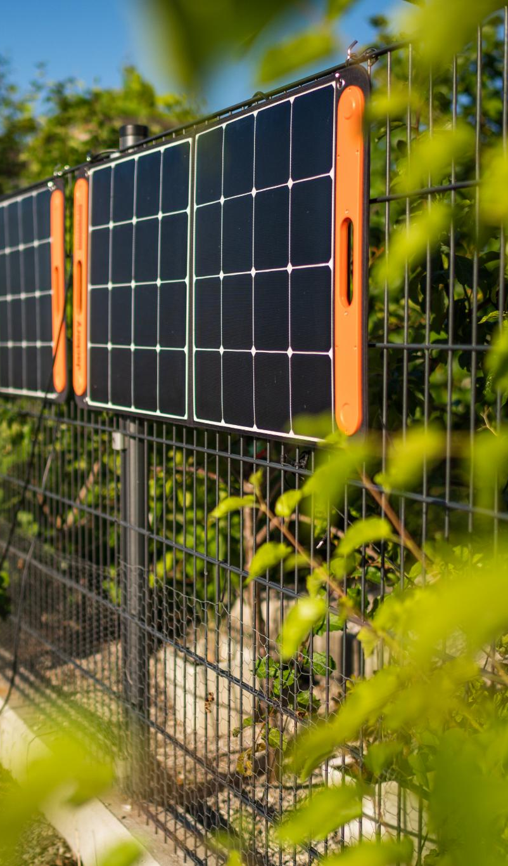
Technology and Market Trends
Hybrid Inverters with Battery Storage
  Hybrid inverters combine solar power with battery storage, enhancing energy independence and backup power during outages.
Smart Grid Support Features
  Smart inverters provide grid support functions like voltage regulation and frequency response, aiding grid modernization.
Semiconductor Innovations
  New semiconductor materials such as Silicon Carbide and Gallium Nitride improve inverter efficiency and reduce size and weight.
Shift to High-Power String Inverters
  Market trends favor high-power string inverters for utility-scale use due to modularity and easier maintenance over central inverters.
Notes:
---
This slide references information from the following file: https://www.futuremarketinsights.com/reports/solar-inverter-market,https://www.srnesolar.com/articledetail/string-vs-micro-vs-hybrid-which-type-of-solar-inverter-is-best.html,https://www.pv-magazine.com/2025/01/29/top-5-global-inverter-trends-to-watch-in-2025/
The solar inverter industry is witnessing significant technological advancements. Hybrid inverters that integrate battery storage are gaining traction, enabling greater energy independence and resilience during outages. Smart inverters with grid-support functionalities such as voltage regulation and frequency response are becoming standard, driven by grid modernization efforts. Semiconductor innovations, including the use of Silicon Carbide (SiC) and Gallium Nitride (GaN), are improving inverter efficiency and reducing size and weight. Additionally, the market is shifting toward high-power string inverters for utility-scale projects, replacing traditional central inverters due to their modularity and ease of maintenance. These trends reflect the growing emphasis on flexibility, digitalization, and compatibility with energy storage systems.

Slide 13

Global Regulatory and Incentive Landscape
US Solar Incentives
  The Investment Tax Credit offers a 30% credit for solar installations through 2025, driving demand in the US.
European Solar Policies
  REPowerEU mandates rooftop solar on new commercial buildings with feed-in tariffs and grants to boost adoption.
Indian Regulatory Reforms
  India’s ALMM regulations and subsidies promote solar cell inclusion and virtual net metering innovations.
Global Energy Goals
  Policies worldwide encourage distributed generation, grid integration, and energy security for sustainable growth.
Notes:
---
This slide references information from the following file: https://www.futuremarketinsights.com/reports/solar-inverter-market,https://www.srnesolar.com/articledetail/string-vs-micro-vs-hybrid-which-type-of-solar-inverter-is-best.html,https://www.pv-magazine.com/2025/01/29/top-5-global-inverter-trends-to-watch-in-2025/
Regulatory frameworks and incentives play a pivotal role in shaping solar inverter demand. In the United States, the Investment Tax Credit (ITC) remains a key driver, offering a 30% credit for solar installations through 2025, although proposed legislation may phase it out thereafter. Net metering policies are transitioning to net billing in several states, impacting residential economics. In Europe, the REPowerEU plan mandates rooftop solar on new commercial buildings and provides feed-in tariffs and grants to accelerate adoption. India has updated its ALMM regulations to include solar cells and introduced reforms for virtual and group net metering, alongside enhanced subsidies under the Surya Ghar Muft Bijli Yojana. These policy shifts aim to promote distributed generation, improve grid integration, and support energy security goals globally.

Slide 14
Performance Metrics and Product Portfolios
Notes:
---
This slide references information from the following file: https://solarswitchreview.com/solar-inverter-efficiency-what-numbers-really-matter/,https://docs.nrel.gov/docs/fy20osti/74462.pdf,https://eureka.patsnap.com/article/renewable-energy-system-diagnostics-solarwind-inverter-performance-metrics,https://businessplankit.com/blogs/kpis/solar-power-inverter
Key Performance Indicators for Solar Inverters, Flagship Products and Attributes

Slide 15
Key Performance Indicators for Solar Inverters
Metric | Description
Efficiency | Conversion performance under real-world conditions
MPPT | Optimizes energy harvest under variable irradiance
THD | Ensures grid compliance and power quality
MTBF | Indicates reliability and durability
Standards | IEC/UL compliance for safety and interoperability
Notes:
---
This slide references information from the following file: https://solarswitchreview.com/solar-inverter-efficiency-what-numbers-really-matter/,https://docs.nrel.gov/docs/fy20osti/74462.pdf,https://eureka.patsnap.com/article/renewable-energy-system-diagnostics-solarwind-inverter-performance-metrics,https://businessplankit.com/blogs/kpis/solar-power-inverter
Evaluating solar inverter performance requires a comprehensive understanding of key metrics. Efficiency ratings, including maximum, European, and CEC efficiency, indicate conversion effectiveness under various conditions. Maximum Power Point Tracking (MPPT) efficiency and the number of trackers determine energy harvest optimization. Total Harmonic Distortion (THD) reflects power quality and compliance with grid standards. Reliability indicators such as Mean Time Between Failures (MTBF) and uptime percentages are critical for long-term performance. Additional factors include DC/AC ratio, input current capability for high-power modules, and smart grid support functions like Volt/Var and frequency-watt control. Compliance with international standards (IEC 62109, IEC 62116, UL1741SB) and robust protection features such as AFCI and rapid shutdown enhance safety. Warranty terms and service network coverage further influence lifecycle costs and customer confidence.

Slide 16
Flagship Products and Attributes
Manufacturer | Model/Series | Key Attributes
Huawei | SUN2000 | AFCI, multi-MPPT, PID suppression, smart monitoring
Sungrow | SG Series | High-power string, multiple MPPT, AFCI
Fronius | GEN24 Plus | Hybrid-ready, backup power, 97.6% efficiency
GoodWe | SDT/HT Series | Up to 12 MPPTs, IP66, high input current
Enphase | IQ8 | Microinverter, panel-level optimization, rapid shutdown
Notes:
---
This slide references information from the following file: https://solarswitchreview.com/solar-inverter-efficiency-what-numbers-really-matter/,https://docs.nrel.gov/docs/fy20osti/74462.pdf,https://eureka.patsnap.com/article/renewable-energy-system-diagnostics-solarwind-inverter-performance-metrics,https://businessplankit.com/blogs/kpis/solar-power-inverter
Leading manufacturers offer diverse product portfolios tailored to residential, commercial, and utility-scale applications. Huawei’s SUN2000 series features multi-MPPT designs, AFCI protection, and integration with FusionSolar monitoring, while its utility-scale solutions support 1500V systems. Sungrow provides SG series string inverters and high-capacity central inverters for large projects. SMA’s Sunny Tripower and Fronius’ GEN24 Plus deliver hybrid capabilities and advanced grid services. GoodWe offers SDT and HT series for C&I applications and XS/DNS/MS series for residential use, emphasizing high MPPT counts and IP66 protection. Growatt’s MOD and SPH hybrid inverters enable storage integration with OTA updates, while Solis focuses on cost-effective residential solutions. Enphase specializes in microinverters with panel-level optimization, and SolarEdge combines inverters with power optimizers for enhanced performance and monitoring. These products reflect industry priorities of efficiency, safety, connectivity, and storage readiness.

