Slide 1
Supplier Evaluation Dashboard
Framework for scoring hardware suppliers (Microsoft example)

Slide 2
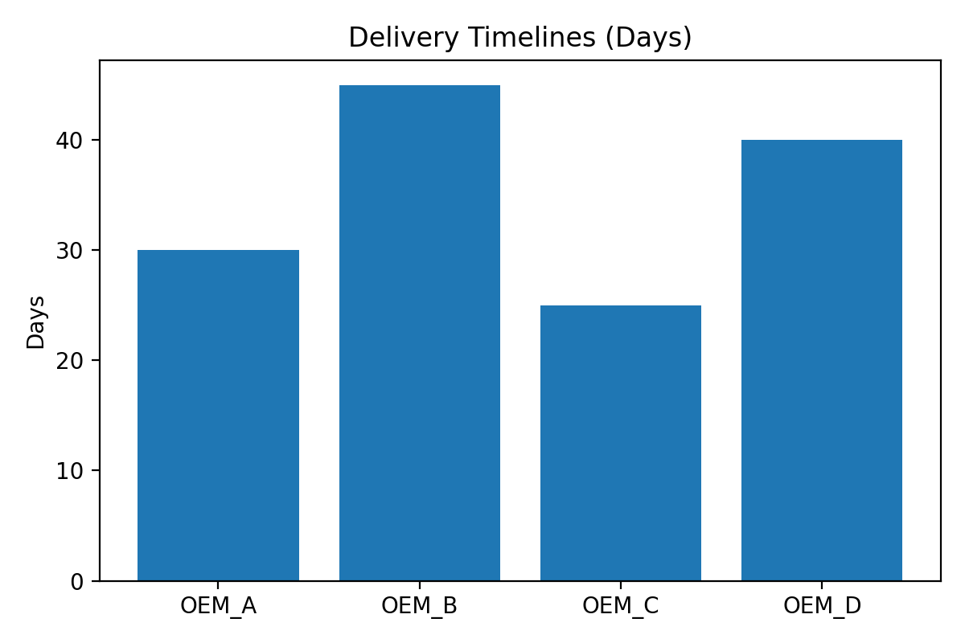
Delivery Timelines

Slide 3
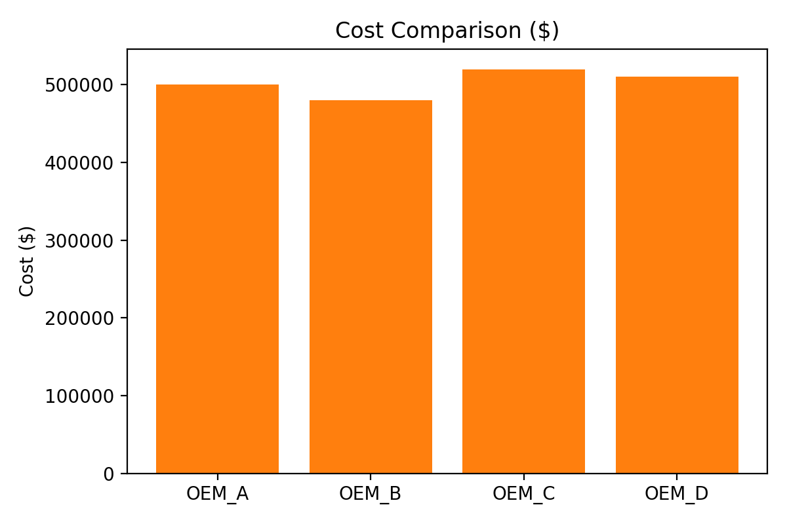
Cost Comparison

Slide 4
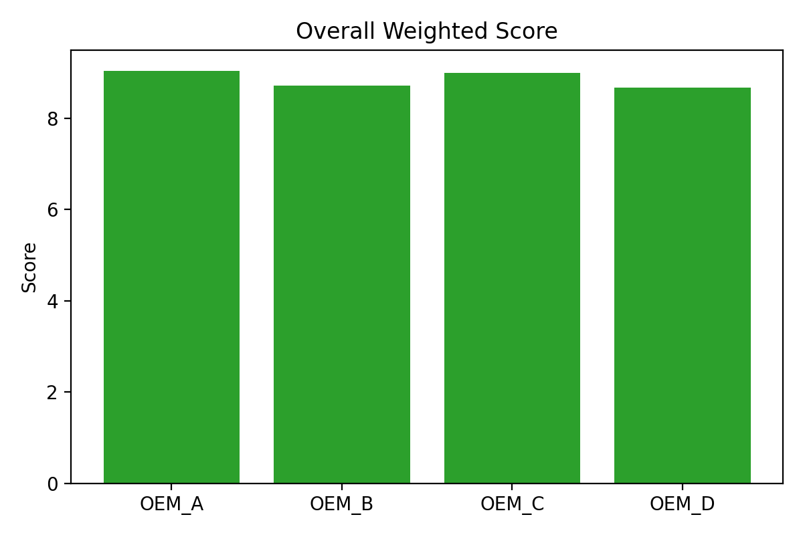
Overall Weighted Score

Slide 5
Criteria & Weightage for Quality Scoring
Criteria and Weightage:
  Quality: 40.0%
  Cost: 20.0%
  Delivery: 20.0%
  Reliability: 20.0%

Slide 6
Vendor Reliability Index
Reliability Index by Supplier:
  OEM_A: 95%
  OEM_B: 92%
  OEM_C: 90%
  OEM_D: 93%

