Slide 1
Recommendation Systems and the Million Song Dataset
Gina Schmalzle
Nordstrom 2014

Slide 2

Last week Manju wrote…
“For the pre-audition, we'd like to ask you to create a recommender solution around the Million Song…. In particular, we'd like you to focus on the Taste Profile.”
My background is in earthquakes.
Earthquake recommenders???
Cool!
Interesting problem, never thought about that before…

Slide 3
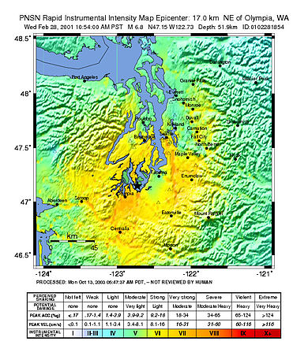

Earthquake Recommenders
Oh, you live in Seattle, then you would love the M6.8 2001 Nisqually Earthquake…
http://theimagearsenal.com/2011/seattles-6-8.html
Wikipedia

Slide 4


Let’s look at the data! The Million Song Dataset
Publicly available audio ‘features’ for a million contemporary music tracks
Taste profile subset contains user data including:
user id
song name and id
artist name and id
how many times the user played the song
date added
date last modified

Slide 5
The Million Song Dataset
I didn’t download the whole shebang, so here are some stats on the data I downloaded:
9,721 users
8,456 unique artists
33,746 unique songs

Slide 6
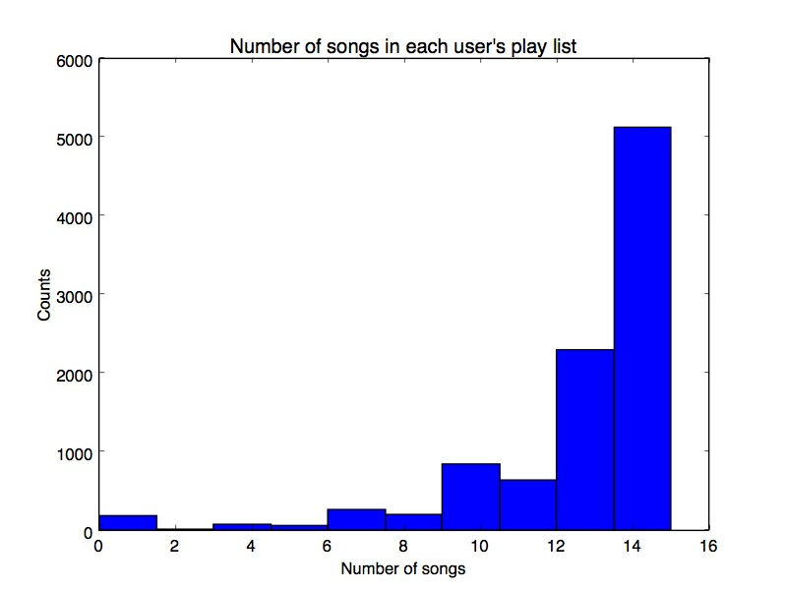
Number of songs in each user’s play list

Slide 7
Thoughts… How to make a recommender from the Taste Profile?
Model approach?
Identify Groups of Users based on their playlist
Dataset is long, not wide (i.e., not many predictor variables)
No “knowns” to test the predicted classification against actual (like genre, etc).
Left with the question: How well does my model predict a recommended song?
I could estimate how similar each user is to each other by counting the number of identical songs in their playlists, but computationally intensive

Slide 8
Thoughts… How to make a recommender from the Taste Profile?
Deterministic Approach
Assumption: Other people that listened to the same song as the ‘recommendee’ have similar tastes.
Grab filtered data from the dataset directly
The filtering involves choosing only those users that have listened to the same songs

Slide 9
Thoughts… How to make a recommender from the Taste Profile?
Deterministic Approach
Pros:
Given our similar-tastes assumption, we have a known outcome (We know precisely who listened to a selected song because it is in their playlist, and we know the other songs in their playlists…)
Easy to understand
Cons: Hard to scale
We will talk about that more later…

Slide 10
Thoughts… How to make a recommender from the Taste Profile?
Data I use: Hierarchical structure: songs nested under artists nested under user
Possible weighting variables:
Number of times the user played a song
When it was added to the playlist
When it was last modified
Keep it simple – Start with user, artist and song

Slide 11
Simple Recommender
Concatenated
and sorted
playlist
User 1 Playlist
Song 1
Song 1
Sorted Song Count
Song 2
Other users with song in their play list
Song 1
Song 3
Song 1 : 3
Song 1
User 2 Playlist
Song 5 : 2
User Input
User 1
Song 2
Song 4
Song 2 : 1
Artist/Song
User 2
Song 3
Song 1
Song 3 : 1
User 3
Song 4
Song 5
Song 4 : 1
User 3 Playlist
Song 5
Song 6 : 1
Song 6
Song 5
(Not including
Selected Song)
Song 1
Song 6
Song 5

Slide 12
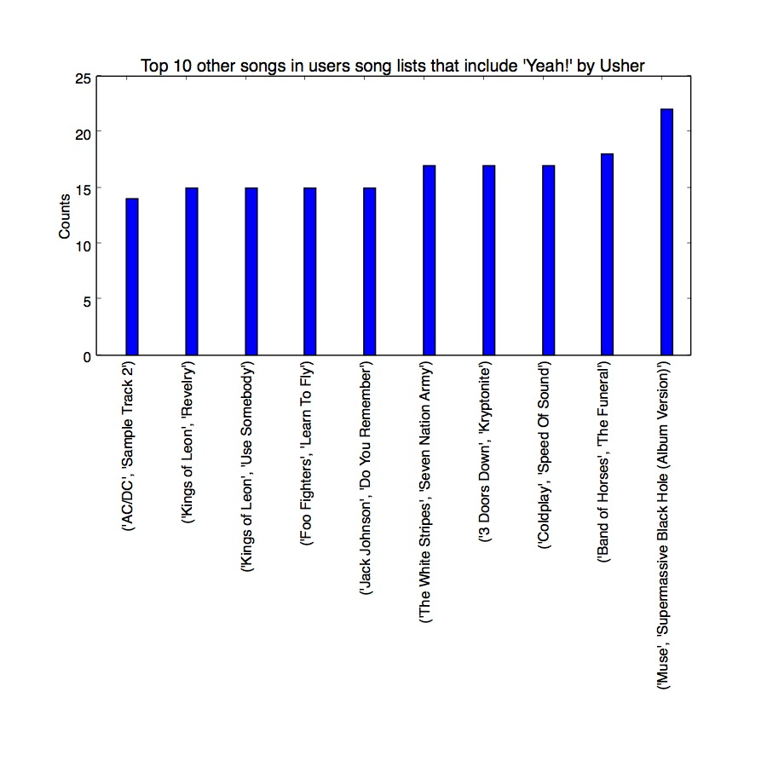
Simple Recommender
How to read:
~23 people who had the song ‘Yeah’ by Usher also had the song ‘Supermasive Black Hole’ by Muse in their play lists…

Slide 13
OK, but what if the user has a history?
Song 1 Users
Concatenated
and sorted
list of users
User 1
User 2
User 1
Sorted User Count
‘Recommendee’ playlist
User 3
User 1
Song 2 Users
User 1 : 3
Song 1
User 1
Most similar users!
User 4
User 2
User 3 : 3
Song 2
User 3
User 2 : 1
Song 3
User 3
User 1
User 4 : 1
User 3
Song 3 Users
User 5 : 1
User 3
User 5
User 1
User 4
(Not including
Recommendee)
User 3
User 5

Slide 14
OK, but what if the user has a history?
Concatenated and sorted songs
User 1 Playlist
Song 1
Sorted Song Count
Sorted User Count
Song 2
Song 1
Song 3
Song 1
Song 1 : 2
User 1 : 3
Song 2
Song 2 : 1
User 3 : 3
Song 3
Song 3 : 1
User 2 : 1
User 3 Playlist
Song 4
Song 4 : 1
User 4 : 1
Song 4
Song 5
Song 5 : 1
User 5 : 1
Song 1
Song 5
(Not including
Recommendee
Songs)

Slide 15
Let’s see how this works…
In python repl:
import recommender as Rec
Rec.user_recommender (user = ‘CAEYTUX1332EA3C8E2’)
Your songs are:
1. Incantation by Delerium
2. Fall Line by Jack Johnson
3. Driving (Acoustic Mix) by Everything but the Girl
4. A Whisper by Coldplay
5. Staple It Together by Jack Johnson
6. Rock The House (Explicit) by Gorillaz
7. Politik by Coldplay
8. Murdoc Is God by Gorillaz
9. Left Hand Suzuki Method by Gorillaz
10. God Put A Smile Upon Your Face by Coldplay
11. Do You Remember by Jack Johnson
12. Crying Shame by Jack Johnson
13. Constellations by Jack Johnson
14. Cocoon by Jack Johnson
15. Belle by Jack Johnson
7 songs by Jack Johnson
3 by Gorillaz
3 by Coldplay
.
.
.

Slide 16

Let’s see how this works…
In python repl:
import recommender as Rec
Rec.user_recommender (user = ‘CAEYTUX1332EA3C8E2’)
-------
User CAEYTUX1332EA3C8E2, you have great taste in music! People with similar play lists are also listening to:
1. If I Could by Jack Johnson
2. I Miss My Dawgs by Lil Wayne
3. Skeleton Boy by Friendly Fires
4. Lovesick by Friendly Fires
5. How It Be Between U & Me? (co-produced by JT Donaldson) by Khia
6. Stand Up Guy (Explicit Album Version) by T.I.
Top song by Jack Johnson

Slide 17

How would you know if the recommender is giving back good recommendations?
Brute force: Take a survey
Find more data with predictor variables

Slide 18
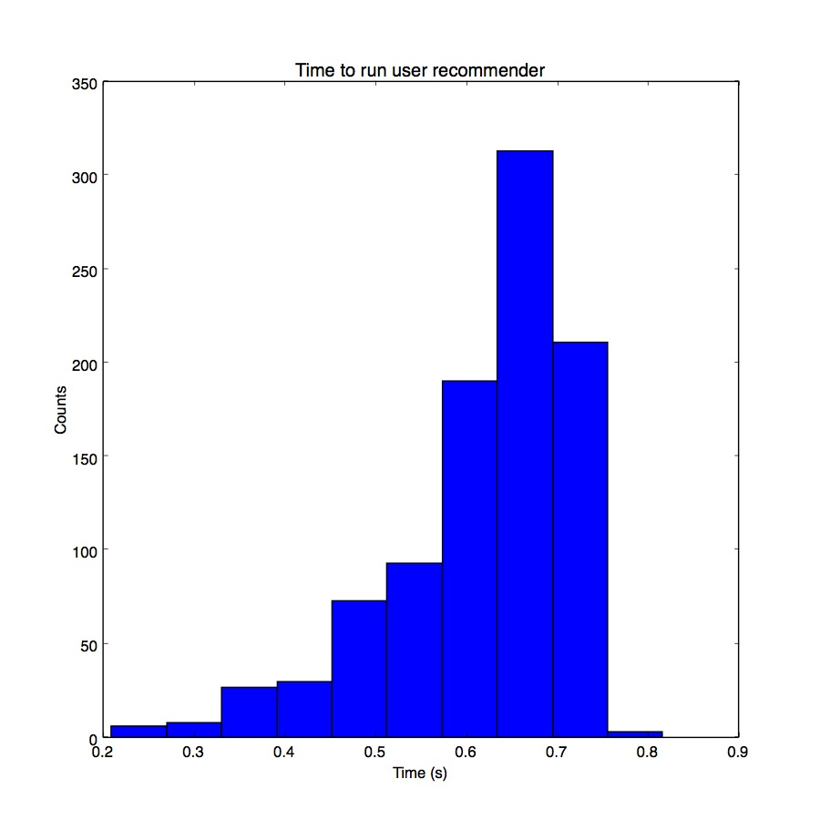
Latency of Recommender Call
Depends on:
Number of users with song in playlist
Number of songs in the users’ playlists
My laptop:
2.2 GHz Intel Core i7 processor
16 Gb Memory
User recommender run 1000 times with random users

Slide 19
Latency of Recommender Call: Pitfalls of the deterministic approach
Time increases as user song lists get larger. Similarly, memory also increases
Modeling approaches can help reduce run time by defining groups – need more predictive variables
Other methods to reduce run time –
1. More filtering – use how many times a song was played and the time it was last listened to.
2. Sampling the data

Slide 20
Simple Recommender
Concatenated
and sorted
playlist
User 1 Playlist
Out of a sampled subset pick:
Song 1
Song 1
Sorted Song Count
Song 2
Other users with song in their playlist
Song 1
Song 3
Song 1 : 3
Song 1
User 2 Playlist
Song 5 : 2
User Input
User 1
Song 2
Song 4
Song 2 : 1
Artist/Song
User 2
Song 3
Song 1
Song 3 : 1
User 3
Song 4
Song 5
Song 4 : 1
User 3 Playlist
Song 5
Song 6 : 1
Song 6
Song 5
(Not including
Selected Song)
Song 1
Song 6
Song 5

Slide 21
Future Recommender Improvements
Include Last.fm dataset – contains predictor variables!
To do list:
Make a relational database that relates song in user’s playlist with the song’s characteristics
Compare current recommender recommended songs with songs in the recommendee’s playlist – how similar are they?
Find ways to reduce latency of recommender

Slide 22
Thanks for listening!
Questions?

