Slide 1
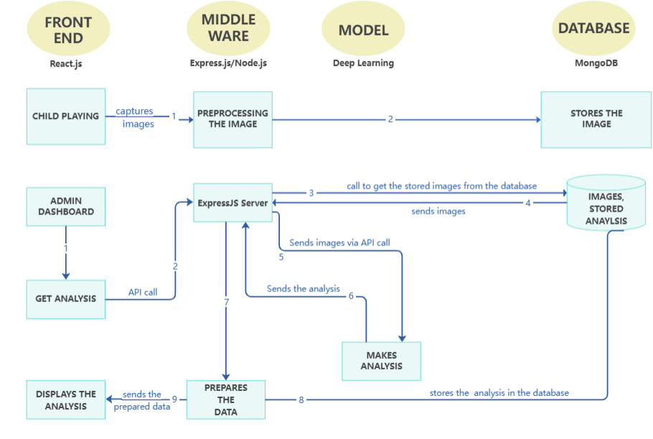
CHILD
INTERFACE
ADMIN
INTERFACE

