Slide 1
HUNGER-RELIEF
BY:
Himanshu Sharma
Yashi Agnihotri
Kanika Kushwaha
Shivani Rastogi

Slide 2
PROJECT DESCRIPTION
Hunger-Relief is one of the organizations working on a mission to eradicate hunger, malnutrition and food-wastage. We work towards getting surplus meals from individuals, communities, weddings, restaurants and corporate cafeterias, as well as prepare freshly cooked meals to serve the underserved. With the help of our passionate volunteers - our Hunger Heroes, along with our programs, we redistribute nutritious meals to those
who don’t have adequate or regular access to it.
Technology Used:--
Html ,CSS,Javascript,Bootstrap,Flask,jinja ,PostgreSQL

Slide 3
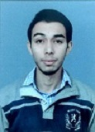
Candidate
Name – Himanshu Sharma
Roll. No. - 1603313021
Phone No. - 9910072742
Email id – himanshu991139@gmail.com
Github Id:- https://github.com/himanshu991139

Slide 4
My Contribution (Front-End)
Description
Front-end web development, also known as client-side development is the practice of producing HTML, CSS and JavaScript for a website or Web Application so that a user can see and interact with them directly. The challenge associated with front end development is that the tools and techniques used to create the front end of a website change constantly and so the developer needs to constantly be aware of how the field is developing.
Contribution
Design the Front-End of the webpage.
Used technology like HTML, CSS , Bootstrap, JavaScript for Creating front end website.
Design Forms to take input From Users
Used Html ,CSS ,Bootstrap for designing Webpage
Validating Form data using JavaScript
Making Webpage Responsive so it provide better interaction to user
Design google form for volunteer registration

Slide 5
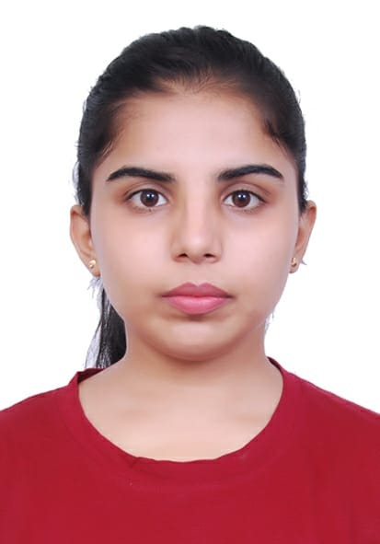
Candidate
NAME-YASHI AGNIHOTRI
RollNo:-1607710096
Phone no-7906875834
E-mail: yashiagnihotri22@gmail.com Github ID:
Github:https:/ github.com/yashi2206

Slide 6
My Contribution (Flask)
Description
Flask is an API of Python that allows to build up web-applications. It was developed by Armin Ronacher. Flask’s framework is more explicit than Django’s framework and is also easier to learn because it have less base code to implement a simple web-Application. A Web-Application Framework or Web Framework is the collection of modules and libraries that helps the developer to write applications without writing the low-level codes such as protocols, thread management, etc. Flask is based on WSGI(Web Server Gateway Interface) toolkit and Jinja2 template engine.
Contribution
Created a venv and activated to start the project
Get and post api using flask
Migrations using alembic which is a part of flask migrate to manage migrations to update a database schema
Decorators(routing) which tells the application which url should be associated with the particular function.
Usage of inbuilt libraries like cors, marshmallow, sqlalchemy

Slide 7
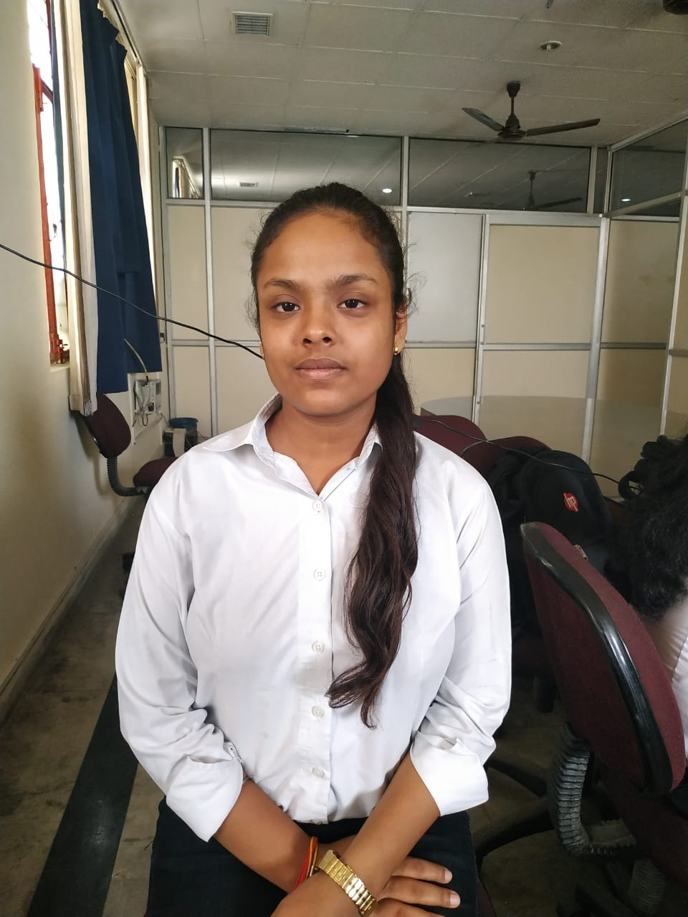
Candidate
Name- KANIKA KUSHWAHA
Reg id- 1633310043
Phone no- 9717654968
Email-kanikakus2012@gmail.com
Github ID:-
https:/github.com/kanikakushwaha

Slide 8
Contribution(DataBase)
Description
We have used PostgreSQL for creating the database. PostgreSQL is a open-source and object-relational database management system. PostgreSQL is the first database management system that implements multi-version concurrency control (MVCC) feature.
It supports materlized view, user defined data types. It features transactions with
Atomicity, Consistency, Isolation, Durability (ACID) properties.Tables can be set to inherit their characteristics from a parent table. Object-relational database management system means the mapping done through relating the tables and considering the tuples as object to map the data.
Contribution
Integrate Database with website
Creating and Update Database
Creating Database with ORM
Create Base class and applying CRUD operation
Created init.py to import directory

Slide 9
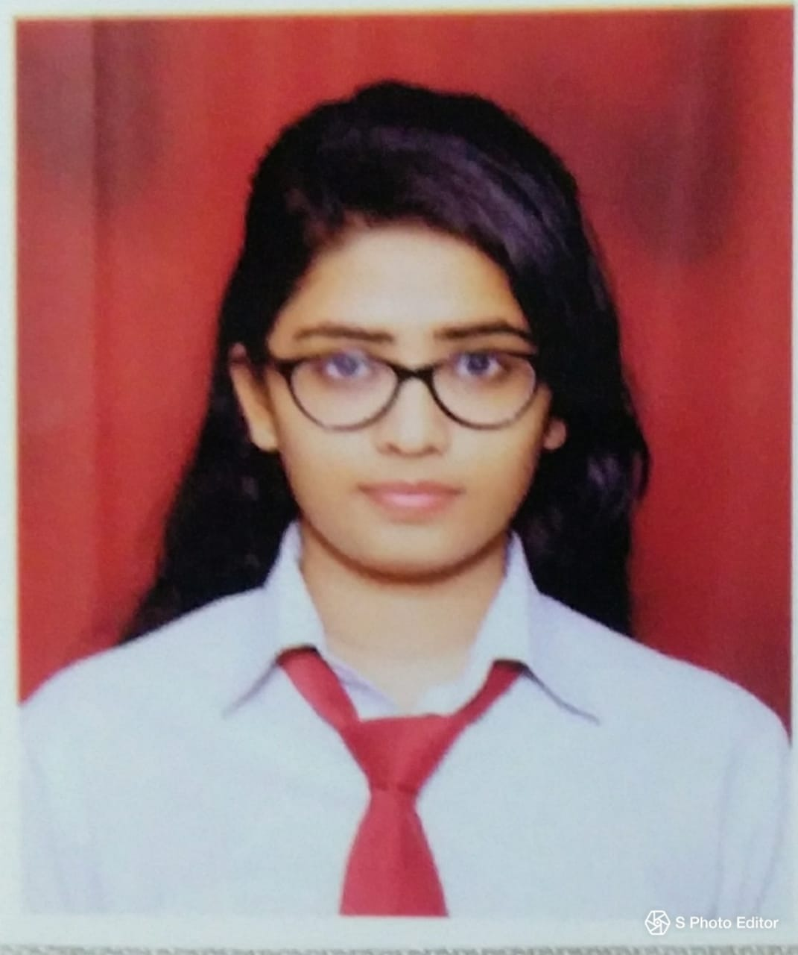
Candidate
Name: Shivani Rastogi Roll.no:1633310088
Mobile:7011822828
E-mail: shivanirastogi1997@gmail.com Github Id:
https:/github.com/ShivaniRastogi

Slide 10
Contribution
Description
Front-end web development, also known as client-side development is the practice of producing HTML, CSS and JavaScript for a website or Web Application so that a user can see and interact with them directly. The challenge associated with front end development is that the tools and techniques used to create the front end of a website change constantly and so the developer needs to constantly be aware of how the field is developing.
Contribution
Dynamic Rendering of data using jinja
Used technology like HTML, CSS , Bootstrap, JavaScript for Modification of code
Use Ajax for put and delete request.
Define Routes for rendering WebPages.
Integrating Email with website

Slide 11
THANK YOU

