Slide 1
Interapp
Action Suggestion Using Face & Voice Sentiment Analysis With Its Application On Video Call

Slide 2
Motivation
Knowing people’s emotion sometime is hard especially during non-real life interaction like video call.
Better knowing people’s emotion and doing stuff accordingly will increase the mutual experiences of the conversation.

Slide 3
Overview
Image
Face Sentiment Analysis
Voice
Real-time Speech Emotion Recognizer
Action Suggestion
Reinforcement Learning using TensorFlow

Slide 4
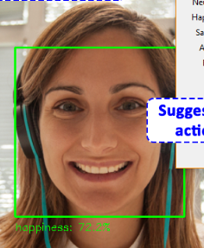
Image (Face Sentiment Analysis)
Face detection using OpenCV
Cropped faces pass to Emopy
Output Probability submit to action suggestion
Screengrab of specific windows

Slide 5
Voice (Real-time Speech Emotion Recognizer)
Capture sound from computer audio output
Feed to Vokaturi for emotion recognizer
Output Probability submit to action suggestion

Slide 6
Action Suggestion (Reinforcement Learning using TensorFlow)
Neural Network model with 2 hidden layers, 128 hidden nodes each
Input data from image and voice analysis.
Pre-defined action are feed to doc2vec for vectorization.
User feedback the effectiveness of the action suggested.

Slide 7
Suggested action selection mechanism
Image Output
TensorFlow core
Audio Output
Suggested Actions
Compare
Predefined Actions
Doc2Vec
Vectorization

Slide 8
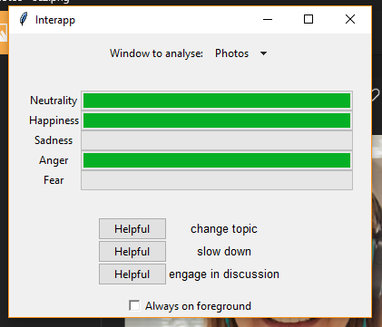
1. Select windows to capture
2. Combined Sentiment analysis
Bugs of old version tsk tsk
3. Suggestion for action with its confidence as font size
4. Feedback of usefulness

Slide 9
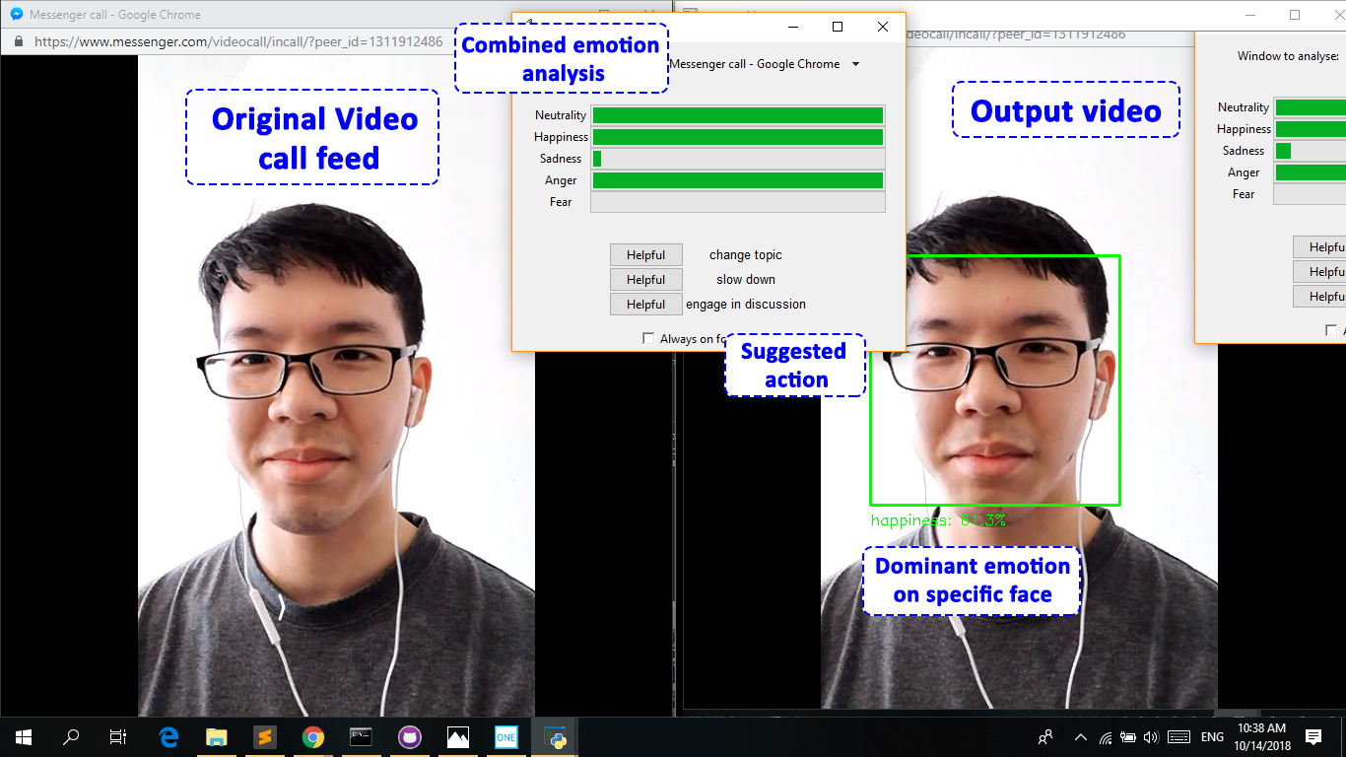

Slide 10
Demo!

Slide 11
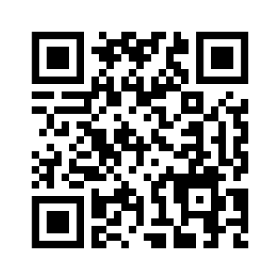
For more info
Github:
https://github.com/pakzan/Interapp
Email:
pakzzzan@hotmail.com
kooltzh@gmail.com

