Slide 1
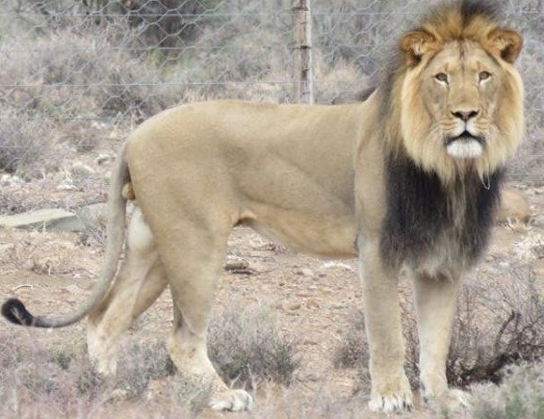

Multi-Objective Optimization for Dynamic Resource Provisioning in a Multi-Cloud Environment using Lion Optimization Algorithm
To be Virtually Presented At
20th IEEE International Symposium on Computational Intelligence and Informatics (CINTI 2020) planned to be organized on November 5-7, 2020 in Budapest, Hungary
By
Shivani Agrawal
Authors
T Chaitra Shivani Agrawal Jeny Jijo Arti Arya

Slide 2
AGENDA
Problem Statement
System Architecture
Proposed Algorithm
Lion Optimization Algorithm
Multi-Objective Optimization
Results and Discussion
Conclusion and Future Scope
References

Slide 3
PROBLEM STATEMENT
In recent years , developments in multi-cloud have been prominent because of its indispensible use in our day-to-day life.
Many recent nature inspired algorithms like grasshopper optimization, hybrid bacteria foraging, whale optimization, etc, are used to solve multi-objective optimization problems like Process Selection, Machine Allocation, Finding the feasible solution and other maximization/minimization problem.
Therefore, in this paper we are using Lion Optimization Algorithm (LOA) for optimizing multi-objectives like minimizing the cost, maximizing the revenue, etc, in order to improve dynamic resource provisioning performance in multi-cloud environment.
As compared to Particle Swarm Optimisation (PSO), we have observed that LOA takes much less time with increasing no. of tasks.

Slide 4
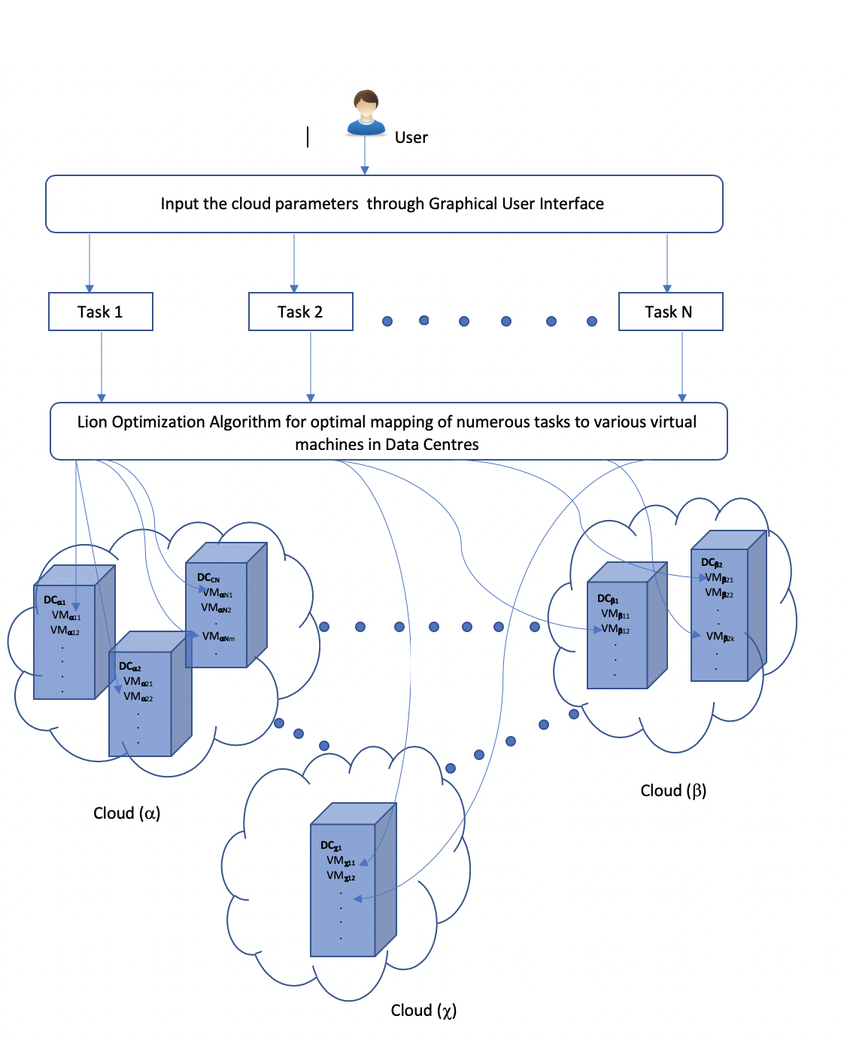
SYSTEM ARCHITECTURE

Slide 5
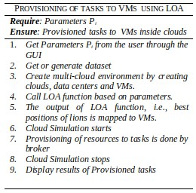
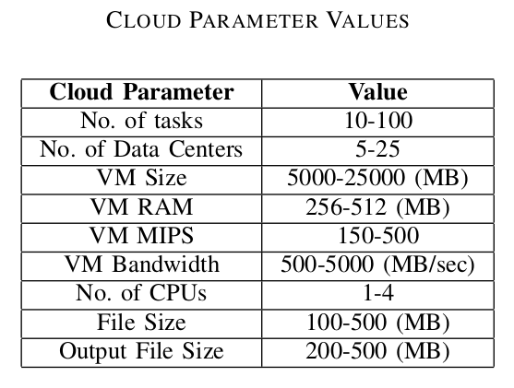
PROPOSED ALGORITHM

Slide 6
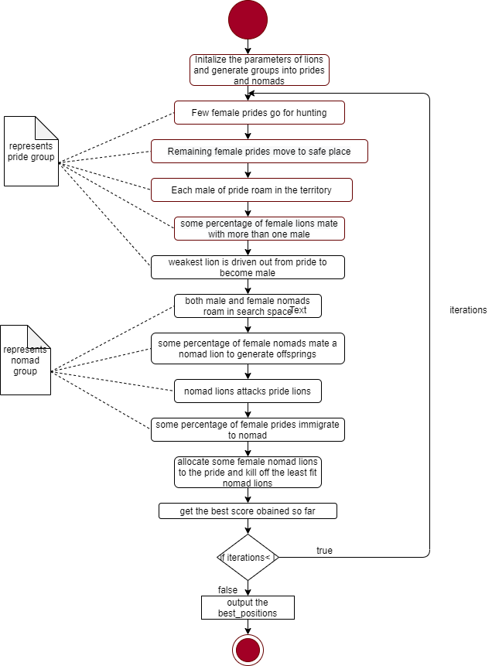
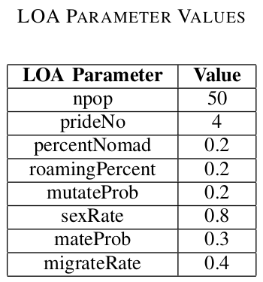
LION OPTIMIZATION ALGORITHM
Generate Population
Hunting
Move to Safe Place
Roaming
Mating
Defence
Migration

Slide 7


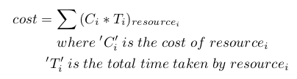


MULTI-OBJECTIVE OPTIMIZATION
Makespan
Average Response Time (ART)
Cost
Completion Time (CT)
Average Resource Utilization (ARU)

Slide 8
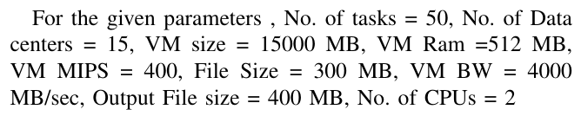
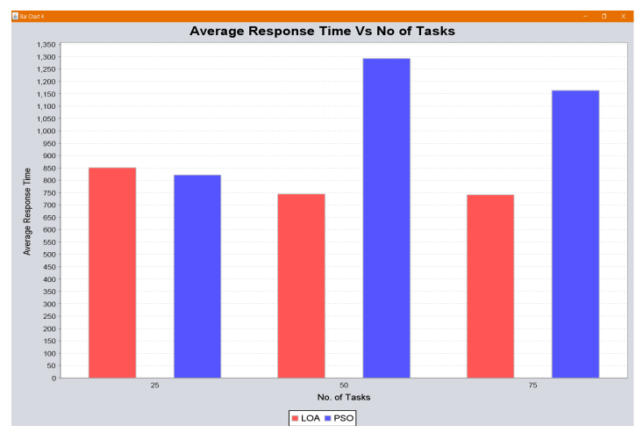
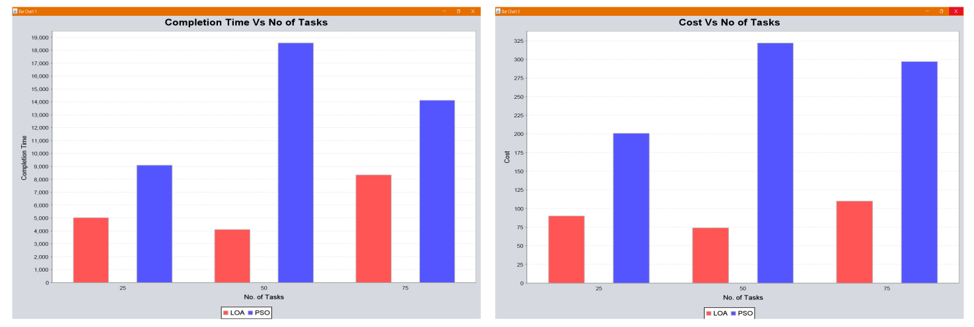
RESULTS AND DISCUSSION

Slide 9
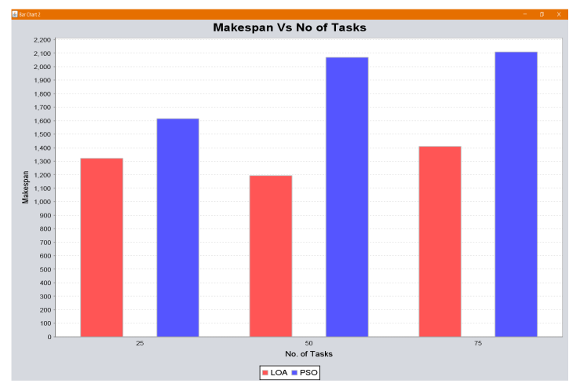
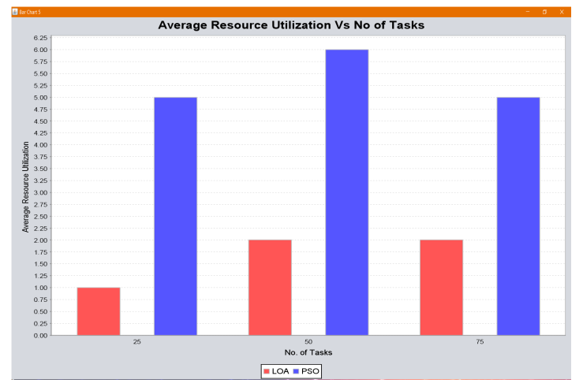
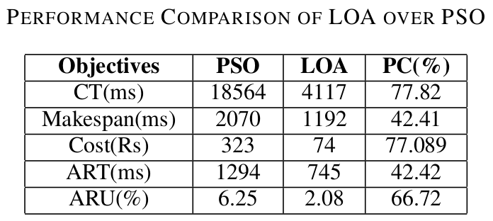
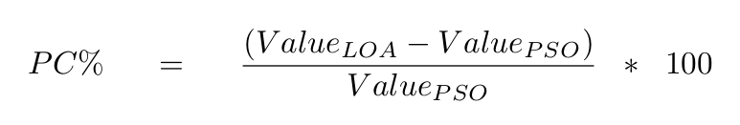
RESULTS AND DISCUSSION

Slide 10
CONCLUSION AND FUTURE SCOPE
This paper addresses performance, efficiency and reliability issues of resource provisioning.
The proposed method using LOA outperforms dynamic resource allocation for all considered objectives.
The result of the proposed method shows better percentage of improvement as compared with the traditional PSO algorithm.
In future, we have planned to consider the performance of the same parameters used in LOA and simulate them in the federated cloud environment .
There will be a study on how to incorporate Live VM migration as an effective mechanism to balance the load.

Slide 11
REFERENCES:
Ab, Samah \& Dogan, Meram & Alqahtani, Ebtdesam, A SURVEY ON RESOURCE ALLOCATION IN CLOUD COMPUTING”, International Journal on Cloud Computing: Services and Architecture (IJCCSA). 6.10.5121/ijccsa.2016.6501.
Janmenjoy Nayak, Bighnaraj Naik, AK Jena, Rabindra K Barik, and Himansu Das, Nature inspired optimizations in cloud computing: applications and challenges”, In Cloud Computing for Optimization: Foundations, Applications, and Challenges, pages 1–26. Springer, 2018
Mala Kalra, Sarbjeet Singh, A review of metaheuristic scheduling techniques in cloud computing”, Egyptian Informatics Journal (2015) 16,275-295.
Prasad Devarasetty, Ch. Satyananda Reddy," Multi objective Ant colony Optimization Algorithm for Resource Allocation in Cloud Computing”, International Journal of Innovative Technology and Exploring Engineering (IJITEE) ISSN: 2278-3075, Volume-8 Issue-2S2 December, 2018.
M. Feng, X. Wang, Y. Zhang and J. Li, "Multi-objective particle swarm optimization for resource allocation in cloud computing," 2012 IEEE 2nd International Conference on Cloud Computing and Intelligence Systems, Hangzhou, 2012, pp. 1161-1165, doi: 10.1109/CCIS.2012.6664566.
M. Yazdani and F. Jolai, Lion optimization algorithm (LOA): a nature-inspired metaheuristic algorithm”, Journal of Computational Design and Engineering, Vol.3, No.1, pp.24-36, 2016.
N. Calheiros, Rajiv R, Anton B, Rajkumar B, CloudSim: a tool kit modeling simulation of cloud computing environments and evaluation of resource provisioning algorithms”, Wiley Online Library, DOI: 10.1002/spe.995, 24 August 2010.
Panda, S. K., \& Jana, P. K. (2015). Efficient task scheduling algorithms for heterogeneous multi-cloud environment. The Journal of Supercomputing, 71(4), 1505–1533. doi:10.1007/s11227-014-1376-6
S. Thamarai Selvi, Christian Vecchiola, Rajkumar Buyya, “Mastering Cloud Computing”, Morgan Kaufmann, Edition ,2013.
Anuradha VP, Sumathi D. A survey on resource allocation strategies in cloud computing. International Conference on Information Communication and Embedded System (ICICES); Chennai. 2014. p. 1–7.
Kumar S, Kumar Sharma V, Kumari R (2014) Self-adaptive spider monkey optimization algorithm for engineering optimization problems. Int J Inf Commun Comput Technol II:96–107
J. Vahidi and M. Rahmati, "Optimization of Resource Allocation in Cloud Computing by Grasshopper Optimization Algorithm," 2019 5th Conference on Knowledge Based Engineering and Innovation (KBEI), Tehran, Iran, 2019, pp. 839-844, doi: 10.1109/KBEI.2019.8735098.
M. A. Tawfeek, A. El-Sisi, A. E. Keshk and F. A. Torkey, "Cloud task scheduling based on ant colony optimization," 2013 8th International Conference on Computer Engineering & Systems (ICCES), Cairo, 2013, pp. 64-69.doi: 10.1109/ICCES.2013.6707172
Sreelakshmi, S.Sindhu "Multi-Objective PSO Based Task Scheduling - A Load Balancing Approach in Cloud",1st International Conference on Innovations in Information and Communication Technology (ICIICT), IEEE, 2019.
Mahya Mohammadi Golchi, Shideh Saraeian and Mehrnoosh Heydari,“A hybrid of firefly and improved particle swarm optimization algorithms for load balancing in cloud environments: Performance evaluation”, Computer Networks, ELSEVIER, 2019.
D. Ardagna, "Cloud and Multi-cloud Computing: Current Challenges and Future Applications," 2015 IEEE/ACM 7th International Workshop on Principles of Engineering Service-Oriented and Cloud Systems, Florence, 2015, pp. 1-2, doi: 10.1109/PESOS.2015.8.
Marwah Hashim Eawna, Salma Hamdy Mohammed, El-Sayed M. El-Horbaty,"Hybrid Algorithm for Resource Provisioning of Multi-tier Cloud Computing",Procedia Computer Science,Volume 65,2015.
I. Gupta, M. S. Kumar and P. K. Jana, "Compute-intensive workflow scheduling in multi-cloud environment," 2016 International Conference on Advances in Computing, Communications and Informatics (ICACCI), Jaipur, 2016, pp. 315-321, doi:10.1109/ICACCI.2016.7732066.
https://github.com/ShivaniSarah/Metaheuristic-Dynamic-Resource-Provisioning-in-Multi-Cloud-Environment/blob/master/README.md

Slide 12
THANK YOU!

Slide 13
Q/A

