Slide 1
BUAN 6340.003 Programming for Data Science Final Project Submission
Shivani shekhavat
sxs175333@utdallas.edu

Slide 2
Austin animal shelter data
Data here I have chosen is from Austin Animal shelter data. The Austin Animal Shelter is the largest no-kill animal shelter and shelters and protects over 18,000 animals each year. According to the data portal, over 90% of animal outcomes are adoptions, transfers to other shelter partners or returning lost pets to owners. By performing explanatory data analysis and data visualization I tried to unveil the potential patterns and trends to help inform what features could be included in final model.
To perform explanatory data analysis, I have used pandas for the extraction and manipulation of data, for visualization I have used matplotlib and seaborn. For printing the visualization, I have used %matplotlib inline.

Slide 3
Column description
age_upon_outcome Age of the animal at the time at which it left the shelter. String
animal_id Unique id for animal String
animal_type Cat, dog, or other (including at least one bat!). String
breed Animal breed. Many animals are generic mixed-breeds, e.g. "Long-haired mix". String
color Color of the animal's fur, if it has fur. String
date_of_birth date of birth of animal DateTime
datetime time of birth of animal DateTime
monthyear Month and year of birth of animal DateTime
name Name of animal String
outcome_subtype Subtype of animal at the time it left the shelter String
outcome_type Ultimate outcome for this animal. Possible entries include transferred,
[mercy] euthanized, adopted. String
sex_upon_outcome Sex of animal at the time it left the shelter String
count No. of animal Numeric
sex sex of animal String
There are some other column as well.

Slide 4
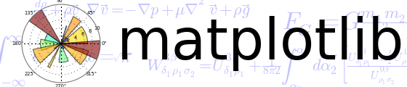




Packages used in project
NumPy
Pandas
Seaborn
Requests
Plotly
matplotlib

Slide 5
Loading of data
endpoint = 'https://data.austintexas.gov/resource/9t4d-g238.json'
count = 1000
pages = 100
Here I used requests package to load data from url

Slide 6
Conversion of columns for pandas
cats_df['date_of_birth'] = pd.to_datetime(cats_df['date_of_birth'])
cats_df['dob_year'] = cats_df['date_of_birth'].dt.year
cats_df['dob_month'] = cats_df['date_of_birth'].dt.month
cats_df['dob_monthyear’] = pd.to_datetime(cats_df['monthyear']).dt.to_period('M’)
cats_df['datetime'] = pd.to_datetime(cats_df['datetime'])
cats_df['outcome_month'] = cats_df['datetime'].dt.month
cats_df['outcome_year'] = cats_df['datetime'].dt.year
cats_df['outcome_weekday'] = cats_df['datetime'].dt.weekday_name
cats_df['outcome_hour'] = cats_df['datetime'].dt.hour
cats_df['breed'].value_counts()

Slide 7
Exploratory Data Analysis
In explanatory analysis of data I firstly checked the parameters by setting up a for loop and then normalized the data by converting it into a data frame.
After performing normalization I did filtration of dataset so that we have cleaned data to analyse it further.
For further meaningful analysis of dataset I have observed the count of different variables given in the dataset and then converted it into pandas data frame to perform visualization.
The visualization of the outcomes and variables of which we have an interest will help us better understand the data and how the variables relate to each other.

Slide 8
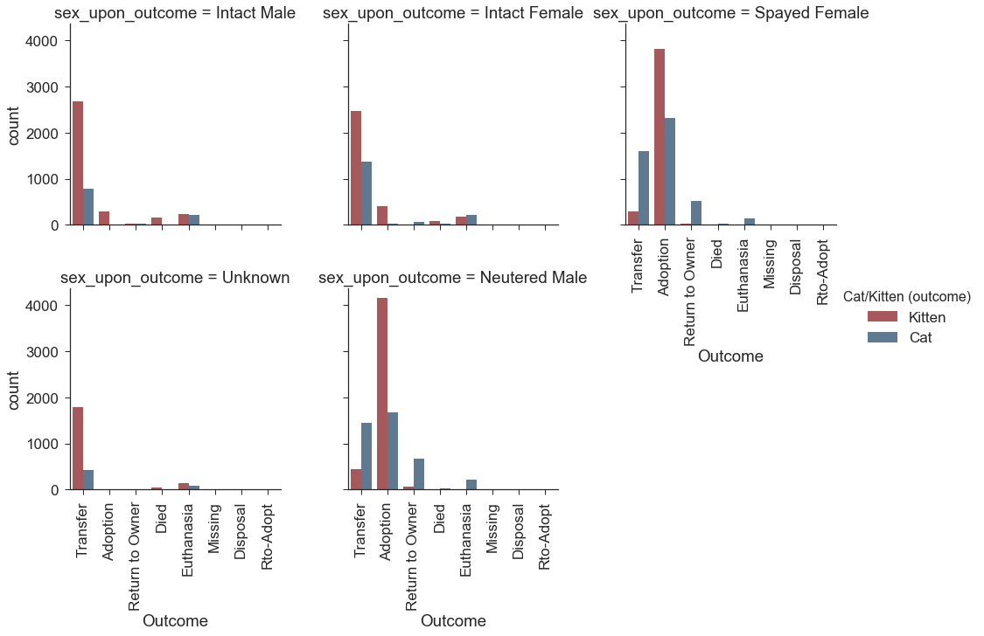
Visualization of data
For the better visualization we need to identify which variable is important so I have choosen outcome_type, cat/kitten and sex_upon_outcome because no shelter will adopt a cat or kitten that has not been spayed or neutered to help control the cat population. To have a better idea about adoption behaviour plotting the sex upon the outcome and if the cat was of kitten or adult age at the time of outcome will be good.

Slide 9
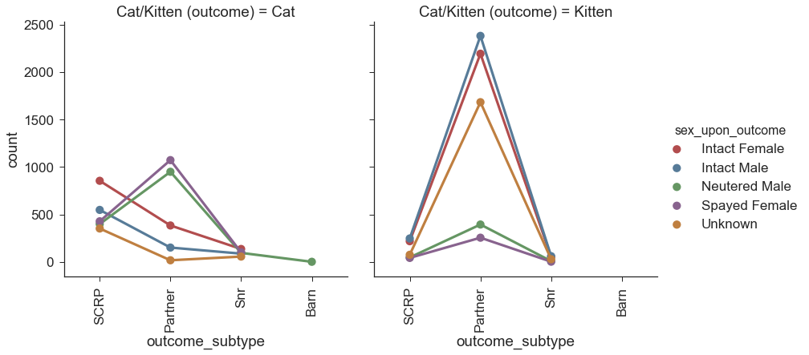
From the previous graph we can see that intact male and female cats are transferred, of which the majority are kittens. We can also identify from previous graph that a significant portion of outcome type are transfers to other facilities, So I have analysed and visualized it a little deeper by considering outcome_subtype variable to see if any transfer subtypes occur more frequently than others depending on the sex and intact status of the cat, as well as the age group. To visualize this I choose factorplot with line graph instead of bar graph.

Slide 10
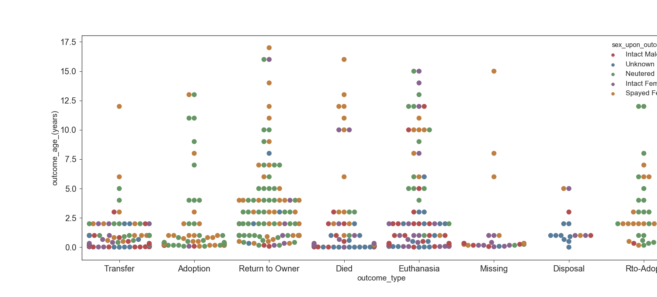
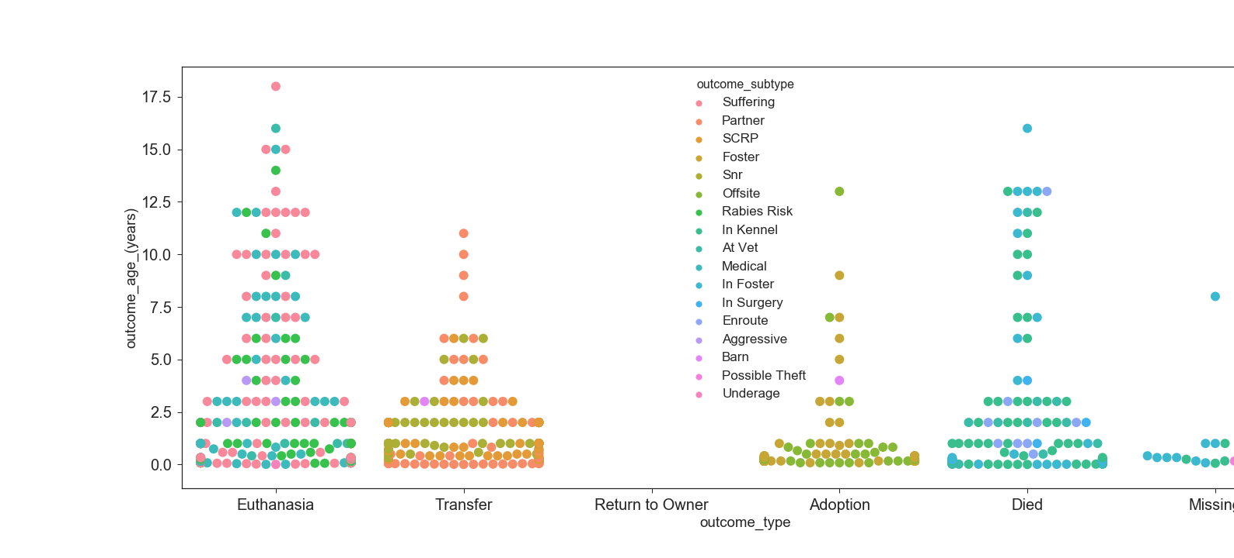
As all the variables which we are considering here are categorical variables, I have used swarmplot function from the seaborn. I used swarmplot on both outcome_type and outcome_subtype.

Slide 11
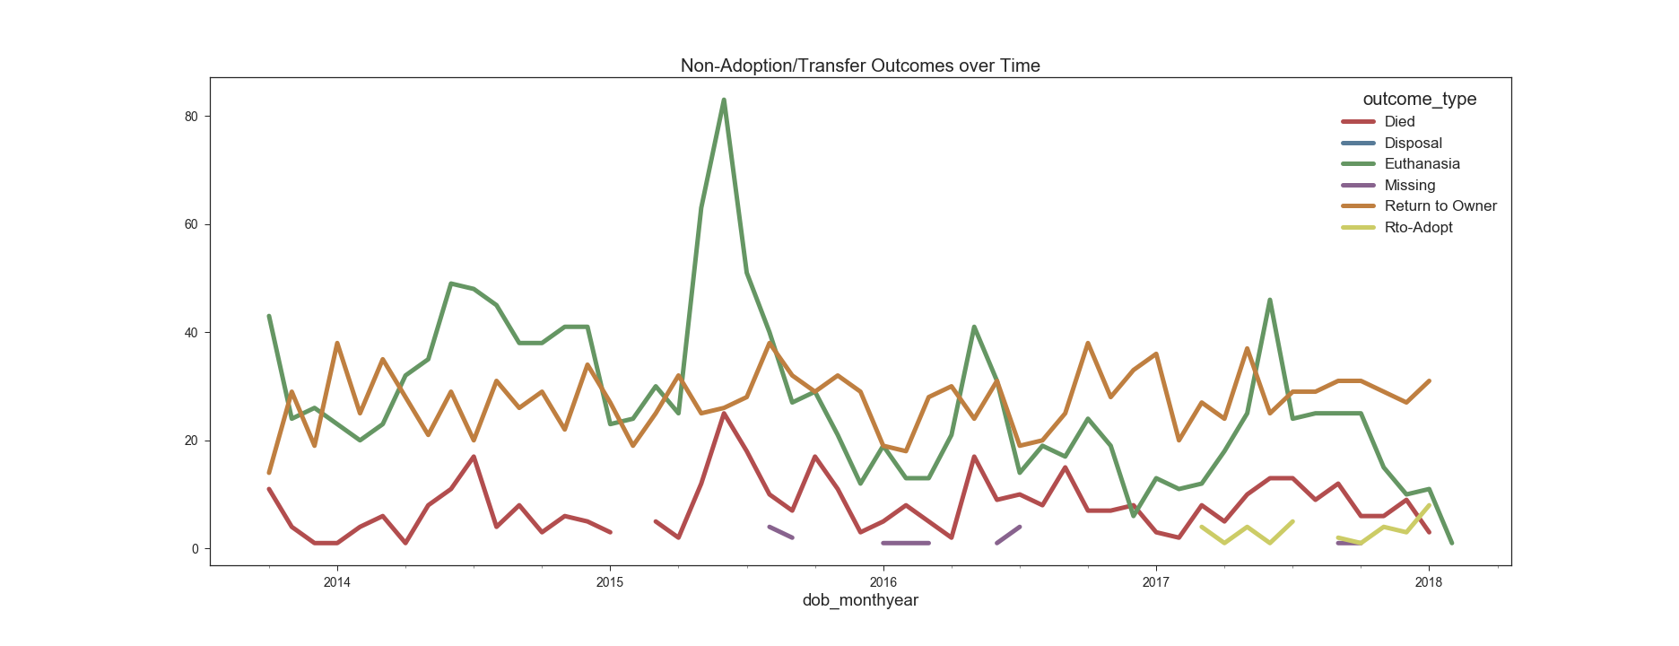
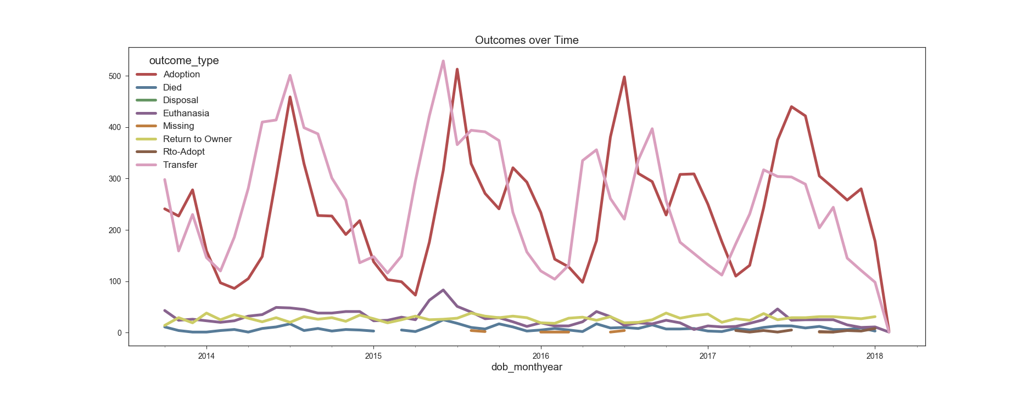
After analysing above graphs we can see that middle of the year is “busy” for cats, particularly June and July when females are in heat and the weather is usually fair. This time of the year is when shelters often intake a lot more kittens and intact strays as part of trapping programs. So analyse this I plotted the counts of the various outcome types over time by month. To get a better look at the other outcomes to see if there are any trends, I have filtered data to exclude adoptions and transfers and plot the line graph for both.

Slide 12
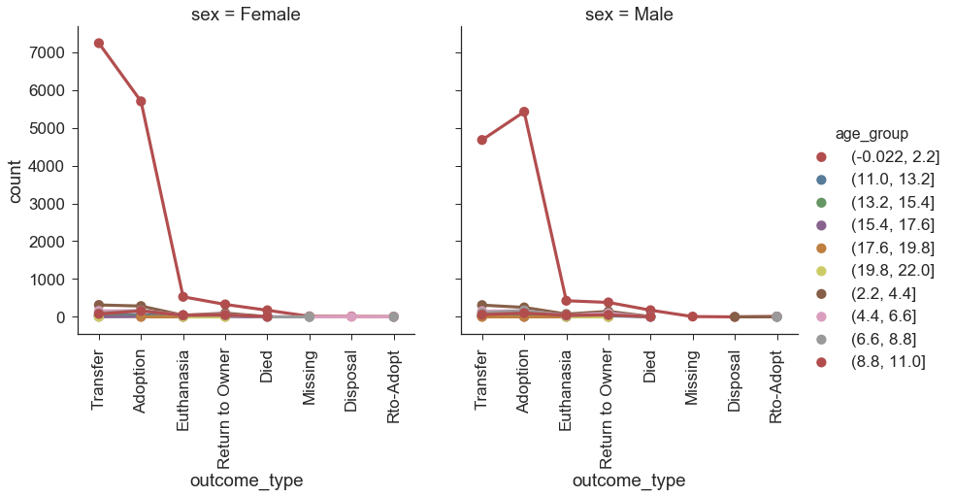
I noticed that cats of kitten age were adopted or transferred to partner facilities much more frequently than adult cats, to have a better idea.I visualized grouping of outcomes based on the age group of the cat.

Slide 13
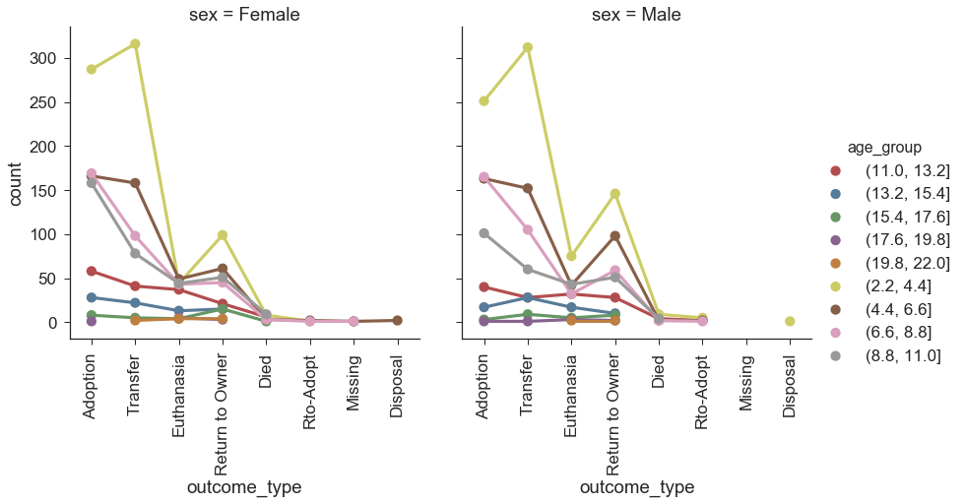
As per our previous observations, we can see that cats of kitten age and under two years old make up the majority of records. Since the number of cats under approximately two years of age is skewing the graph, I have filtered the data by taking out the age group to get a visualization of the other age groups.

Slide 14
THANK YOU

