Slide 1

CLASSIFICATION- PREDICTING RESULTS OF BANK MARKETING CAMPAIGNS
SHIVANI SHREYAS
- Group 22
- sxs180194

Slide 2
PROBLEM STATEMENT
  Improve Marketing Campaign of a Portuguese bank by analyzing their past marketing campaign data and recommending the kind of customers to target
MOTIVATION
  Banco de Portugal offered their clients fixed term deposits . Data was collected about each client, type of contact and outcome
  The main objective of this project is to identify the most responsive customers before the marketing campaign so that the bank will be able to efficiently reach out to them, saving time and marketing resources
  To achieve this objective, classification algorithms will be employed
  Classified all clients into two groups: "yes" to term deposits and 'no' to term deposits
  Our dataset contains 4119 rows and 21 features

Slide 3
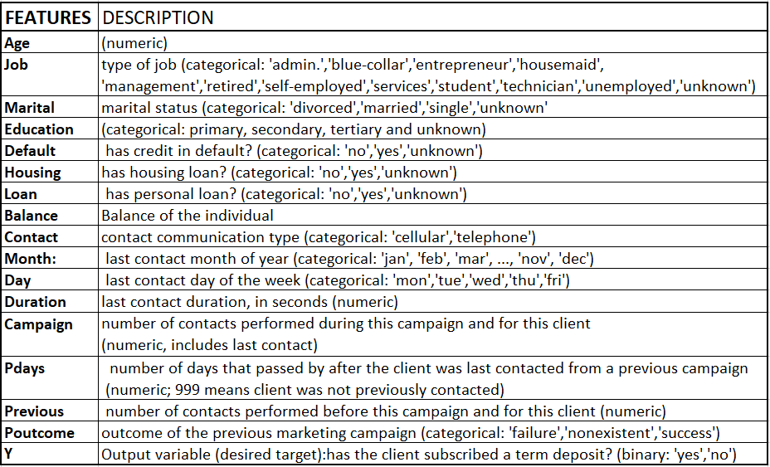

Slide 4
MISSSING VALUES
There are several missing values in some categorical attributes, all coded with the “unknown” label
For this analysis, I will use them as class labels to help draw more insight and predict the outcome
DURATION
The Duration feature was dropped due to risk of data leakage
The time cannot be known until after a call has ended
Including it in a predictive model would not provide realistic results
SCALING
The scaling method we are using is the Standard Scaler
Since a majority of the values in each column are very small, the data would unnecessarily be skewed if we use min-max scaling and so, we decide to use Standard Scaling
CLASSIFICATION MODELS
KNN, Logistic Regression, Linear SVM, Linear SVM with Kernel, SVM with RBF kernel, Decision tree, Voting Classifiers, Bagging and Pasting, Adaboost, Gradient boosting, PCA
ANALYZING THE RESULTS
False Positive, means the client do NOT SUBSCRIBED to term deposit, but the model thinks he did.
False Negative, means the client SUBSCRIBED to term deposit, but the model said he dont.
Our objective here, is to find the best model by confusion matrix with the lowest False Positive as possible

Slide 5
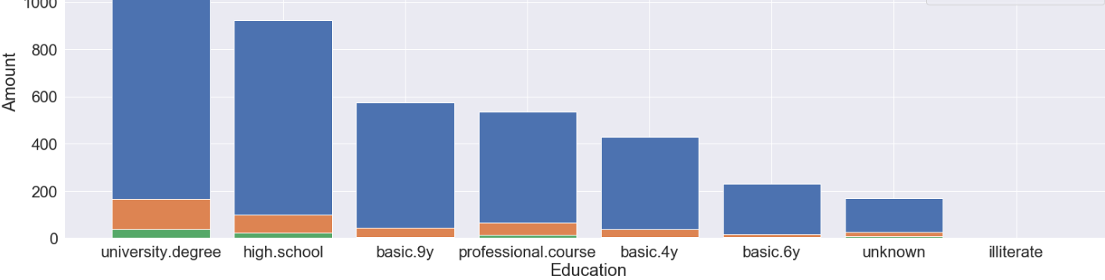
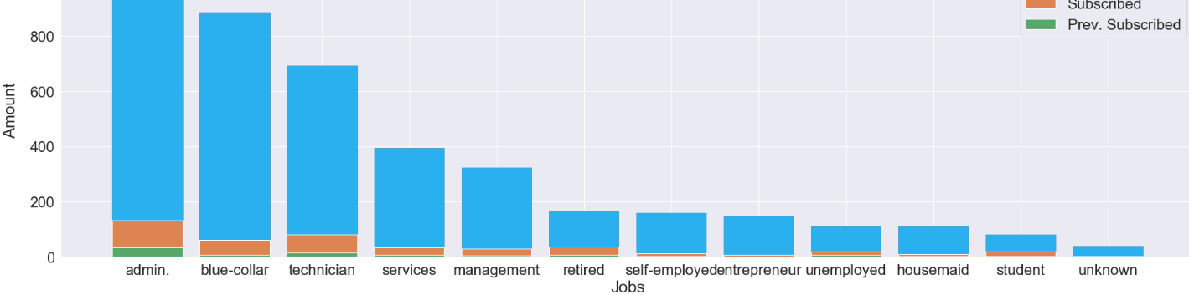
DATA EXPLORATION

Slide 6
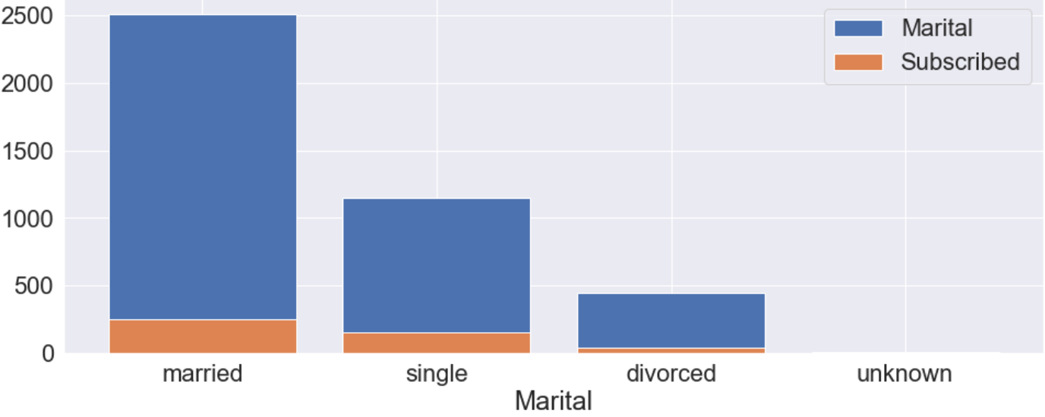
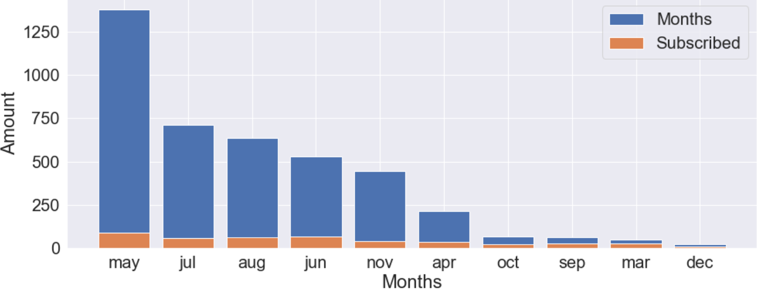
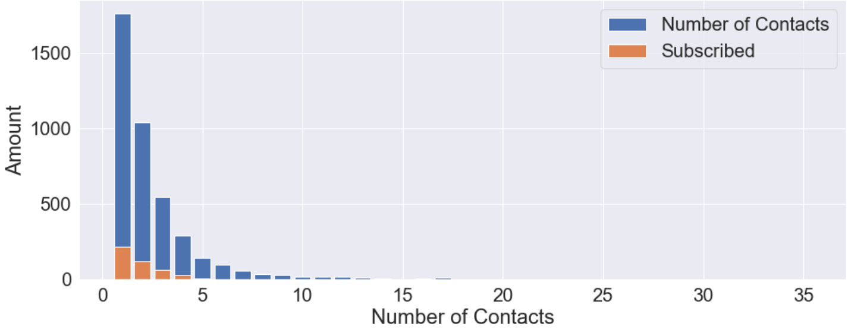
Marital
Months
Campaign

Slide 7
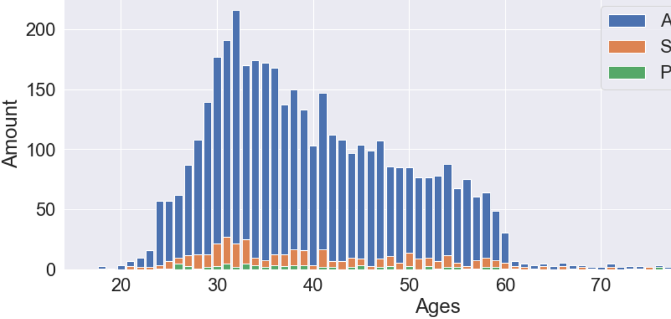
Age

Slide 8
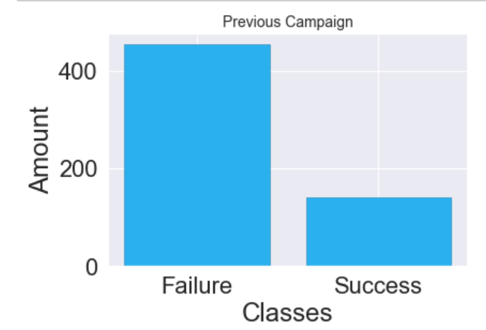
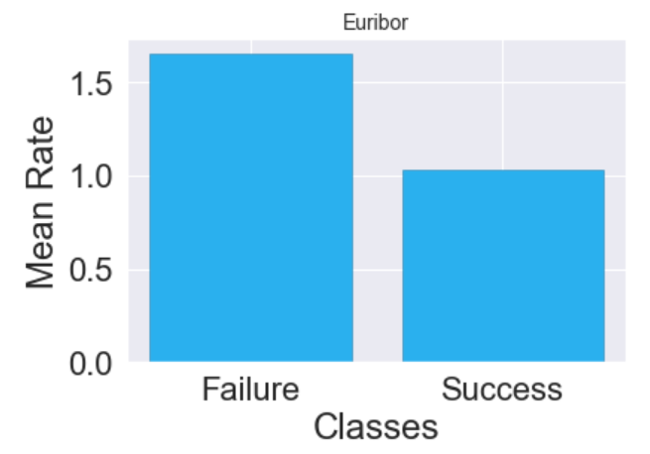
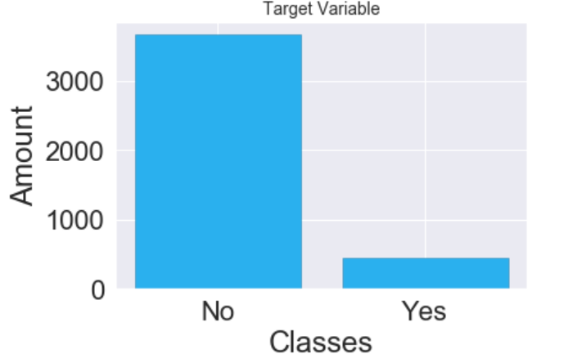

Slide 9
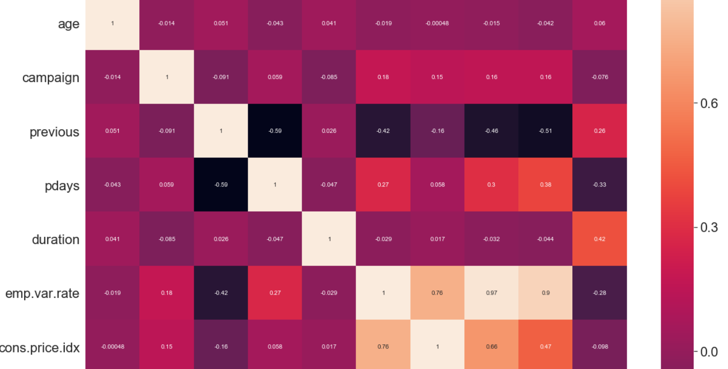
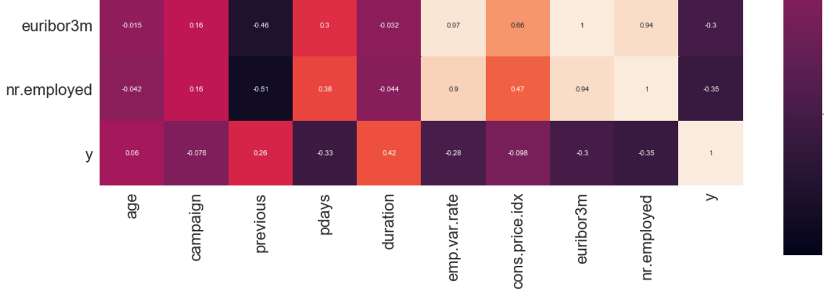

Slide 10
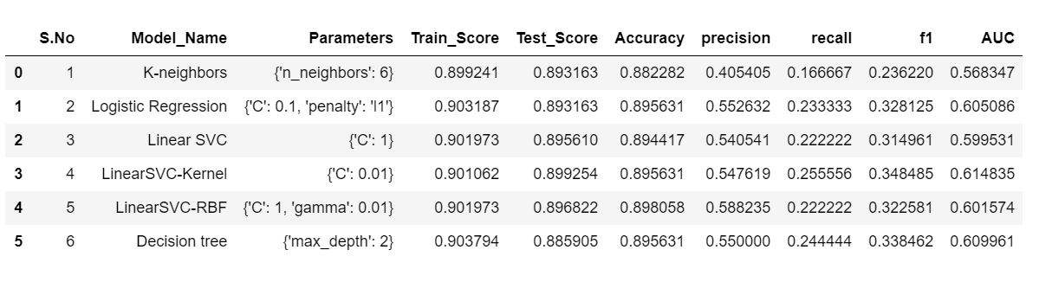
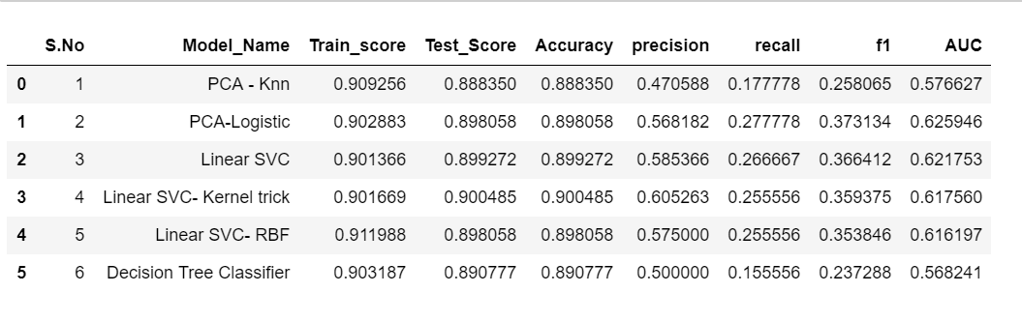
COMPARISON OF MODEL RESULTS BEFORE AND AFTER PRINCIPAL COMPONENT REDUCTION

Slide 11
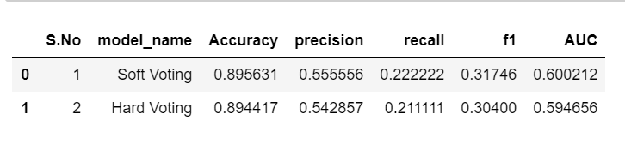
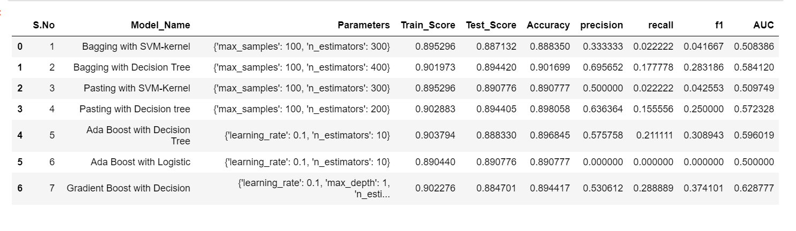
VOTING CLASSIFIERS
BAGGING AND BOOSTING

Slide 12
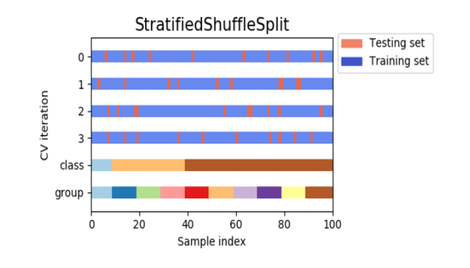
DISCUSSION
Best model is SVM with Kernel
Best Hyperparameter is C= 0.01
Train score is 0.901
Test score is 0.899
Precision is 0.547
Recall score is 0.2555
F1 score is 0.34
AUC is 0.614
The final model is selected based on the AUC score which is a better evaluation criteria than the Accuracy of the model since the target variable is highly imbalanced and the accuracy can give us a false assumption of the model output
IMBALANCED DATA
We used StratifiedShuffleSplit instead of regular train test split to ensure that relative class frequencies is approximately preserved in each train and validation fold
Creates splits by preserving the same percentage for each target class as in the complete set

Slide 13
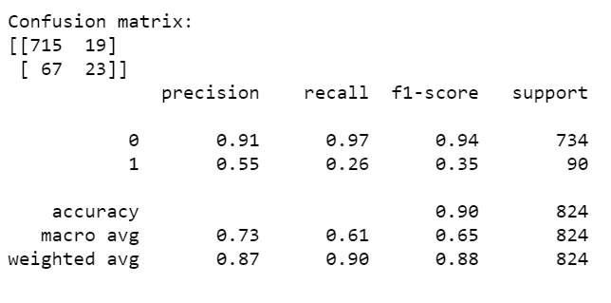
ANALYZING THE RESULTS USING CONFUSION MATRIX
False Positive means the client do NOT SUBSCRIBED to the term deposit but the model thinks he did
False Negative means the client SUBSCRIBED to term deposit but the model says he does not
The first one is more harmful, since we think that we have the client but we don’t and we risk missing the client in future campaigns
Our objective is to find the best model from confusion matrix with the lowest False Positive
Results of SVM with kernel

Slide 14
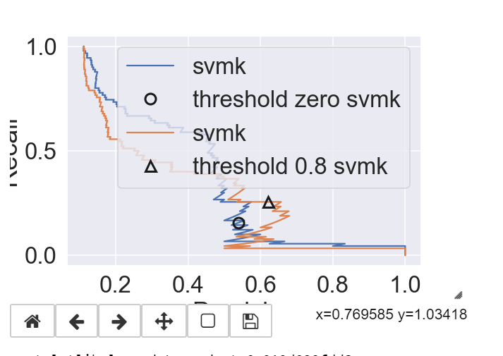
PRECISION RECALL CURVE (SVM-KERNAL)
Tried varying the Threshold from 0.5 to 0.8
The precision and recall scores did not improve a lot. This may be because of the high imbalance in the Target variable

Slide 15
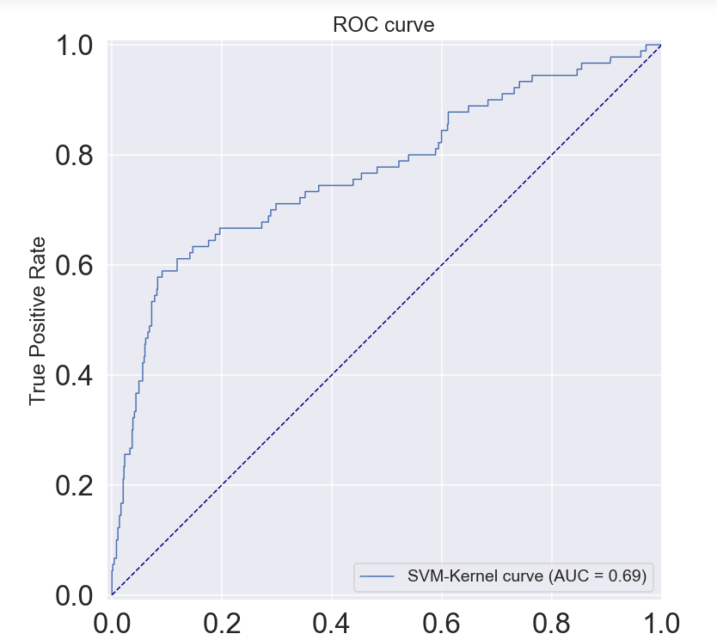
AUC -69%
ROC CURVE

Slide 16
Future work
  Rebalance the train data: Oversample the minority class to overcome the unbalanced response output
  Explore various resampling techniques like undersampling, oversampling ,SMOTE to overcome unbalanced data set
  Find other ways to improve Precision scores.
References:
  https://archive.ics.uci.edu/ml/datasets/Bank+Marketing#
  www.Kaggle.com

