Slide 1
Data Management Project
Shivani Tayade

Slide 2
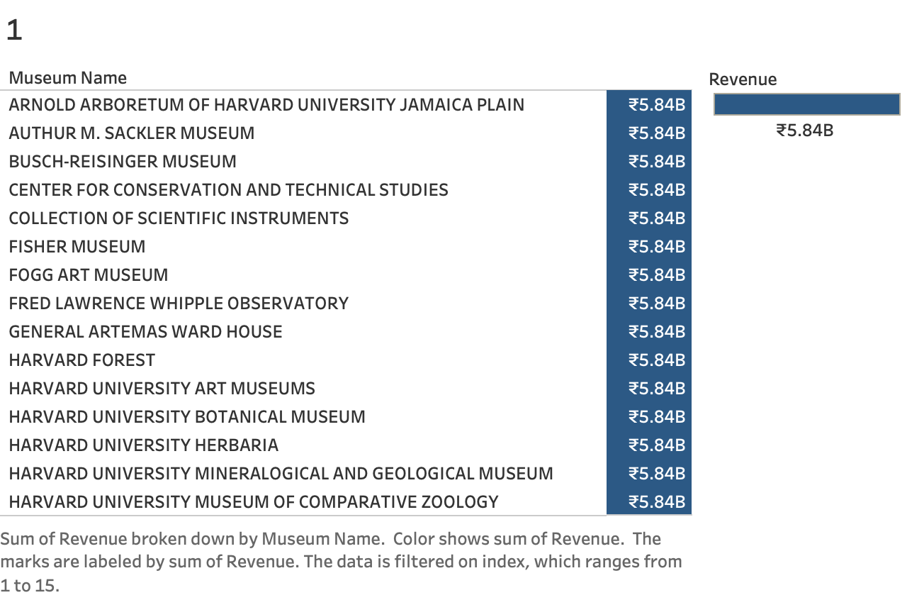
Museums Generating the Highest Revenue:
Insights: The most profitable museums can be seen as examples of success. By understanding their strategies, such as visitor engagement or exhibit quality, these practices can inspire improvements in other museums.

Slide 3
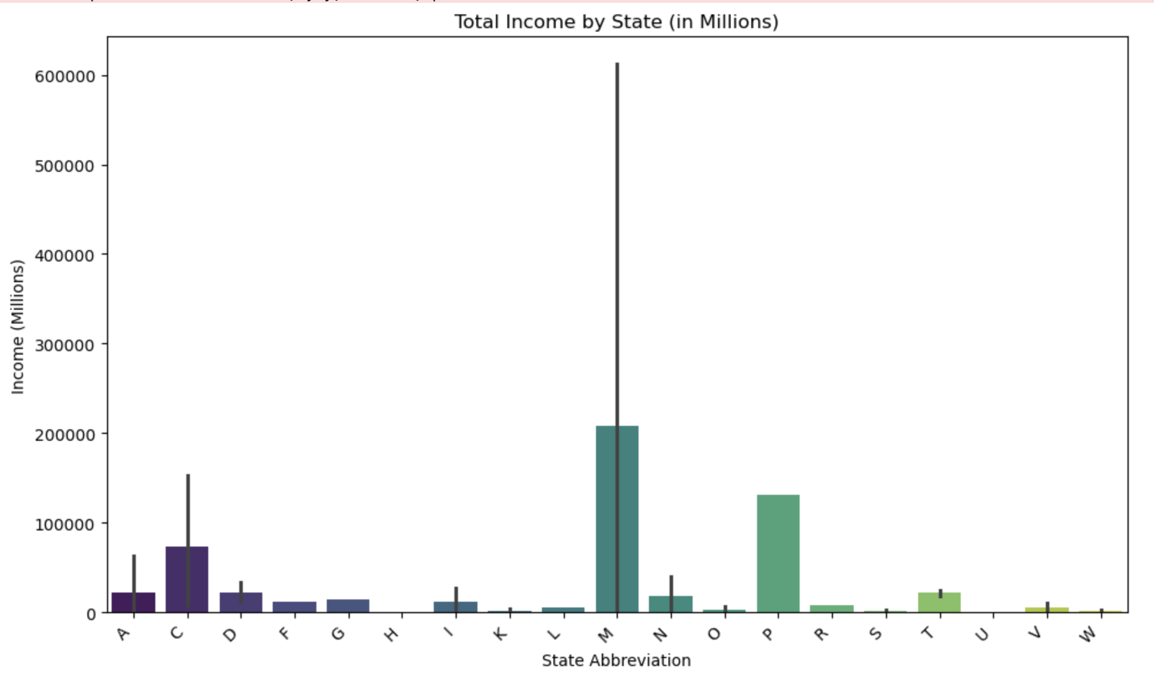
Total Income Generated by Museums in Each State
Insight: States generating higher income might indicate areas with strong museum-going culture or effective tourism strategies. This can help prioritize investment and marketing in these states or replicate successful models in underperforming ones.

Slide 4
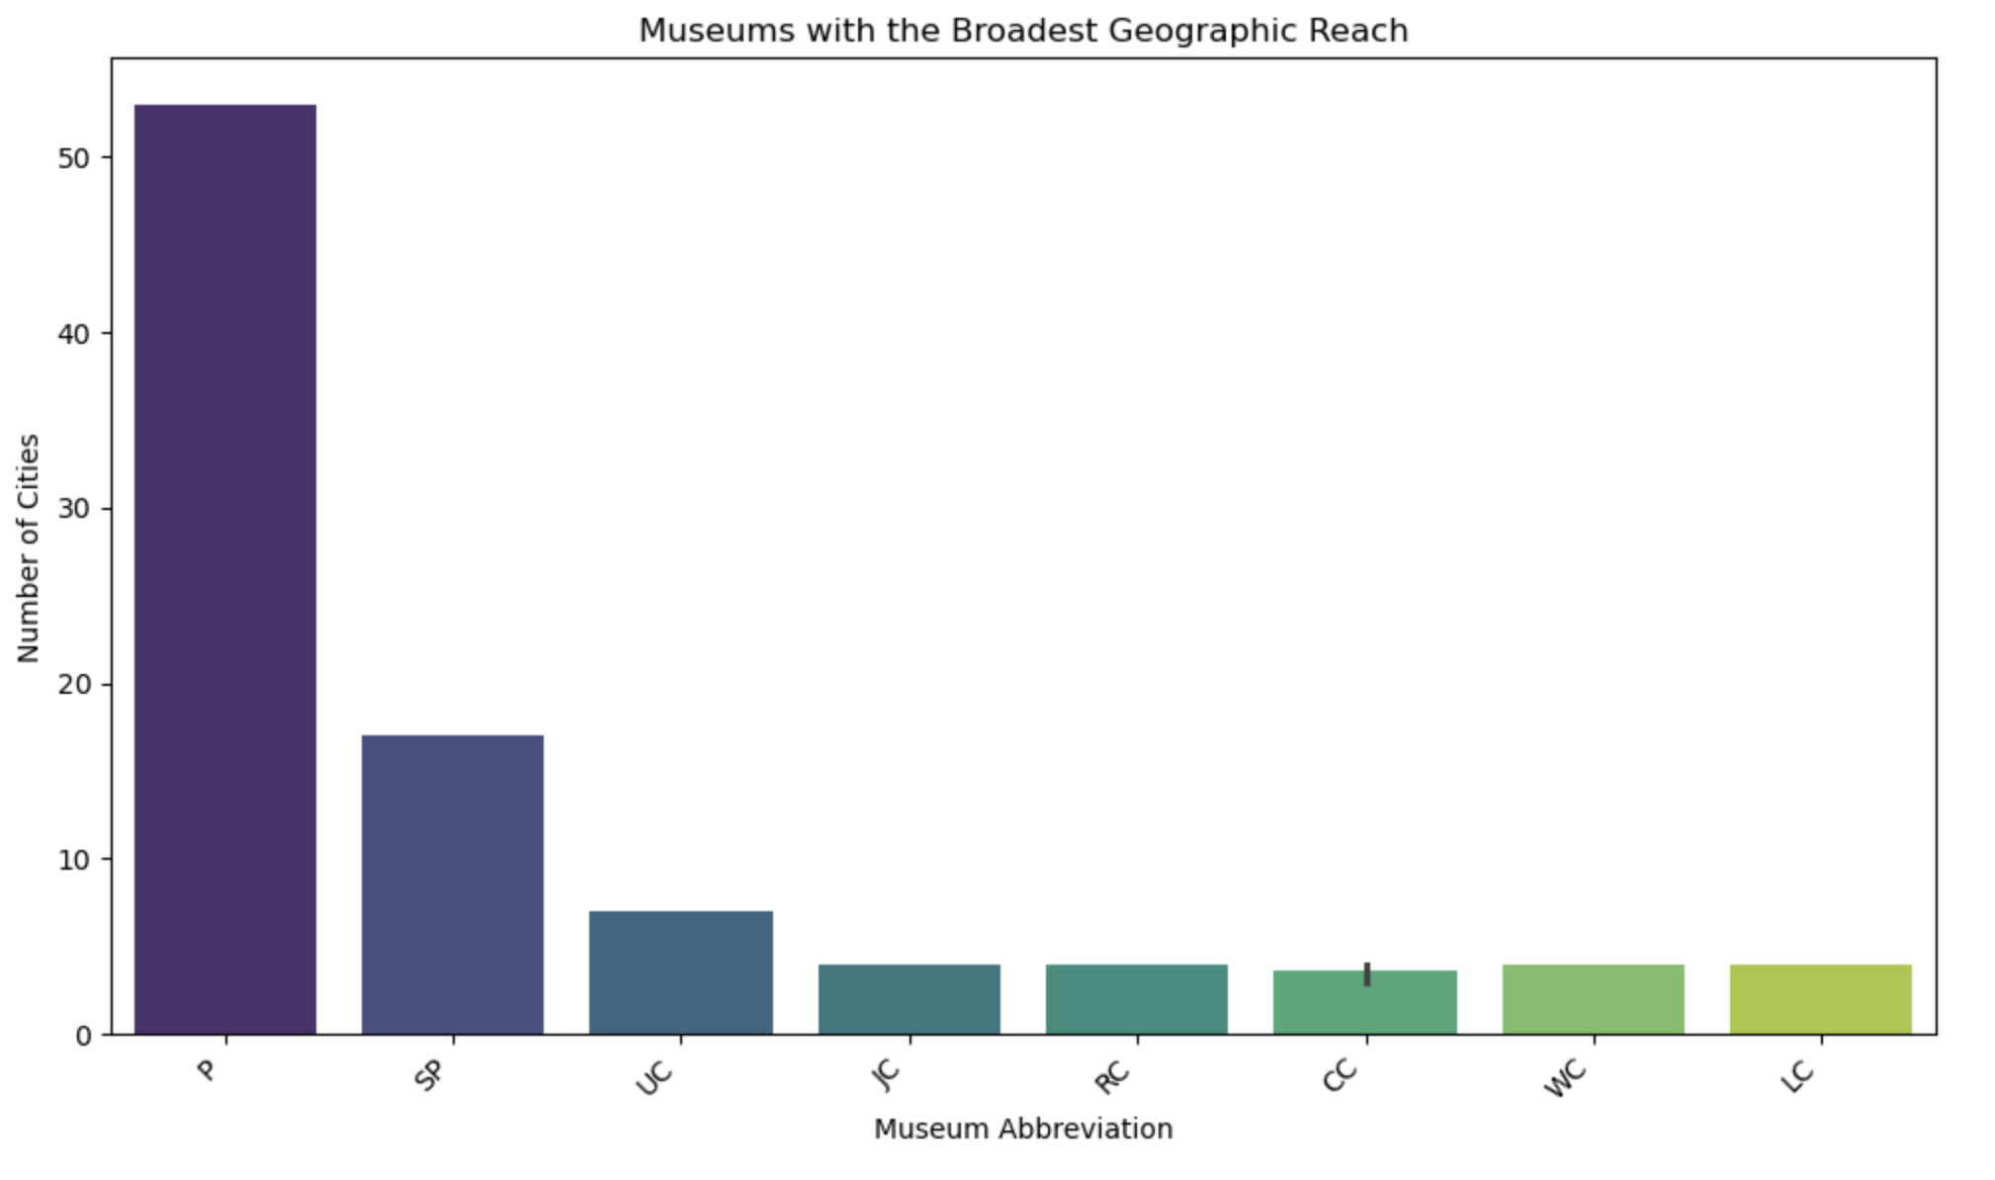
Museums Located in the Most Cities
Insight: Museums (Planetarium) with multiple locations might indicate strong institutional presence or popularity. Supporting these museums further can amplify their cultural impact.

Slide 5
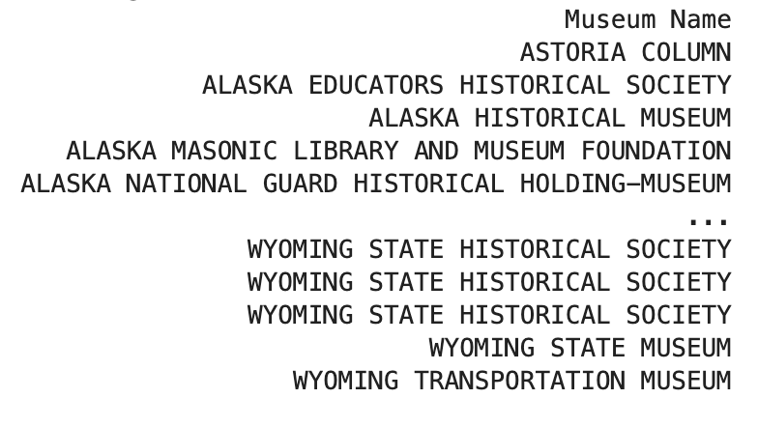
Museums Lacking Financial Details
Total Museum Count: 21566
Insight: Missing financial data suggests inefficiencies in record-keeping or reporting. This is a call to standardize and improve data collection to ensure transparency and strategic decision-making.

Slide 6
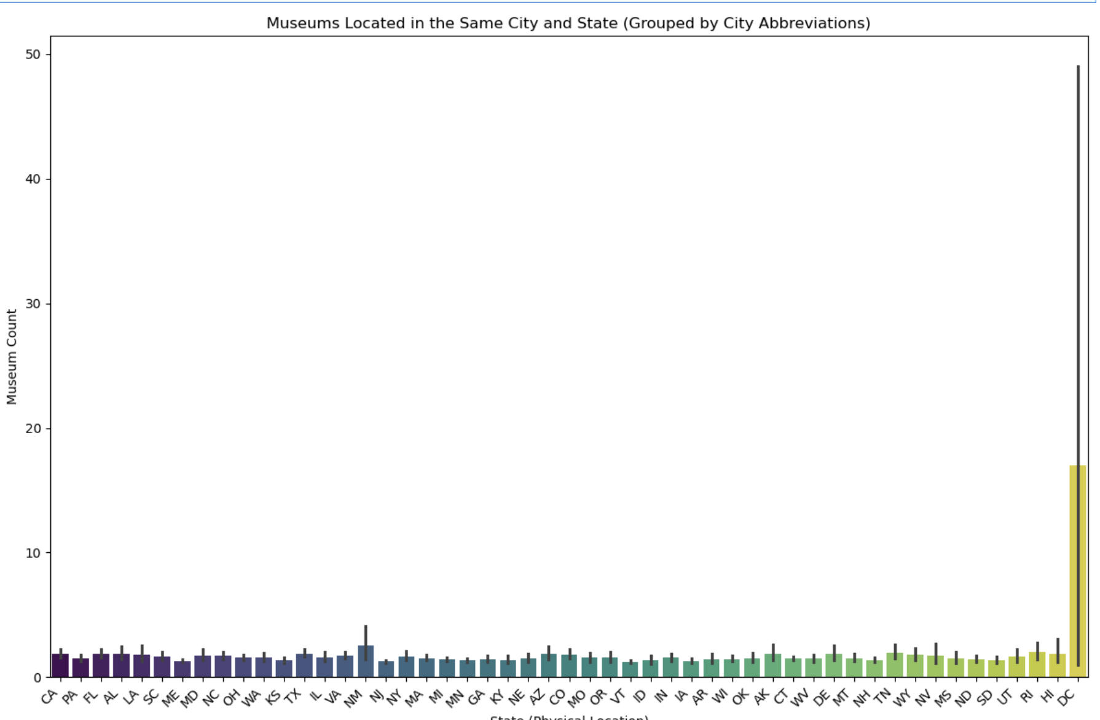
Museums Located in the Same City and State (Grouped Bar Chart)
Insight: Cities with multiple museums could focus on collaborative efforts, such as joint exhibitions or tourism campaigns, to create a cultural hub and attract more visitors.

Slide 7
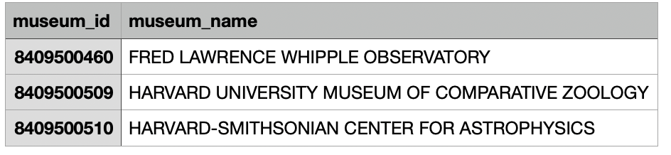
Average Revenue of the Top 3 Museums
Insight: Understanding the average earnings of top-performing museums helps set benchmarks for growth. Lower-performing museums can assess where they lag behind.

Slide 8
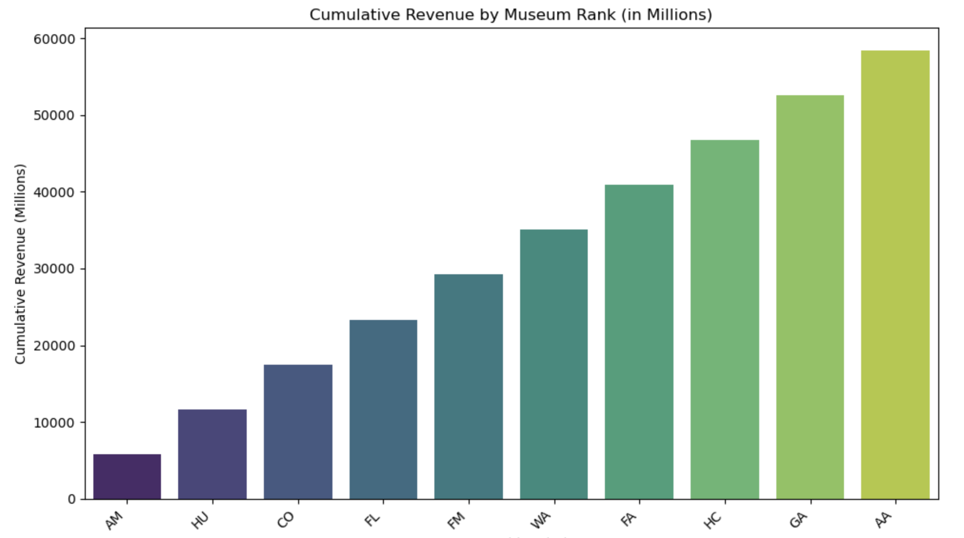
Cumulative Revenue by Rank
Insight: Observing revenue trends across ranks can identify revenue disparities and uncover whether a few museums dominate earnings or if revenue is more evenly distributed.

Slide 9
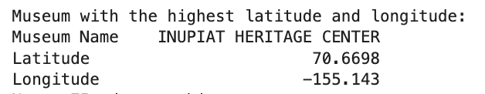
Museum with the Highest Latitude and Longitude
Insight: The museum in the farthest geographic location might indicate untapped opportunities in isolated regions or areas with unique cultural significance.

Slide 10
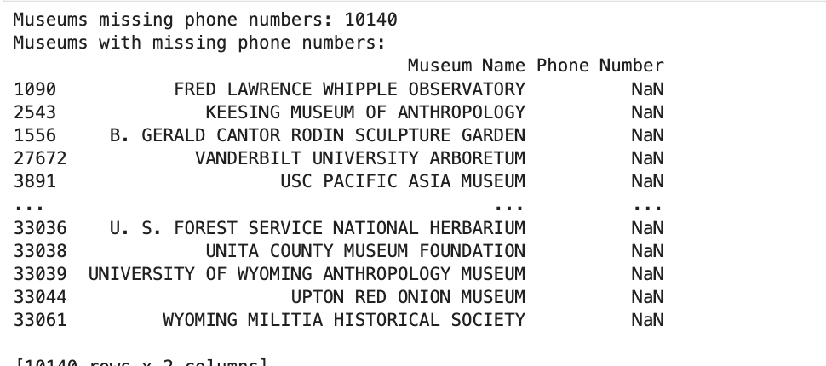
Museums Missing Phone Numbers
Insight: Missing contact information reflects operational inefficiencies that could hinder communication and visitor engagement. Improving this ensures smoother interactions with the public.

Slide 11
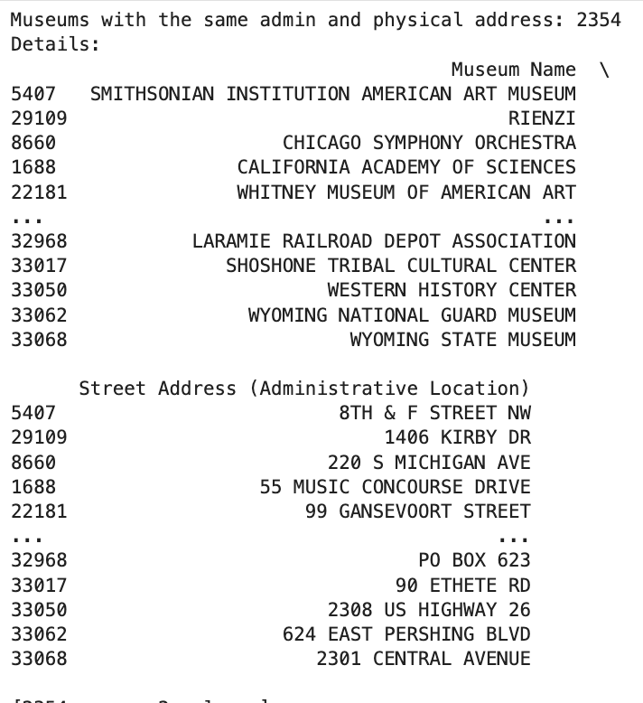
Museums with same Administrative and physical Location
Insight: Museums with the same admin and physical addresses may indicate smaller operations, such as local or single-location institutions, which might need different support compared to larger networks.

Slide 12
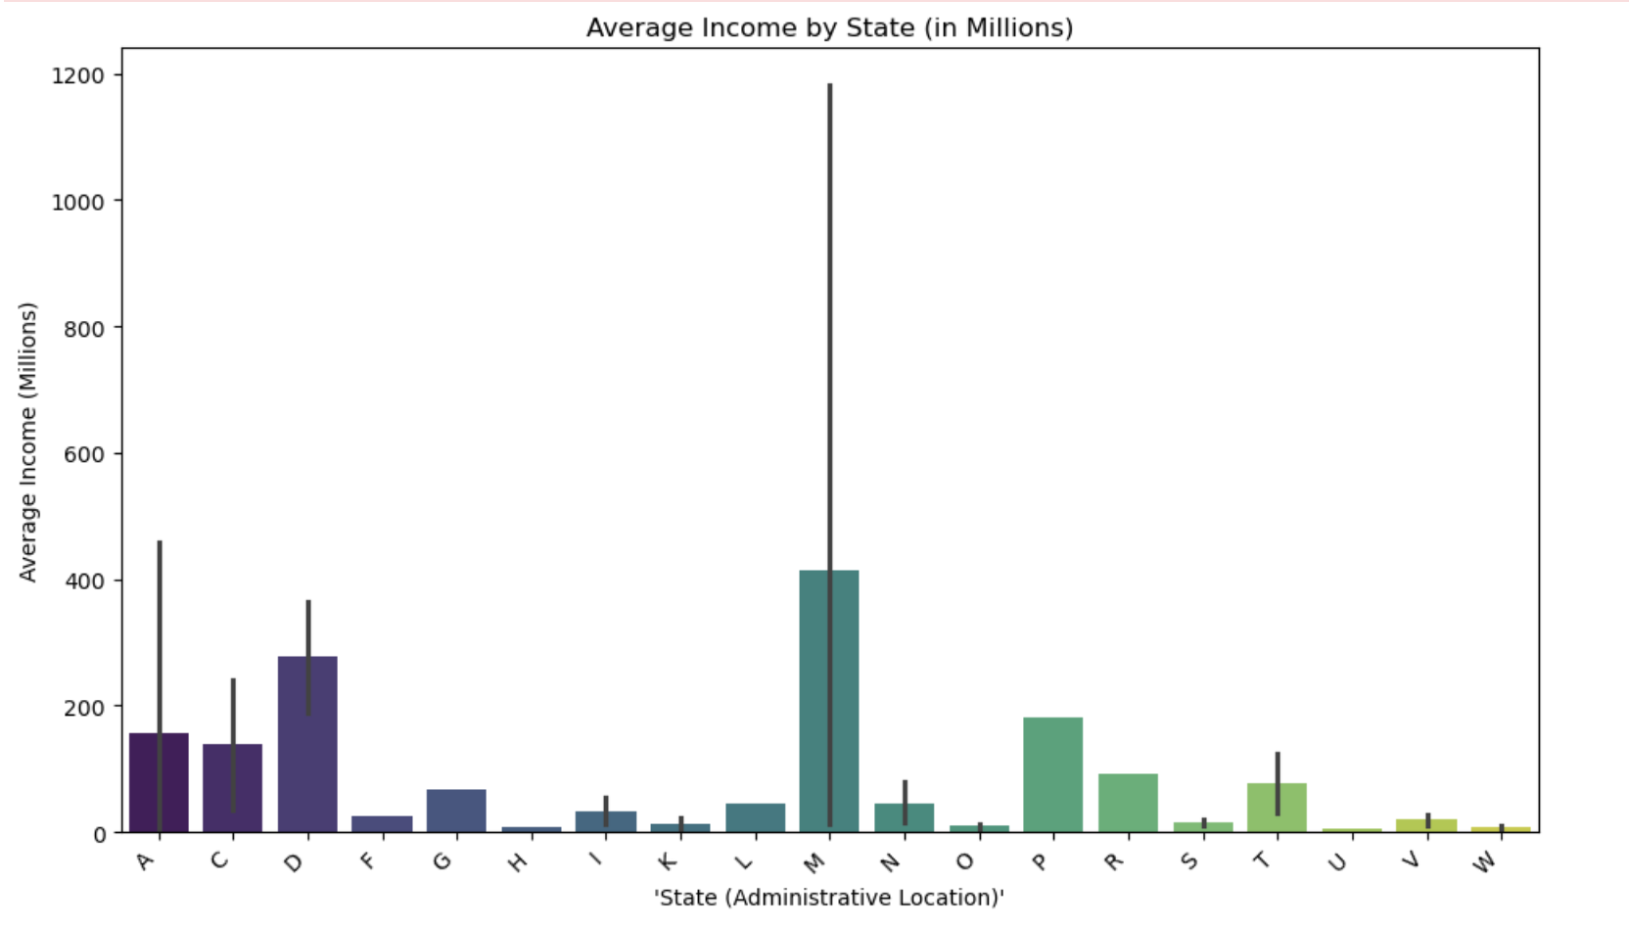
QUERY 11
Average Income by State And Overall
Insight: Knowing the national average income for museums can help set expectations and provide a baseline for assessing performance.
Whereas, State-level average income provides a clearer picture of regional museum performance. High-performing states can guide strategies for growth in lagging regions.

