Slide 1
Solving Traveling Salesman Problem using Genetic Algorithm
Team 21
Devesh Kandpal
Shivani Udupa

Slide 2
Problem Statement
Given a set of N cities, the problem is to find the shortest possible route that visits each city just once.
The brute force approach to solving this problem would be to find the best route out the possible N! routes
Genetic algorithm, uses the concept of natural selection, where in a possible “fitter” offspring is produced by the fit parents of the previous generation, there by finding a more optimized solution every coming generation. This eliminates the to need to examine each one of the N! possible routes to find the best solution.

Slide 3
Sequence of Steps
Generate the Go generation genotype which a collection of random sequence of genes
Map each genotype to its phenotype, which in this case would be the order of the cities traversed
Repeat for N generations until an optimal solution is obtained
Calculate the fitness of each organism, which is the inverse of distance traversed to visit each city once
Sort the organisms of the population based on their fitness
Consider the top fit organisms of the current generation for spawning the next generations
Generate the next population’s genotype by crossover between randomly chosen fit parents from the previous generation

Slide 4
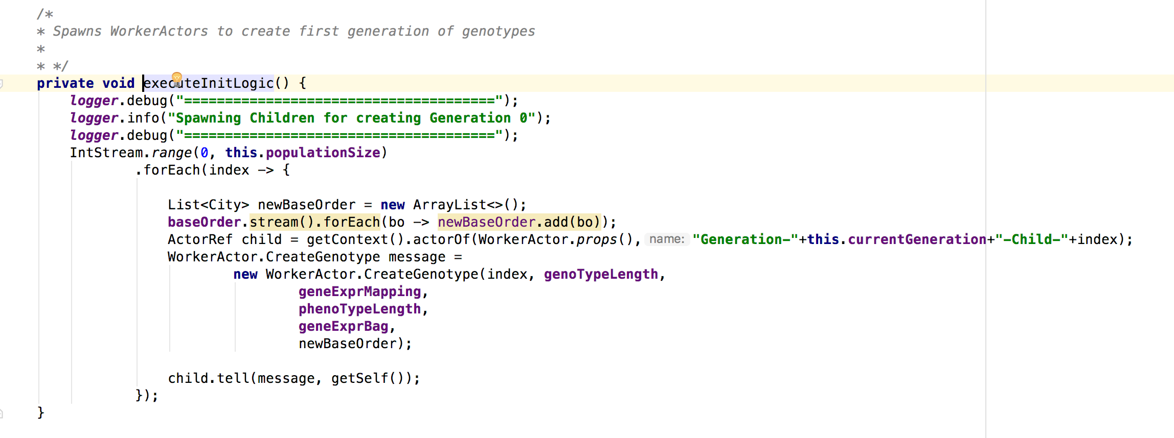
Details of Implementations
1.The initial genotype for the population is generated as a random sequence fixed length of genes, pattern of A or B followed by a numeric values( ex A12B23) .A and B are functions that alter the order of base route of cities based on the numeric value.
Master Implementation

Slide 5
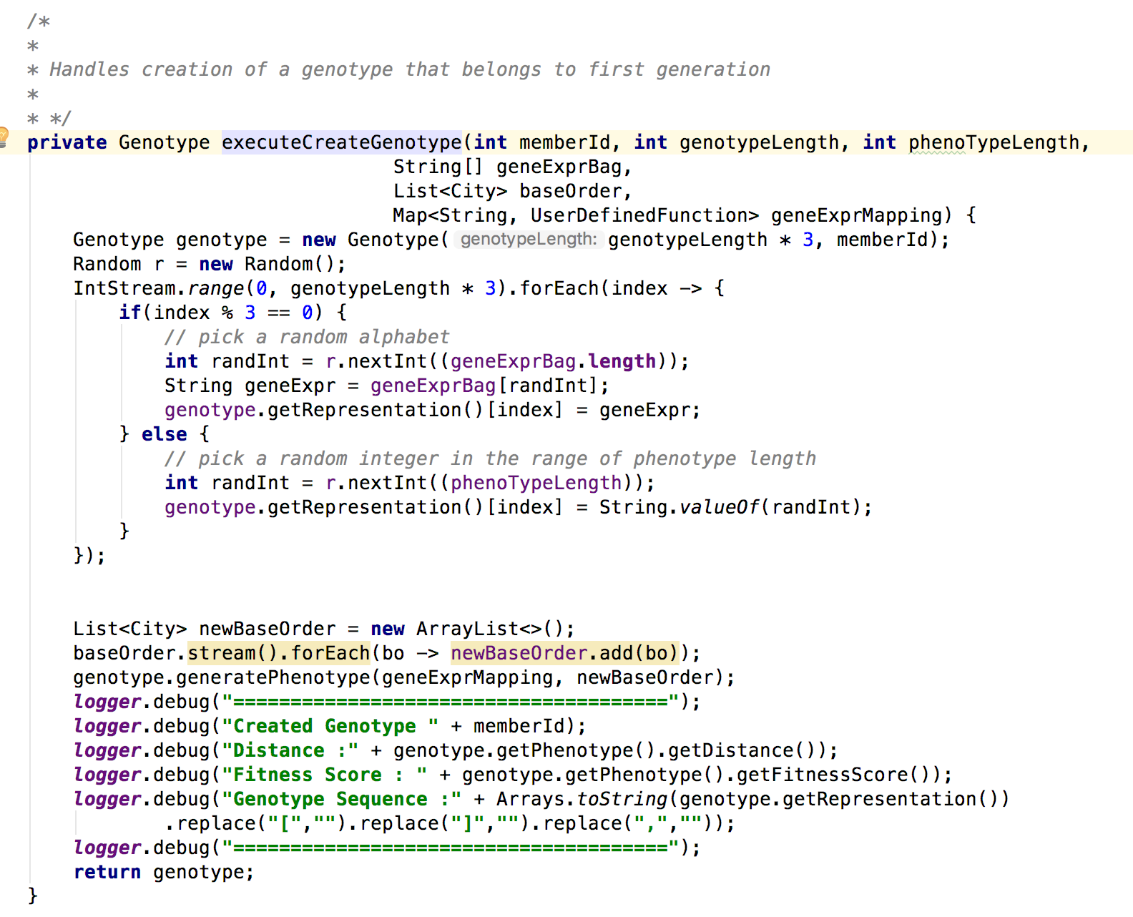
Details of Implementations
Worker Implementation to generate genotype object for the population

Slide 6
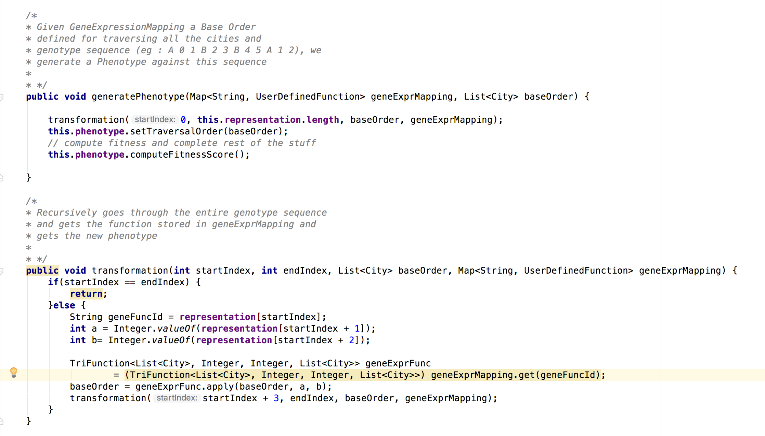
Details of Implementations
2. Map each genotype to its phenotype, which in this case would be the order of the cities traversed

Slide 7
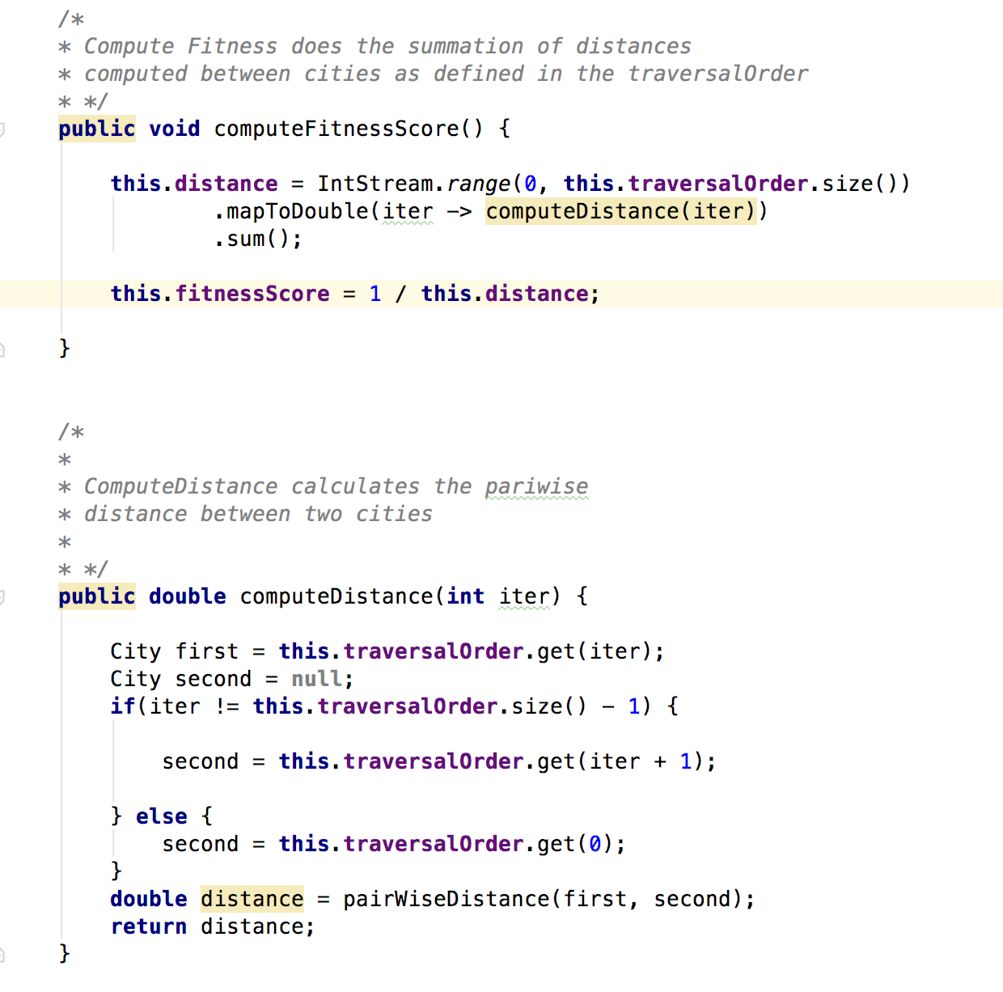
Details of Implementations
3. Calculate the “Fitness” of each organism , which is the inverse of the distance traversed by the salesperson to visit each city in the order dictated by the phenotype

Slide 8
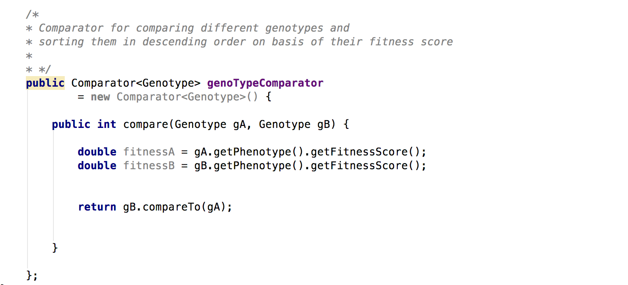
Details of Implementations
4. The organisms of the population are sorted in descending order of its fitness

Slide 9
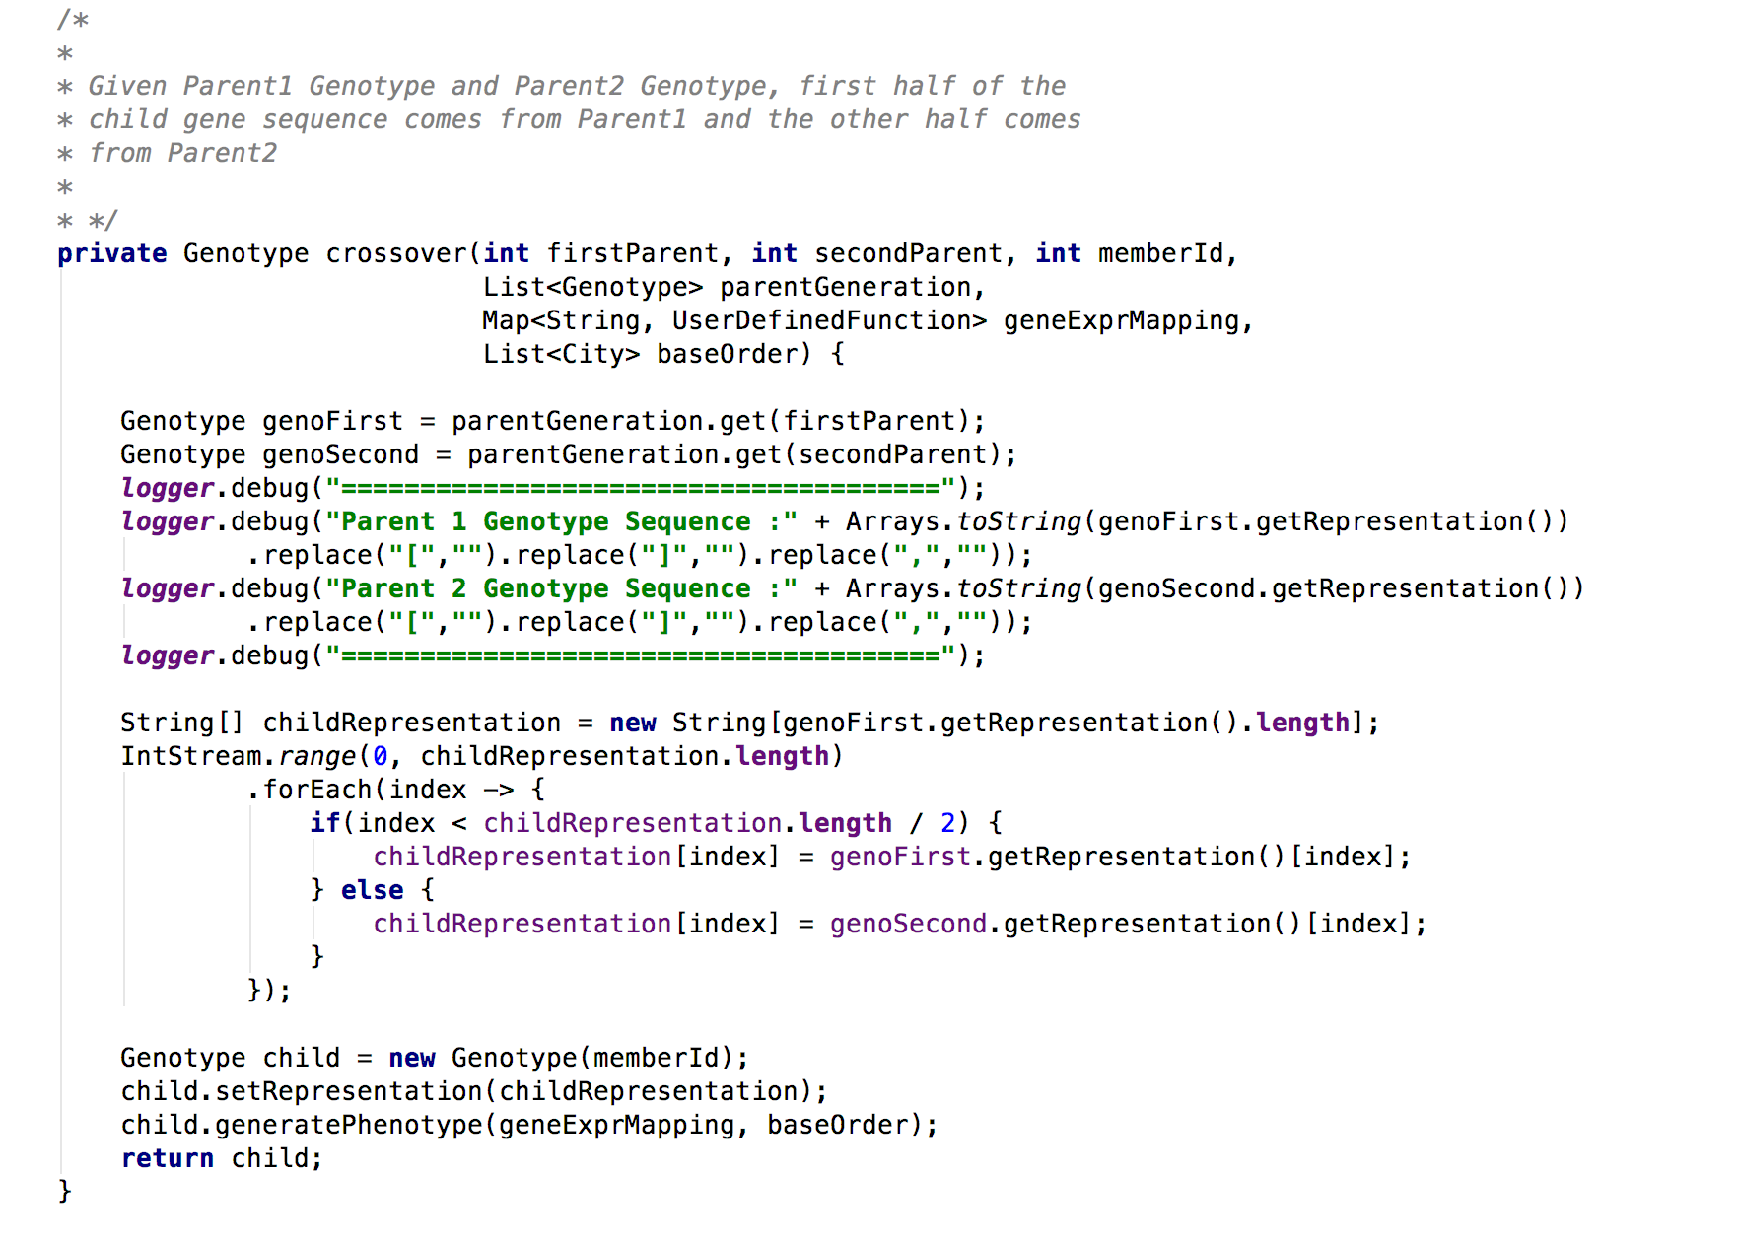
Details of Implementations
5. The next generation is generated from top 80% of the previous generation , and parents are chosen randomly from the collection (80% of the fittest parents create a child when chose in random) .The cross over function, that generates the child genotype, takes the first half of the one parent and another half from the other parent to generate a new sequence of genes.

Slide 10
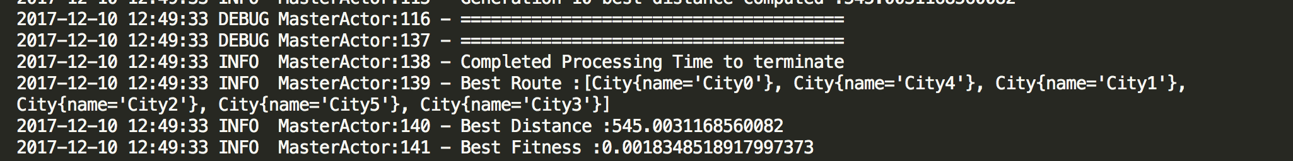
Details of Implementation
6.For every subsequent generation, the best fitness score of that generation is compared with the existing best. If the value is better, then it replaces the existing best, and the whole cycle is continued for another ten generations, till we are satisfied that there can be no better solution, thus leading to the program termination.

Slide 11
Program Execution Architecture
Actor Driver
Master Actor
Return Result
Create genotype/regenerate genotype
Worker Actor
….spawn child node for every member of the population….
Worker Actor

Slide 12
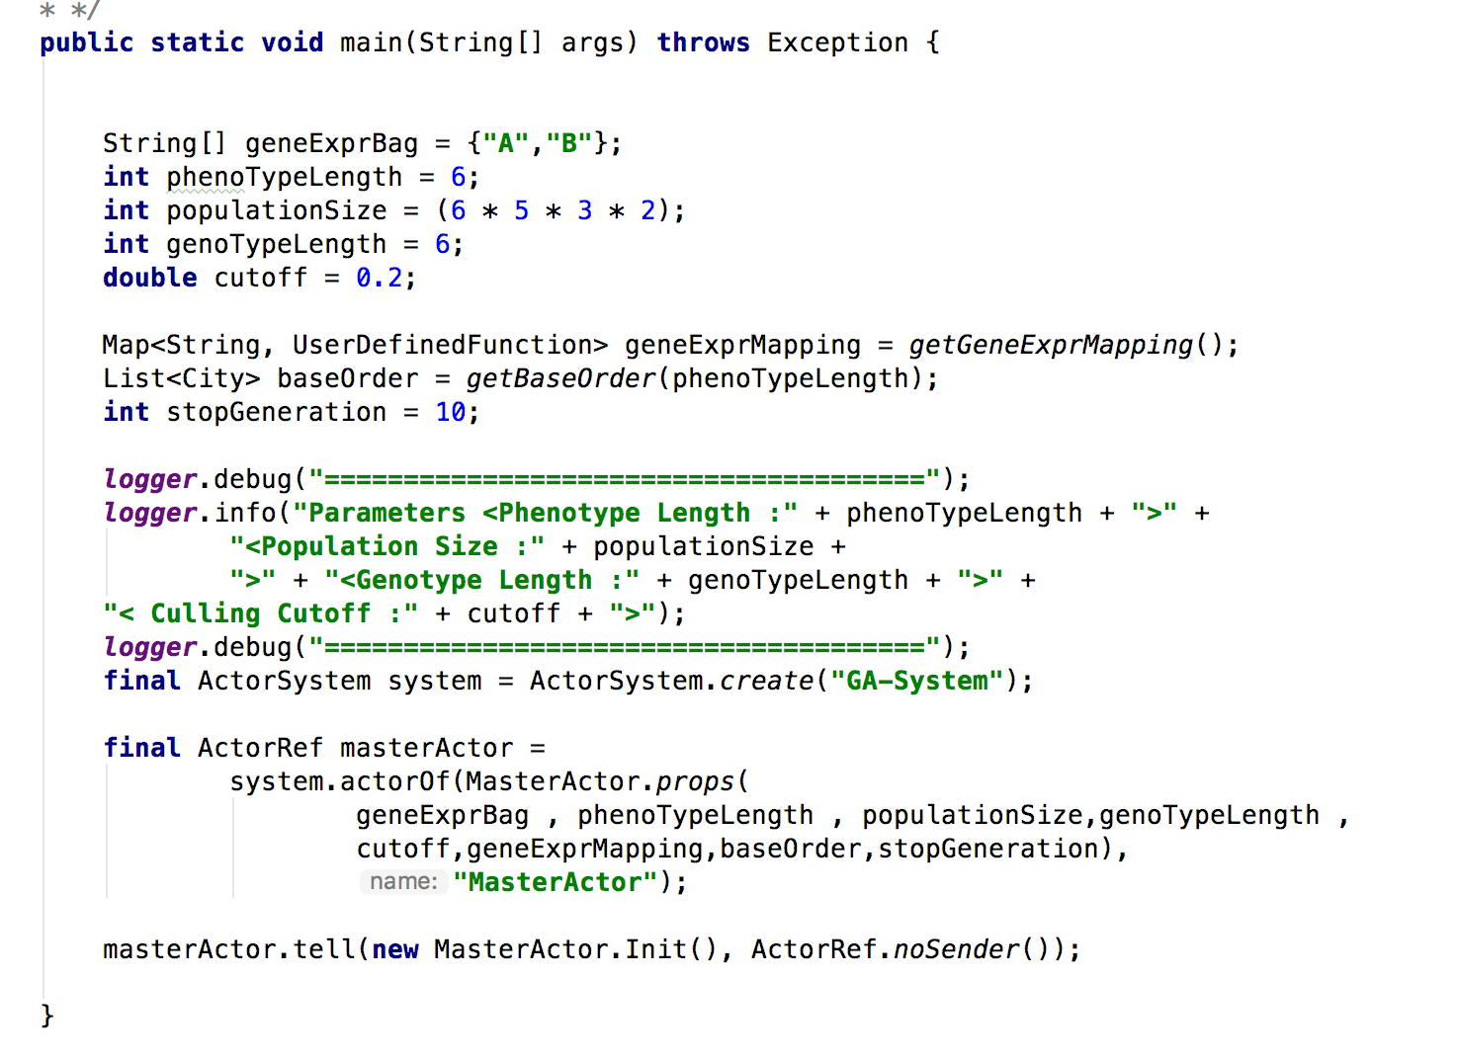
Program Execution Architecture
Actor Driver (core.ActorDriver.java)
Initializing actor system
Creating the master actor
Suppling init parameters to master actor such as phenotype length, genotype length and many more

Slide 13
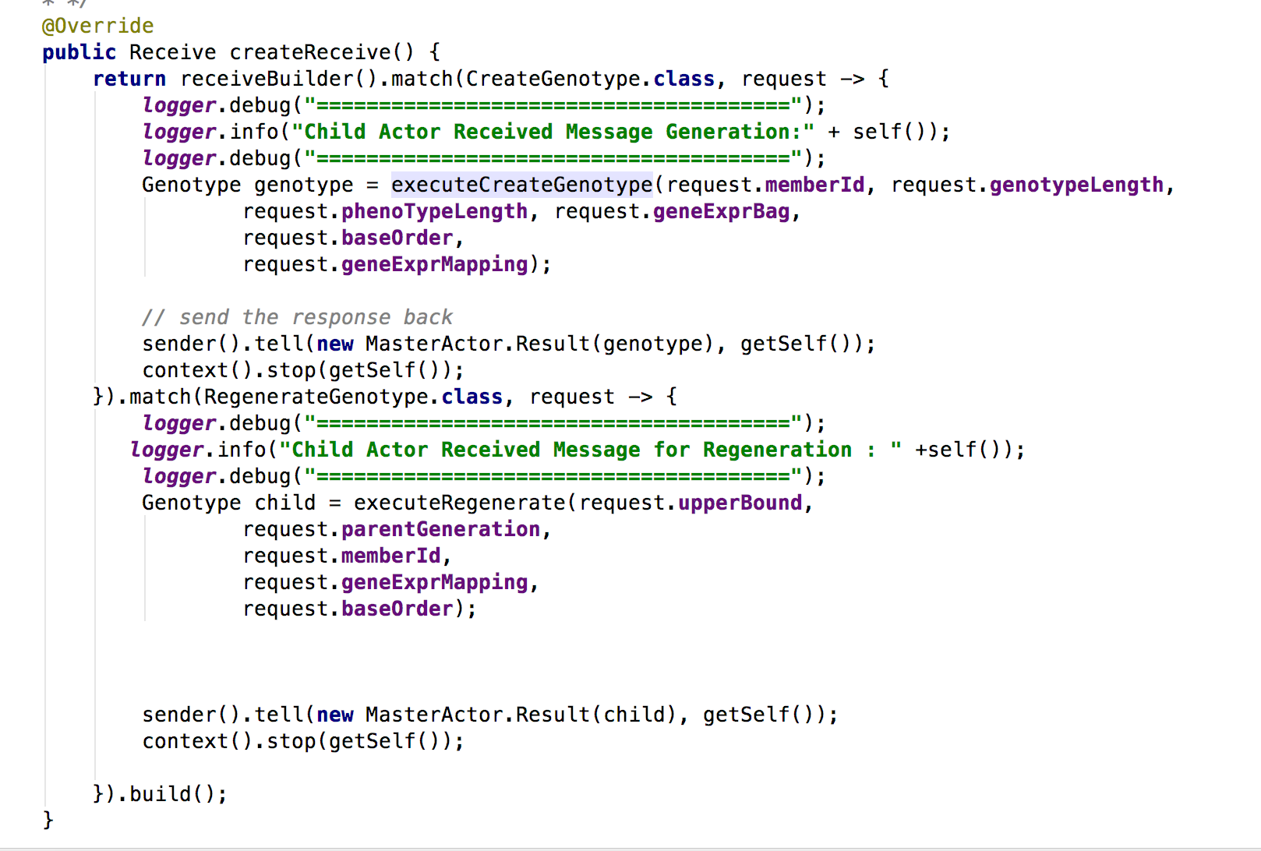
Program Execution Architecture
Master Actor (actors.MasterActor.java)
Spawns Worker Actors for genotype generation / regeneration
Sorts genotype results based on fitness score
Determines if optimal solution has been reached or not

Slide 14
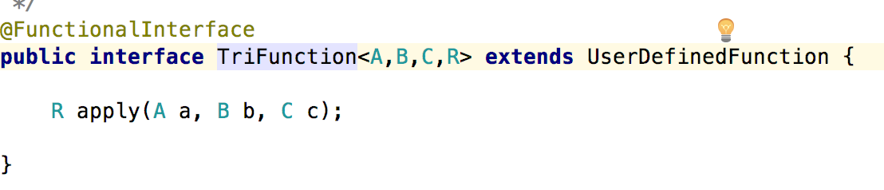
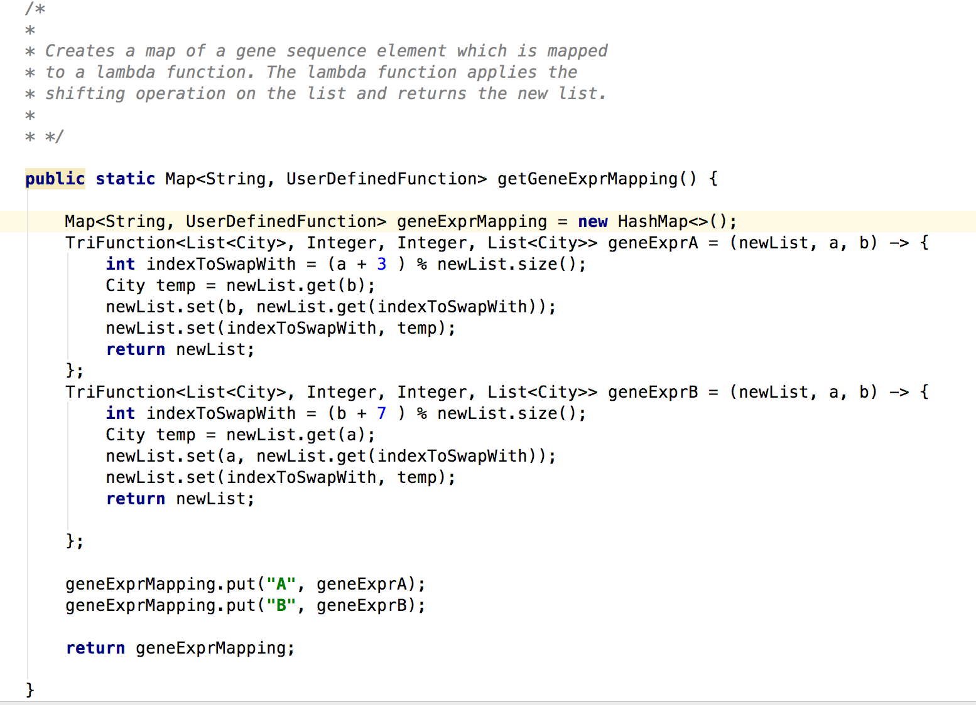
Program Execution Architecture
Worker Actor (actors.WorkerActor.java)
Creates Genotype object, maps it to phenotype object, calculates distance
And fitness score
Create new genotype objects using crossover
Kills itself after each task is completed (Generation and Regeneration)
Mapping function for converting Genotype to Phenotype

Slide 15

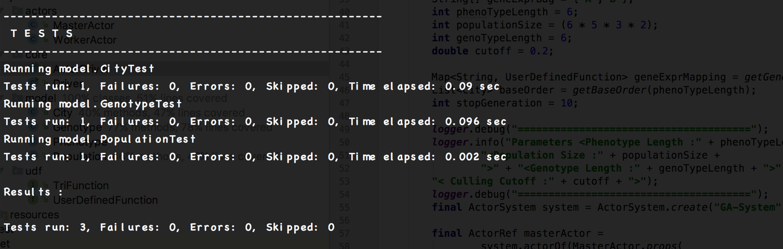
Unit Test Coverage

Slide 16
Result And Conclusion
We have been able to reach an optimal solution with one-fourth of total possible solution space using GA approach for solving Travelling Saslesman problem.
Statistics :
Total Cities = 6
Genotype Length = 6
Total Solution = 6!
Population = 6!/4 ~ 180
Number of Generations Spawned = 11

Slide 17
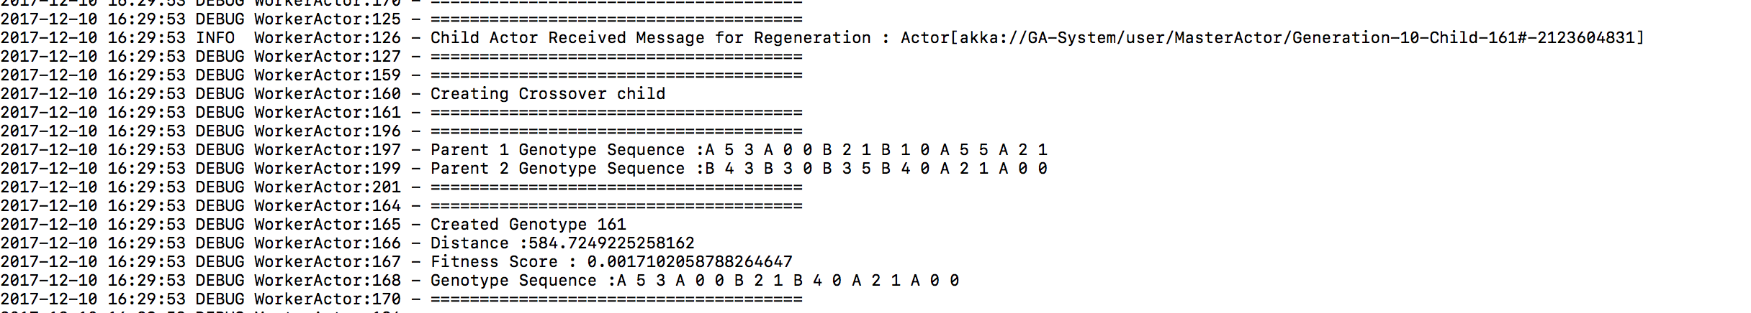
Result And Conclusion
Sample log cross over and fitness function calculation

Slide 18
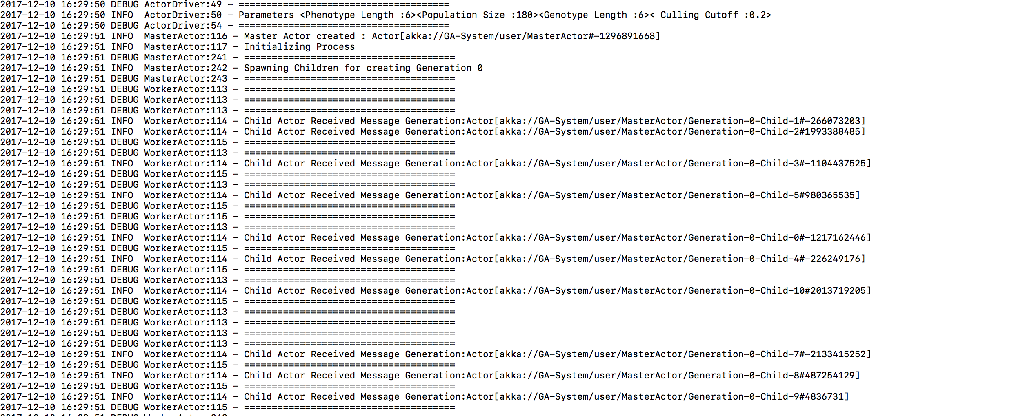
Result And Conclusion
Initialization of Master and Spawning of Worker Actors for creating 1st generation of genotypes

Slide 19
Running the Application
Download the source code from :
https://github.com/ShivaniUdupa/INFO6205_21/tree/master/Final-Project
mvn clean install (Have Maven and Java preinstalled)
After successfully running unit test cases and maven build
java –jar ./target/final-project-1.0-SNAPSHOT.jar

