Slide 1

ALY 6000 – MODULE 6
Shivani V
2022/10/28

Slide 2
LEADING 200 youtuber’s data analysis

Slide 3
Introduction
The dataset includes the information of the top-most youtubers globally.
It consists of the count of subscribers, likes, comments, views, engagement rate

Slide 4

Observations
United States of America holds 41.7 percent of the top 200 YouTube channels, followed by India with 24.6 percent and Brazil with 4.5 percent.
Wide range of audience follow Music videos, followed by Entertainment and Gaming.
Majority of the spectators enjoy watching Gaming videos, Music videos, and Entertainment videos.

Slide 5
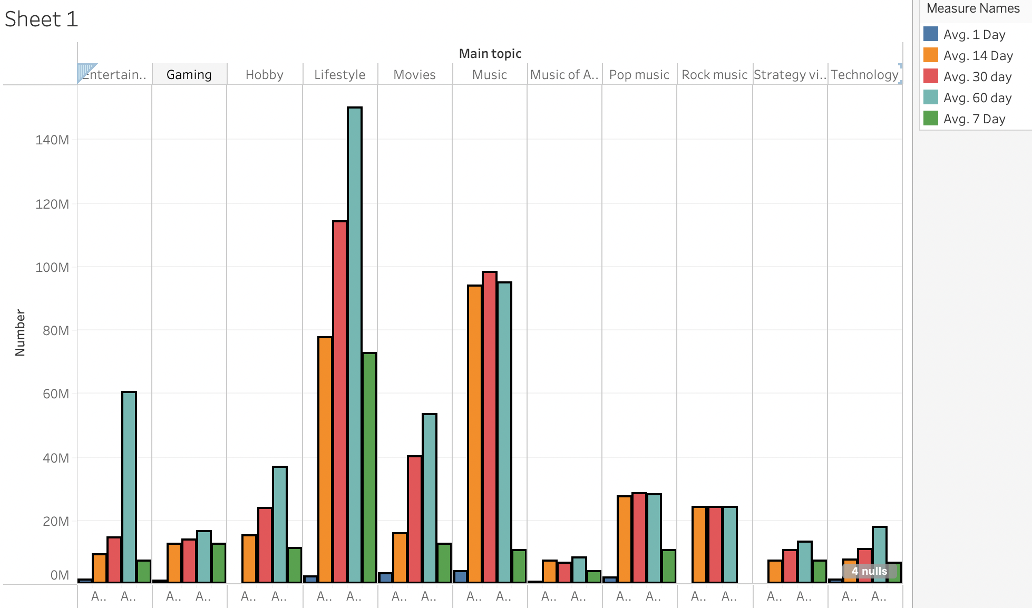
Analysis on Average views for a channel

Slide 6
Predictions
For an aspiring youtuber, it is predicted that if the content chosen on Music, Gaming or Entertainment, the channel is going to be a success.
As per the data, there is a high chance of getting into the top hundreds if the geographic area is United States, followed by India.
For an existing youtuber to make a video for engaging audience to get more views, Music, Film and Animation related content must be chosen.

Slide 7
References
Top 200 Youtubers Data (cleaned). (2022b, July 8). Kaggle. https://www.kaggle.com/datasets/syedjaferk/top-200-youtubers-cleaned

Slide 8
THANK YOU

