Slide 1
National Health and Nutrition Examination Survey (NHANES) - Analysis

Slide 2
About
A comprehensive program conducted by the National Center for Health Statistics (NCHS), a part of the Centers for Disease Control and Prevention (CDC)
Aimed at assessing the health and nutritional status of adults and children across the United States
Combines interviews and physical examinations
Surveys around 5,000 people each year, selected to be representative of the national population
The survey collects a broad range of health data. This includes demographic information, dietary habits, health questions, medical and dental exams, and physiological measurements.

Slide 3
Dataset: 2017-March 2020 Pre-pandemic (https://wwwn.cdc.gov/nchs/nhanes/continuousnhanes/default.aspx?Cycle=2017-2020)
Selected Files:
Demographics data: P_DEMO
Laboratory data: P_HDL, P_TRIGLY, P_TCHOL
Examination data: P_BPXO
Dietary data: P_DSQTOT
Deliverable: Analysis of basic health checks and identifying trends in laboratory, examination and dietary data based on age, gender and race.

Slide 4
Workflow
data preparation
weighted mean calculation and segmentation
visualizations

Slide 5
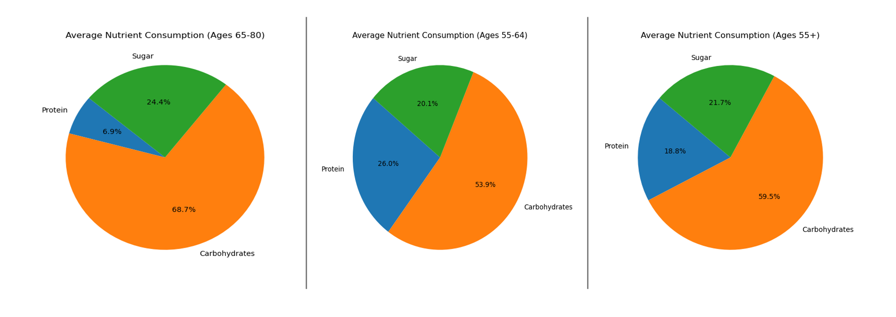
Supplement Intake: Age
Average carbohydrate and sugar intake increased with age, while average protein intake decreased as people got older. This suggests older adults may be consuming more foods high in carbs and sugar but less protein-rich foods compared to younger people.

Slide 6
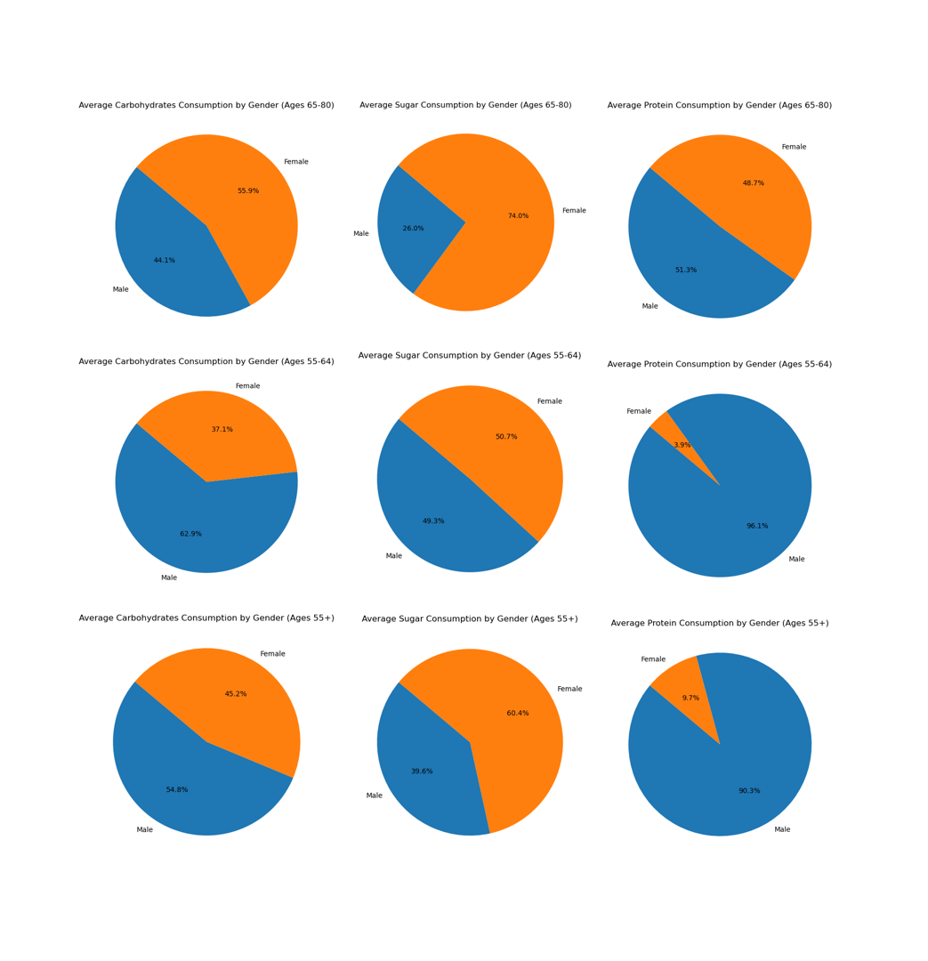
Supplement Intake: Age and Gender
While carb intake was almost balanced for both males and females of the same age, males had higher average protein intake. However, females consumed more sugar than males in the same age range.

Slide 7
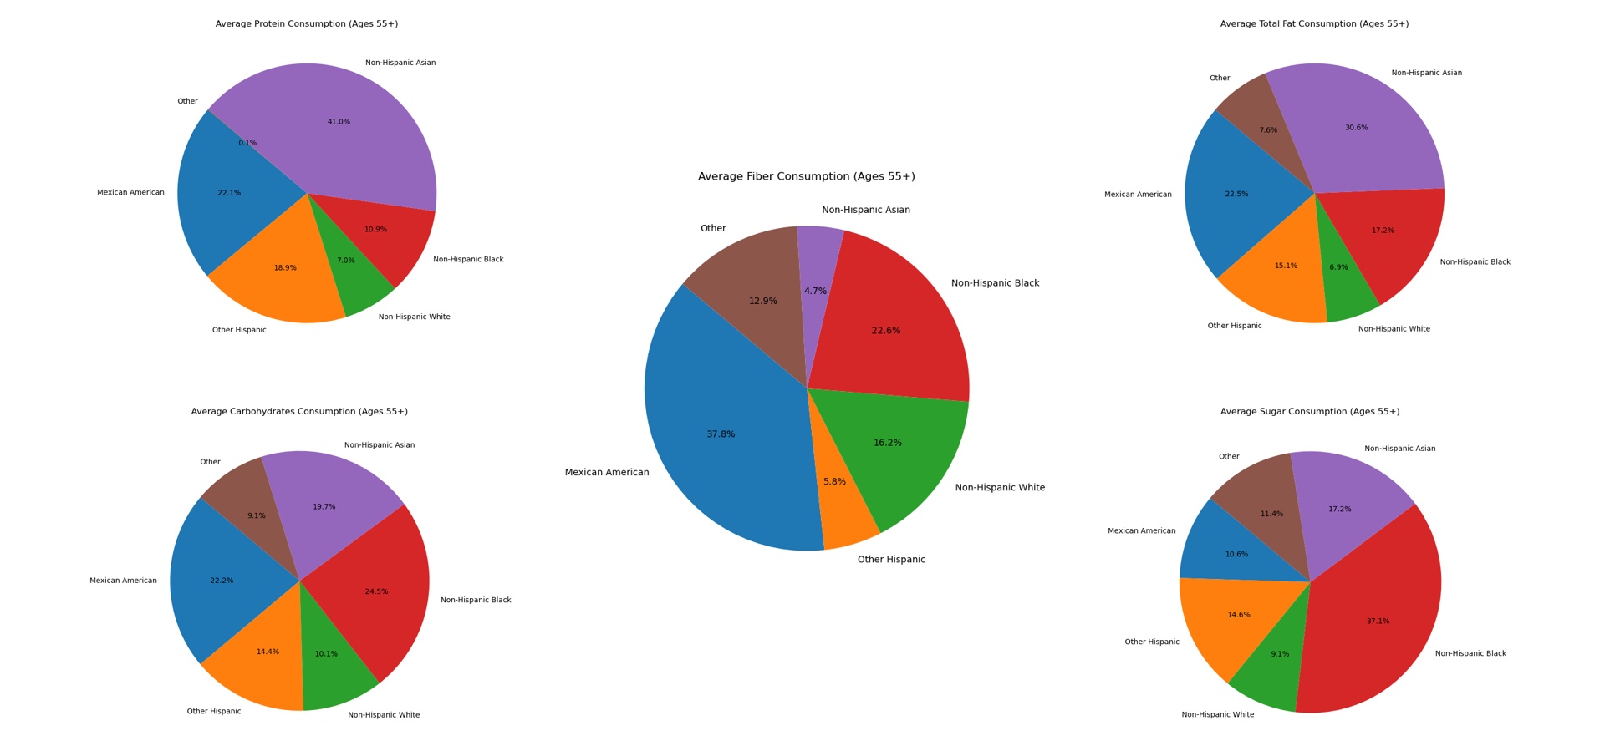
Supplement Intake: Age and Race
Non-Hispanic Asians have the highest average protein and fat intake. Carbohydrate intake is highest among non-Hispanic Asians, non-Hispanic Blacks, and Mexican Americans. Non-Hispanic Blacks have the highest sugar consumption, while Mexican Americans have the highest fiber intake.

Slide 8
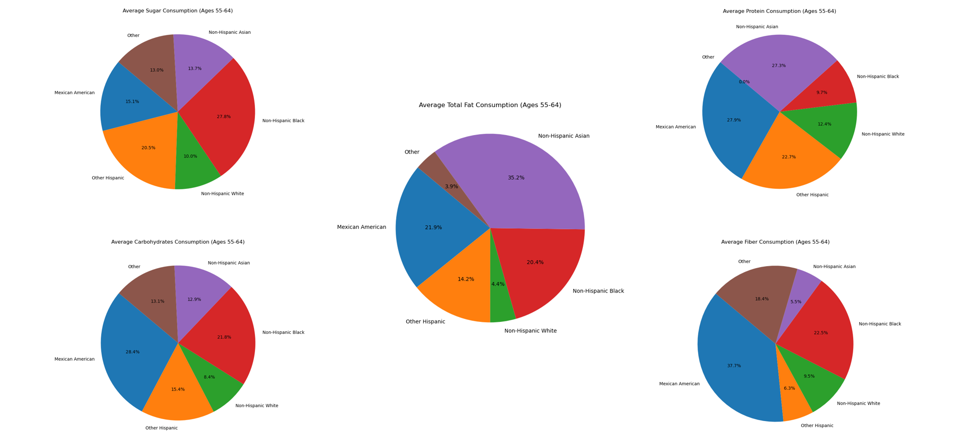
Supplement Intake: Age and Race

Slide 9
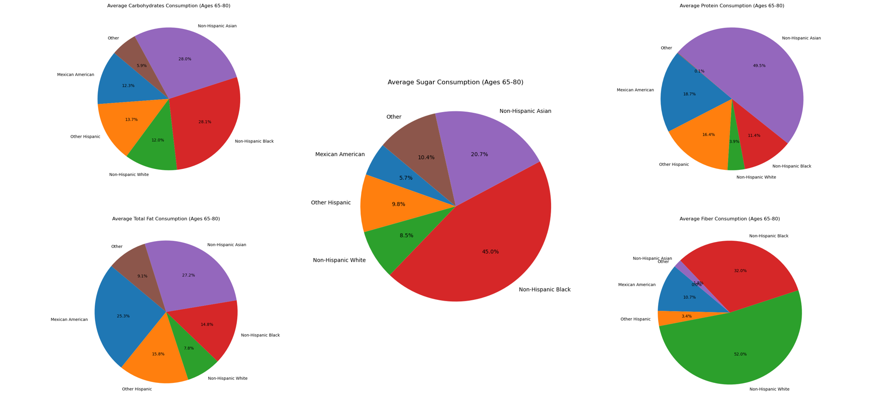
Supplement Intake: Age and Race

Slide 10
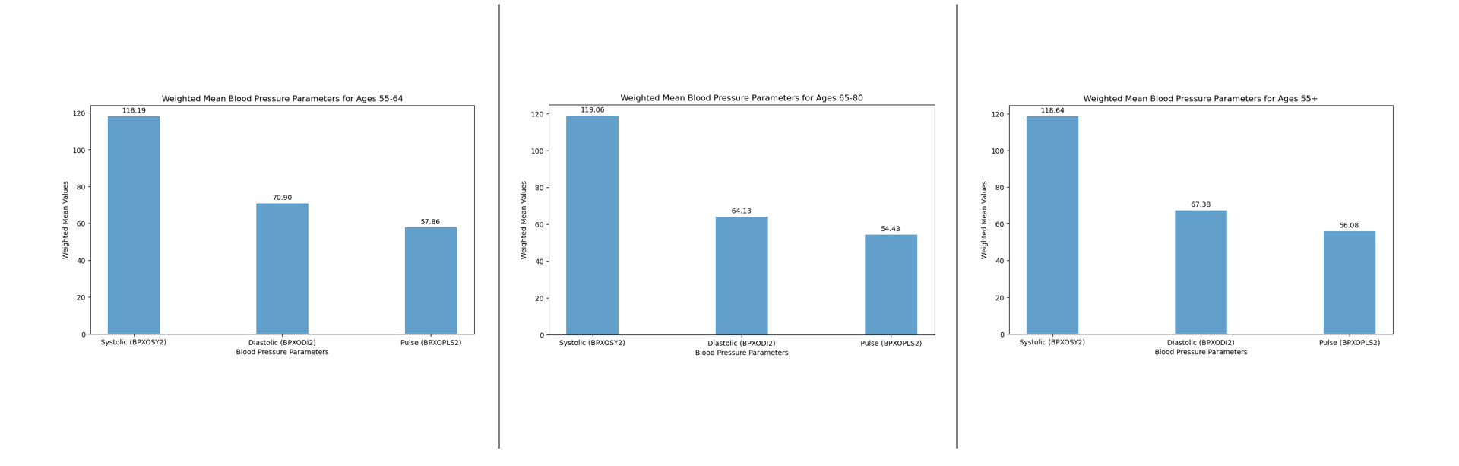
Blood Pressure Parameters: Age
Systolic and Diastolic blood pressure trends leveled off after age 55.

Slide 11
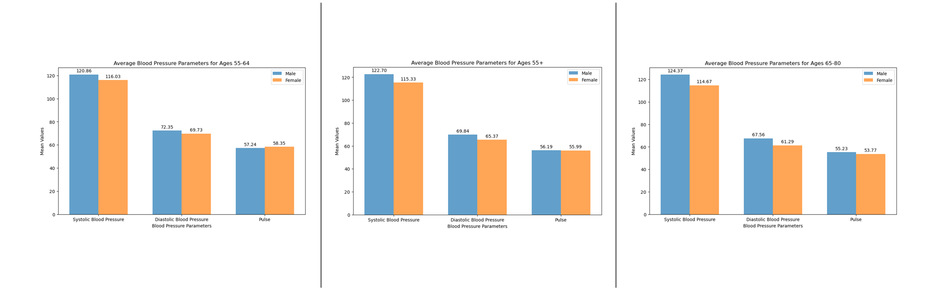
Blood Pressure Parameters: Age and Gender
While males had higher average blood pressure than females overall, the gender gap did not widen significantly across the older age brackets.

Slide 12
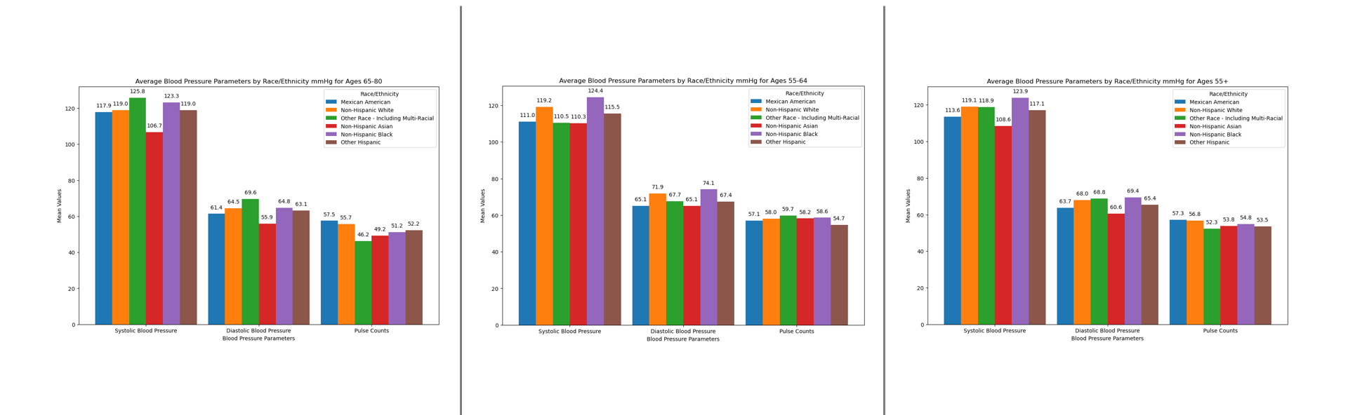
Blood Pressure Parameters: Age and Race
Highest blood pressure levels seen in non-Hispanic Blacks and lowest in non-Hispanic Asians.

Slide 13
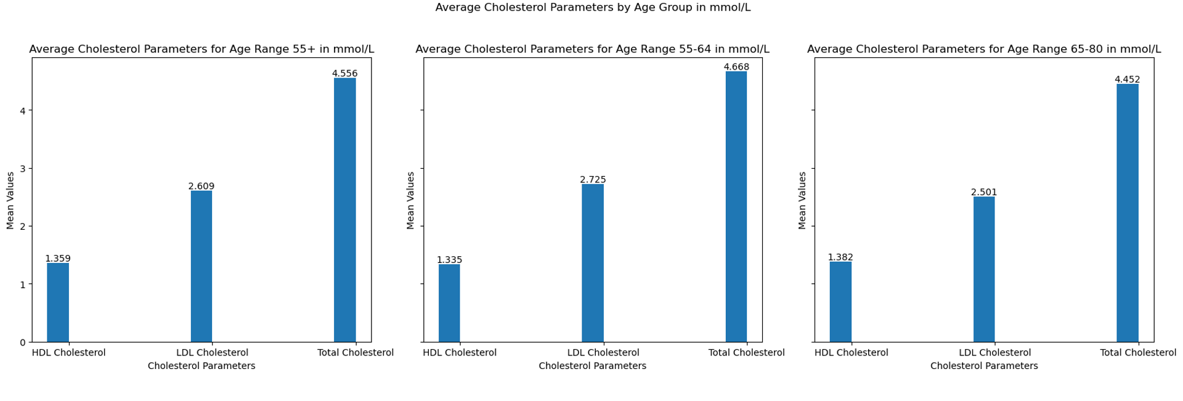
Cholesterol Parameters: Age
LDL levels peaked in the 55-64 age bracket before declining slightly in the older groups.

Slide 14
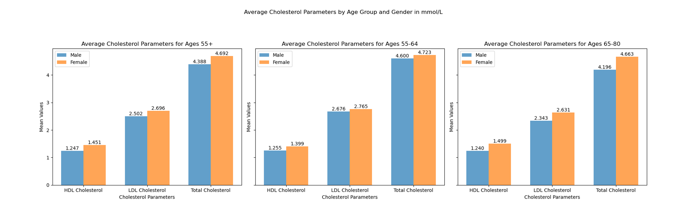
Cholesterol Parameters: Age and Gender
Average LDL cholesterol levels were higher for females compared to males across age groups. The peak in the 55-64 age range was also higher in women.

Slide 15
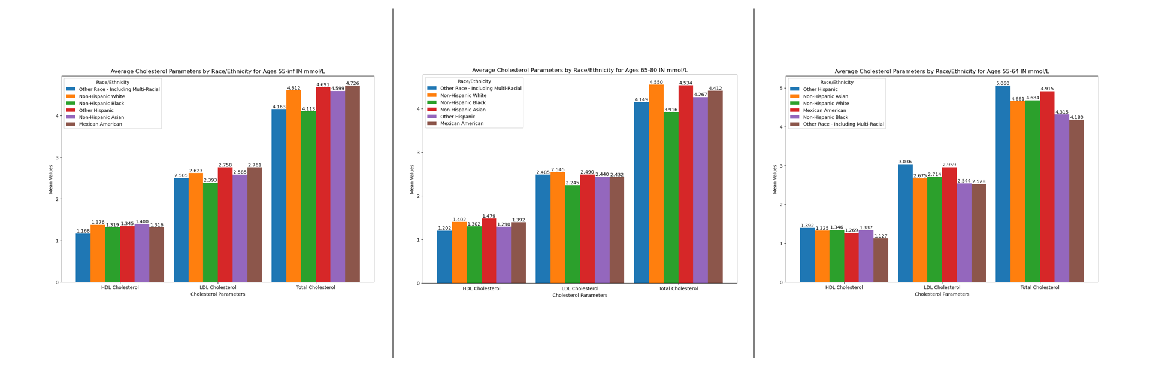
Cholesterol Parameters: Age and Race
The racial/ethnic groups with the highest average LDL cholesterol levels within age brackets were Other Hispanics, Mexican Americans, and Non-Hispanic Whites. Non-Hispanic Blacks lower mean LDL cholesterol overall, though levels still increased with age.

Slide 16
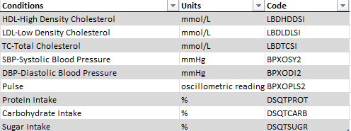
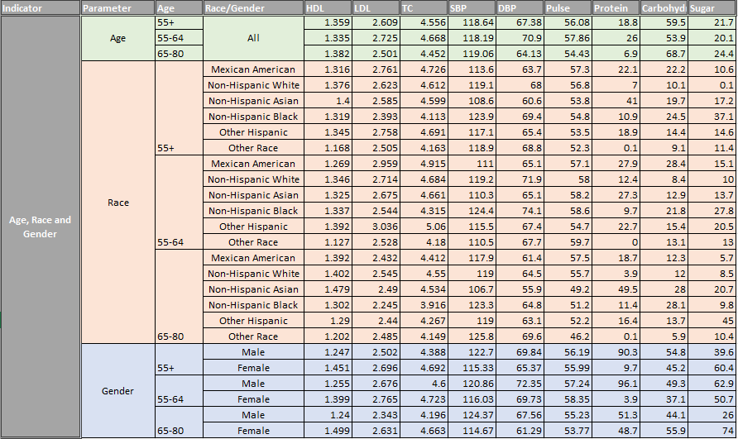
Results Table:

Slide 17
References:
https://wwwn.cdc.gov/nchs/nhanes/
https://matplotlib.org/stable/gallery/index.html

