Slide 1
Chapter 1: Business Intelligence and its Impacts

Slide 2
Outline
Examples of Business Intelligence (BI)
Data, Information, and Knowledge
What is BI
Factors that drive BI
BI and Related Technologies
BI in contemporary organizations
  Improvement in Operational Performance
  Improvement in Customer Service
  Identification of New Opportunities in Contemporary Organizations

Slide 3
Business Intelligence – A Highly Important Field
      Benefits
        Management effectively aided
        Intellectual capital better deployed
        Business operations improved
        Customer service enhanced
        New opportunities identified

Slide 4
Data, Information, Knowledge
Data
  May or may not be correct
  Ex. Sales order at a restaurant included a large burger, medium fries and milkshake
Information
  Subset of data
  Data possessing context, relevance, and purpose
  Ex. The numbers indicating the daily sales (in dollars, quantity, etc.) of burgers, fries, vanilla milkshakes
Knowledge
  Justified beliefs about relationships among concepts
  Ex. The relationship between the quantity of bread that should be ordered, the quantity of bread in inventory, and the daily sales of burgers and other products that use bread.

Slide 5
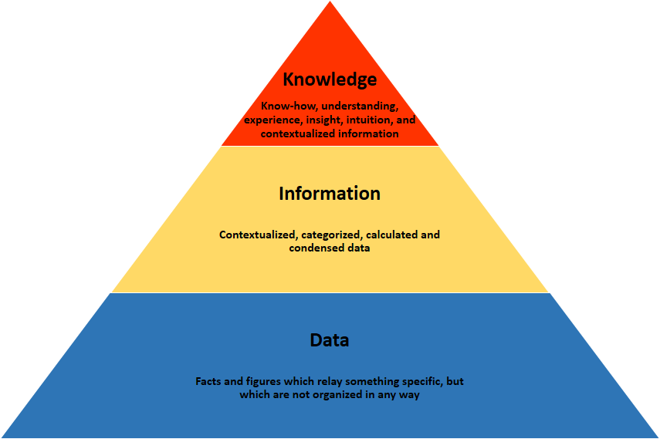
Information Pyramid

Slide 6
Data, Information, Knowledge, and Decisions
Raw facts, observations, or perceptions
Data that has been processed so as to have context, relevance, and purpose
Decisions
Data
Justified beliefs about relationships relevant to the decision
Information
Knowledge
Analyze
Interpret
Apply
© Sabherwal & Becerra-Fernandez

Slide 7
What is Business Intelligence (BI)?
Information technology which provides decision makers with valuable information and knowledge by leveraging a variety of data sources as well as structured and unstructured information.
  Data sources external or internal to the organization
  Information quantitative or qualitative
  Output: knowledge
  Input: information and data
Business intelligence tools: used in BI solutions
Business solutions: support the BI process

Slide 8
BI Product, Process, Solution, and Tools
BI Product
Data and Information (External & Internal; Structured & Unstructured)
BI Process
Information (that leads to knowledge and/or enables decision making)
BI Solution
Other Technologies (e.g., Data Warehouse, Data Mining)
BI Tools
© Sabherwal & Becerra-Fernandez

Slide 9
Factors that drive BI
Exploding data volumes
Increasingly complicated decisions
Need for quick reflexes
Technological Progress

Slide 10
Factors that drive BI
    Exploding data volumes
      Cheaper storage
      More electronic connections (Internet, intranet,…)
      Regulatory changes (Sarbanes Oxley Act 2002)
      BI solutions provide managers the ability to more effectively utilize these larger data volumes

Slide 11
Factors that drive BI
Increasingly complicated decisions
  Multi-industry, global competition
  Decisions from structured and unstructured data
  BI solutions provide managers the ability to make decisions that incorporate all the important factors and are based on integration across the information.

Slide 12
Factors that drive BI
Need for quick reflexes
  Faster pace of change (volatility)
  Windows of opportunity close rapidly
  Overcome processing delays
    Converting data from variety of sources
    Integrating information across sources
    Making the results available to the decision maker
    BI solutions help address each of the three types of delays.

Slide 13
Factors that drive BI
Technological Progress
  Decision Support Systems (DSS): Information system that supports business or organizational decision-making activities
  Enterprise Resource Planning Systems (ERPS):
  Data warehousing
  Data mining
  Text mining
BI vendors have the necessary inputs for developing effective BI tools, and organizations adopting them have the platform to make BI solutions most effective

Slide 14

ERPS

Slide 15
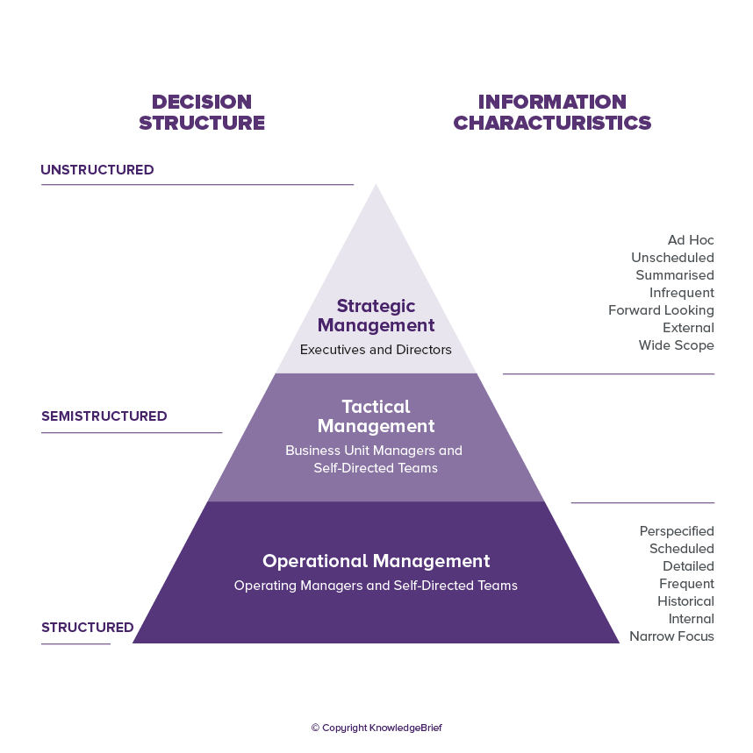
DSS

Slide 16
BI is not KM
Knowledge Management (KM)
Inputs
  Information
  Knowledge
Output
  Creation of new knowledge
  Conversion to another form of knowledge
  Application of knowledge in making a decision
Business Intelligence (BI)
Inputs
  Data
  Information
Output
  Information presented in a friendly fashion
  New knowledge or insight

Slide 17
Roles of Data, Information, and Knowledge in Business Intelligence
Business Intelligence
Only Explicit (but not Tacit) Knowledge
Decisions
Data
Information
Knowledge
© Sabherwal & Becerra-Fernandez

Slide 18
Roles of Data, Information, and Knowledge in Knowledge Management
Knowledge discovery in data and information; potential overlap between BI and KM
Knowledge Management
Both Explicit and Tacit Knowledge
Decisions
Data
Information
Knowledge
© Sabherwal & Becerra-Fernandez

Slide 19
BI is not data warehousing, data mining nor decision support systems
Data warehouse
  A single logical repository for an organizations data
Data mining
  The process of discovering hidden patterns from data stored electronically (ex. in a data warehouse)
Decision support systems
  Use data as input along with prior knowledge to create rules that guide decisions
Business Intelligence
  Presents information to individuals with little technical expertise

Slide 20
Roles of Data, Information, and Knowledge in Data Warehousing
Structured data, primarily internal
Data Warehousing
Data
Information
Knowledge
Decisions
© Sabherwal & Becerra-Fernandez

Slide 21
Roles of Data, Information, and Knowledge in Data Mining
Data Mining
Data
Information
Knowledge
Decisions
© Sabherwal & Becerra-Fernandez

Slide 22
Roles of Data, Information, and Knowledge in Decision Support Systems
Either support for decision making (DSS) or automation of decision making (Automated Decision Systems)
Decision Support System
Data
Information
Knowledge
Decisions
Knowledge embedded as rules within the system
© Sabherwal & Becerra-Fernandez

Slide 23
Four Contributions of BI
Dissemination of user-friendly, real-time information
Creation of new knowledge based on the past
Responsive and anticipative decisions
  Decision-making based more closely on all the latest information
  Incorporate predictions regarding the future
Improved planning for the future
  More effective use of information
  Use of past data for predictions about the future
  Development of knowledge based on information about the past

Slide 24
Three Benefits of BI to Organizational Success(Contemporary Organizations)
Improvement in operational performance
  Provide real-time information on how performing
  Help make organizations more efficient
Improvement in customer service
  Improve quality of customer service provided
  Identify problems and potential solutions quickly
  Reduce customer concerns and improve retention
Identification of new opportunities
  Facilitate new insights through discover of unknown patterns
  Track innovative projects more effectively

Slide 25
BI Significance
Companies need to have accurate, up-to-date information on customer preferences , So that company can quickly adapt to their changing demands
BI applications can also help managers to be better informed about actions that a company’s competitors are taking
It help analysts and managers to determine which adjustments are mostly likely to respond to changing trends
IT can help companies develop a more consistent,data-based decision, which can produce better results than making business decisions by “guesswork”

Slide 26
Modules
Dashboards
Key Performance Indicators
Graphical OLAP
Forecasting
Graphical Reporting

Slide 27
Dashboards
BI dashboards can provide a customized snapshot of daily operations, and assist the user in identifying problems and the source of those problems, as well as providing valuable, up-to-date information about financial results, sales and other critical information – all in one place

Slide 28
Key Performance Indicators
BI provides simplified KPI management and tracking with powerful features, formulae and expressions, and flexible frequency, and threshold levels.
This module enables clear, concise and tracking of performance as compared to a previous period.
Intuitive, color highlighters can efficiently present information to management and team members.
Users can further analyze performance with easy-to-use features like drill down, drill through, slice and dice and graphical data mining (OLAP Techniques)

Slide 29
Graphical OLAP
Graphical Business Intelligence (BI) OLAP technology makes it easy for your users to find, filter and analyse data, going beyond numbers, and allowing users to visualize the information with eye-catching, stunning displays, and valuable indicators and gauges, charts, and a variety of graph types from which to choose

Slide 30
Forecasting and Predictive Analysis
Our predictive analysis uses historical product, sales, pricing, financial, budget and other data, and forecasts the measures with numerous time series options, e.g., year, quarter, month, week, day, hour or even second to improve your planning process

Slide 31
Reports
BI Reports delivers web-based BI reports to anyone (or everyone) in the organization within minutes!
The BI suite is simple to use, practical to implement and affordable for every organization.
With this BI reporting and performance reporting module, you just point-and-click and drag-and-drop and it can instantly create a report to summarize your performance metrics, or operational data

Slide 32
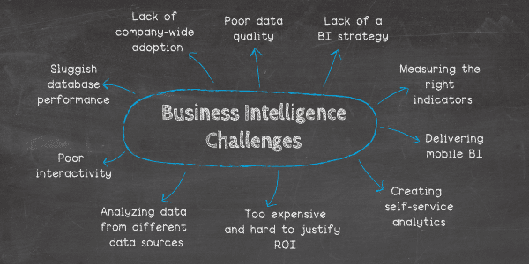
Obstacles/Challenges to BI

Slide 33
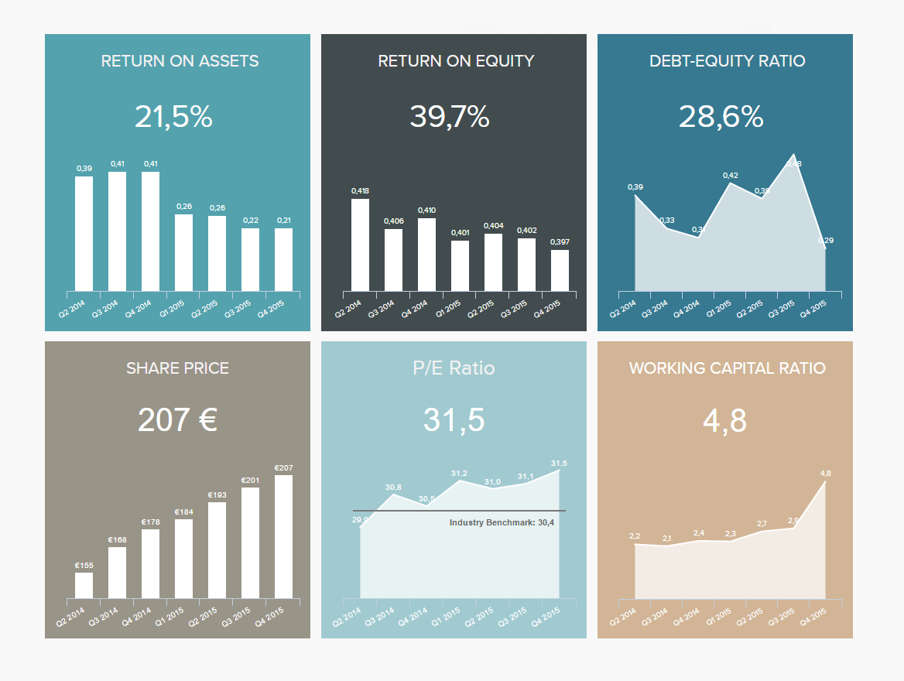
Too expensive and hard to justify the ROI of BI
Budgets and resources are tight everywhere but especially for small businesses
The price of deploying BI is a primary concern among small and medium-sized enterprises (SMEs).
SMEs are discouraged by the prohibitive costs of acquiring the right software
Limited resources make looking for qualified professionals such as data science experts, IT infrastructure professionals and consulting analysts impractical and worrisome
The main concern is with infrastructure investments needed to deploy BI software

Slide 34
Lack of company-wide adoption
Clear objectives and predetermined Key Performance Indicators will help guide a successful BI adoption.
Always choose only the best fit for your department or industry.
The right BI software can deliver insightful and actionable information without needing a data scientist to collect, prepare and analyze complex data and process it into reports management can understand.
Empowering staff across a small business with dashboards they can immediately use encourages adoption and ensures BI success.
Its always better to choose cloud-based enterprise-wide BI tool

Slide 35

Analyzing data from different data sources
Reporting/analyzing across data sources was their biggest challenge
The problem is data is often spread across a variety of different systems and software. With data spread across multiple systems, getting the information you need can be an arduous task.
BI tools can easily merge different data sets on the fly without the need of restructuring databases or setting up a data warehouse.

Slide 36
Businesses aren’t measuring the right indicators
It is important that a wide range of appropriate Key Performance Indicators(KPIs) are used to measure progress and performance.
An online KPI dashboard software enables entrepreneurs to visualize and share their numbers according to their own individual needs.

Slide 37
Delivering mobile-based BI is no easy feat
We live in a mobile age, with more mobile devices than human
So there is a demand for mobile based BI solutions
While developing mobile-optimized BI solutions can prove a developmental challenge, it’s possible to log in and pull invaluable insights from mobile devices wherever you are in the world without losing any key features or functionality.

Slide 38
Providing true self-service analytics
Advancements in interactive BI dashboard tools mean that anyone can access critical insights on a multitude of mobile devices.
Today’s best solutions are intuitive, visual, and easy to master, which means that no need to rely on anyone else within the organization

Slide 39
Dealing with the impact of poor data quality
Data Quality Management promotes quality control throughout the organization
Lacking a clearly defined BI strategy
Without a clearly defined data-driven strategy, it is still shooting in the dark
Working with powerful BI dashboards that promote interactive data visualization, it develops a strategic roadmap to help in data direction, fluidity, and add value throughout the organization

Slide 40
Poor BI functionality & interactivity
Many businesses face this issue as people need to collect and analyze data from a number of sources, often from platforms or programs that are incredibly manual and lack interactivity.
This leads to inaccuracies, inefficiencies, and costly mistakes that can potentially stunt the growth of the business.
Working with interactive BI dashboards, intuitive, interactive visual data that will helps in achieving the results.

Slide 41
Sluggish query and database performance
One of the most widely-reported BI challenges to date, slow database performance leads to internal challenges, including business intelligence security issues
poor query performance or sluggish database responses will cost more
To overcome this challenge, it’s important to not only quality-control of data and prepare it thoroughly for analysis and centralize your most valuable insights

Slide 42
Impacts of Business Intelligence
Dissemination of real-time information in user-friendly format to a variety of users
Enablement of responsive and anticipative
decisions
Improved operational
performance
Business Intelligence
Improved
customer service
Facilitation of new knowledge based on the new insights in information
Improved planning for the future
Identification of
new opportunities
© Sabherwal & Becerra-Fernandez

Slide 43
Recap
We have:
Discussed some of the basics of BI
Distinguished among data, information, and knowledge
Explained what BI is and how it differs from other information technologies
Discussed the factors driving the importance of BI
Examined some direct effects of BI and looked at its impacts on organizational performance

Slide 44
Key Terms
business intelligence
data
data mining
data warehouse
decision support systems
information
knowledge
knowledge management
organizational impacts
© Sabherwal & Becerra-Fernandez

