Slide 1

Data Science Case Study
Shivani Gupta

Slide 2
Problem Statement
A leading telecommunications company, is facing a significant challenge with customer churn. The company has been experiencing a high rate of customer attrition, leading to revenue loss and a decline in market share. To address this issue, it wants to implement a machine learning solution for predicting customer churn.

Slide 3
Data Understanding & Feature Engineering
Data set provided has the following definition:
1. Age: ranges between 18 & 79
2. Gender: Either 0 or 1
3. Income: Has a multi modal distribution
4. Account length
5. Contract Type: Either 0 or 1 or 2
6. Call duration: described later in descriptive statistics
7 . Data Usage: described later in descriptive statistics
8. Churn- Either 0 (Non- Churn cases) or 1 (for Churn cases)
The dataset has no identifier for customer. For that , a new feature is created by combining Age, Gender, Income & account length and a key is formed which acts as a customer identifier. There are 1000 keys in the dataset

Slide 4
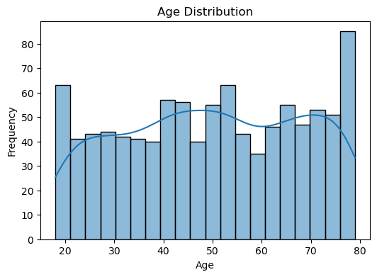
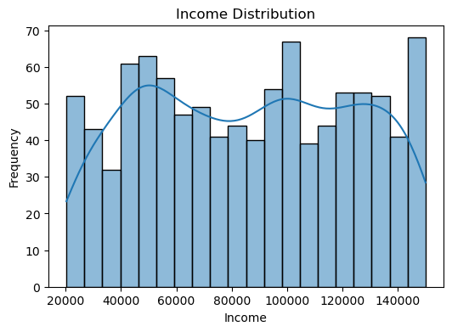
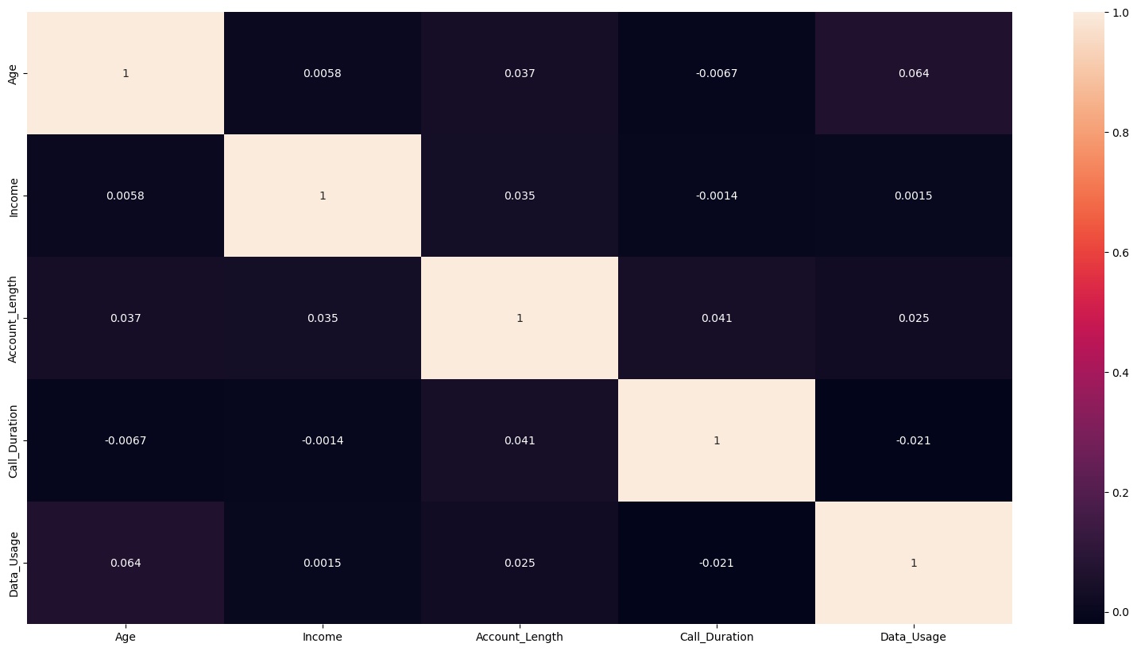
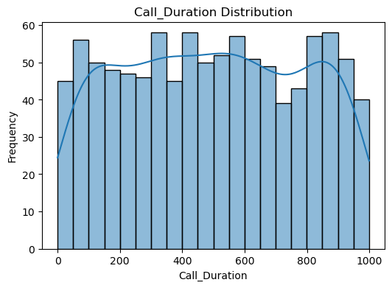
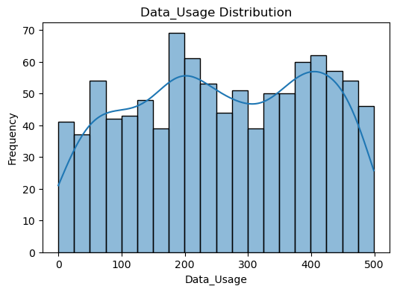
EDA: Univariate and Bivariate analysis(1/2)
No correlation seen
Age, income, call duration, data usage have multi modal kind of distribution

Slide 5
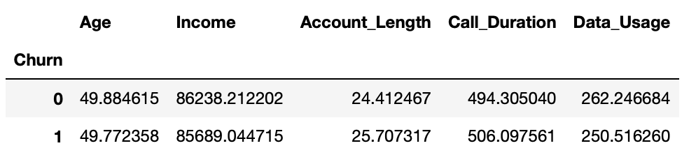
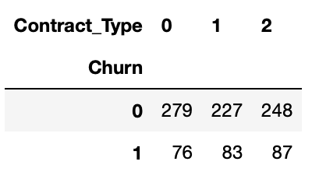
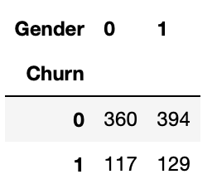
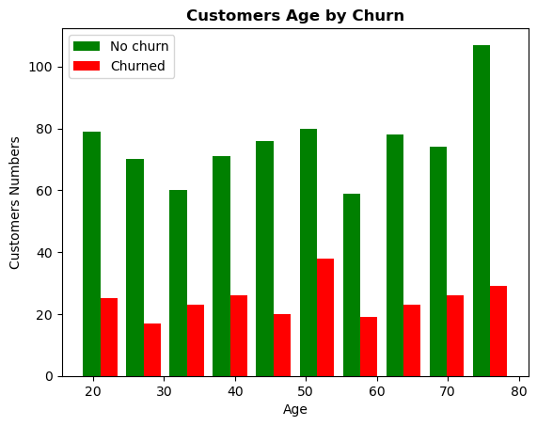
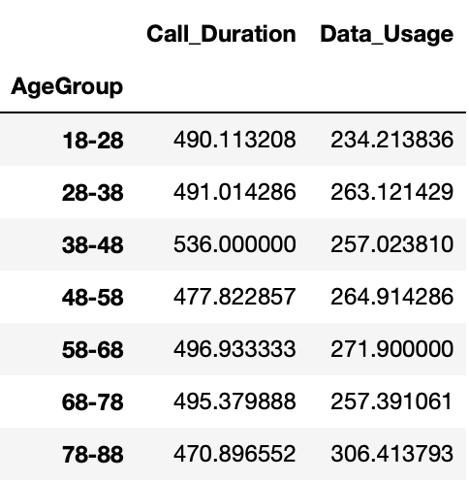
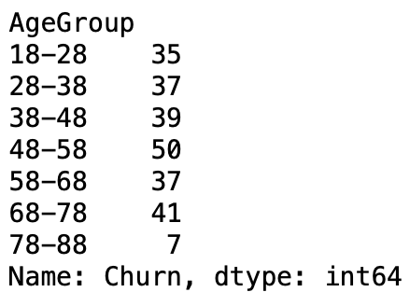
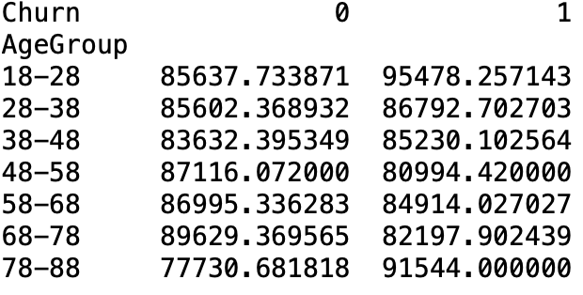
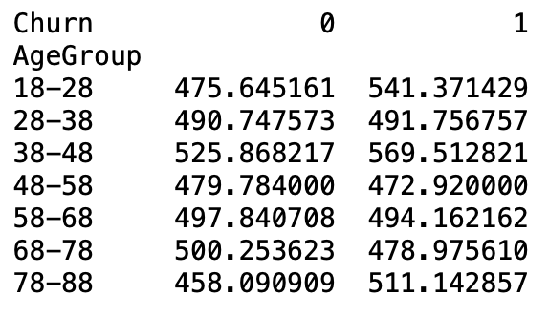
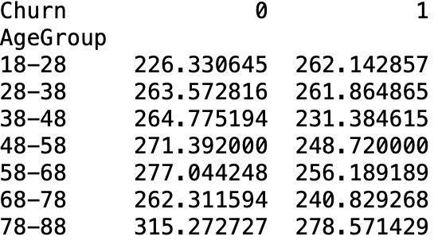
EDA: Further exploration(2/2)
Mean difference between variables for churn and non-churn customers
Contract Type wise Churn
Gender Wise Churn
Churned customers have lesser income, mean call duration and
mean data usage. However, relative to No churn cases, difference is not significant
Contract Type 0 has the minimum Churn
Contract type 2 has max
Gender 0 has less churn as compared to Gender 1
Age group Wise Churn
Age group Wise Churn
Age group Wise Churn
The age group with maximum churn is 48-58 with a churn rate of 50
Age group 38-48 has max mean call duration.
78-88 has max mean data usage duration
Nothing significant in Age wise Churn. Numbers are
consistent throughout age groups
Age group Wise mean income
Age group Wise mean call duration
Age group Wise mean data usage
The mean income of Age groups in the range 78-88 and 18-28
is the highest. They tend to churn more
Nothing significant in Data usage and call duration for churn vs not-churn cases

Slide 6
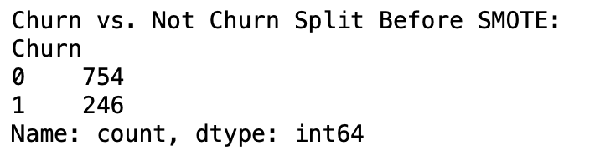
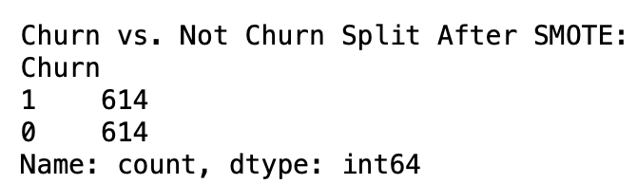
Data imbalance , SMOTE and pre-processing
Data is imbalanced which means Churn vs Non-Churn cases are not equal
After applying SMOTE
Pre-processing- In data preprocessing, scaling has been done using Standard scaler as the range of all numeric variables are different in the dataset and scaling helps to bring them on a common scale

Slide 7
Candidate algorithms, Grid-search, cross-validating and testing
Algorithms evaluated are – Random Forest, Logistic Regression, SVC, KNN, Decision Tree, Naïve Bayes
Cross validation has been performed on training set and results have been generated. It provides an estimate of the model's performance across different subsets of the training data, giving insights into its stability and generalization ability. It may not represent performance on test data. It gives an estimate of how model with perform when deployed.
Testing on test set has also been performed. It provides a a final assessment of the model's performance on completely unseen data, which is crucial for evaluating its effectiveness. However, it relies on a single test dataset, which may not fully capture the variability of real-world data. Limited test data may also impose problems

Slide 8
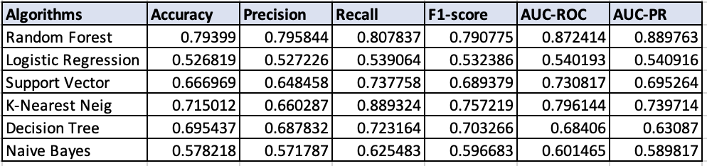
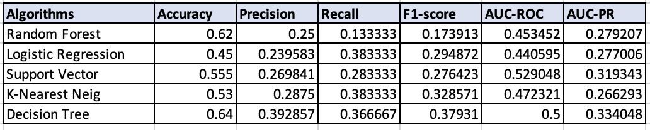
Results and model performance
Using cross validation
Using test set
Random Forest has the best performance. However, performance on test data can be improved by incorporating more training data during model and having sufficient testing data for testing. Regularization, more features, less complexity can be implemented

Slide 9
Thank You

