Slide 1
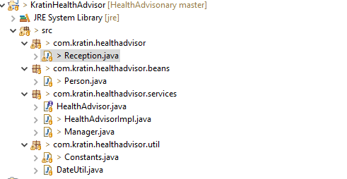
Project Structure

Slide 2
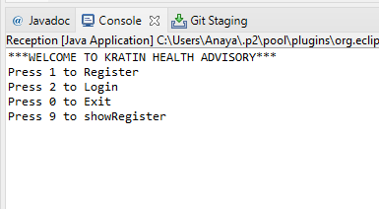
Project in Execution
Main Menu

Slide 3
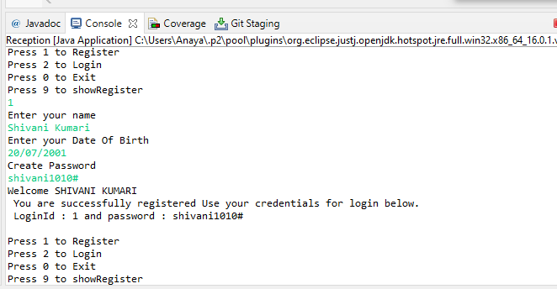
Register Menu (Option 1 of main menu - screenshot)

Slide 4
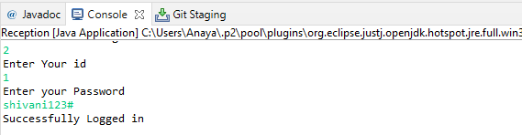
Login Menu (Option 2 of main menu - screenshot)

Slide 5
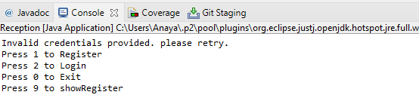
For invalid option selection below error message will appear:

Slide 6
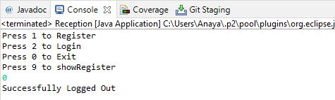
Exit Process (Option 0 of main menu - screenshot)

Slide 7
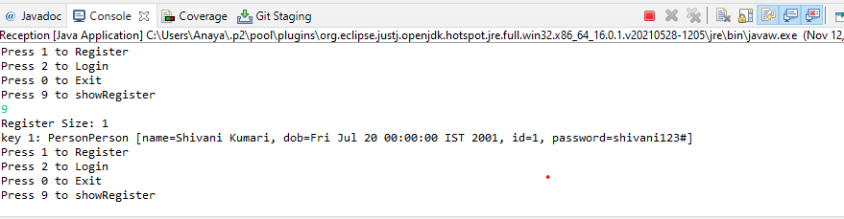
Show Register, currently enabled for all users (Option 9 of main menu - screenshot)

Slide 8
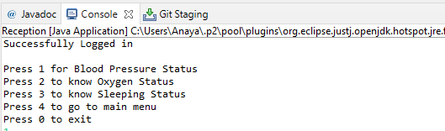
USER MENU-
Now Let’s see after – Successful Login Process

Slide 9
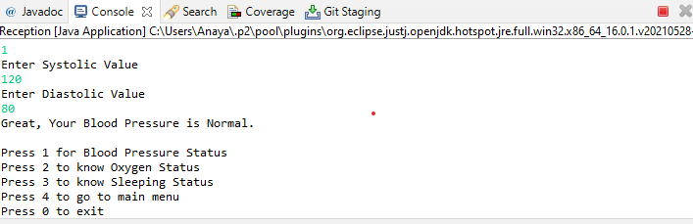
To know Blood Pressure Status
Press- 1

Slide 10
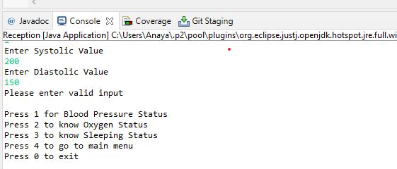
For invalid input to know Blood Pressure status below message will appear:
NOTE
1.Because Systolic value is not more than 190 and not less than 70.
2.Diastolic value is not more than 100 and not less than 50.

Slide 11
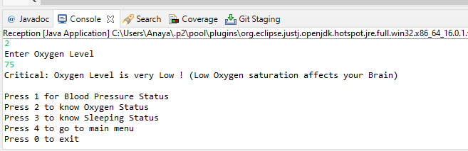
To know Oxygen Status
Press- 2

Slide 12
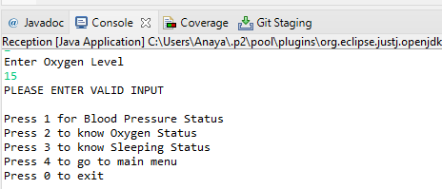
If you have entered invalid data to know Oxygen level status so following message will be show-

Slide 13
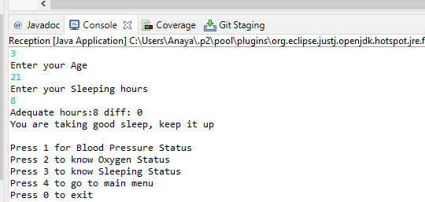
To know Sleeping status
Press-3

Slide 14
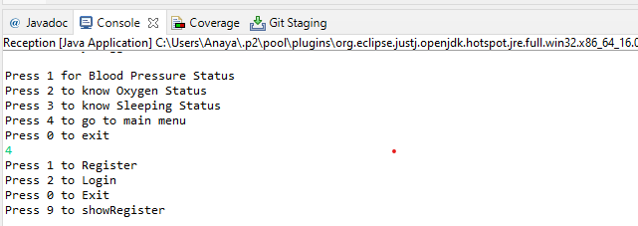
Go to main menu
Press-4

Slide 15
To exit
Press-0

