Slide 1

Project Title: Home Smart Locker System Submitted by: Shivani UID: 21BCS6285

Slide 2
Problem Statement
Traditional lockers are manual and lack security.
Home appliances are becoming smarter, but locker systems are outdated.
Need: A secure, user-friendly locker system that fits modern homes.
Goal: Build an interactive smart locker with authentication, reservation, and user control.

Slide 3
Objectives
Design a smart locker system tailored to home users.
Implement multi-user authentication with role-based access.
Create a responsive, interactive, and secure front-end.
Apply heuristic evaluation principles for good UX/UI design.
Add features like reservation, auto-logout, and activity history.

Slide 4
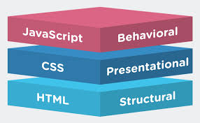
Technologies Used
HTML5 — for structure
CSS3 — for styling and responsiveness
JavaScript (Vanilla) — for interactivity and logic
GitHub — for version control and publishing
Visual Studio Code — for development

Slide 5

System Architecture
Login Authentication
Users validate with Username/Password
Role-based Dashboard
Admin: Control all lockers
User: Control assigned locker
Locker Interaction
Open / Lock / Reserve
Security Features
Auto-logout after inactivity
Password change option

Slide 6
Key Features
🛡️ Multi-User Login System
🔒 Locker Access Control (Admin/User)
⏰ Locker Reservation Timer (auto expire)
📋 Locker Activity Tracking (History Logs)
🔥 Auto-Logout after 5 min Inactivity
👁️ Show/Hide Password Option
🔔 Real-Time Notifications

Slide 7
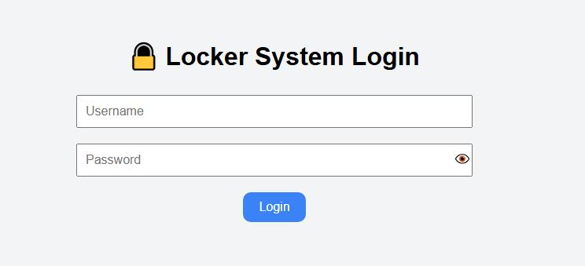
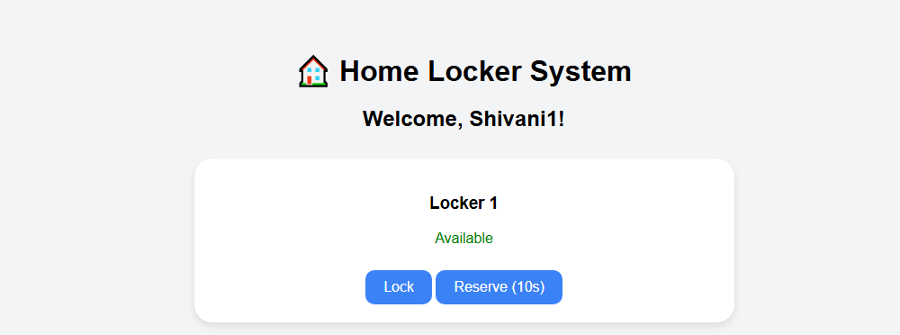
User Interface

Slide 8
Challenges Faced
Designing a simple yet powerful role-based access
system.
Managing session timeout (Auto logout after
inactivity).
Ensuring good heuristic design (feedback, visibility,
control).
Making the locker dashboard dynamic and scalable.

Slide 9
Future Enhancements
Connect with IoT hardware (like real locker doors
via sensors).
Biometric Authentication (fingerprint, face
unlock).
Email/SMS alerts on locker activity.
Admin dashboard with analytics (locker usage
reports).

Slide 10
Conclusion
Successfully built a smart, interactive, secure home
locker system.
Project meets goals of usability, security, and good
UI design.
Ready for real-world application with further IoT
integration.
Learned important skills in web development,
security, and UX/UI.

