Slide 1
Calculator
Simple Calculator program in Python using Tkinter for the graphical user interface(GUI)

Slide 2
Explanation:
GUI Components:
tk.Entry(): input field where the expressions and results are displayed.
tk.Button(): Buttons for digits, operations and functions like clearing(clear), decimal point(.) and calculating result(=).
2. Functions:
button_click(item): Adds the clicked button value (number or operator) to the input field.
Button_clear():Clears the current input.
Button_equal(): Evaluates the mathematical expression entered and displays the result. If there’s an error(e.g., invalid input), it shows “Error”.
Click the buttons to input numbers and operations and use the equals button(=) to calculate the result.

Slide 3
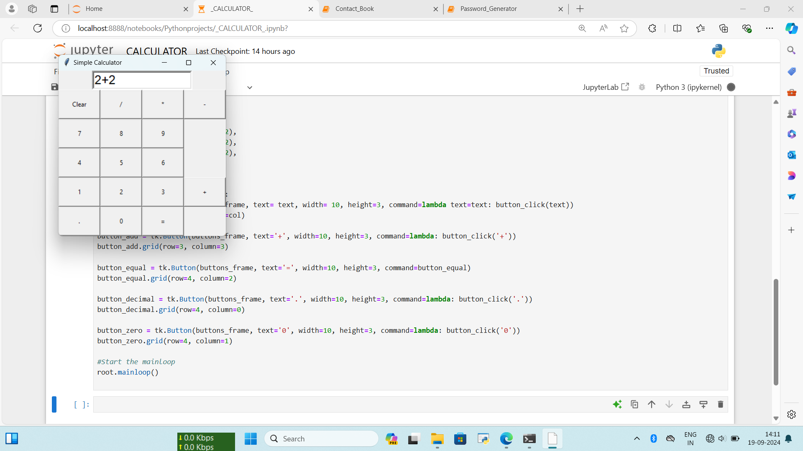
Output:

Slide 4

Example:

