Slide 1

Mini Project Second Review Presentation On Real-Time Vision Detection
SIDDAGANGA INSTITUTE OF TECHNOLOGY, TUMKUR
Department of Computer Science and Engineering
Under the guidance of
Mrs. Sheela S
Assistant Professor
Dept. of CSE, SIT, Tumkur
By:
Nayana Chandrashekhara Hegde – 1SI22CI033
Prathusha – 1SI22CI040
Shivani Yargol – 1SI22CI050

Slide 2
TABLE OF CONTENTS​
Problem statement​
Introduction ​
Literature Survey​​
Proposed system​
Requirements​
Applications​
Conclusion​
References​

Slide 3
PROBLEM STATEMENT:
The problem statement is developing a system capable of detecting objects in real-time from various input sources, including webcams, videos and images.
​
OBJECTIVES:
To develop a lightweight and efficient object detection system using OpenCV and a pre-trained MobileNet SSD model.
To implement object localization and classification algorithms to accurately detect and classify objects within an image or video feed.
To optimize the system for speed and accuracy to ensure practical performance in real-world applications.
To implement an interactive system allowing users to choose input sources for object detection.

Slide 4
INTRODUCTION
Object detection is a computer vision technique used to identify and classify objects in images or videos.
It involves two key tasks:
i) Localization (drawing bounding boxes).
ii) Classification (categorizing objects).
Our project implements object detection using the MobileNet SSD model with OpenCV and Python.
Testing has been conducted on various images and videos to validate the model's performance.
While MobileNet SSD is designed for efficiency, achieving real-time detection on extremely low-resource devices remains a challenge. Our project demonstrates the practical capabilities of this model for various input sources.

Slide 5
LITERATURE SURVEY INSIGHTS
A review of research on object detection based on deep learning​(2020) – Demonstrated the efficiency of MobileNet SSD for real-time object detection, reinforcing our model choice.
Object detection with a webcam using python(2021) – Implemented webcam-based detection using Python, highlighting OpenCV’s suitability for real-time processing.
Detection of Real Time Objects Using TensorFlow and OpenCV (2019) – Used TensorFlow & OpenCV for object detection, helping us understand feature extraction and bounding box predictions.
Efficient Python-Based Motion Detection System Using OpenCV for Enhanced Security(2019) – Compared YOLO and other models, assisting in evaluating alternative detection methods.

Slide 6
Visual Object Detection and Tracking using YOLO and SORT​(2020) – Focused on object detection for visually impaired assistance, showcasing practical real-world applications.
Real-time object detection and face recognition system to assist the visually impaired​ (2021) – Explored motion detection with OpenCV, strengthening our approach to video frame processing.
Research on Object Detection and Recognition Based on Deep Learning in Unmanned Supermarkets​ (2021) – Researched computer vision-based object classification, helping us refine our model’s labeling accuracy.
Object Detection and Recognition and ​Age-Gender Prediction using YOLO and ​OpenCV ​(2022) – Implemented YOLO & OpenCV for multi-task detection (e.g., age-gender prediction), expanding our understanding of detection possibilities.

Slide 7
PROPOSED SYSTEM
INPUT
The system captures a live video stream as input from a webcam or another video source.
Each frame of the video is treated as an individual image for processing.
PROCESSED INPUT
The captured video frames are resized to 300*300 pixels to match the input size required by the MobileNet SSD model.​
Normalization: The pixel values are then normalized to a range of [-1, 1] by scaling them using a factor of 1/127.5, ensuring consistency for the model’s processing.

Slide 8
PROPOSED SYSTEM (CONTINUED)
OBJECT DETECTION (MOBILENET SSD):​
Feature Extraction : The MobileNet architecture extracts key features from the preprocessed image, such as edges, textures, and patterns.​
Bounding Box Prediction : The SSD (Single Shot Multibox Detector) component predicts bounding boxes for objects within the image.​
​
Class Label Prediction : The model assigns a class label (e.g., person, car, etc.) to each detected object with a confidence score indicating the likelihood of the object being in that class.​

Slide 9
PROPOSED SYSTEM(CONTINUED)
POST-PROCESSING:​
Confidence Thresholding : Detections with confidence scores below a specified threshold (e.g., 0.2) are filtered out to reduce false positives.​
Non-Maximum Suppression (Optional) : helps reduce duplicate detections by keeping only the most relevant bounding box for each object. It eliminates overlapping boxes based on confidence scores, ensuring cleaner and more accurate detection results. ​
OUTPUT:​
The system overlays bounding boxes and class labels on the detected objects in real-time, displaying them on the video stream.​
Real-time performance ensures smooth tracking of moving objects in the live video feed.​

Slide 10
FLOWCHART
Webcam/videos
/images
Preprocessing, Resize And Normalize
Input
Feature Extraction MobilenetSSD
Post processing filter detections
Output : Bounding boxes and labels displayed on live video feed
Img2 : Visual representation of the object detection model's workflow​

Slide 11
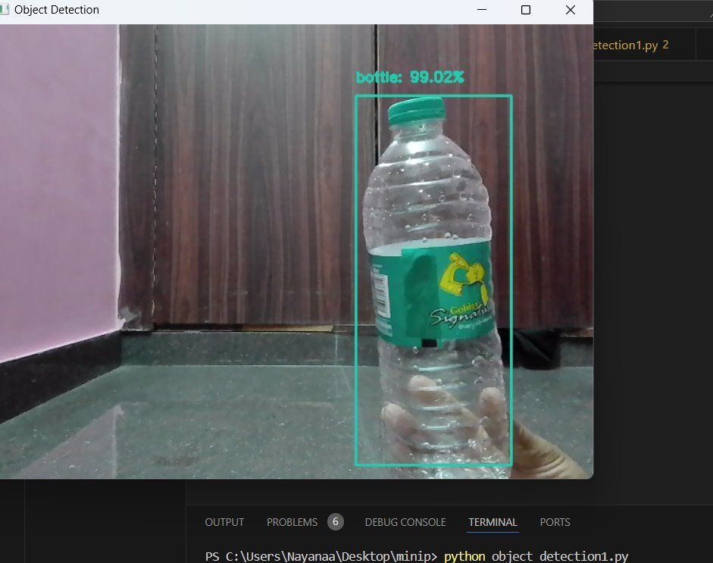
DEMONSTRATION
The detection runs in real-time, ensuring smooth tracking of moving objects.
The confidence score (99%) indicates the model's certainty about the classification.

Slide 12
REQUIREMENTS
Software:​
OpenCV: Used for image processing and real-time video capture.
MobileNet SSD: A pre-trained model utilized for object detection.
Python: Programming language used for the implementing the system.
​
Hardware:​
Webcam: Captures the real-time video feed for object detection.​

Slide 13
APPLICATIONS
Real-time Video Surveillance: Using a webcam, the system can detect people, vehicles, and other objects in real-time, making it suitable for security monitoring or alert systems.​
​
Basic Image and Video Analysis:The system can be used for analyzing static images and video feeds to detect and label objects, providing insights for educational or research purposes.
Industrial Automation: The system can be applied in manufacturing or warehouses to detect objects on conveyor belts, aiding in item recognition or tracking process.
Smart Inventory Management: The system can be used to detect and classify objects for inventory tracking in small scale setups, improving organization and efficiency.

Slide 14
CONCLUSION
MobileNet SSD is a highly efficient model for real-time object detection, effectively balancing speed and accuracy. It’s lightweight architecture makes it ideal for applications like surveillance and automation.​
Project Achievement:We have implemented a real-time object detection system using MobileNet SSD. The system efficiently detects and labels objects (e.g., persons, cars) from multiple input sources, including webcam feeds, video files, and static images. It operates with minimal computational resources, making it suitable for live surveillance, video analysis, and basic automation scenarios.
Current Progress:​The system can detect and label objects in real-time using a webcam feed. This capability highlights its potential for real-world applications, including basic security surveillance and video-based object analysis.

Slide 15
REFERENCES
[1] J Deng, X Xuan, W Wang, Z Li, H Yao, Z Wang, A review of research on object detection based on deep learning, pages- 8,Journal of Physics: Conference Series, 2020​
​
[2] Ali Basrah Pulungan1*, Zhfranul Nafis2, Muhammad Anwar3, Hastuti4, Hamdani5, Dwiprima Elvanny Myori , Object Detection With a Webcam Using The Python Programming Language,pages-9,Journal of Applied Engineering and Technological Science​
​
[3] A Talele , A Patil, B Barse, Detection of real time objects using Tenser Flow and OpenCV, pages-4,Asian Journal For Convergence In Technology (AJCT) ISSN-2350-1146, 2019​
​
[4] A Bathija, G Sharma, Visual object detection and tracking using yolo and sort pages-4,International Journal of Engineering Research Technology, 2019​
​
[5] A Aralikatti, J Appalla , S Kushal, GS Naveen ,S Lokesh, BS Jayasri, Real time object detection and face recognition system to assist the visually impaired pages-13,Journal of Physics: Conference Series, Volume 1706, First International Conference on Advances in Physical Sciences and Materials 13-14 August 2020, Coimbatore, India​
​

Slide 16
REFERENCES(CONTINUED)
[6] S Praveen A motion detection System in python and OpenCV, J Shah 2021 Third International Communication Technologies and Virtual Mobile Networks(ICICV)​
​
[7] H Liu, Y Li, D Liu, Object detection and recognition system based on computer vision analysis, Journal of Physics : Conference Series,2021​
​
[8] M Moulavi , A Barge , R Vishwakarma , B Dhengle , A Nadaph , Object Detection and Recognition and Age-Gender Prediction using YOLO and OpenCV ,pages-6, 2022•researchgate.net​
​

Slide 17
Thank You

