Slide 1
FANG: Leveraging Social Context for Fake News Detection using Graph Representation
Professor: Members:
Sanasam Ranbir Singh Shivank Thapa
TEAM: SHAP Himanshu Bisht
Mentor: Anurag Yadav
Mahima Malik Prabhat Singh

Slide 2
Introduction
Social media an important source of information with no credibility.
Many sites detect fake news but require manual fact checking as they work on textual evidence based approach and therefore not scalable.
To automate the process of fake news detection, contextual based approach seems a good approach.
In contextual based approach the engagement pattern of user is analyzed when he faces real news vs when he faces fake news.
News Title | Time | No. of Post | Support | Deny | Comment | Report
Virginia Republican school wants to check children’s genitals before using bathroom (FAKE NEWS) | 0 – 3 hrs | 38 | 0.0 | 0.03 | 0.19 | 0.78
 | 3- 6 hrs | 21 | 0.0 | 0.10 | 0.10 | 0.80
 | 6h+ | 31 | 0.0 | 0.10 | 0.14 | 0.76
1,100,000 people killed by guns in USA since Lennon was shot in Dec 8, 1980 (REAL NEWS) | 0 – 3h | 9 | 0.56 | 0.0 | 0.0 | 0.44
 | 3h+ | 36 | 0.50 | 0.0 | 0.11 | 0.39

Slide 3
GOAL
Till now the work in contextual based approach did not put emphasis on quality of representation, modeling of entities and their interaction.
The social context of news circulation can be represented as a heterogeneous network.
A graph representation that models all major social actors and their interaction
Built an inductive graph learning framework.
To demonstrate that the model is robust in case of limited training data.
Report significant improvement in fake news detection compared to other models.

Slide 4
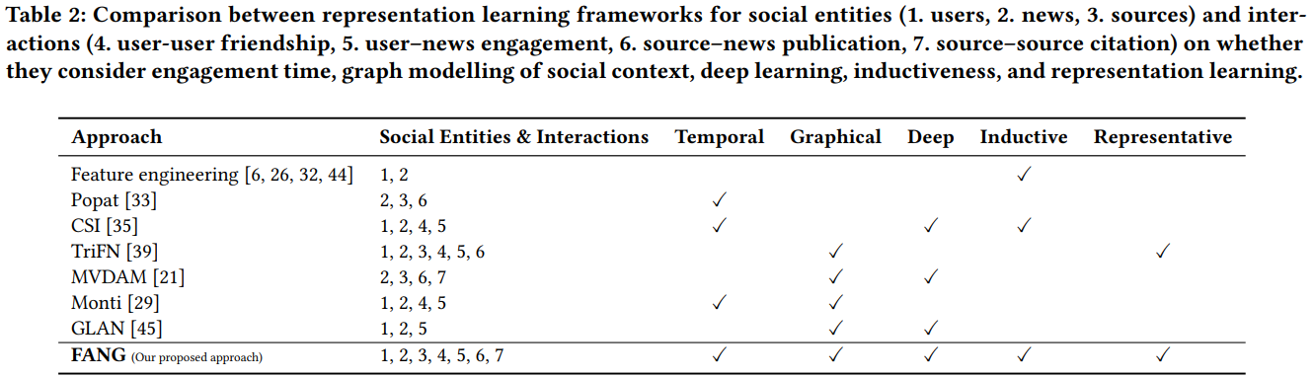
Why we are considering context of an article over content of article?
Content or textual evidence based approach requires human efforts and is even more difficult in claims in image or video.
Context based approach rather than focusing on content focuses on how user react and respond to fake articles compared to real news.
Also considering the context we can make use of echo chamber concept

Slide 5
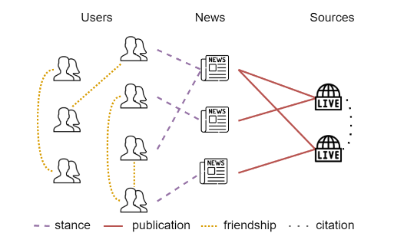
Methodology
We will define the notation used, define the problem of fake news detection formally and process of construction of social context graph - FANG.
Let 'G' be our social context graph, its entites and interactions can be defined as:
A : a list of questionable news articles, each modeled as a feature vector x_{a}.
S : a list of news sources, where each source has published at least one article in A, modeled as feature vector x_{s}.
U : list of users engages in spreading an article in A or connected to another user, modeled as feature vector x_{u}.
E : list of interactions, each interaction modeled as a relation between two entities at time t defined by label x_{e}.
Social context graph

Slide 6
Graph construction
News articles: We construct a TF.IDF vector from text body of article and enrich the representation by weighting pre-trained embeddings from GloVe of each word with its TF.IDF value, forming semantic vector. Finally, concatenate the TF.IDF and semantic vector to get feature vector x_{a}.
News Sources: We concatenate the TF.IDF vector from textual content of the news websites and semantic vector from words in Homepage and About Us section to get semantic vector x_{s}.
Social Users: We use a concatenation of TF.IDF vector from user attributes like demographics and network structures, and a semantic vector derived from user profile's description as semantic vector x_{u}.
Social Interactions: We add an edge to list of interactions for each pair of entities (v_{i} , v_{j}) Є (A Ո S Ո U) if they are linked via interaction type x_{e}.

Slide 7
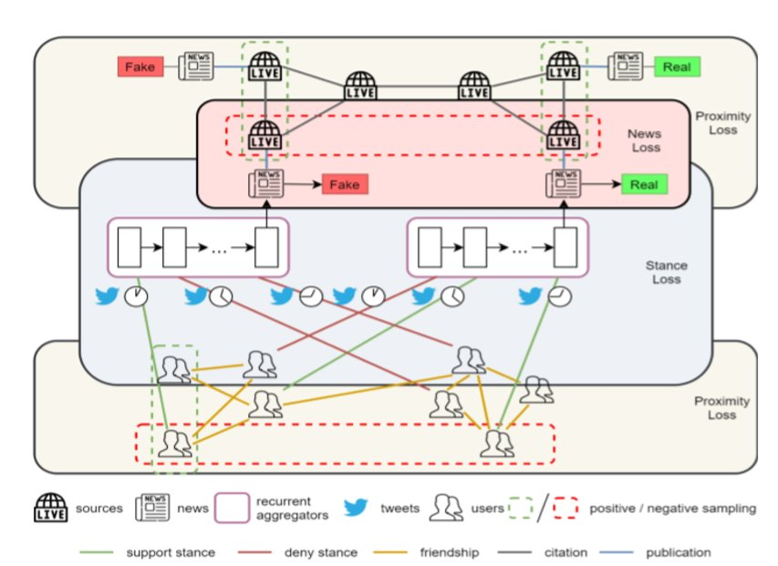
FANG Framework
GraphSage is used as representation learning framework in FANG.
We can obtain structural representation of source (z_{u}) and source (z_{r}).
For news nodes, enrich their representation with user engagement temporality using an aggregation function which maps news a and its engaged users U, into a temporal representation v_{a}^{temp}.
Incorporated an attention mechanism on top of Bi-LSTM to focus on essential engagement during encoding.

Slide 8

FANG Framework (Contd.)
LSTM is given as input a sequence of user-article engagement, {e₁, e₂,… e_{|U|}}.
Each e_{i} is represented as x_{ei} = (z_{Ui} , meta(e_{i})), where z_{Ui} = GraphSage(U_{i}) and
meta(e_{i}) = (time(e_{i}), stance(e_{i})).
Bi-LSTM gives two sequences as output: Forward sequence(H^{f}) and Backward sequence(H^{b}).
Attention is derived from similarity of hidden state and news features, so the attention weight is formulated as:
Here, l-meta dimension,
e – encoder dimension, M_{e} and M_{m} are optimizable projection matrices for engagement and meta features.
We finally concatenate H^{f} and H^{b} to obtain temporal representation v_{a}^{temp} and combine it with structural representation to get a single representation for article a, given as
z_{a} = v_{a}^{temp} + GraphSage(a).

Slide 9

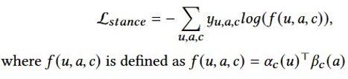

Optimization & Loss Function
FANG achieves learning generalizable representations while optimizing fake news detection objectives by optimizing 3 concurrent losses:
Unsupervised Proximity Loss: It uses the hypothesis that closely connected social entities often behave similarly.
Self-supervised Stance Loss: It uses the hypothesis that if a user expresses a stance with respect to a news article, their respective representations should be close.
Supervised Fake News Loss: We obtain the contextual representation of article a, va as concatenation of za and zs.

Slide 10
Benchmark the performance of FANG
We benchmark the performance of FANG on fake news detection considering three parameters Contextual, Temporal and Graphical against several competitive models which are :
Content-Only Model (Feature SVM)
Euclidean Contextual Model (CSI)
Graph Learning Model (GCN)
Outcome:
All context-aware models (i.e., CSI(-t), CSI, GCN, and FANG(-t)) and FANG improve over the context-unaware baseline.
Time-sensitive CSI and FANG improve over their time-insensitive variants.
Two graph-based models, FANG(-t) and GCN are consistently better than the Euclidean CSI(-t).
Overall, FANG outperforms the other context-aware, temporally-aware, and graph-based models.

Slide 11
DISCUSSION
RQ1: Does FANG work well with limited training data?
RQ2: Does FANG differentiate between fake and real news based on their contrastive engagement temporality
RQ3: How effective is FANG’s representation learning?

Slide 12
Application
The concept of echo chamber is briefly discussed in our paper, and taking it forward we have come up with a way in which we can determine echo chambers in our given data.
We can mold our graph to contain only user and news as nodes and edges as user-user and user-news. After this we can apply Proximity Loss and Stance Loss functions on this data and we will get well represented features for each node.
Taking feature of each user node we can cluster users and each cluster can be viewed as an echo chamber.
We tried similar experiment on news – news graph and used Fake News loss in this case. Then we did K Means clustering.

