Slide 1
Teaching machine to play Blackjack
Shivank Yadav
RA1711003010488

Slide 2
AIM
Our Goal is to teach Machine to play Blackjack.
Technology stack
Python 3.6
OpenAI gym module.
Numpy, collections and sys for programming
Matplotlib and basemap for plotting utilities.

Slide 3
Blackjack
This is the version where the player plays with dealer.
The game starts with dealer having one face up and one face down card, while player having two face up cards. They're playing against a fixed dealer.
The goal is to obtain cards that sum to as near as possible to 21 without going over.
Face cards (Jack, Queen, King) have point value 10.
Aces can either count as 11 or 1, If the player holds an ace that he could count as 11 without going bust, then the ace is said to be usable.
This game is played with an infinite deck (or with replacement).

Slide 4
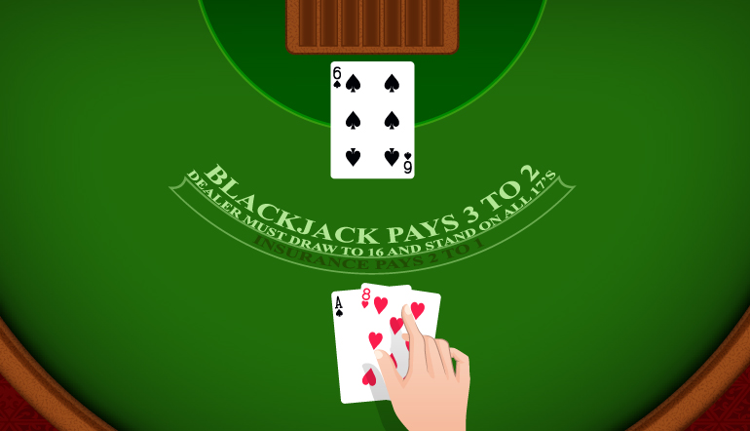
The player can request additional cards (hit=1) until they decide to stop (stick=0) or exceed 21 (bust).
After the player sticks, the dealer reveals their facedown card, and draws until his sum is 17 or greater. If the dealer goes bust the player wins.
If neither player nor dealer busts, the outcome (win, lose, draw) is decided by whose sum is closer to 21. The reward for winning is +1, drawing is 0, and losing is -1.

Slide 5
Reinforcement learning

Slide 6
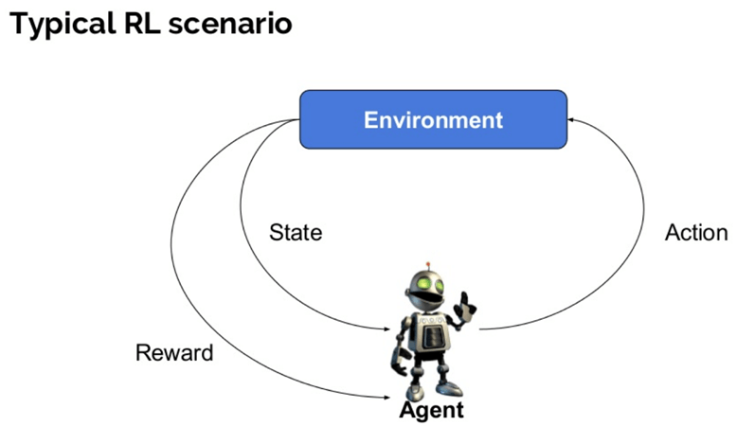
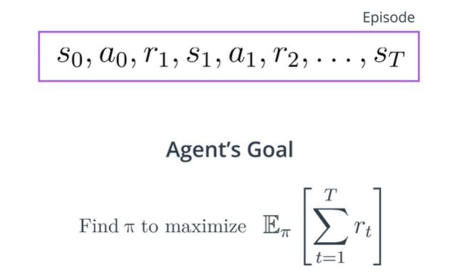
We have an agent and environment. Time is broken into discrete time steps and at every time step, the agent receives a reward and state from the environment, and chooses an action to perform in response.
For any episode, the agent's goal is to find the optimal policy in order to maximize expected cumulative reward.

Slide 7
Monte Carlo Control Algo.

Slide 8
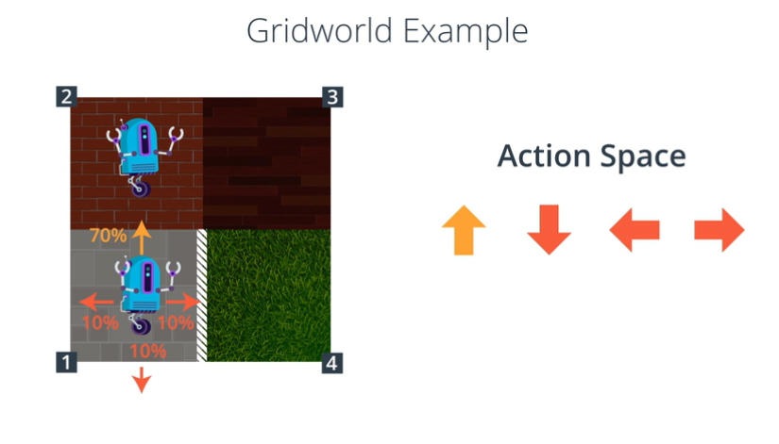
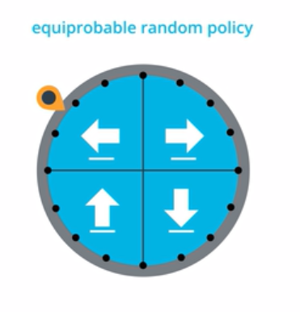
The agent at every action receives a reward of -1, but at the state 4(terminal state), reaching it will reward the agent +10.

Slide 9
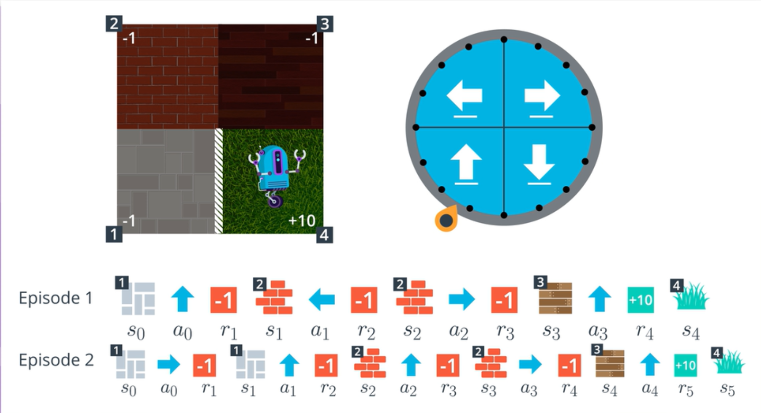
Is this information valuable?
If so, how can an agent use it to improve it’s strategy?

Slide 10
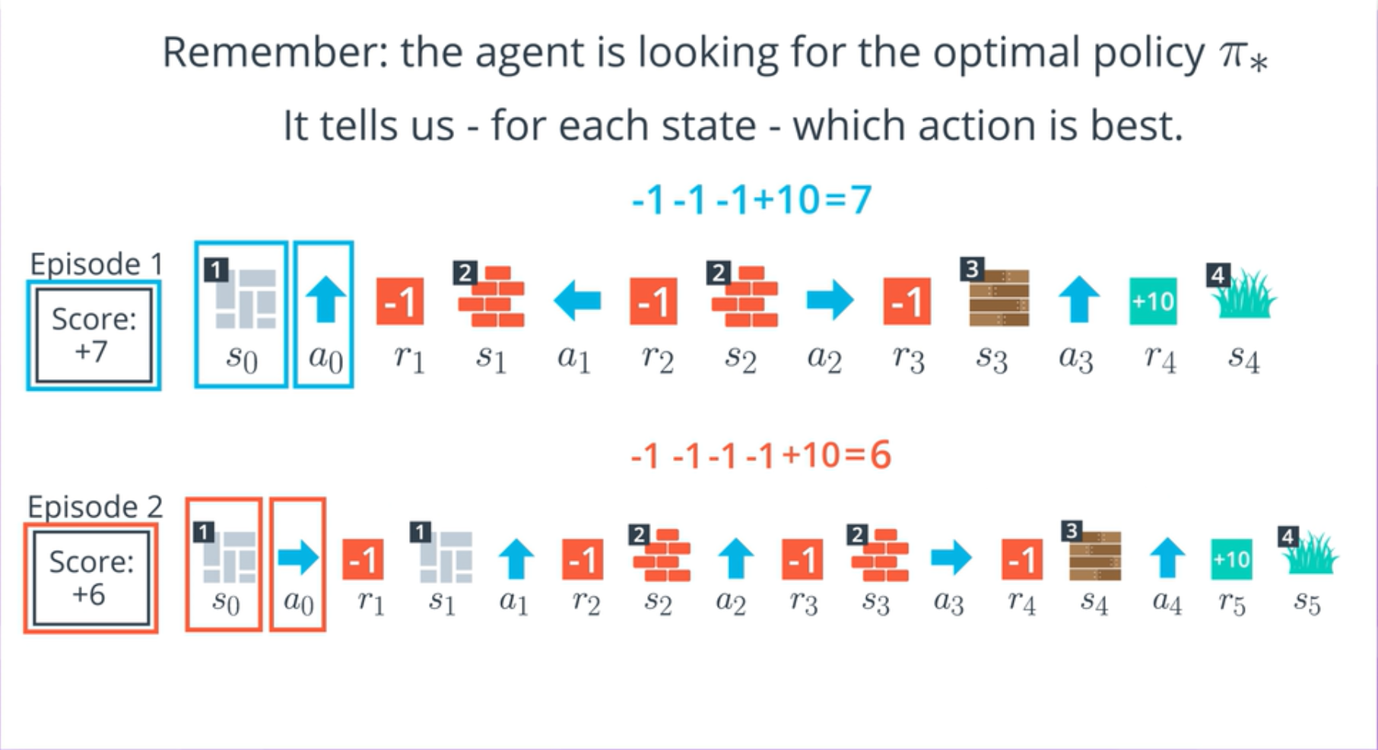

Slide 11
To Truly understand the environment, the agent needs more episodes:
Reason 1: The agent hasn’t tried out each action from each state.
Reason 2: The environment’s dynamics are stochastic.
This is the foundation principle of Monte Carlo Control methods.
Monte Carlo methods - even though the underlying problem involves a great degree of randomness, we can infer useful information that we can trust just by collecting a lot of samples.
The approach is divided into 2 parts:
Prediction and Improvement

Slide 12
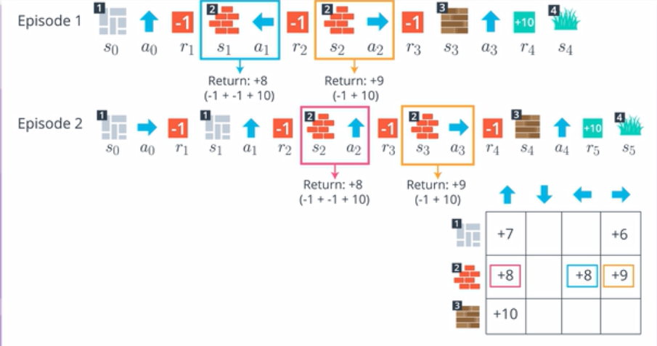
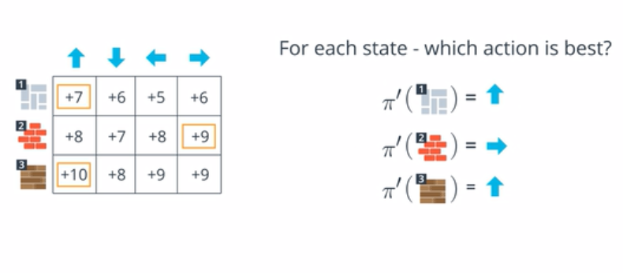
Prediction
Q-Table: Each entry stores expected cumulative return. This table is equivalent to action-value function.
Improvement

Slide 13
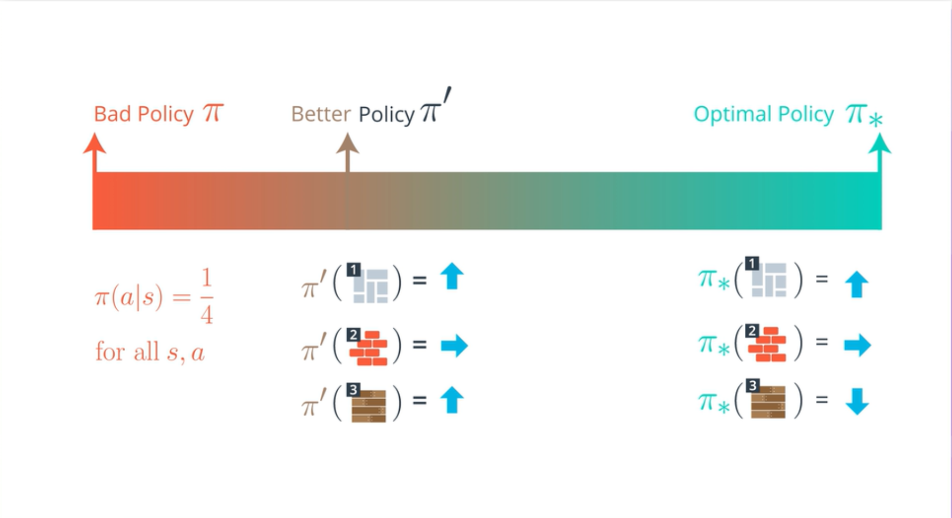

Slide 14
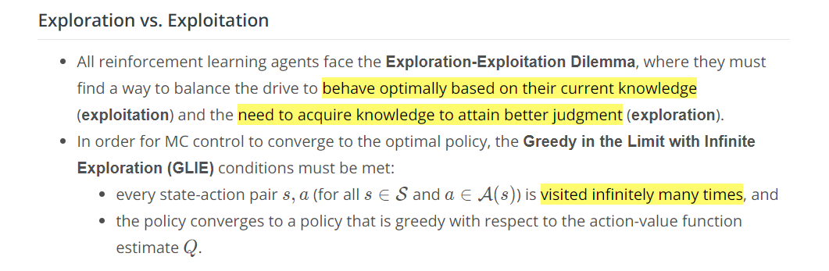
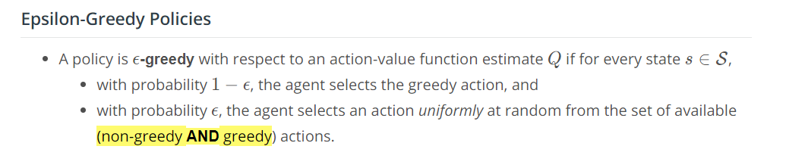
e = 1/num_episodes

Slide 15
Applying Monte Carlo Control Algo. On Blackjack

Slide 16
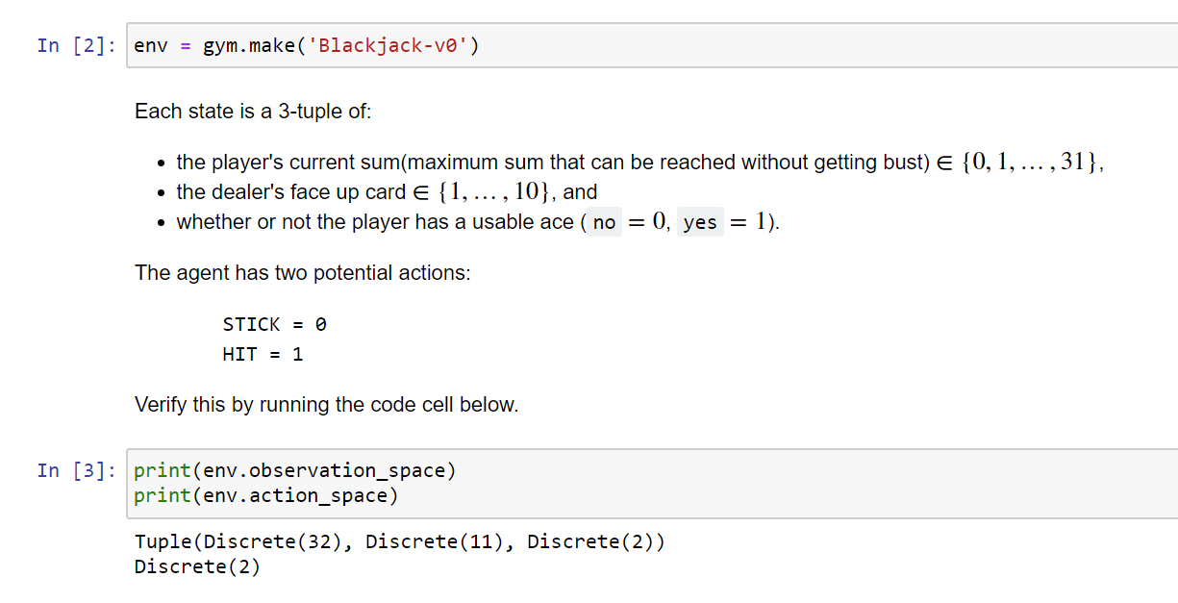
Environment Description
The game of blackjack is an episodic task.
This means that the agent is rewarded +1, -1 or 0 on winning, losing or drawing the match respectively.
We will train the agent for 5 to 7 lakhs of episodes/rounds with the dealer.
State
Actions

Slide 17
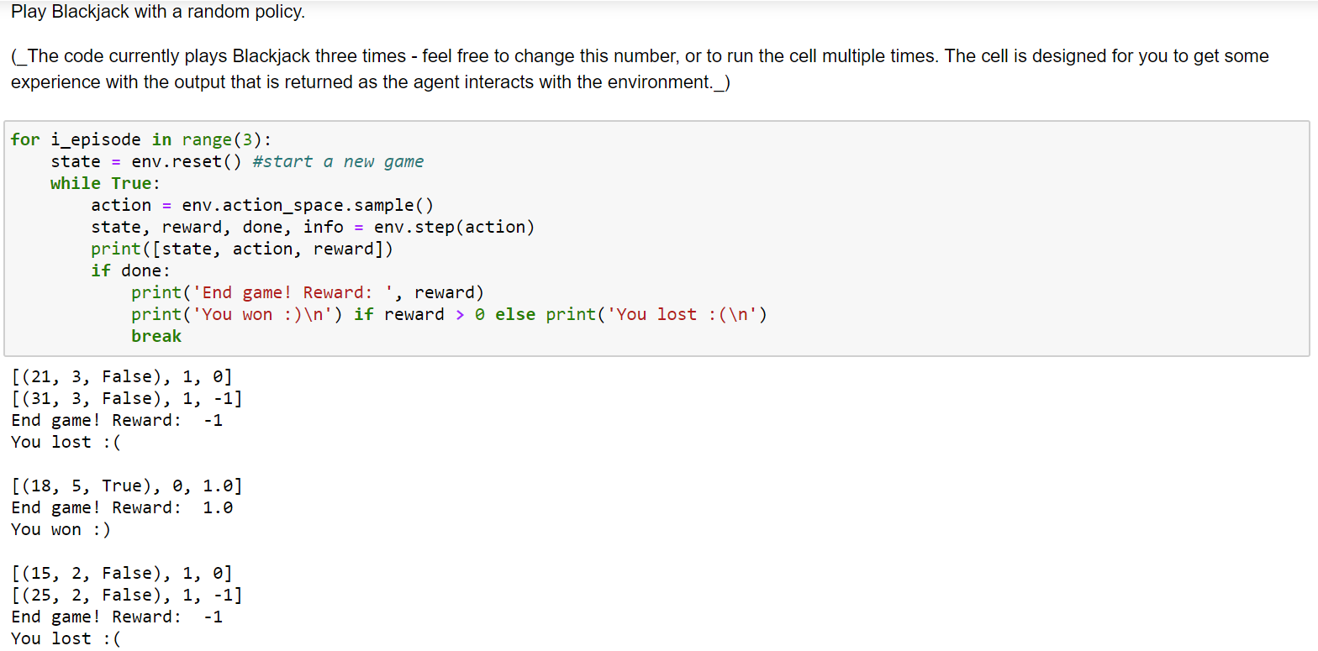
Let’s play Blackjack randomly

Slide 18
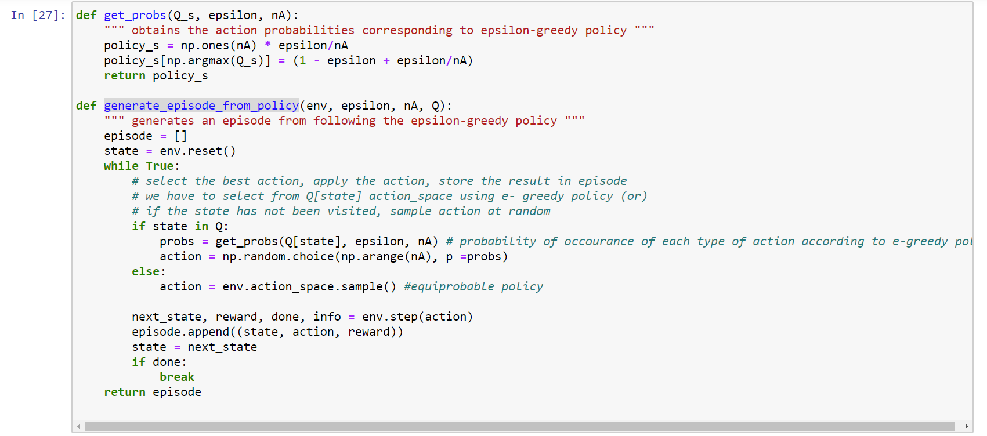
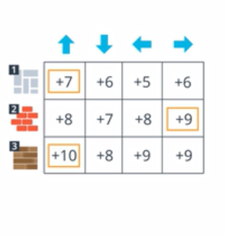
Helper Functions.

Slide 19
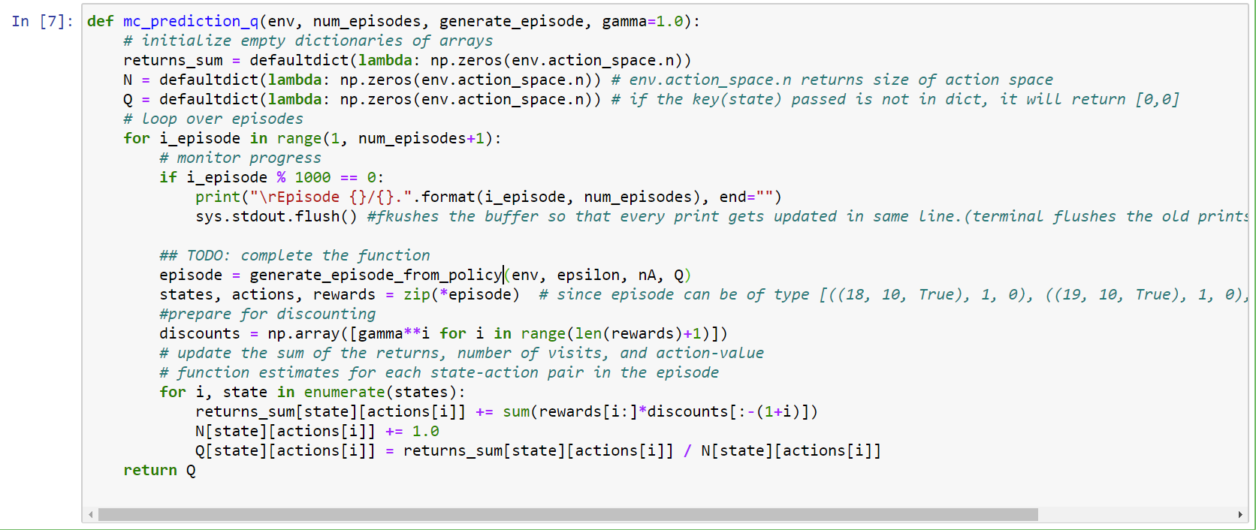
Monte Carlo Algorithm

Slide 20
Output Policy

Slide 21
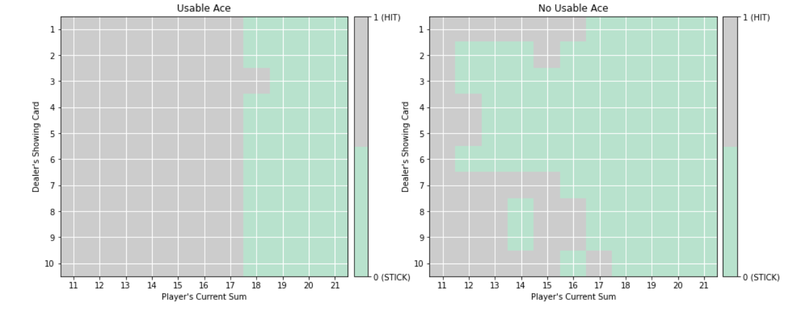
The true optimal policy 𝜋∗π∗ can be found in Figure 5.2 of the textbook (and appears below).

Slide 22
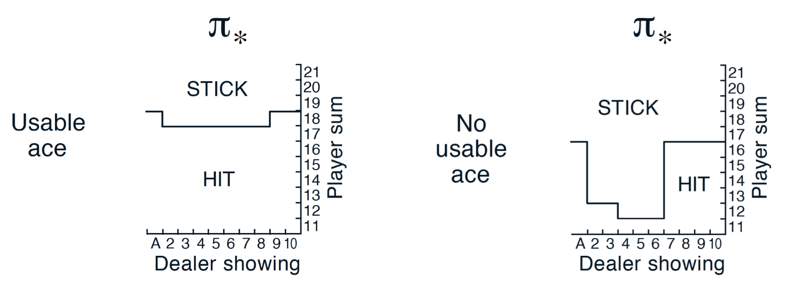
Optimal Policy

