Slide 1
Litcoin
Making our own Cryptocurrency

Slide 2

Agenda
01
The problem of illegal transactions can be easily solved by the Blockchain technology.
02
We have two layers of defence enabled by
->Linking of the blocks to form the blockchain (by verifying transactions).
-> Broadcasting the blockchain to various nodes to form a Distributed P2P network driven by the Consensus Protocol.
03
Even if he is somehow able to make the transaction, either by cheating the consensus algorithm or by his large computational power, he will still fail in the verification of the transaction by the other nodes.
04
To accomplish the tasks we need to implement 4 functions:
-- createBlock()
-- verifyTransaction()
-- mineBlock() or something equivalent for proof of work
-- viewUser()

Slide 3

Team Members
Rishab Nahar
Rohan Sinha
Thakur Shivank Singh
Vamsi Krishna
Team Member
Team Member
Team Member
Team Member
Id No-2018A7PS0173H
Id No-2018A7PS0417H
Id No-2018A7PS0439H
Id No-2018A8PS0929H
f20180173@Hyderabad.bits-pilani.ac.in
f20180417@Hyderabad.bits-pilani.ac.in
f20180439@Hyderabad.bits-pilani.ac.in
f20180929@Hyderabad.bits-pilani.ac.in
9780953106
9582986225
9381437916
8008057181

Slide 4
Procedure to make a transaction
To create public and private keys for the client
Confirming the transaction
Transaction Complete
We then confirm the transaction. A digital signature is generated which is essential for the authenticity of the client.
The transaction is considered complete when the block is added to the blockchain successfully following all the protocols and checks.
For any client we have to create a wallet which generates the public and private key
Step-1
Step-2
Step-3
Step-4
Final step
Making Transaction
Mining the Block
If we want to transfer Litcoin, we have to provide Sender public and private key and Recipient public key and the transaction amount
The node that has received the block will mine and broadcast it to all the neighbouring nodes for further verification of the transactions.

Slide 5
Creating and Mining the blocks
Creating Block
When transactions are made and communicated to a node, the miner tries to create a block which consist of all the transactions which are present in in his/her node. The block consists of attributes like block no., timestamp, transaction details, nonce and previous hash.
01
Mining of Block
02
After the block is created, the miner tries to “mine” the block. For mining to be successful the Hash corresponding to the block must satisfy certain criteria depending on the difficulty. After computing the required nonce the block is “mined”.
03
Consensus Protocol
After one node mines a block then other nodes tries to resolve conflicts by following Consensus Protocol which says that maximum length blockchain will be accepted. It also checks the validity of the blockchain alongside to ensure that the blockchain hasn’t been attacked/tampered.
04
Rewarding Miner
The miner is rewarded with Litcoins for all the computation power, effort and resources to mine the block. He may also receive a small tip from the transaction recipients / senders.

Slide 6


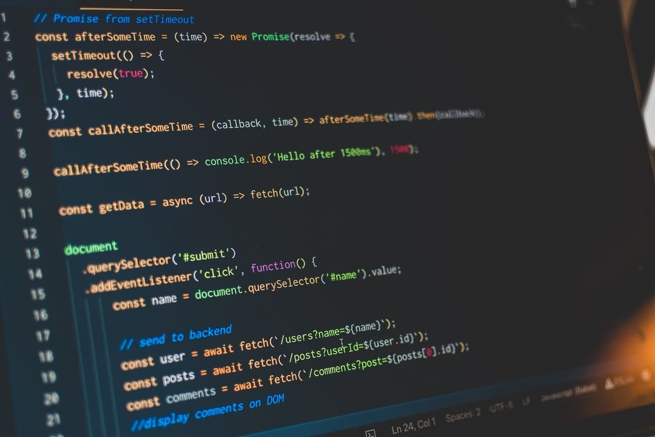
Basic Structure of code
Classes:
To implement the various functionalities our team has made 2 different classes. One for the client and other for the node/miner.
UI:
To implement UI of the above project we have used CSS, HTML, JavaScript.
Language Used:
We have chosen Python 3.7 as it includes a lot of support with various useful modules and packages.
IDE Used:
PyCharm

Slide 7
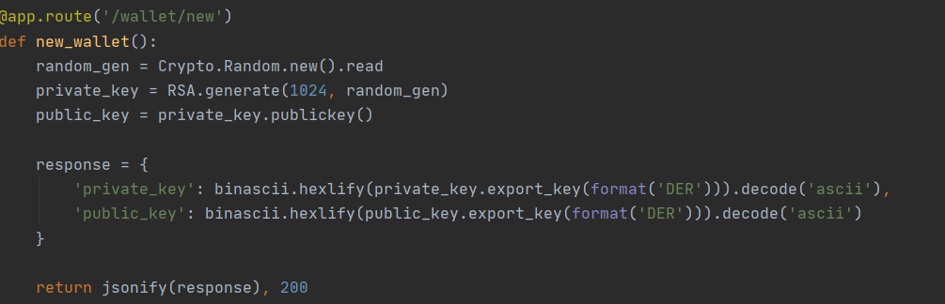
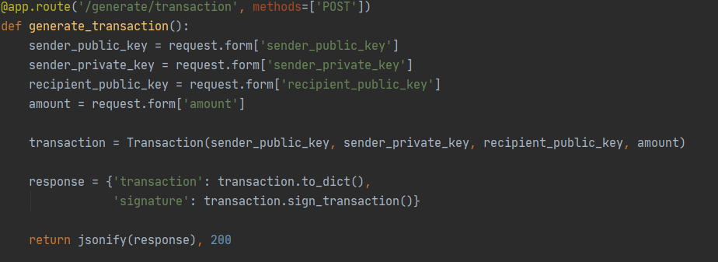
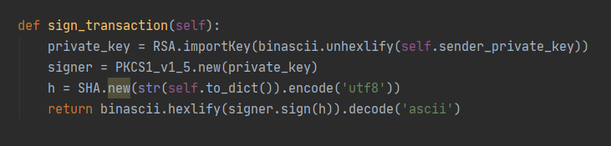
Blockchain_client Class
Creating New Wallet
This function creates a new wallet for any client. The wallet contains the public and private key for the client generated using the RSA algorithm.
Generating Transaction
This function generates the transaction by accumulating all details like sender public and private key , recipient public key and the amount. All these values are requested from the form using Java Script modules.
Signing the Transaction
This function generates the digital signature
for the transaction using the sender’s private key by the SHA algorithm.

Slide 8
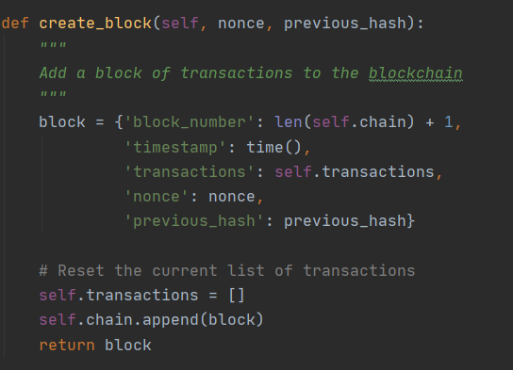
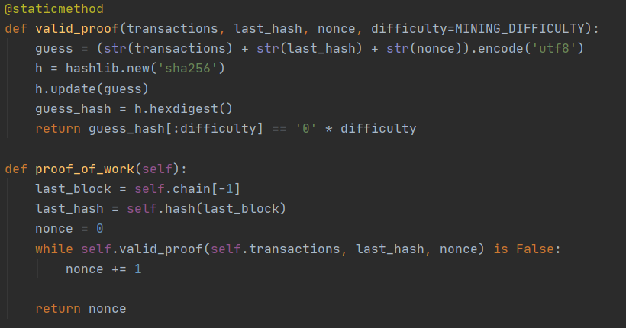
Blockchain Class
Create Block
This function creates a block which includes various attributes like block no. , timestamp, transaction details, nonce, previous hash. This functions also clears the transaction list and appends the block to the chain
Mine Block/Proof of Work
This function is involved in the process of mining the block. Using brute force , we try to get the required nonce and inturn the Hash which satisfies the difficulty specified. The proof of work computes the computational complexity/work it took to reach the right Hash.

Slide 9
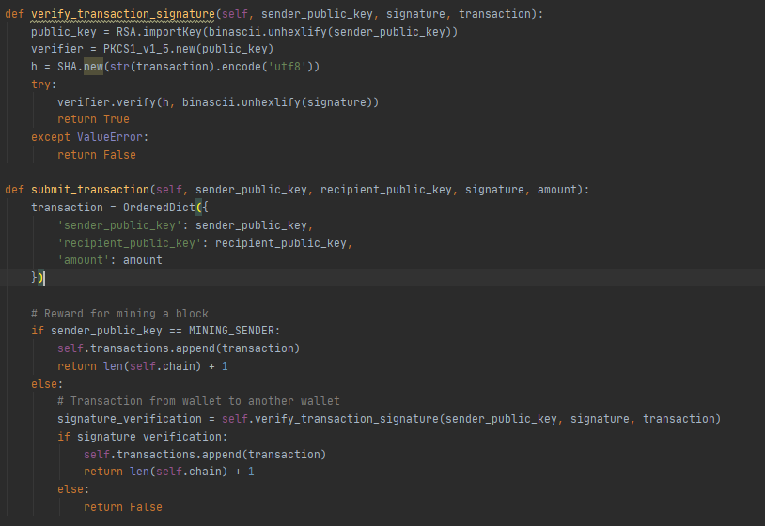
Blockchain Class(Continued)
Verify Transaction
This function verifies the signature generated during the transaction by using the verifier method in the Json library. It uses the sender public key along with the transaction list to verify the signature.
This “Signature” method is one of the ways to implement
The Zero Knowledge Proof algorithm
t = g^e
c = H(m || t)
d = e – (x*c)
The miner would send (c, d) as the signature, along with the message m.
Which is basically a hash of the message with a proof that he knows the secret x.
To verify the signature you would use the public key y = g^x to compute y^c * g^d = t
and then you would compute the hash. (All this is accomplished using the RSA function here)
It would give you the proof that the signer knows x (authentication, non-repudiation) and that the message hasn't been tampered (integrity) with zero knowledge of the value of x !

Slide 10
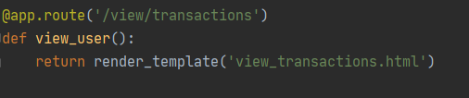
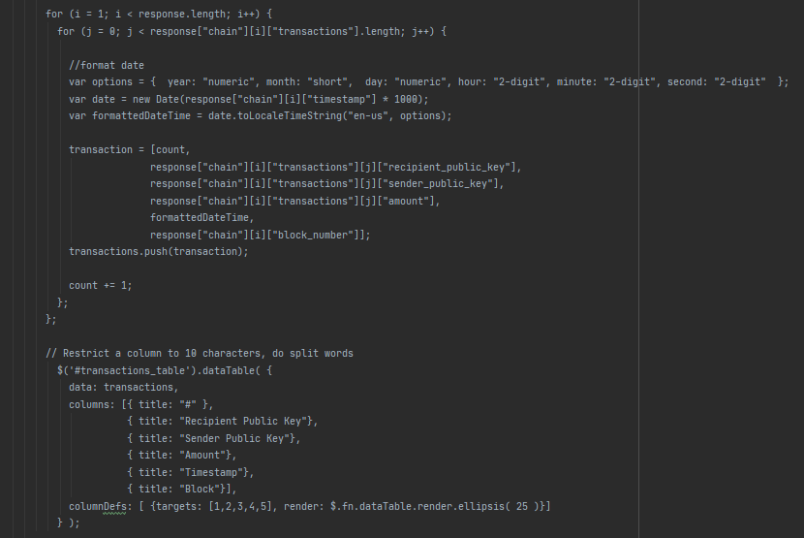
Blockchain Class(Continued)
View User
We have implemented the View User function in Java Script as it relies heavily on requests and calls. In java script we use the jsonify response to get/post all the details regarding the transactions like public key of both sender and recipient, amount, Timestamp, Block no. in blockchain.

Slide 11
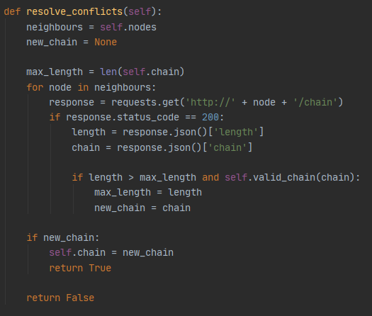
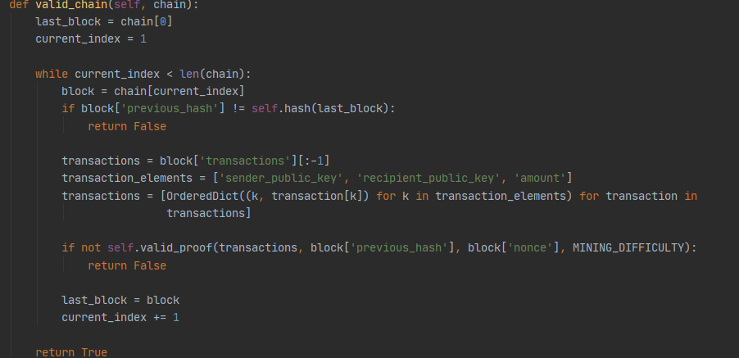
Blockchain Class(Continued)
Consensus Protocol
Valid Chain
The above function checks the consensus protocol by checking the longest valid chain and replaces all smaller sub-chains present on other nodes by the longest chain.
The above chain checks the validity of the chain by cross-checking the previous_hash and last_block hash. It also changes the index of the current_block according to the validity.

Slide 12
Dependencies
Our Project works on the following dependencies:
Python libraries –
flask ( Web Framework ),
pycrypto (used to implement RSA, creating Signatures, other crypto functions), hashlib
requests
urllib
json , other python packages for UI
Our project runs with the python compiler (version 3.7). PyCharm IDE was very useful to manage all the files and various bunch of functions easily.

Slide 13
Thank you

