Slide 1

Vegetable Market Analysis
Prepared by:
Brajesh V Kulkarni
Shivanni Shinde
Sourabh Wabale
Somya Gupta

Slide 2
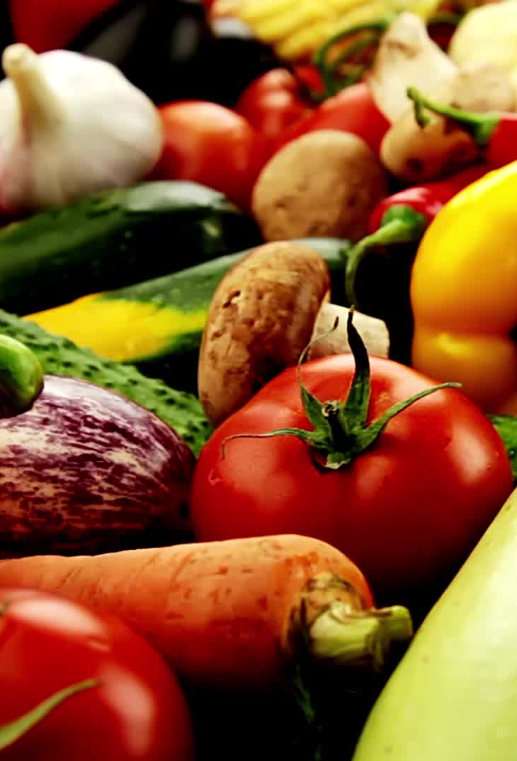
Introduction
Comprehensive Analysis: We conducted an in-depth analysis of the Noida vegetable market, including pricing dynamics, seasonal trends, income group impacts, and technology integration using Python's Selenium library.
Market Insights: Our study provides valuable insights into market size, competition, challenges, success factors, and the role of technology in improving operations and customer experiences.
Quick Commerce: We also highlight the growing significance of the quick commerce vegetable business in Delhi.

Slide 3
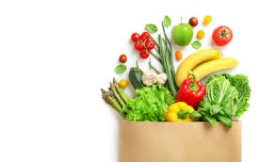
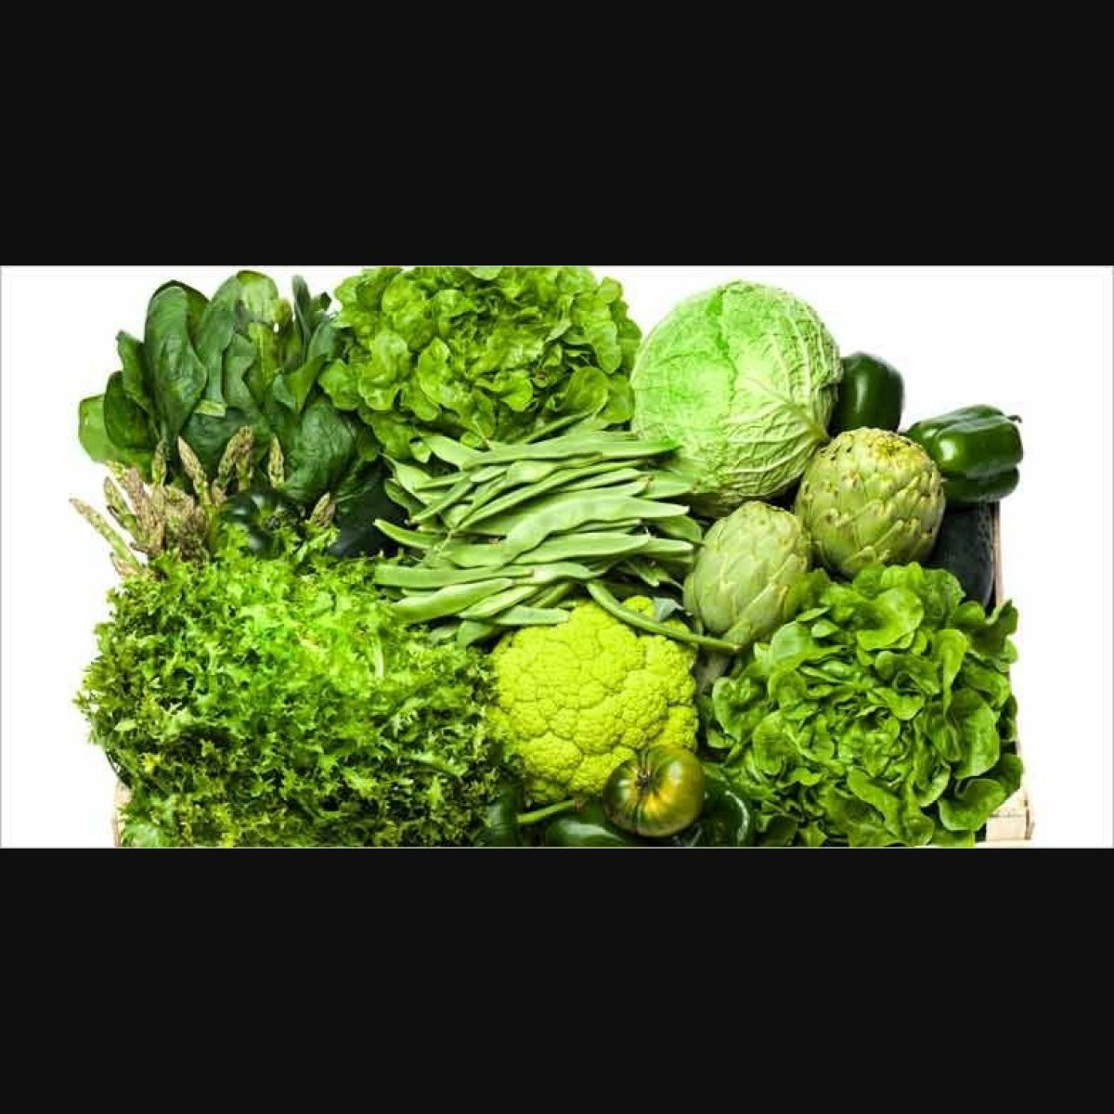
Objectives
Our first step is to gather comprehensive and trustworthy data from relevant websites, forming the foundation of our vegetable market analysis.
We conduct a thorough examination of the Noida vegetable market, scrutinizing price trends and variations to offer valuable insights into market dynamics.
Through price analysis, we identify which vegetables are in season, aiding consumers and vendors in making well-informed choices.

Slide 4
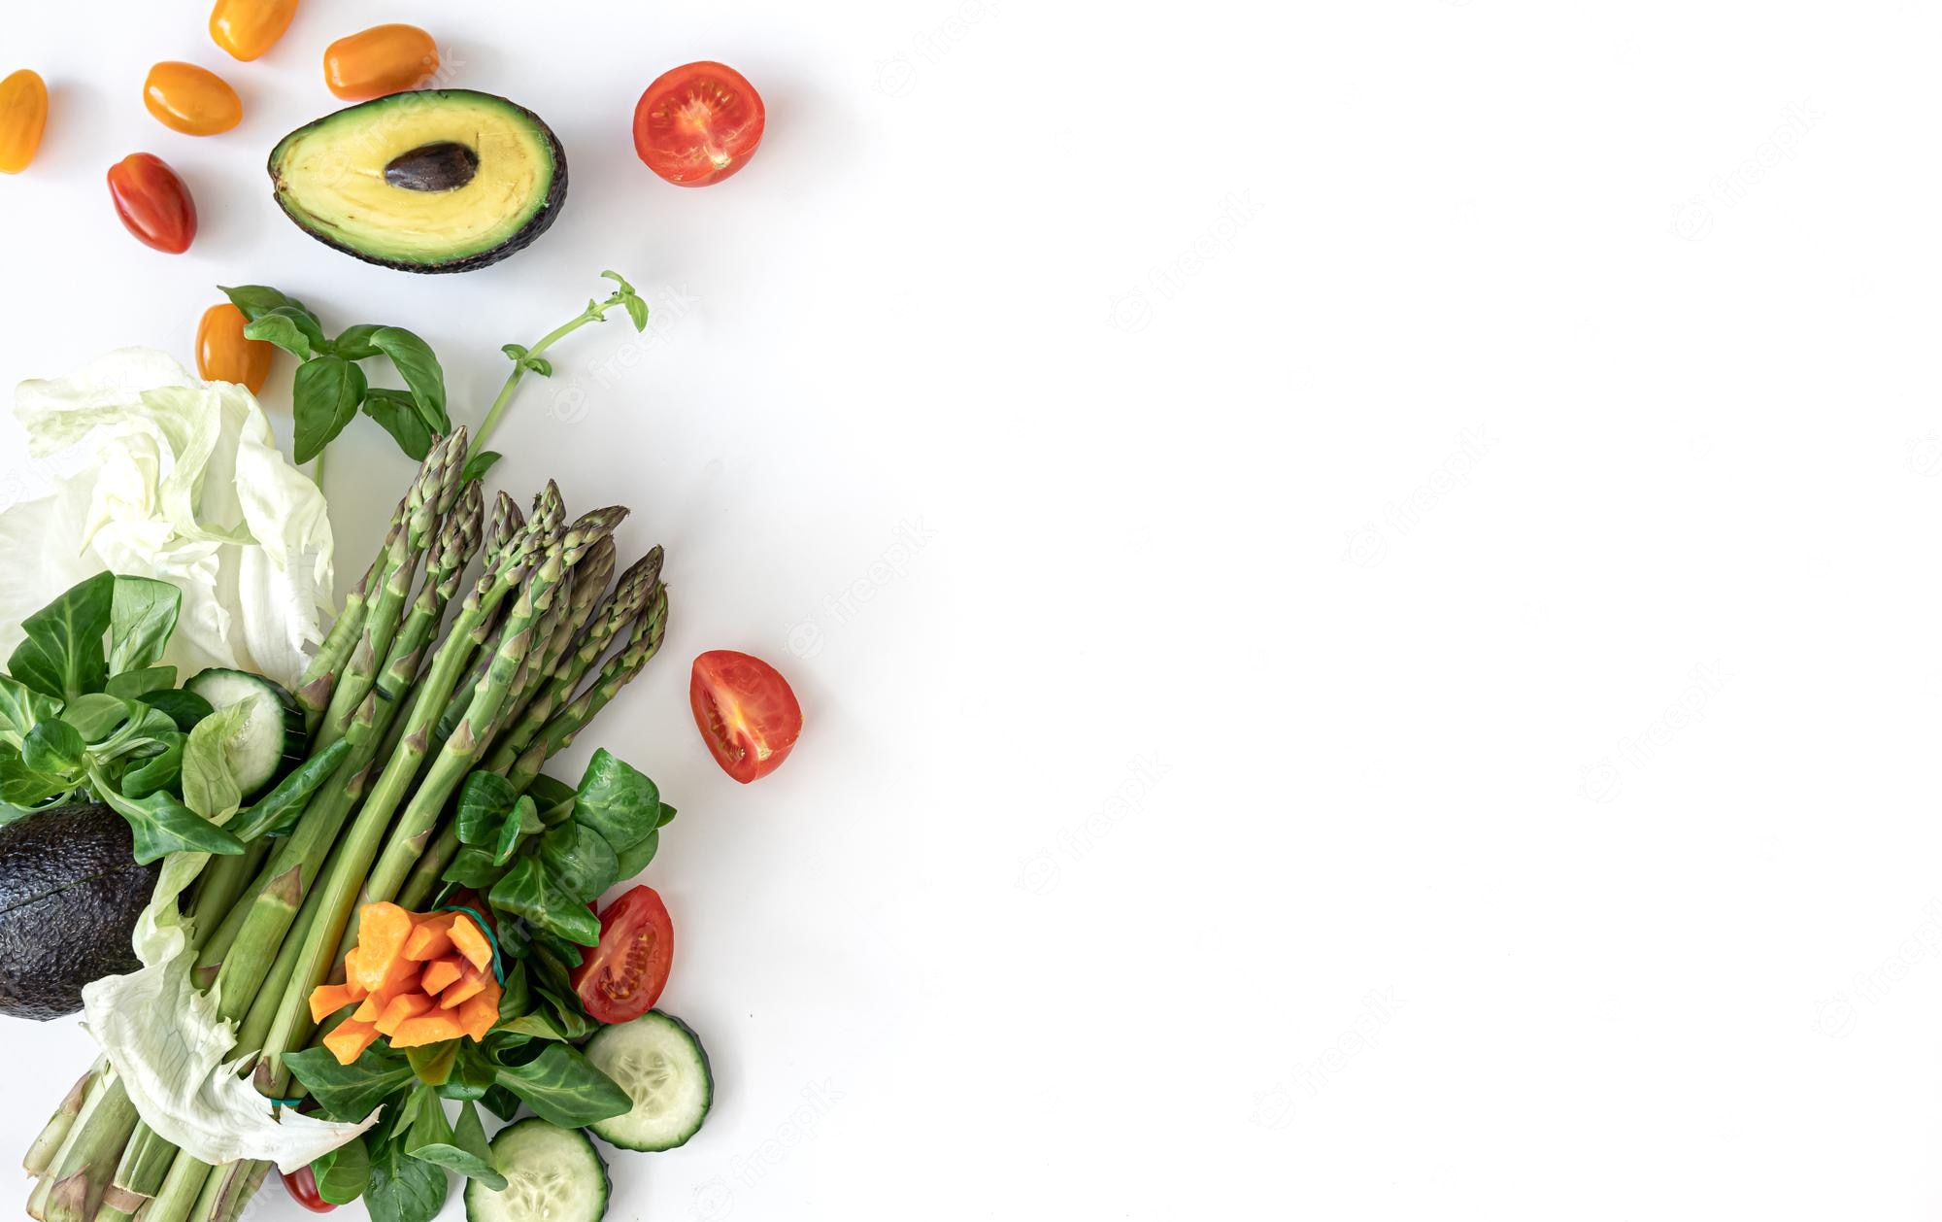
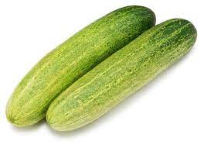
"THE AVERAGE MONTHLY PRICE OF VEGETABLES IN THE NOIDA MARKET"
Analyzing the average price of each vegetable each month is a valuable aspect of your vegetable market analysis project.
Price Trends: The analysis revealed pronounced price fluctuations throughout the year, driven primarily by seasonal factors.
Stability in Some Vegetables: Certain vegetables maintained relatively stable prices year-round, suggesting consistent availability and affordability for consumers.

Slide 5
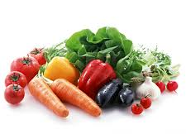
DIFFERENCES OR SIMILARITIES IN THE PRICES OF VEGETABLES IN NOIDA AND NEARBY MARKET
Noida consistently offers lower prices for most vegetables, making it a cost-effective option.
The price difference highlights the potential for significant savings in Noida.
Factors such as proximity to agricultural regions and market competition contribute to the lower prices.
Noida's lower prices provide opportunities for affordability and improved profit margins.

Slide 6
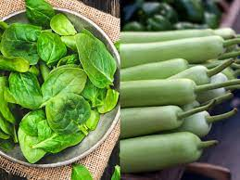
SEASONAL VEGETABLES BY OBSERVING THE FLUCTUATIONS IN PRICE ON DIFFERENT TIME PERIODS
The chart illustrates the price fluctuations of different seasonal vegetables over time.
It showcases the variations in prices during different months or seasons throughout the year.
The fluctuations in vegetable prices can be influenced by external factors such as weather conditions, season, location , and market demand.
The chart reveals correlations between price movements and vegetables season.

Slide 7
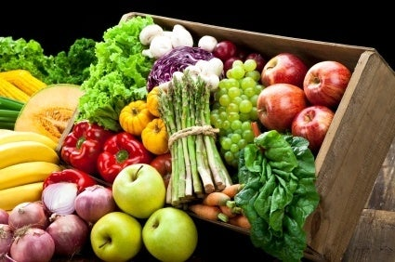
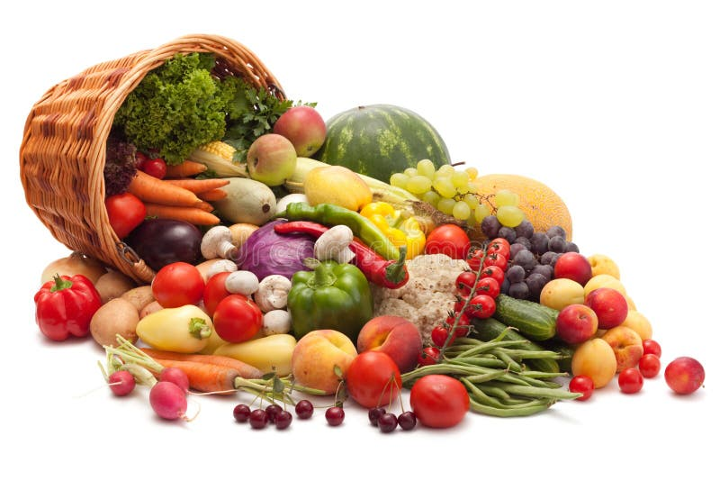
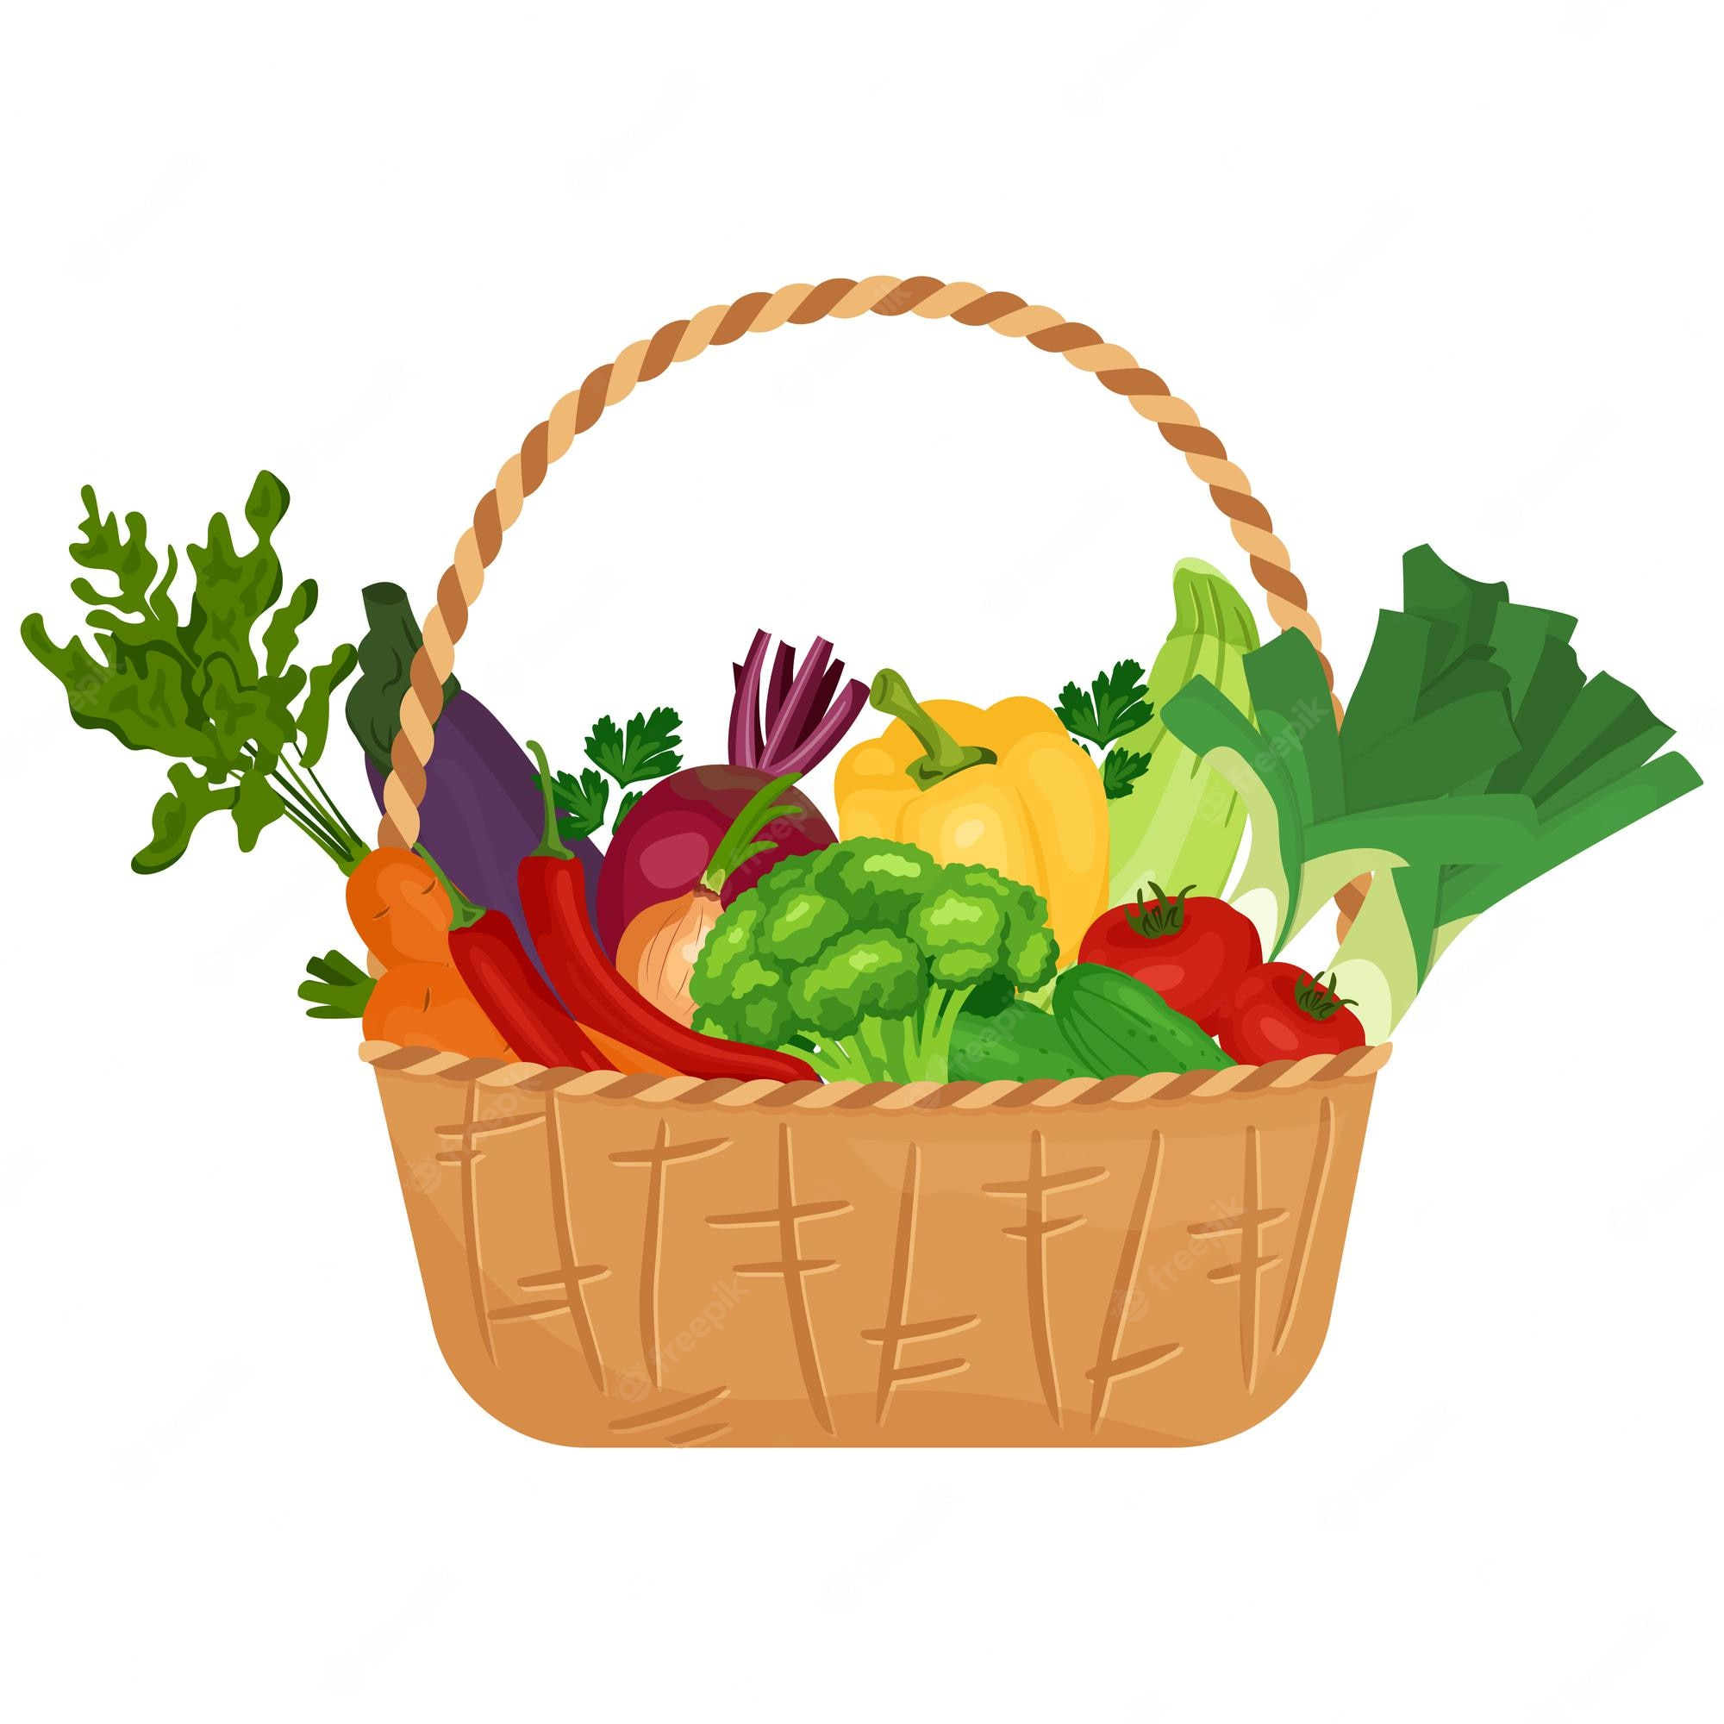
"VEGETABLE BASKET EXPENDITURE BY INCOME GROUP"
Middle income
Low Income :
Sorrel Leaves
Beetroot
Shallot Peral
Colocasia Leaves
Garlic
Onion
Potato
Green chillies
Garlic
Onion
Potato
Green chillies
Ash gourd
Clustered beans
Baby corn
French beans
Total - 242
Total - 306
High Income
Garlic
Onion
Potato
Green chillies
Green Peas
Mango Raw
Drumsticks
Mushroom
Total - 451

Slide 8
CHANGE IN BASKET PRICE OF DIFFERENT INCOME GROUPS OVER TIME
The price trend in the Higher income group can be seen more as compared to the middle and lower income groups which shows that the prices of the higher income basket fluctuated

Slide 9
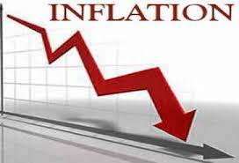
INFLATION RATE FOR EACH INCOME GROUP"
Findings From Charts
Low-Income Areas: Inflation Decrease: -13%
Significant price drop, improving affordability for low-income households.
Middle-Income Areas: Inflation Decrease: -4%
Potential stabilization in prices, benefiting middle-income families.
Higher-Income Areas: Inflation Decrease: -2%
Slight price drop, with milder impact on higher-income households.
Overall Market Trends:
Decreasing vegetable prices across income groups.
Suggests potential market stability and improved affordability.
Monitor trends for sustained consumer relief.
This single slide effectively conveys the key points regarding the impact of vegetable price fluctuations in different income areas

Slide 10
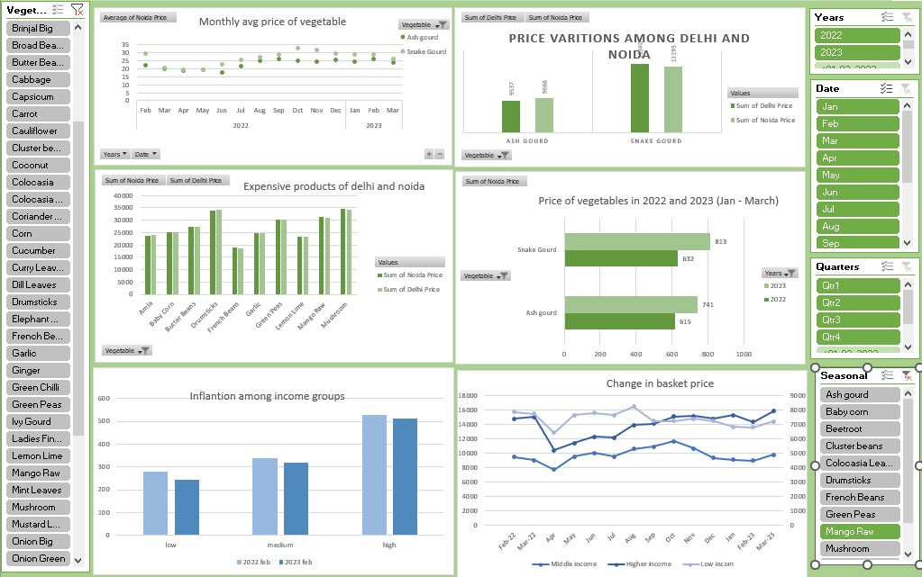
Vegetable market price Analysis

Slide 11
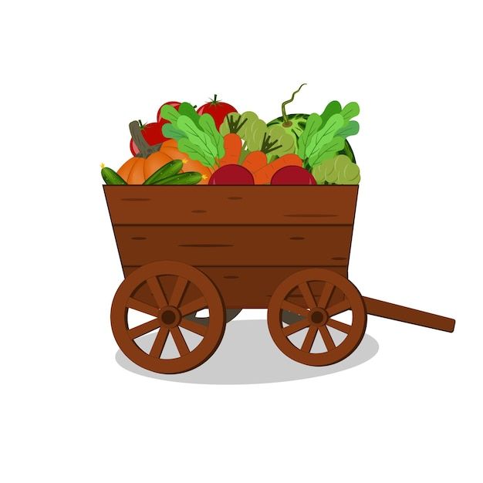
Case Study on Quick Commerce Vegetable Business in Delhi:

Slide 12

Market Size and Potential for Quick Commerce Vegetable Business in Delhi:
Delhi's Quick Commerce Vegetable Business is booming because more people in the city want quick and fresh vegetable deliveries.
There's a lot of competition and some challenges with delivering on time and maintaining quality.
But there's a chance for this business to get bigger because people in Delhi like different things and investors are interested.
It's important to follow the rules and work with partners to succeed.
The future looks good because more people are moving to cities and how they shop for vegetables is changing.

Slide 13





Competitive landscape for quick commerce vegetable business in Delhi:
Market Competition: Numerous companies compete in the quick vegetable delivery market, including big players and smaller local businesses.
Price Wars: Competition often leads to price battles, benefiting consumers seeking lower prices.
Quality Matters: Companies stand out by offering better quality and fresher vegetables.
Customer-Centric: Quick delivery, loyalty programs, and innovative technology are key to attracting and retaining customers.
Challenges: Maintaining service quality while keeping prices low remains a challenge.
Market Potential: With Delhi's growing population and changing shopping habits, there's room for new entrants.

Slide 14

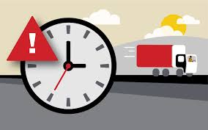
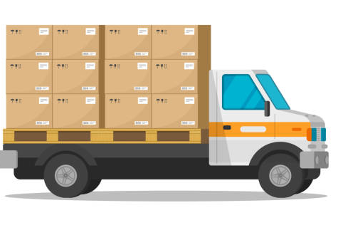
Key challenges faced by the quick commerce vegetable business in Delhi
Delivery Delays: Traffic and logistics can cause delays in getting vegetables to customers quickly.
Quality Control: Ensuring that vegetables stay fresh during delivery can be a challenge.
Competition: Many businesses are fighting to attract the same customers.
Price Pressure: Trying to keep prices low while maintaining quality can be tough.
Customer Expectations: Customers expect on-time delivery and high-quality produce.
Logistics Costs: Handling transportation and delivery expenses can eat into profits.
Seasonal Variations: The availability and cost of vegetables change with the seasons, affecting business.
Regulatory Compliance: Adhering to food safety and delivery regulations is crucial but can be complex.
Supply Chain Issues: Ensuring a steady supply of fresh vegetables can be challenging.
Tech Investments: Keeping up with technology for efficient operations can be costly.

Slide 15

KEY SUCCESS FACTORS
Quality and Freshness: Providing high-quality and fresh vegetables is essential for customer satisfaction and building a good reputation.
Price Competitiveness: Offering competitive prices relative to market standards ensures affordability and attracts price-conscious consumers.
Efficient Supply Chain: An efficient supply chain with reliable sources of vegetables, effective distribution, and minimal wastage is crucial for maintaining consistent product availability and reducing costs.
Customer Service and Convenience: Offering excellent customer service, convenient ordering options, and on-time deliveries can build strong customer loyalty and drive repeat business.

Slide 16
Conclusion
The vegetable market analysis project showed us how prices change and what people with different incomes in Noida prefer when buying vegetables.
It highlighted that it's crucial to create strategies that consider what people can afford and the different things they like to buy.
The results also pointed out that there's a big opportunity for fast vegetable delivery businesses in Delhi, especially online ones, because many people live fast-paced lives in the city.

Slide 17

THANK YOU
We express our gratitude to our dedicated team members for their hard work in conducting the analysis, our mentors and guides for their invaluable support throughout the project, everyone in attendance today for their time and attention, and the Selenium library in Python for streamlining data extraction and analysis, which significantly contributed to our project's success.

