Slide 1
JavaScript
JavaScript is one of the 3 languages all web developers must learn:
1. HTML to define the content of web pages
2. CSS to specify the layout of web pages
3. JavaScript to program the behavior of web pages
JavaScript is a light-weight object-oriented programming language which is used by several websites for scripting the web pages.
It was introduced in the year 1995 for adding programs to the web pages in the Netscape Navigator browser. Since then, it has been adopted by all other graphical web browsers.
Although, JavaScript has no connectivity with Java programming language. The name was suggested and provided in the times when Java was gaining popularity in the market.

Slide 2
Application of JavaScript -
JavaScript is used to create interactive websites. It is mainly used for:
Client-side validation,
Dynamic drop-down menus,
Displaying date and time,
Displaying pop-up windows and dialog boxes (like an alert dialog box, confirm dialog box and prompt dialog box),

Slide 3
JavaScript Example -
JavaScript provides 3 places to put the JavaScript code: within body tag, within head tag and external JavaScript file.
Let’s create the first JavaScript example.
<html>
<body>
<script type="text/javascript">
document.write(“Welcome to Java Script");
</script>
</body>
</html>
The script tag specifies that we are using JavaScript.
The text/javascript is the content type that provides information to the browser about the data.
The document.write() function is used to display dynamic content through JavaScript. We will learn about document object in detail later.

Slide 4
Places to put JavaScript code
1 - Between the body tag of html
2 - Between the head tag of html
3 - In .js file (external javaScript)
1) JavaScript Example : code between the body tag
In the above example, we have displayed the dynamic content using JavaScript. Let’s see the simple example of JavaScript that displays alert dialog box.
<html>
<body>
<script type="text/javascript">
alert("Hello World");
</script>
</body>
</html>

Slide 5
2) JavaScript Example : code between the head tag
Let’s see the same example of displaying alert dialog box of JavaScript that is contained inside the head tag.
In this example, we are creating a function msg(). To create function in JavaScript, you need to write function with function_name as given below.
To call function, you need to work on event. Here we are using onclick event to call msg() function.
<html>
<head>
<script type="text/javascript">
function msg(){
alert("Hello World");
}
</script>
</head>
<body>
<p>Welcome to JavaScript</p>
<form>
<input type="button" value="click" onclick="msg()"/>
</form>
</body>
</html>

Slide 6
3 - External JavaScript file -
We can create external JavaScript file and embed it in many html page.
It provides code re usability because single JavaScript file can be used in several html pages.
An external JavaScript file must be saved by .js extension.
Let’s create an external JavaScript file that prints Hello World in a alert dialog box.
message.js
function msg(){
alert("Hello World");
}

Slide 7
Let’s include the JavaScript file into html page. It calls the JavaScript function on button click.
index.html
<html>
<head>
<script type="text/javascript" src="message.js"></script>
</head>
<body>
<p>Welcome to JavaScript</p>
<form>
<input type="button" value="click" onclick="msg()"/>
</form>
</body>
</html>

Slide 8
JavaScript Comment -
The JavaScript comments are meaningful way to deliver message. It is used to add information about the code, warnings or suggestions so that end user can easily interpret the code.
Types of JavaScript Comments
There are two types of comments in JavaScript.
Single-line Comment
Multi-line Comment
JavaScript Single line Comment
It is represented by double forward slashes (//). It can be used before and after the statement.
Example 1 -
<script>
// It is single line comment
document.write("hello javascript");
</script>

Slide 9
Example 2 -
<script>
var a=10;
var b=20;
var c=a+b;//It adds values of a and b variable
document.write(c);//prints sum of 10 and 20
</script>
JavaScript Multi line Comment
It can be used to add single as well as multi line comments. So, it is more convenient.
/* your code here */
It can be used before, after and middle of the statement.
Example -
<script>
/* It is multi line comment.
It will not be displayed */
document.write("example of javascript multiline comment");
</script>

Slide 10
JavaScript Variable -
A JavaScript variable is simply a name of storage location. There are two types of variables in JavaScript : local variable and global variable.
There are some rules while declaring a JavaScript variable (also known as identifiers).
Name must start with a letter (a to z or A to Z), underscore( _ ), or dollar( $ ) sign.
After first letter we can use digits (0 to 9), for example value1.
JavaScript variables are case sensitive, for example x and X are different variables
Correct JavaScript variables
var x = 10;
var _value="sonoo";
Incorrect JavaScript variables
var 123=30;
var *aa=320;

Slide 11
Example of JavaScript variable
Let’s see a simple example of JavaScript variable.
<html>
<body>
<script>
var x = 10;
var y = 20;
var z=x+y;
document.write(z);
</script>
</body>
</html>

Slide 12
JavaScript local variable
A JavaScript local variable is declared inside block or function. It is accessible within the function or block only. For example:
<script>
function abc(){
var x=10;//local variable
}
</script>
JavaScript global variable
A JavaScript global variable is accessible from any function. A variable i.e. declared outside the function or declared with window object is known as global variable. For example:

Slide 13
<html>
<body>
<script>
var data=200;//gloabal variable
function a(){
document.write(data);
}
function b(){
document.write(data);
}
a();//calling JavaScript function
b();
</script>
</body>
</html>
Declaring JavaScript global variable within function
To declare JavaScript global variables inside function, you need to use window object. For example:

Slide 14
<html>
<body>
<script>
function m(){
window.value=100;//declaring global variable by window object
}
function n(){
alert(window.value);//accessing global variable from other function
}
m();
n();
</script>
</body>
</html>

Slide 15
Internals of global variable in JavaScript
When you declare a variable outside the function, it is added in the window object internally. You can access it through window object also. For example:
var value=50;
function a(){
alert(window.value);//accessing global variable
}

Slide 16
Javascript Data Types -
JavaScript provides different data types to hold different types of values. There are two types of data types in JavaScript.
Primitive data type
Non-primitive (reference) data type
JavaScript is a dynamic type language, means you don't need to specify type of the variable because it is dynamically used by JavaScript engine. You need to use var here to specify the data type. It can hold any type of values such as numbers, strings etc. For example:
var a=40;//holding number
var b="Rahul";//holding string

Slide 17
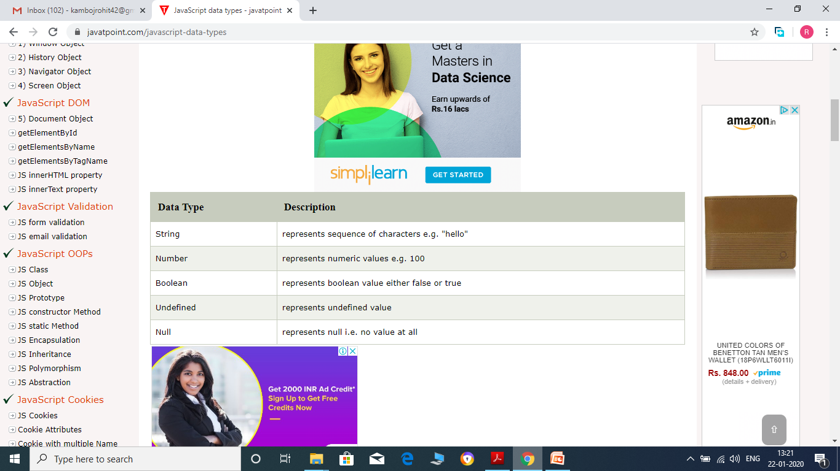
JavaScript primitive data types
There are five types of primitive data types in JavaScript. They are as follows:
Difference b/w null and undefined -

Slide 18
In JavaScript, undefined means a variable has been declared but has not yet been assigned a value, such as:
var TestVar;
alert(TestVar); //shows undefined
alert(typeof TestVar); //shows undefined
null is an assignment value. It can be assigned to a variable as a representation of no value:
var TestVar = null;
alert(TestVar); //shows null
alert(typeof TestVar); //shows object
From the preceding examples, it is clear that undefined and null are two distinct types: undefined is a type itself (undefined) while null is an object.
null === undefined // false
null == undefined // true
null === null // true

Slide 19
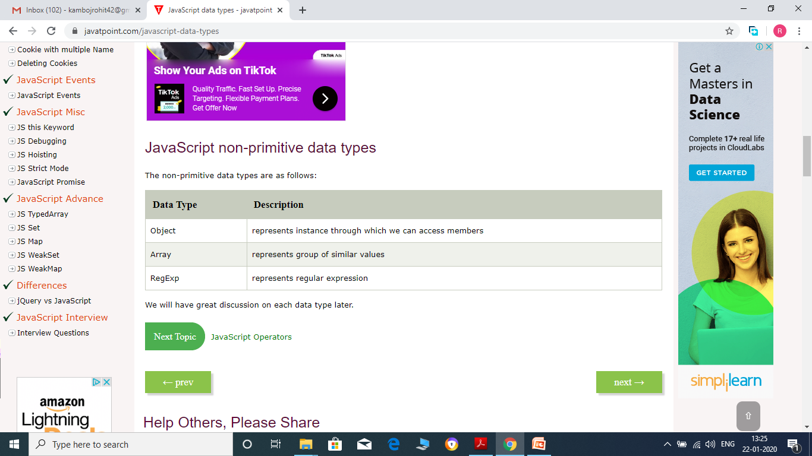
JavaScript non-primitive data types
The non-primitive data types are as follows:

Slide 20
JavaScript Operators -
JavaScript operators are symbols that are used to perform operations on operands.
There are following types of operators in JavaScript.
Arithmetic Operators
Comparison (Relational) Operators
Bitwise Operators
Logical Operators
Assignment Operators
Special Operators

Slide 21
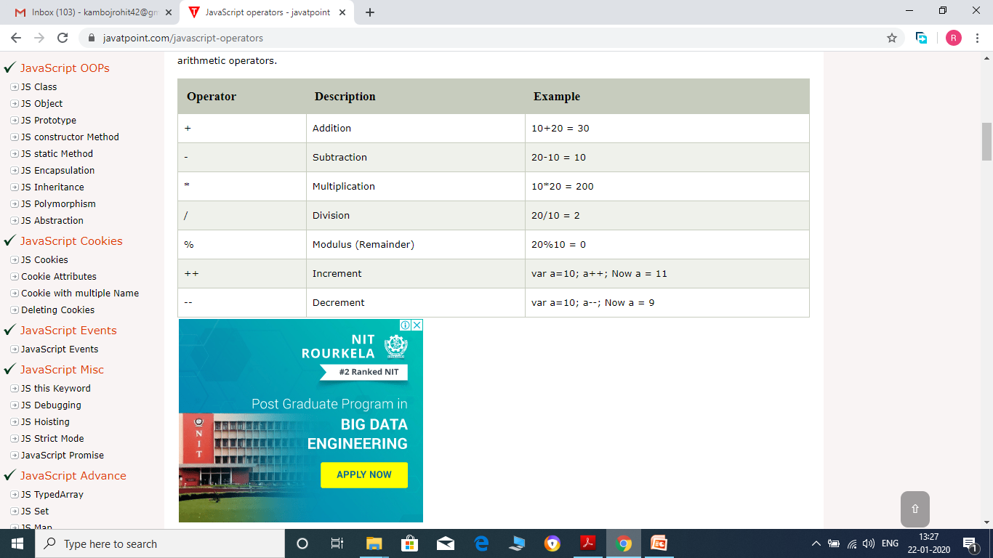
JavaScript Arithmetic Operators -

Slide 22
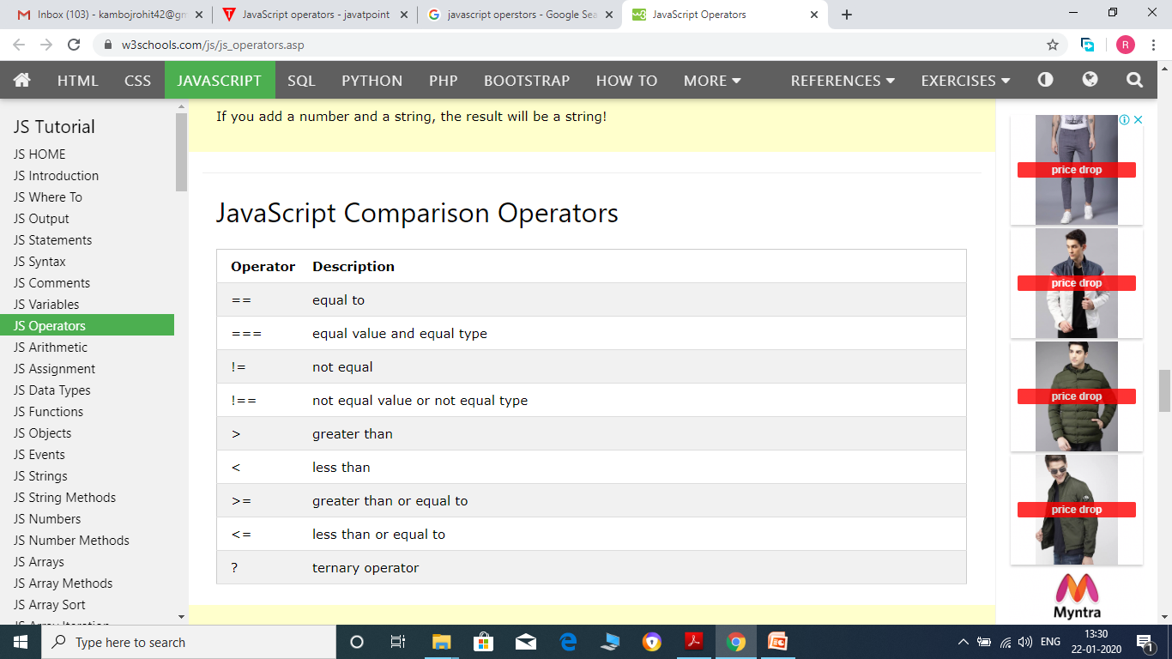
JavaScript Comparison Operators –

Slide 23
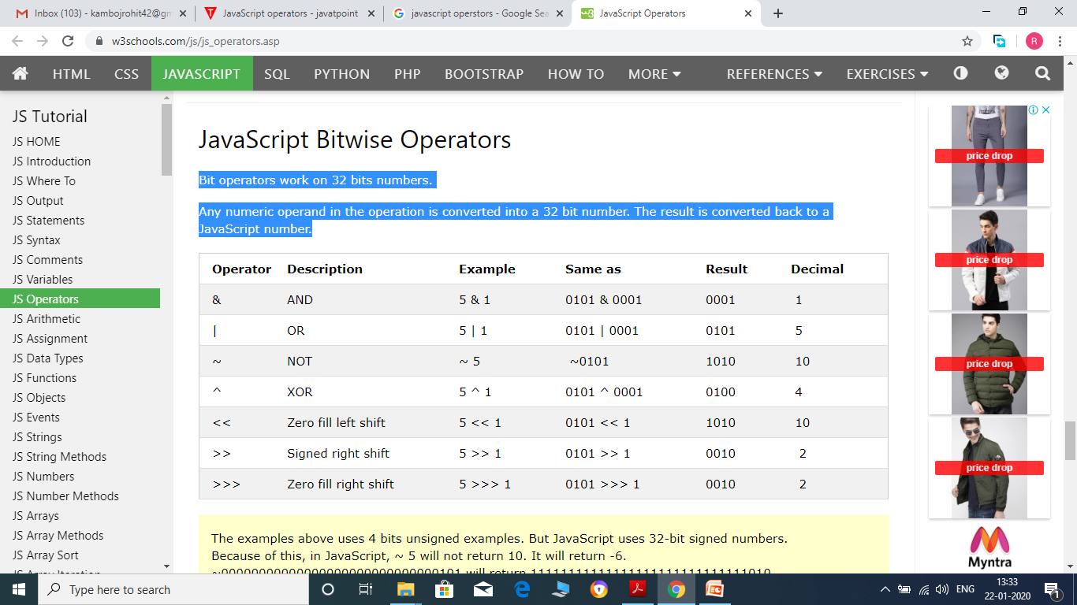
JavaScript Bitwise Operators -
Bit operators work on 32 bits numbers.
Any numeric operand in the operation is converted into a 32 bit number. The result is converted back to a JavaScript number.

Slide 24
The examples above uses 4 bits unsigned binary numbers. Because of this ~ 5 returns 10.
Since JavaScript uses 32 bits signed integers, it will not return 10. It will return -6.
00000000000000000000000000000101 (5)
11111111111111111111111111111010 (~5 = -6) (2’s complement)
A signed integer uses the leftmost bit as the minus sign.

Slide 25
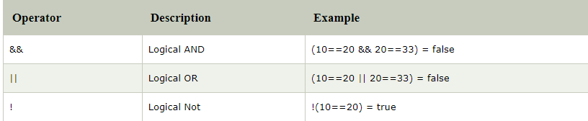
JavaScript Logical Operators
The following operators are known as JavaScript logical operators.

Slide 26
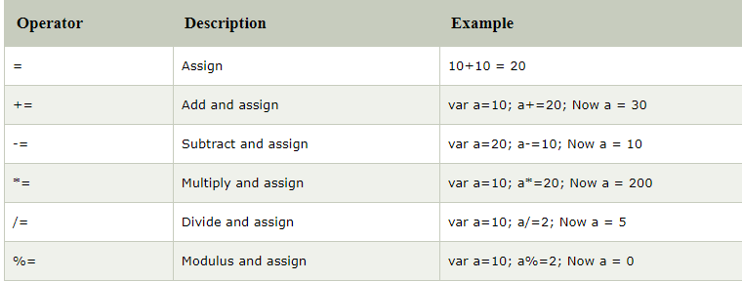
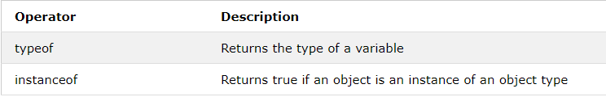
JavaScript Assignment Operators
The following operators are known as JavaScript assignment operators.
JavaScript Type Operators

Slide 27
JavaScript If-else -
The JavaScript if-else statement is used to execute the code whether condition is true or false. There are three forms of if statement in JavaScript.
If Statement
If else statement
if else if statement
JavaScript If statement
It evaluates the content only if expression is true. The signature of JavaScript if statement is given below.
if(expression){
//content to be evaluated
}

Slide 28
Example –
<script>
var a=20;
if(a>10){
document.write("value of a is greater than 10");
}
</script>
JavaScript If...else Statement
It evaluates the content whether condition is true of false.
Example –
<script>
var a=20;
if(a%2==0){
document.write("a is even number");
}
else{
document.write("a is odd number");
}
</script>

Slide 29
JavaScript If...else if statement
It evaluates the content only if expression is true from several expressions. The signature of JavaScript if else if statement is given below.
if(expression1){
//content to be evaluated if expression1 is true
}
else if(expression2){
//content to be evaluated if expression2 is true
}
else if(expression3){
//content to be evaluated if expression3 is true
}
else{
//content to be evaluated if no expression is true
}

Slide 30
Example –
<script>
var a=20;
if(a==10){
document.write("a is equal to 10");
}
else if(a==15){
document.write("a is equal to 15");
}
else if(a==20){
document.write("a is equal to 20");
}
else{
document.write("a is not equal to 10, 15 or 20");
}
</script>

Slide 31
JavaScript Switch – works exactly same as in C, C++ or java
JavaScript Loops -
The JavaScript loops are used to iterate the piece of code using for, while, do while or for-in loops. It makes the code compact. It is mostly used in array.
There are four types of loops in JavaScript.
for loop
while loop
do-while loop
All of these loops works exactly same as in C, C++ or java

Slide 32
For.. In loop – The for/in statement loops through the properties of an object.
The block of code inside the loop will be executed once for each property.
Syntax
for (var in object) { code block to be executed }
Example –
<script type = "text/javaScript">
// creating an Object
var languages = { first : "C", second : "Java", third : "Python", fourth : "PHP“, fifth : "JavaScript" };
// using for..in loops
for (itr in languages)
{
document.write(languages[itr] + "<br >");
}
< /script>

Slide 33
JavaScript Functions
A JavaScript function is a block of code designed to perform a particular task.
A JavaScript function is executed when "something" invokes it (calls it).
Example –
<!DOCTYPE html>
<html>
<body>
<h2>JavaScript Functions</h2>
<p id="demo"></p>
<script>
function myFunction(p1, p2) {
return p1 * p2;
}
document.getElementById("demo").innerHTML = myFunction(4, 3);
</script>
</body>
</html>

Slide 34
JavaScript Function Syntax
A JavaScript function is defined with the function keyword, followed by a name, followed by parentheses ().
The parentheses may include parameter names separated by commas: (parameter1, parameter2, ...)
The code to be executed, by the function, is placed inside curly brackets: {}
function name(parameter1, parameter2, parameter3) { // code to be executed }
Function parameters are listed inside the parentheses () in the function definition.
Function arguments are the values received by the function when it is invoked.
Inside the function, the arguments (the parameters) behave as local variables.

Slide 35
Function Invocation
The code inside the function will execute when "something" invokes (calls) the function:
When an event occurs (when a user clicks a button)
When it is invoked (called) from JavaScript code
Automatically (self invoked)

Slide 36
Function Return
When JavaScript reaches a return statement, the function will stop executing.
If the function was invoked from a statement, JavaScript will "return" to execute the code after the invoking statement.
Functions often compute a return value. The return value is "returned" back to the "caller":
<html>
<body>
<h2>JavaScript Functions</h2>
<p id="demo"></p>
<script>
var x = myFunction(4, 3);
document.getElementById("demo").innerHTML = x;
function myFunction(a, b) {
return a * b;
}
</script>
</body>
</html>

Slide 37
JavaScript Objects –
A javaScript object is an entity having state and behavior (properties and method). For example: car, pen, bike, chair, glass, keyboard, monitor etc.
JavaScript is an object-based language. Everything is an object in JavaScript.
JavaScript is template based not class based. Here, we don't create class to get the object. But, we directly create objects.

Slide 38
Creating Objects in JavaScript
There are 3 ways to create objects.
By object literal
By creating instance of Object directly (using new keyword)
By using an object constructor (using new keyword)
1) JavaScript Object by object literal
The syntax of creating object using object literal is given below:
object={property1:value1,property2:value2.....propertyN:valueN}
As you can see, property and value is separated by : (colon).
Let’s see the simple example of creating object in JavaScript.

Slide 39
<html>
<body>
<script>
var emp={id:102,name:"Shyam",salary:40000}
document.write(emp.id+" "+emp.name+" "+emp.salary);
</script>
</body>
</html>
2) By creating instance of Object
The syntax of creating object directly is given below:
var objectname=new Object();
Here, new keyword is used to create object.
Let’s see the example of creating object directly.

Slide 40
<html>
<body>
<script>
var emp=new Object();
emp.id=101;
emp.name="Ravi Malik";
emp.salary=50000;
document.write(emp.id+" "+emp.name+" "+emp.salary);
</script>
</body>
</html>

Slide 41
3) By using an Object constructor
Here, you need to create function with arguments. Each argument value can be assigned in the current object by using this keyword.
The this keyword refers to the current object.
The example of creating object by object constructor is given below.
<html>
<body>
<script>
function emp(id,name,salary){
this.id=id;
this.name=name;
this.salary=salary;
}
e=new emp(103,"Vimal Jaiswal",30000);
document.write(e.id+" "+e.name+" "+e.salary);
</script>
</body>
</html>

Slide 42
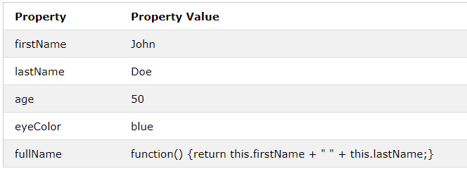
Object Methods
Objects can also have methods.
Methods are actions that can be performed on objects.
Methods are stored in properties as function definitions.

Slide 43
Example –
<p id="demo"></p>
<script>
// Create an object:
var person = {
firstName: "John",
lastName : "Doe",
id : 5566,
fullName : function() {
return this.firstName + " " + this.lastName;
}
};
// Display data from the object:
document.getElementById("demo").innerHTML = person.fullName();
</script>

Slide 44
Defining method in JavaScript Object
We can define method in JavaScript object. But before defining method, we need to add property in the function with same name as method.
<html>
<body>
<script>
function emp(id,name,salary){
this.id=id;
this.name=name;
this.salary=salary;
this.changeSalary=changeSalary;
function changeSalary(otherSalary){
this.salary=otherSalary;
}
}
e=new emp(103,"Sonoo Jaiswal",30000);
document.write(e.id+" "+e.name+" "+e.salary);
e.changeSalary(45000);
document.write("<br>"+e.id+" "+e.name+" "+e.salary);
</script>
</body>
</html>

Slide 45
JS Array –
An array is a special variable, which can hold more than one value at a time.
If you have a list of items (a list of car names, for example), storing the cars in single variables could look like this:
var car1 = "Saab"; var car2 = "Volvo"; var car3 = "BMW";
However, what if you want to loop through the cars and find a specific one? And what if you had not 3 cars, but 300?
The solution is an array!
An array can hold many values under a single name, and you can access the values by referring to an index number.

Slide 46
Creating an Array -
Using an array literal is the easiest way to create a JavaScript Array.
Syntax:
var array_name = [item1, item2, ...];
Example –
<body>
<p id="demo"></p>
<script>
var cars = ["Saab", "Volvo", "BMW"];
document.getElementById("demo").innerHTML = cars;
</script>
</body>

Slide 47
Using the JavaScript Keyword new
The following example also creates an Array, and assigns values to it:
Example
<p id="demo"></p>
<script>
var cars = new Array("Saab", "Volvo", "BMW");
document.getElementById("demo").innerHTML = cars;
</script>

Slide 48
Access the Elements of an Array
You access an array element by referring to the index number.
This statement accesses the value of the first element in cars:
var name = cars[0];
Example
var cars = ["Saab", "Volvo", "BMW"]; document.getElementById("demo").innerHTML = cars[0];

Slide 49
Changing an Array Element
This statement changes the value of the first element in cars:
cars[0] = "Opel";
Example
var cars = ["Saab", "Volvo", "BMW"]; cars[0] = "Opel"; document.getElementById("demo").innerHTML = cars[0];
Array Elements Can Be Objects
JavaScript variables can be objects. Arrays are special kinds of objects.
Because of this, you can have variables of different types in the same Array.
You can have objects in an Array. You can have functions in an Array. You can have arrays in an Array:
myArray[0] = Date.now; myArray[1] = myFunction; myArray[2] = myCars;

Slide 50
The length Property
The length property of an array returns the length of an array (the number of array elements).
Example
var fruits = ["Banana", "Orange", "Apple", "Mango"]; fruits.length; // the length of fruits is 4
Looping Array Elements
The safest way to loop through an array, is using a for loop:
Example
<script>
var emp=["Ajay","Vijay","Sanjay"];
for (i=0;i<emp.length;i++){
document.write(emp[i] + "<br/>");
}
</script>

Slide 51
Or –
<p id="demo"></p>
<script>
var emp=["Ajay","Vijay","Sanjay"];
for(var a in emp)
{
document.write(emp[a]);
}
</script>
Adding Array Elements -
The easiest way to add a new element to an array is using the push() method:
Example
var fruits = ["Banana", "Orange", "Apple", "Mango"]; fruits.push("Lemon"); // adds a new element (Lemon) to fruits

Slide 52
New element can also be added to an array using the index of array: -
<button onclick="myFunction()">Try it</button>
<p id="demo"></p>
<script>
var fruits = ["Banana", "Orange", "Apple", "Mango"];
document.getElementById("demo").innerHTML = fruits;
function myFunction() {
fruits[fruits.length] = "Lemon";
document.getElementById("demo").innerHTML = fruits;
}
</script>

Slide 53
WARNING !
Adding elements with high indexes can create undefined "holes" in an array:
Example
<p id="demo"></p>
<script>
var fruits, text, fLen, i;
fruits = ["Banana", "Orange", "Apple", "Mango"];
fruits[6] = "Lemon";
fLen = fruits.length;
text = "";
for (i = 0; i < fLen; i++) {
text += fruits[i] + "<br>";
}
document.getElementById("demo").innerHTML = text;
</script>

Slide 54
The Difference Between Arrays and Objects -
In JavaScript, arrays use numbered indexes.
In JavaScript, objects use named indexes.
Arrays are a special kind of objects, with numbered indexes.
When to Use Arrays. When to use Objects -
JavaScript does not support associative arrays.
You should use objects when you want the element names to be strings (text).
You should use arrays when you want the element names to be numbers.

Slide 55
Sorting an Array -
The sort() method sorts an array alphabetically:
Example
var fruits = ["Banana", "Orange", "Apple", "Mango"]; fruits.sort(); // Sorts the elements of fruits
Reversing an Array -
The reverse() method reverses the elements in an array.
You can use it to sort an array in descending order:
Example
var fruits = ["Banana", "Orange", "Apple", "Mango"]; fruits.sort(); // First sort the elements of fruits fruits.reverse(); // Then reverse the order of the elements

Slide 56
Numeric Sort -
By default, the sort() function sorts values as strings.
This works well for strings ("Apple" comes before "Banana").
However, if numbers are sorted as strings, "25" is bigger than "100", because "2" is bigger than "1".
Because of this, the sort() method will produce incorrect result when sorting numbers.
You can fix this by providing a compare function:
Example –
<p>Click the button to sort the array in ascending order.</p>
<button onclick="myFunction()">Try it</button>
<p id="demo"></p>
<script>
var points = [40, 100, 1, 5, 25, 10];
document.getElementById("demo").innerHTML = points;
function myFunction() {
points.sort(function(a, b){return a - b});
document.getElementById("demo").innerHTML = points;
}
</script>

Slide 57
Use the same trick to sort an array descending:
Example
var points = [40, 100, 1, 5, 25, 10]; points.sort(function(a, b){return b - a});
The Compare Function -
The purpose of the compare function is to define an alternative sort order.
The compare function should return a negative, zero, or positive value, depending on the arguments:
function(a, b){return a - b}
When the sort() function compares two values, it sends the values to the compare function, and sorts the values according to the returned (negative, zero, positive) value.

Slide 58
If the result is negative a is sorted before b.
If the result is positive b is sorted before a.
If the result is 0 no changes are done with the sort order of the two values.
Example:
The compare function compares all the values in the array, two values at a time (a, b).
When comparing 40 and 100, the sort() method calls the compare function(40, 100).
The function calculates 40 - 100 (a - b), and since the result is negative (-60), the sort function will sort 40 as a value lower than 100.
Array Functions – There are lots of array functions available in java script. You can learn them on your own.

Slide 59
JavaScript Strings -
A JavaScript string is zero or more characters written inside quotes.
You can use single or double quotes for defining a string:
Example
var carName1 = "Volvo XC60"; // Double quotes var carName2 = 'Volvo XC60'; // Single quotes
String Length
To find the length of a string, use the built-in length property:
Example
var txt = "ABCDEFGHIJKLMNOPQRSTUVWXYZ"; var sln = txt.length;

Slide 60
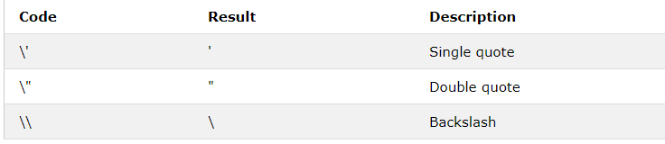
Escape Character -
Because strings must be written within quotes, JavaScript will misunderstand this string:
var x = "We are the so-called "Vikings" from the north.";
The string will be chopped to "We are the so-called ".
The solution to avoid this problem, is to use the backslash escape character.
The backslash (\) escape character turns special characters into string characters:

Slide 61
Example –
<p id="demo"></p>
<script>
var x = "We are the so-called \"Vikings\" from the north.";
document.getElementById("demo").innerHTML = x;
</script>
The sequence \' inserts a single quote in a string:
Example
var x = 'It\'s alright.';
The sequence \\ inserts a backslash in a string:
Example
var x = "The character \\ is called backslash.";

Slide 62
Strings Can be Objects
Normally, JavaScript strings are primitive values, created from literals:
var firstName = "John";
But strings can also be defined as objects with the keyword new:
var firstName = new String("John");
Don't create strings as objects. It slows down execution speed.

Slide 63
String Methods – There are lots of string methods available in java script, some important one are as follows –
indexOf() and lastIndexOf() –
The indexOf() method returns the index of (the position of) the first occurrence of a specified text in a string. The lastIndexOf() method returns the index of the last occurrence of a specified text in a string
Example
var str = "Please locate where 'locate' occurs!"; var pos = str.indexOf("locate"); // 7
Example
var str = "Please locate where 'locate' occurs!"; var pos = str.lastIndexOf("locate"); // 21

Slide 64
Both methods accept a second parameter as the starting position for the search:
Example
var str = "Please locate where 'locate' occurs!"; var pos = str.indexOf("locate", 15); // 21
Extracting String Parts -
There are 3 methods for extracting a part of a string:
slice(start, end)
substring(start, end)
substr(start, length)
The slice() Method
slice() extracts a part of a string and returns the extracted part in a new string.
The method takes 2 parameters: the start position, and the end position (end not included).
Example
var str = "Apple, Banana, Kiwi"; var res = str.slice(7, 13); // Banana

Slide 65
If a parameter is negative, the position is counted from the end of the string.
This example slices out a portion of a string from position -12 to position -6:
Example
var str = "Apple, Banana, Kiwi"; var res = str.slice(-12, -6); // Banana
If you omit the second parameter, the method will slice out the rest of the string:
Example
var res = str.slice(7);
The substring() Method
substring() is similar to slice().
The difference is that substring() cannot accept negative indexes.

Slide 66
The substr() Method
substr() is similar to slice().
The difference is that the second parameter specifies the length of the extracted part.
Example
var str = "Apple, Banana, Kiwi"; var res = str.substr(7, 6);
The result of res will be:
Banana

Slide 67
Converting to Upper and Lower Case
A string is converted to upper case with toUpperCase():
Example
var text1 = "Hello World!"; // String var text2 = text1.toUpperCase(); // text2 is text1 converted to upper
A string is converted to lower case with toLowerCase():
Example
var text1 = "Hello World!"; // String var text2 = text1.toLowerCase(); // text2 is text1 converted to lower

Slide 68
trim() -
The trim() method removes whitespace from both sides of a string:
Example
var str = " Hello World! "; alert(str.trim());
The charAt() Method
The charAt() method returns the character at a specified index (position) in a string:
Example
var str = "HELLO WORLD"; str.charAt(0); // returns H

Slide 69
Document Object Model
The document object represents the whole html document.
When html document is loaded in the browser, it becomes a document object. It is the root element that represents the html document. It has properties and methods. By the help of document object, we can add dynamic content to our web page.

Slide 70
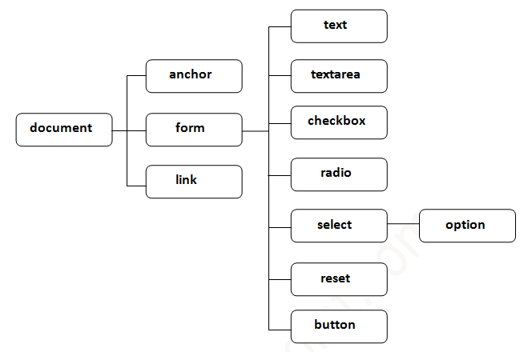
Properties of document object -

Slide 71
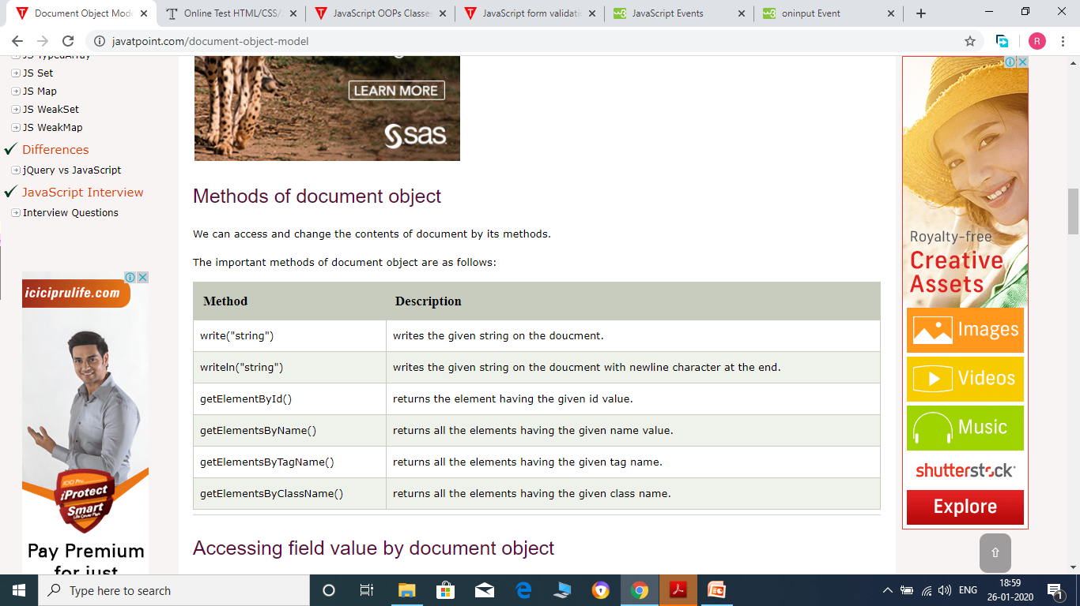

Slide 72
Accessing field value by document object – In this example, we are going to get the value of input text by user. Here, we are using document.form1.name.value to get the value of name field.
<script type="text/javascript">
function printvalue(){
var name=document.form1.name.value;
alert("Welcome: "+name);
}
</script>
<form name="form1">
Enter Name:<input type="text" name="name"/>
<input type="button" onclick="printvalue()" value="print name"/>
</form>

Slide 73
Here, document is the root element that represents the html document.
form1 is the name of the form.
name is the attribute name of the input text.
value is the property, that returns the value of the input text.
document.getElementById() method -
The document.getElementById() method returns the element of specified id.
document.getElementsByName() method –
The document.getElementsByName() method returns all the element of specified name.

Slide 74
Example of document.getElementsByName() method -
In this example, we going to count total number of genders. Here, we are using getElementsByName() method to get all the genders.
<script type="text/javascript">
function totalelements()
{
var allgenders=document.getElementsByName("gender");
alert("Total Genders:"+allgenders.length);
}
</script>
<form>
Male:<input type="radio" name="gender" value="male">
Female:<input type="radio" name="gender" value="female">
<input type="button" onclick="totalelements()" value="Total Genders">
</form>

Slide 75
document.getElementsByTagName() method –
The document.getElementsByTagName() method returns all the element of specified tag name.
Example of document.getElementsByTagName() method-
In this example, we going to count total number of paragraphs used in the document.
<script type="text/javascript">
function countpara(){
var totalpara=document.getElementsByTagName("p");
alert("total p tags are: "+totalpara.length);
}
</script>
<p>This is a pragraph</p>
<p>Here we are going to count total number of paragraphs by getElementByTagName() method.</p>
<p>Let's see the simple example</p>
<button onclick="countpara()">count paragraph</button>

Slide 76
innerHTML -
The innerHTML property can be used to write the dynamic html on the html document.
It is used mostly in the web pages to generate the dynamic html such as registration form, comment form, links etc.
Example of innerHTML property
In this example, we are going to create the html form when user clicks on the button.
<script type="text/javascript" >
function showcommentform() {
var data="Name:<input type='text' name='name'><br>Comment:<br><textarea rows='5' cols='80'></textarea>
<br><input type='submit' value='Post Comment'>";
document.getElementById('mylocation').innerHTML=data;
}
</script>
<form name="myForm">
<input type="button" value="comment" onclick="showcommentform()">
<div id="mylocation"></div>
</form>

Slide 77
Show/Hide Comment Form Example using innerHTML -
<!DOCTYPE html>
<html>
<head>
<title>First JS</title>
<script>
var flag=true;
function commentform(){
var cform="<form action='Comment'>Enter Name:<br><input type='text' name='name'/><br/>
Enter Email:<br><input type='email' name='email'/><br>Enter Comment:<br/>
<textarea rows='5' cols='70'></textarea><br><input type='submit' value='Post Comment'/></form>";
if(flag){
document.getElementById("mylocation").innerHTML=cform;
flag=false;
}else{
document.getElementById("mylocation").innerHTML="";
flag=true;
}
}
</script>
</head>
<body>
<button onclick="commentform()">Comment</button>
<div id="mylocation"></div>
</body>
</html>

Slide 78
JavaScript Form Validation
It is important to validate the form submitted by the user because it can have inappropriate values. So, validation is must to authenticate user.
JavaScript provides facility to validate the form on the client-side so data processing will be faster than server-side validation. Most of the web developers prefer JavaScript form validation.
Through JavaScript, we can validate name, password, email, date, mobile numbers and more fields.
Example
In this example, we are going to validate the name and password. The name can’t be empty and password can’t be less than 6 characters long.

Slide 79
<script>
function validateform(){
var name=document.myform.name.value;
var password=document.myform.password.value;
if (name==null || name==""){
alert("Name can't be blank");
return false;
}else if(password.length<6){
alert("Password must be at least 6 characters long.");
return false;
}
}
</script>
<body>
<form name="myform" method="post" action="abc.jsp" onsubmit="return validateform()" >
Name: <input type="text" name="name"><br/>
Password: <input type="password" name="password"><br/>
<input type="submit" value="register">
</form>

Slide 80
Retype Password Validation –
<script type="text/javascript">
function matchpass(){
var firstpassword=document.f1.password.value;
var secondpassword=document.f1.password2.value;
if(firstpassword==secondpassword){
return true;
}
else{
alert("password must be same!");
return false;
}
}
</script>
<form name="f1" action="register.jsp" onsubmit="return matchpass()">
Password:<input type="password" name="password" /><br/>
Re-enter Password:<input type="password" name="password2"/><br/>
<input type="submit">
</form>

Slide 81
JavaScript Number Validation –
Let's validate the textfield for numeric value only. Here, we are using isNaN() function.
<script>
function validate(){
var num=document.myform.num.value;
if (isNaN(num)){
document.getElementById("numloc").innerHTML="Enter Numeric value only";
return false;
}else{
return true;
}
}
</script>
<form name="myform" onsubmit="return validate()" >
Number: <input type="text" name="num"><span id="numloc"></span><br/>
<input type="submit" value="submit">
</form>

Slide 82
JavaScript Events
An HTML event can be something the browser does, or something a user does.
Here are some examples of HTML events:
An HTML web page has finished loading
An HTML input field was changed
An HTML button was clicked
Often, when events happen, you may want to do something.
JavaScript lets you execute code when events are detected.

Slide 83
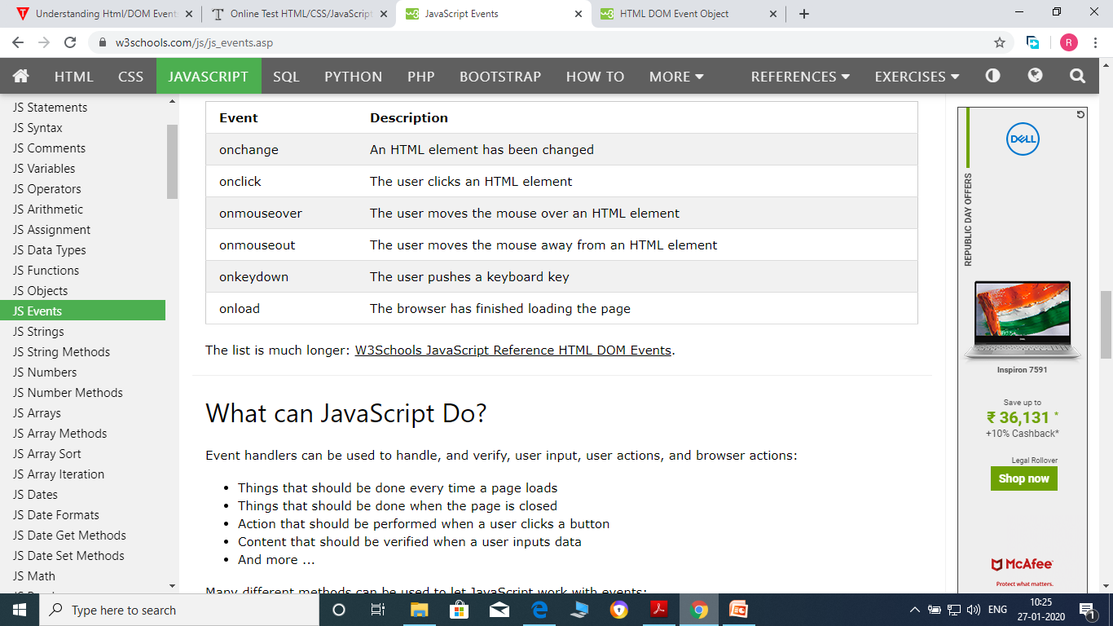
Common HTML Events -
Here is a list of some common HTML events:

Slide 84
onchange Event –
The onchange event occurs when the value of an element has been changed.
For radiobuttons and checkboxes, the onchange event occurs when the checked state has been changed.
<body>
<p>Select a new car from the list.</p>
<select id="mySelect" onchange="myFunction()">
<option value="Audi">Audi</option>
<option value="BMW">BMW</option>
<option value="Mercedes">Mercedes</option>
<option value="Volvo">Volvo</option>
</select>
<p>When you select a new car, a function is triggered which outputs the value of the selected car.</p>
<p id="demo"></p>
<script>
function myFunction() {
var x = document.getElementById("mySelect").value;
document.getElementById("demo").innerHTML = "You selected: " + x;
}
</script>
</body>

Slide 85
Example 2 –
<body>
<p>This example demonstrates how to assign an "onchange" event to an input element.</p>
Enter your name: <input type="text" id="fname" onchange="myFunction()">
<p>When you leave the input field, a function is triggered which transforms the input text to upper case.</p>
<script>
function myFunction() {
var x = document.getElementById("fname");
x.value = x.value.toUpperCase();
}
</script>

Slide 86
onclick Event –
The onclick event occurs when the user clicks on an element.
Example -
<p>Click the button to trigger a function that will output "Hello World" in a p element with id="demo".</p>
<button onclick="myFunction()">Click me</button>
<p id="demo"></p>
<script>
function myFunction() {
document.getElementById("demo").innerHTML = "Hello World";
}
</script>

Slide 87
Example 2 –
<body>
<p>This example uses the HTML DOM to assign an "onclick" event to a p element.</p>
<p id="demo">Click me.</p>
<script>
document.getElementById("demo").onclick = function() {myFunction()};
function myFunction() {
document.getElementById("demo").innerHTML = "YOU CLICKED ME!";
}
</script>
</body>

Slide 88
onmouseover Event and onmouseout Event –
The onmouseover event occurs when the mouse pointer is moved onto an element, or onto one of its children.
The onmouseout event occurs when the mouse pointer is moved out of an element, or out of one of its children.
<body>
<img onmouseover="bigImg(this)" onmouseout="normalImg(this)" border="0" src="smiley.gif" alt="Smiley" width="32" height="32">
<p>The function bigImg() is triggered when the user moves the mouse pointer over the image.</p>
<p>The function normalImg() is triggered when the mouse pointer is moved out of the image.</p>
<script>
function bigImg(x) {
x.style.height = "64px";
x.style.width = "64px";
}
function normalImg(x) {
x.style.height = "32px";
x.style.width = "32px";
}
</script>
</body>

Slide 89
Example 2 –
<h1 id="demo" onmouseover="mouseOver()" onmouseout="mouseOut()">Mouse over me</h1>
<script>
function mouseOver() {
document.getElementById("demo").style.color = "red";
}
function mouseOut() {
document.getElementById("demo").style.color = "black";
}
</script>

Slide 90
onkeydown Event –
The onkeydown attribute fires when the user is pressing a key (on the keyboard).
<body>
<p>A function is triggered when the user is pressing a key in the input field.</p>
<input type="text" onkeydown="myFunction()">
<script>
function myFunction() {
alert("You pressed a key inside the input field");
}
</script>
</body>

Slide 91
Example 2 -
<body>
<p>Press and hold down a key inside the text field to set a red background color. Release the key to set a green background color.</p>
<input type="text" id="demo" onkeydown="keydownFunction()" onkeyup="keyupFunction()">
<script>
function keydownFunction() {
document.getElementById("demo").style.backgroundColor = "red";
}
function keyupFunction() {
document.getElementById("demo").style.backgroundColor = "green";
}
</script>
</body>

Slide 92
onload Event –
The onload event occurs when an object has been loaded.
onload is most often used within the <body> element to execute a script once a web page has completely loaded all content (including images, script files, CSS files, etc.).
<body onload="myFunction()">
<script>
function myFunction() {
alert("Hi, Mark!");
}
</script> <h2>Hi, Mark!</h2>
</body>

