Slide 1
Predicting various Covid-19 trends using Time Series Analysis
Project by :
Shivansh Jaiswal 2001CS66
Under the mentorship of : Dr. Sourav Kumar
Assistant Professor
IIT Patna

Slide 2
Problem Statement
To run time-series analysis on a Covid-19 Data Set and using it to predict future trends of Covid-19, also analysing the trends regarding COVID-19 in Developing and Developed Areas.

Slide 3
Time Series Analysis
Methodology
Import Dataset/Libraries
Visualizing the Dataset
Pre-process the Dataset
Choosing the appropriate Model
Residual Data is White Noise?
Compare Accuracy with testing data/plot residuals
Training the model on training dataset (Selecting the best parameters)
Exit
If NO => Repeat

Slide 4
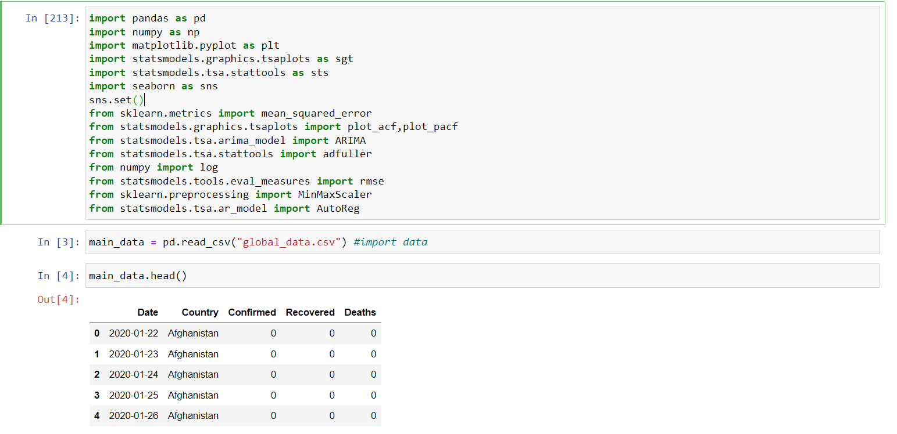
Getting the Dataset
The dataset is obtained via the link: https://github.com/datasets/covid-19
The libraries used are given above

Slide 5
Visualizing and Pre-processing the Dataset
The dataset gives the no. Covid-19 Cases and Deaths as a function of daily time intervals.
First, extract the data pertaining to our country, India.
Set the Date as Date-Time object instead of plain text, also set it as my main index.

Slide 6
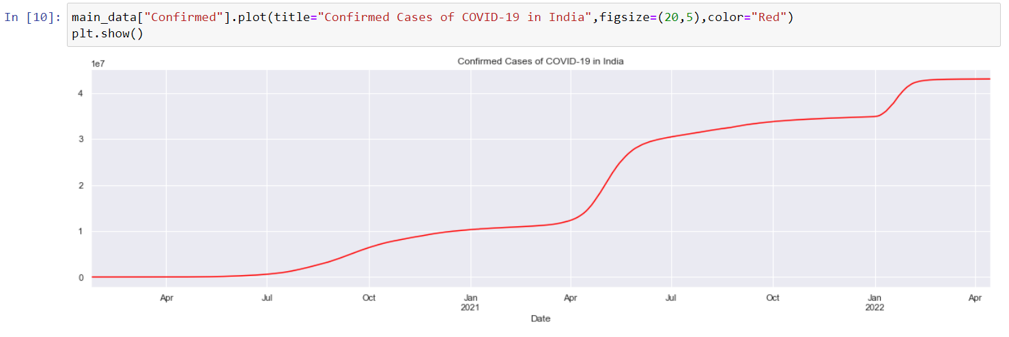
Visualizing and Pre-processing the Dataset
After setting the appropriate index, let’s plot the data

Slide 7
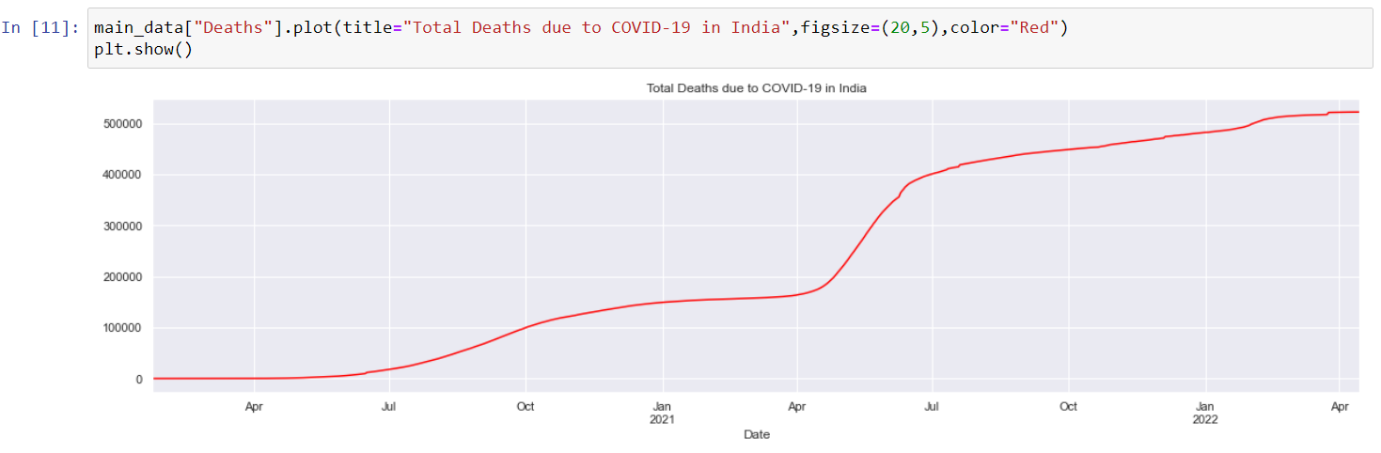
Visualizing and Pre-processing the Dataset
Plot of Total Deaths due to Covid-19 in India

Slide 8
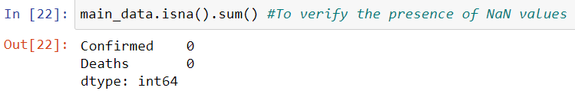
Visualizing and Pre-processing the Dataset
Set the time frequency as “daily”.
To make sure that no NaN values are present

Slide 9
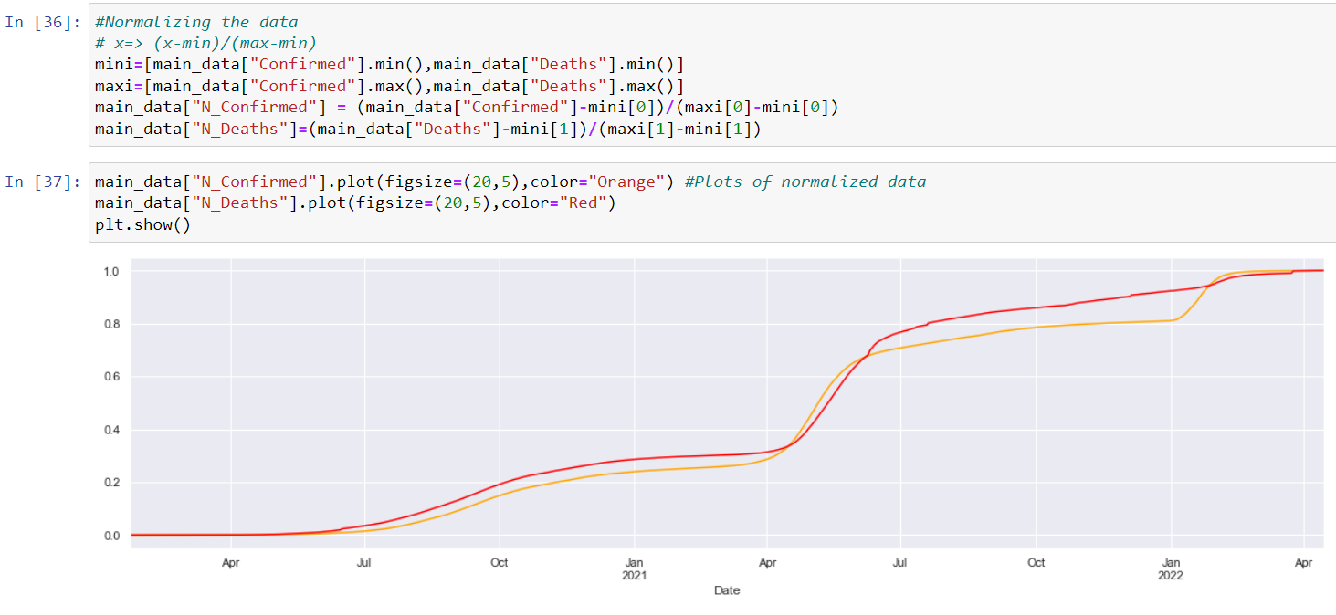
Normalizing the Dataset
We see that the scales vary greatly in Confirmed Cases and Total Deaths, so we normalize the data to get uniformity.
To normalize we transform the output value of the dataset as F(t) => (F(t) – min) / (max - min)

Slide 10
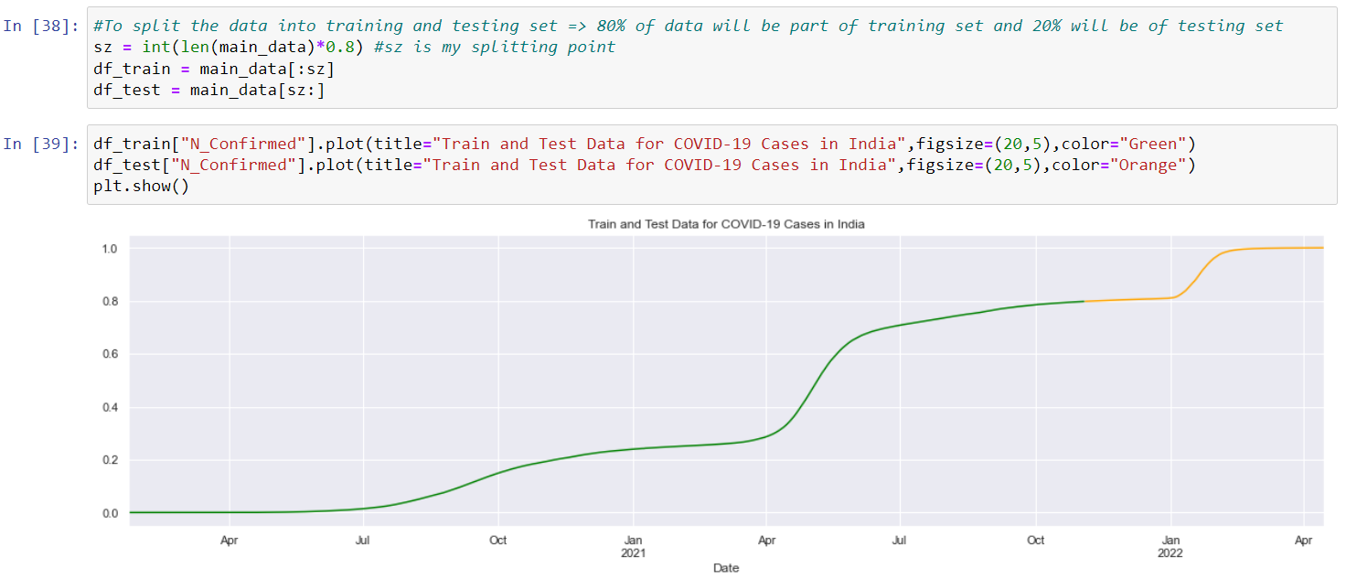
Splitting Dataset
Let’s choose to have 80% of the data as training set and 20% as testing set

Slide 11
Auto Regressive (AR) Model
Auto Regressive (AR) Model uses observations of data from previous time stamps to predict the output of the data at the next time stamp.
The AR model of order p a.k.a AR(p), describes the relationship between Y(t) , or the data value at current time stamp, to be related via the values of previous time stamps as follows.
By performing regression on the training dataset, the appropriate values of coefficients are found. These coeffients are known as PACF (Partial Auto Correlation Factor)

Slide 12
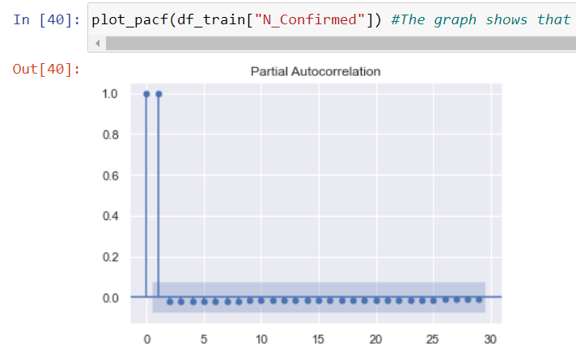
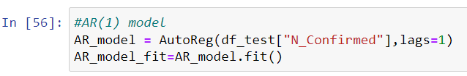
Using AR Model
Import Library
The PACF that were obtained:
Clearly, the Coefficients become insignificant after 2. So, we can drop then and use an AR(1) model.

Slide 13
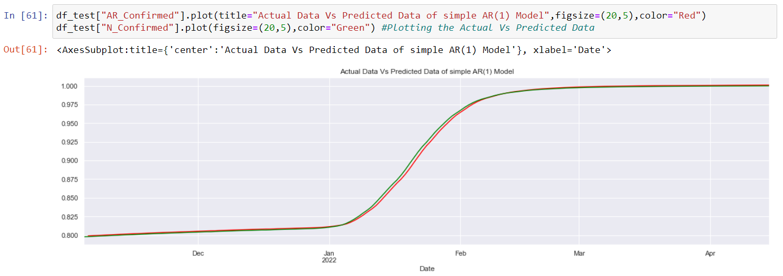
Results: AR model
Plot of Predicted Data Vs Actual Data on testing data of COVID-19 Confirmed Cases

Slide 14

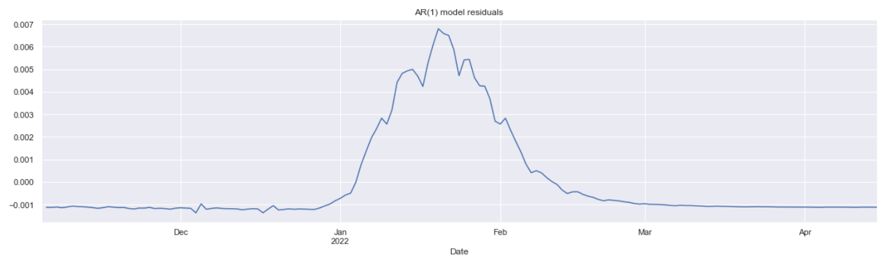
Results: AR model
Plot of AR model Residuals

Slide 15
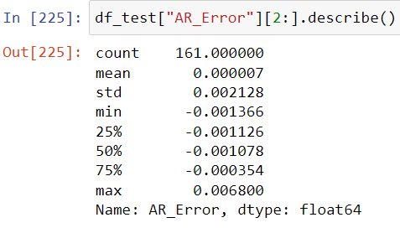
Results: AR model
The mean is very close to zero, which are strong indicators of white noise.
However, from the plot, we see that the mean is not constant with time. Mean is higher in the interval Jan 2022 to Feb 2022.
This suggests a possibility of better prediction, to reduce the overestimation in the interval from Jan 2022 to Feb 2022

Slide 16

Auto Regressive Integrated Moving Average Model (ARIMA)
ARIMA model assumes the dependence of output function y(t) both on its past values and past errors. It is a combination of Auto Regressive and Moving Average Model, carried on dataset, which is assumed to become stationary after certain amount of “differencing” applied to it.
ARIMA is a combination of ARMA with an “Integrated” feature, which involves “differencing” the time series several times till it becomes approximately stationary and applying ARMA model to it, then “Integrating” to get the predicted equation of original time series.

Slide 17
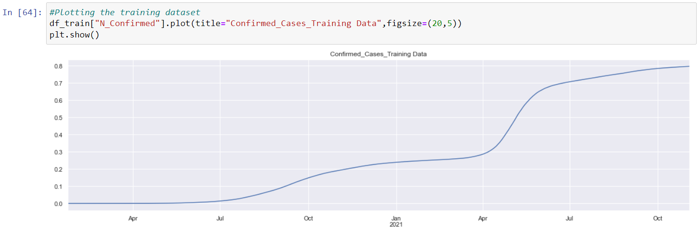
Using ARIMA Model
Import Library
Plotting the Dataset
Clearly, the Dataset is not stationary, the mean increases with time. Small seasonality can also be observed.

Slide 18
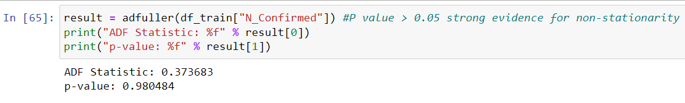
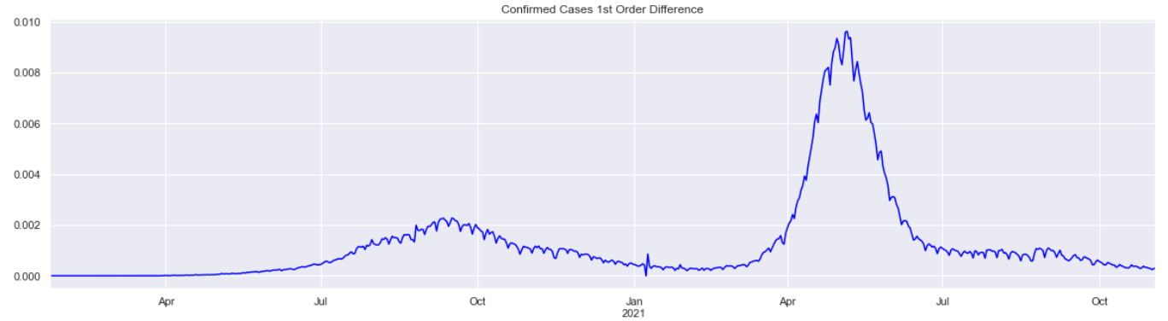
Using ARIMA Model
The adfuller test gave strong evidence against stationarity, with a p-value of >0.05
Plot of 1st Order Difference shows non-constant mean with little trend of seasonality, So, we take the 2nd Order Difference.

Slide 19
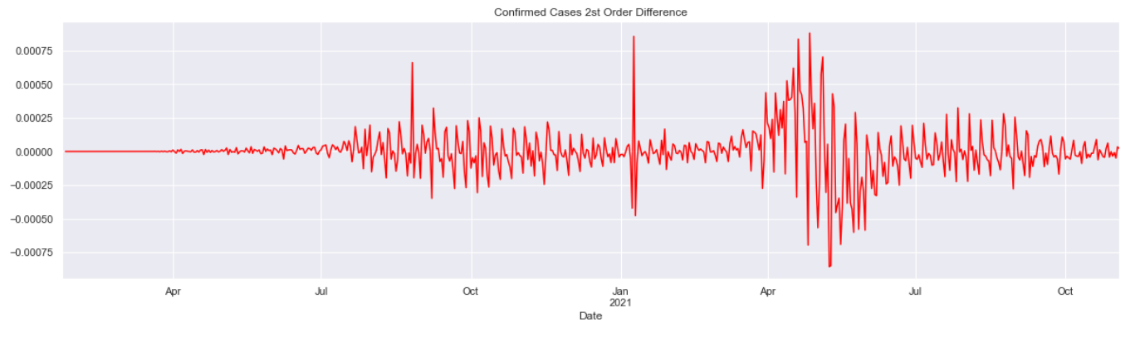
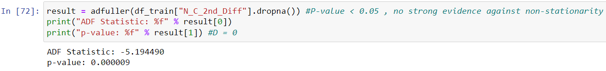
Using ARIMA Model
Plot of 2nd Order Difference shows approximately constant mean around zero and no observable seasonality, however a little variation of slandered deviation can be seen, nevertheless, we stop at this stage.
Adfuller test gives a p-value of around 0.9e-5, which is less than 0.05, thus we have assumed stationarity

Slide 20
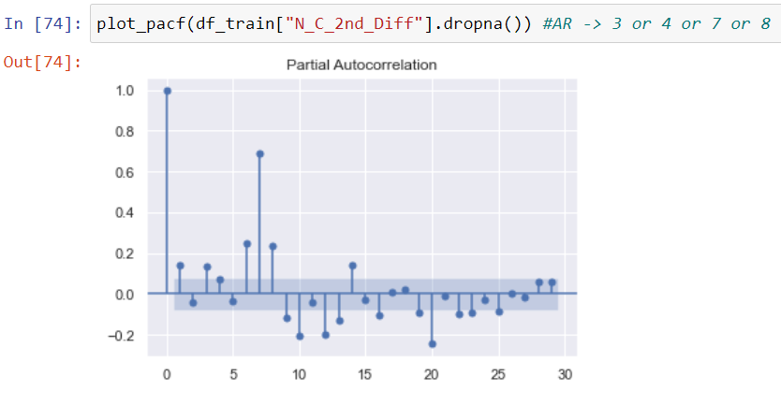
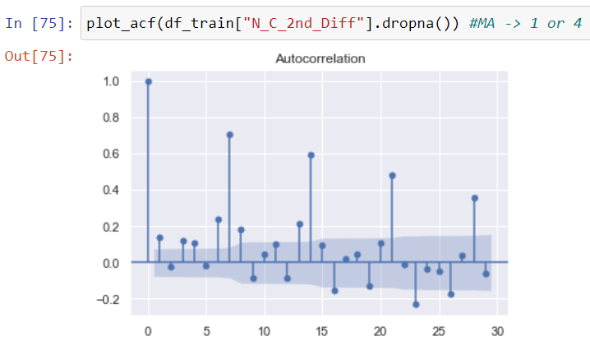

Using ARIMA Model
Plot of PACF
Plot of ACF
After many trials and errors, we found it most appropriate to use ARIMA(4,2,1) model

Slide 21
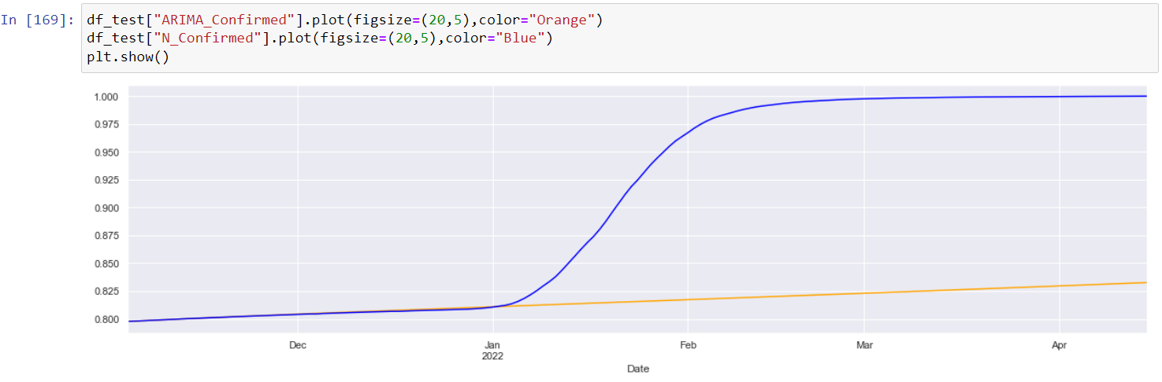
Results: ARIMA Model
The results were accurate enough till the starting of Jan 2022, but then became way-off. Despite many trials, this was the best that I could come up with.
Improvement: I tried to improve by incorporating rolling forecast.

Slide 22
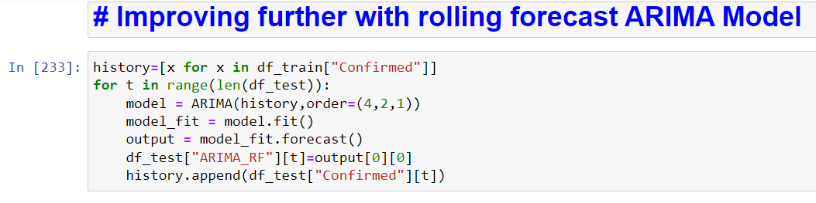
Improving
Rolling forecast: We keep updating the model while predicting from testing dataset i.e. after predicting the next time stamp, we observe the actual value and re-evaluate our model and incorporate the effects of actual value in our model.
Code for rolling forecast.

Slide 23
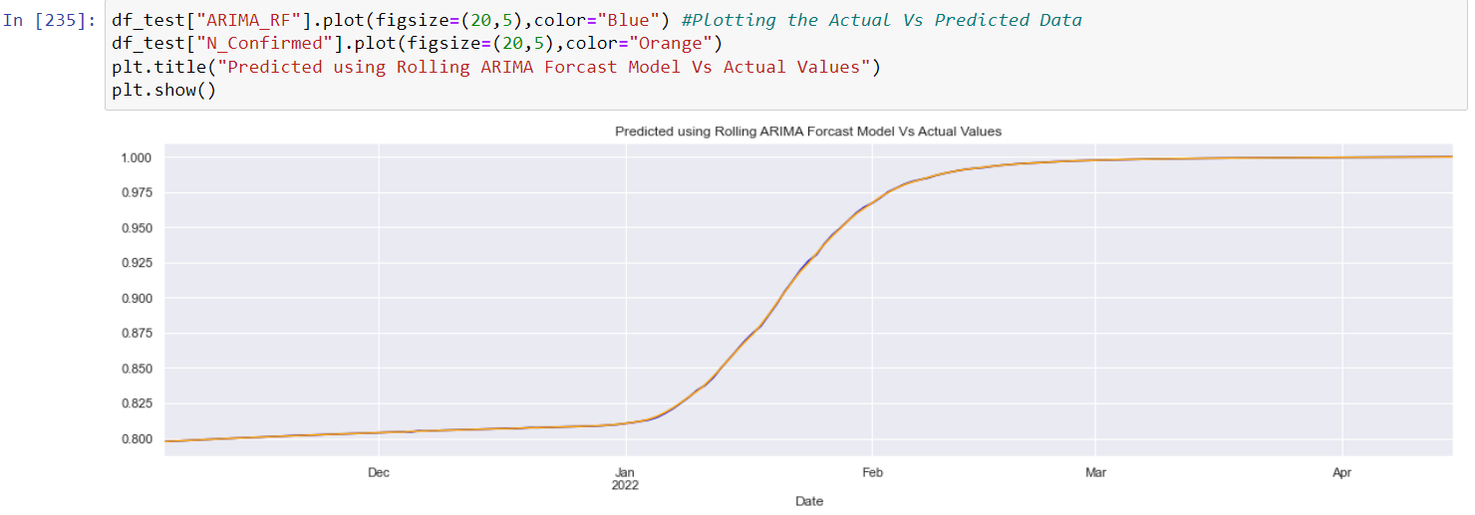
Results using Rolling Forecast
Plot of Predicted vs Actual Values
We see significant improvement by applying rolling forecast. Now the Predicted values almost overlap the Actual Values in graph

Slide 24
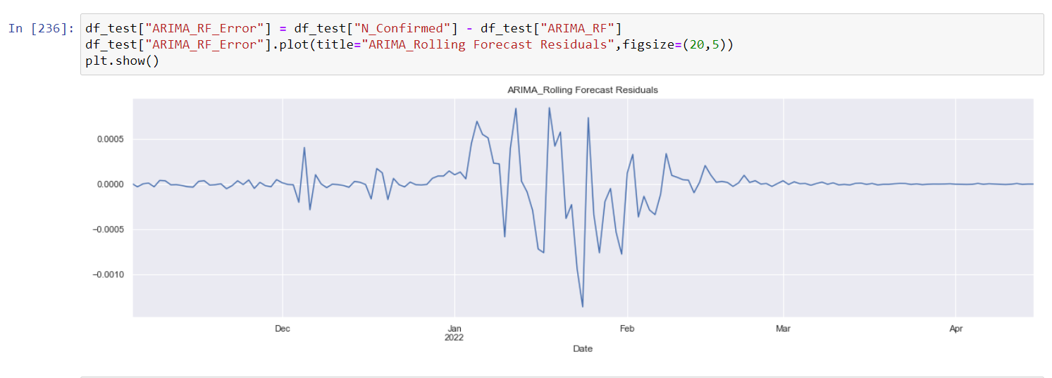
Results using Rolling Forecast
Plot of Residuals
We see, that at least, compared to our previous AR(1) model, now the mean is approximately constant, although the standard deviation is quite high in around middle-end of Jan 2022

Slide 25
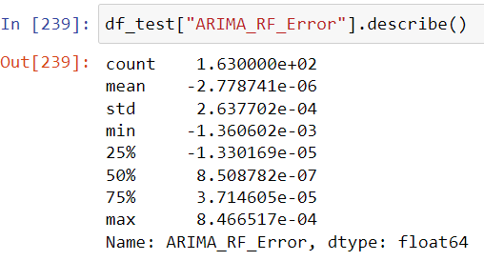
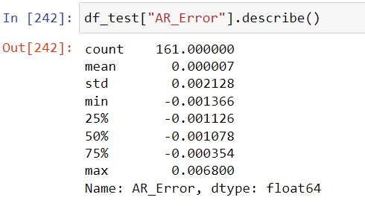
Comparison of Errors
Data of Residuals: A Comparison
Observations:
The mean and standard deviation of ARIMA Residuals is much lower than AR Residuals.
The Range of Error i.e. the difference between maximum and minimum error is also much lower in ARIMA model.
The root mean-squared error is also ~10% lower in ARIMA. So, the ARIMA Residuals are closer to white noise than AR Residuals, suggesting that ARIMA model with rolling forecast gave better results.

Slide 26
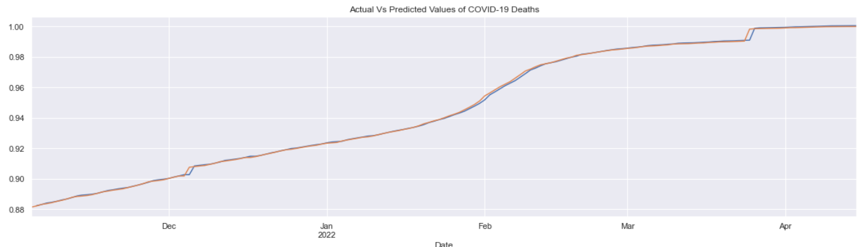
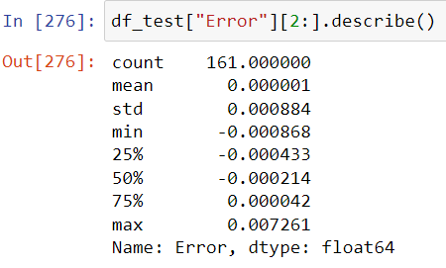
Covid-19 Deaths in India
Predicted Vs Actual Values using similar analysis: A Comparison
Information regarding residuals-
Here also, we observe the mean to be very close to zero.

Slide 27
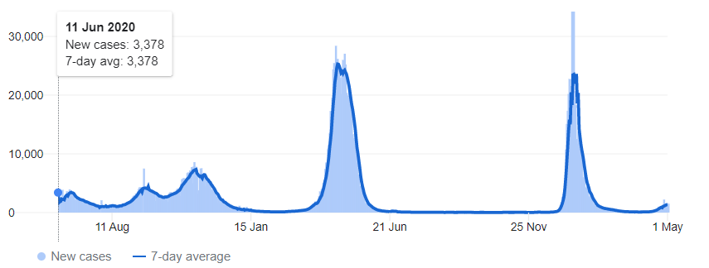
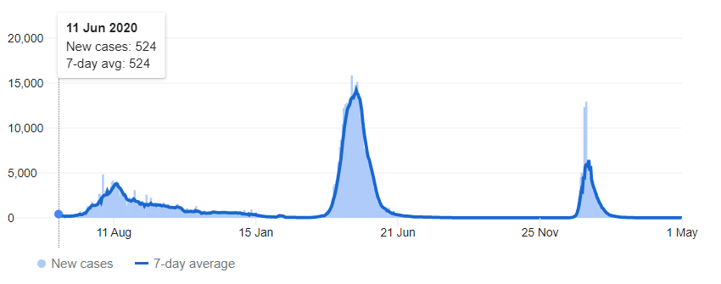
Covid-19
Comparison of trends of COVID-19 in Delhi (metro city) and Bihar (developing state)
Fresh Cases Vs Time
Delhi
Bihar

Slide 28
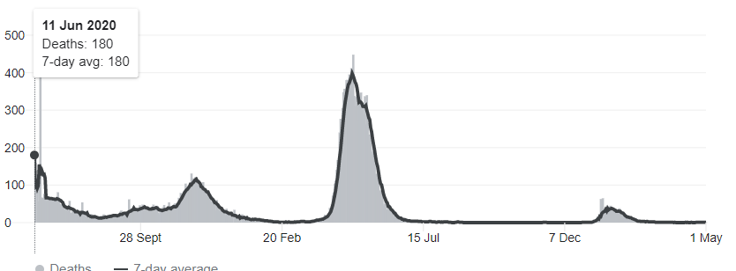
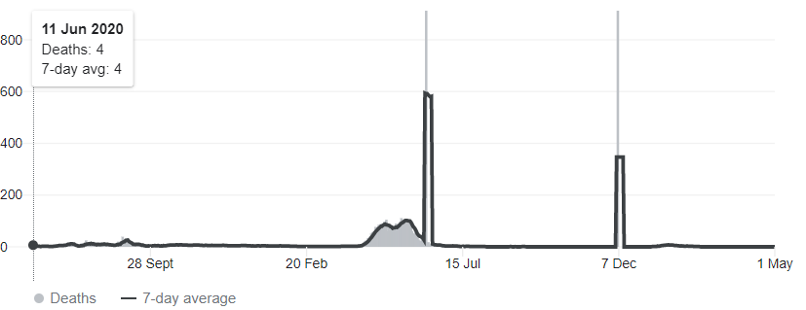
Covid-19
Comparison of trends of COVID-19 in Delhi (metro city) and Bihar (developing state)
Covid-19 Deaths Vs Time
Delhi
Bihar

Slide 29
Observations
Metro Cities like Delhi, Mumbai are well connected to outside world compared to developing states, so rising cases are more in Delhi, as compared to Bihar.
Despite of better medical facilities, Delhi has larger number of deaths initially, the primary reason is due to larger infected population and large influx of people coming from foreign countries. However, in the later stages, the difference is much lesser.

Slide 30
THANK YOU

