Slide 1
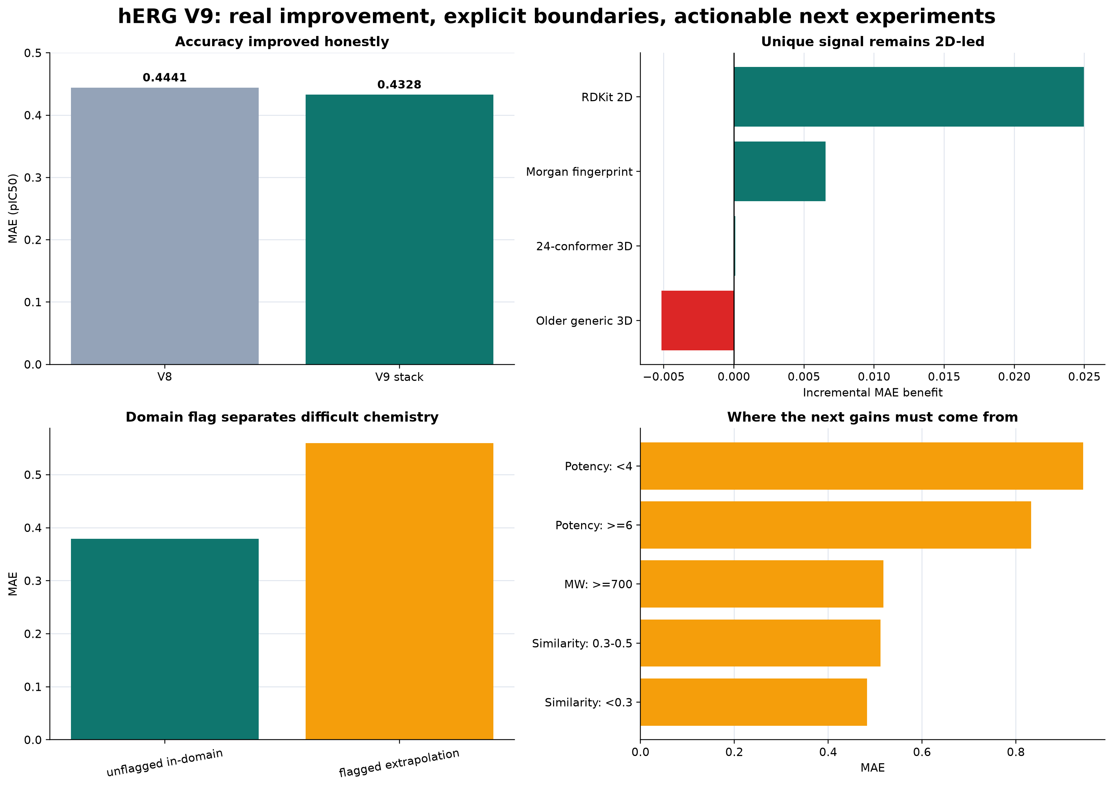
PLATFORM PROGRESS REVIEW
hERG Prediction
Platform
Honest gains, clear boundaries,
and the next experiments
18,801 structures
8,455 scaffolds
5 nested folds
Shivansh Sahni • August 18, 2026
hERG platform meeting | internal results
01
Notes:
Open with the contribution, not just the metric: we now have a broad, traceable hERG potency platform evaluated under a deliberately difficult scaffold-held-out design. The meeting goal is to agree on the next evidence-generating experiments.
[Sources]
- /Users/shivanshsahni/Downloads/Personal/Wang/Menin/research/reports/platform/herg_meeting_2026_08_18/MEETING_BRIEF.md
- /Users/shivanshsahni/Downloads/Personal/Wang/Menin/research/reports/platform/herg_meeting_2026_08_18/figures/06_graphical_summary.png
[/Sources]

Slide 2
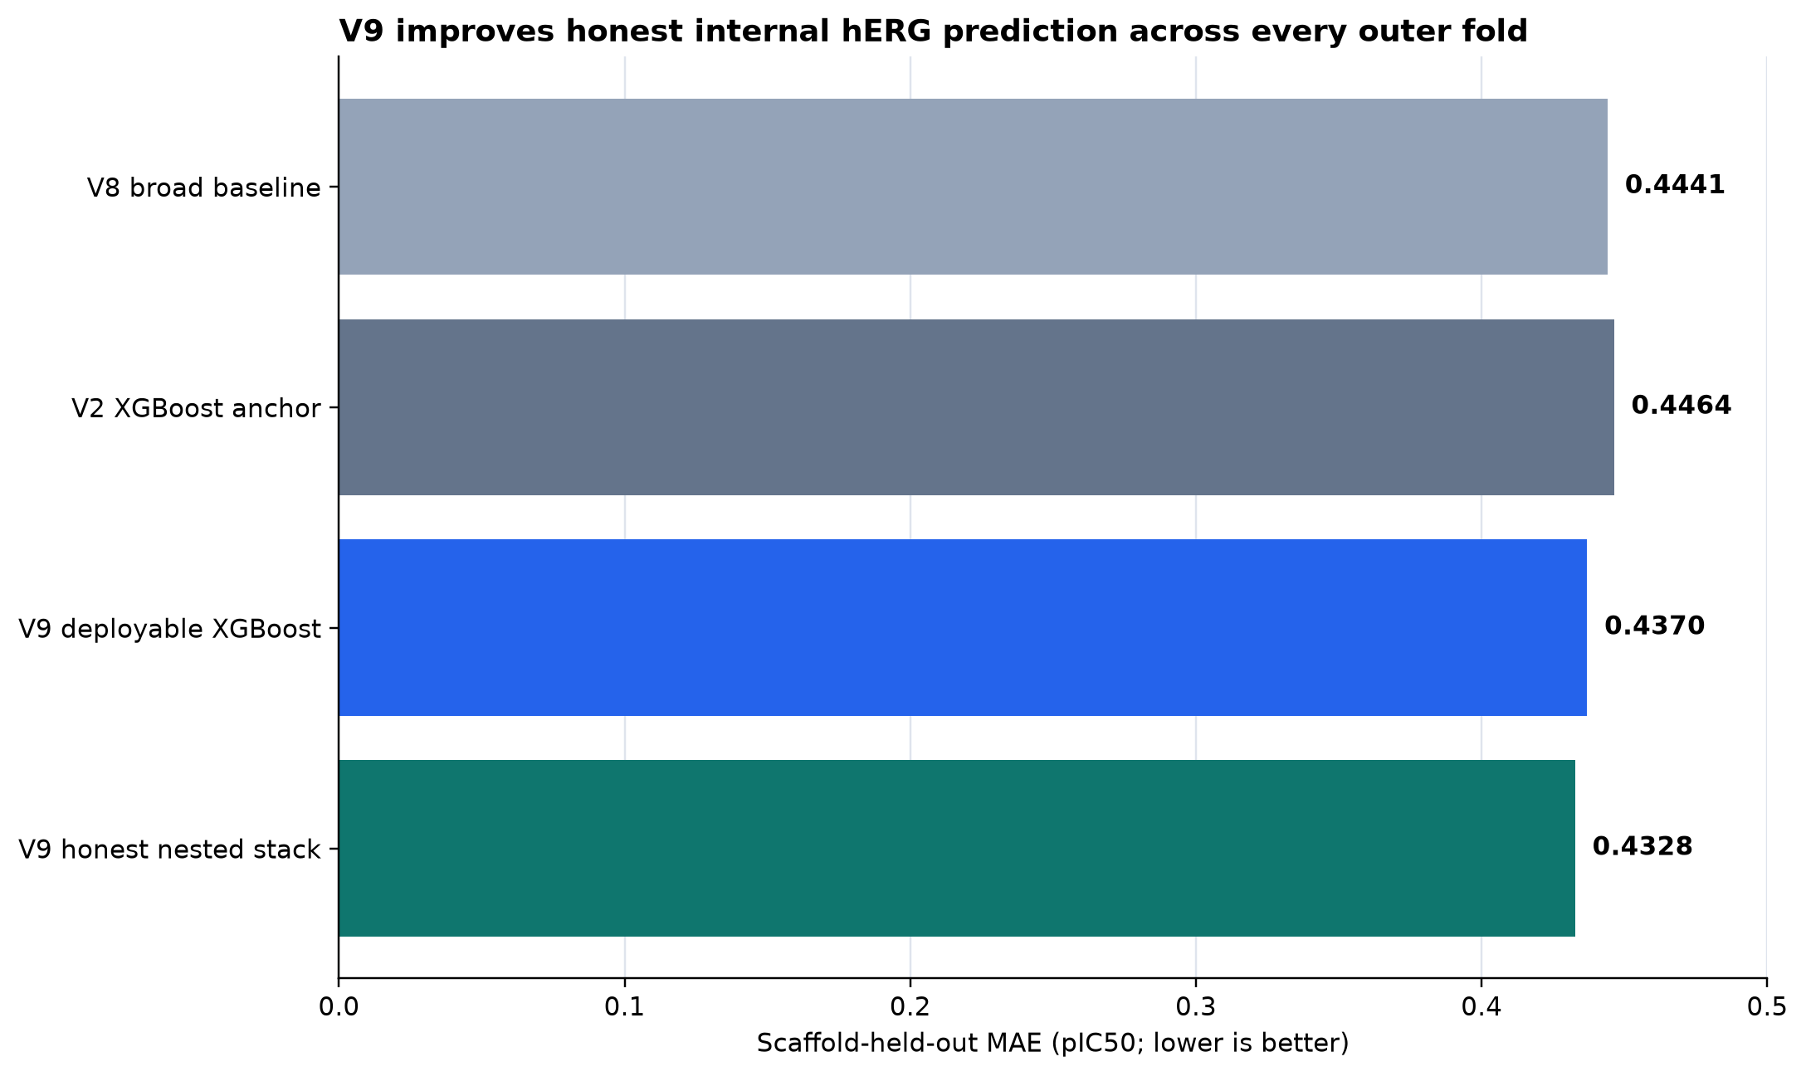
HEADLINE RESULT
The strongest honest internal result so far
0.4328
91.8%
MAE in pIC50
V9 nested stack
predictions within
1.0 log unit
−0.0114 MAE vs V8
95% scaffold-bootstrap CI: −0.0141 to −0.0086
All five outer folds improved.
Important: the stack is the best cross-fitted internal evidence. The frozen deployable XGBoost artifact is slightly weaker (MAE 0.4370).
Internal analysis | train-only nested scaffold evaluation
02
Notes:
The improvement is small in absolute pIC50 units, but it is repeatable across every outer fold and the scaffold-cluster confidence interval excludes zero. Do not call this external superiority. Also distinguish the cross-fitted stack from the single deployable XGBoost model.
[Sources]
- /Users/shivanshsahni/Downloads/Personal/Wang/Menin/research/reports/platform/herg_meeting_2026_08_18/MEETING_BRIEF.md
- /Users/shivanshsahni/Downloads/Personal/Wang/Menin/research/reports/platform/herg_meeting_2026_08_18/RESULT_TRACEABILITY.csv
- /Users/shivanshsahni/Downloads/Personal/Wang/Menin/research/reports/platform/herg_meeting_2026_08_18/figures/01_model_progress.png
[/Sources]

Slide 3
WHY THE RESULT IS CREDIBLE
The evaluation is designed to resist inflated metrics
18,801
8,455
5
0
exact training structures
scaffold groups
nested outer folds
repository validation/test
labels opened
1
2
3
4
Collapse
Separate
Select
Evaluate
Structure-level targets prevent repeated measurements from masquerading as independent compounds.
8,455 scaffold groups keep related chemotypes together during splitting.
Hyperparameters and mixtures are chosen only inside each outer-training context.
Each compound is predicted once in a held-out scaffold fold; repository validation/test outcomes stay sealed.
Internal analysis | train-only nested scaffold evaluation
03
Notes:
This slide explains why the MAE is not directly comparable to random-split or duplicate-rich benchmarks. The key governance statement is that all adaptive choices were confined to training folds and the repository validation/test outcomes remained sealed.
[Sources]
- /Users/shivanshsahni/Downloads/Personal/Wang/Menin/research/reports/platform/herg_meeting_2026_08_18/TECHNICAL_QA.md
- /Users/shivanshsahni/Downloads/Personal/Wang/Menin/research/reports/platform/herg_meeting_2026_08_18/MEETING_BRIEF.md
[/Sources]

Slide 4
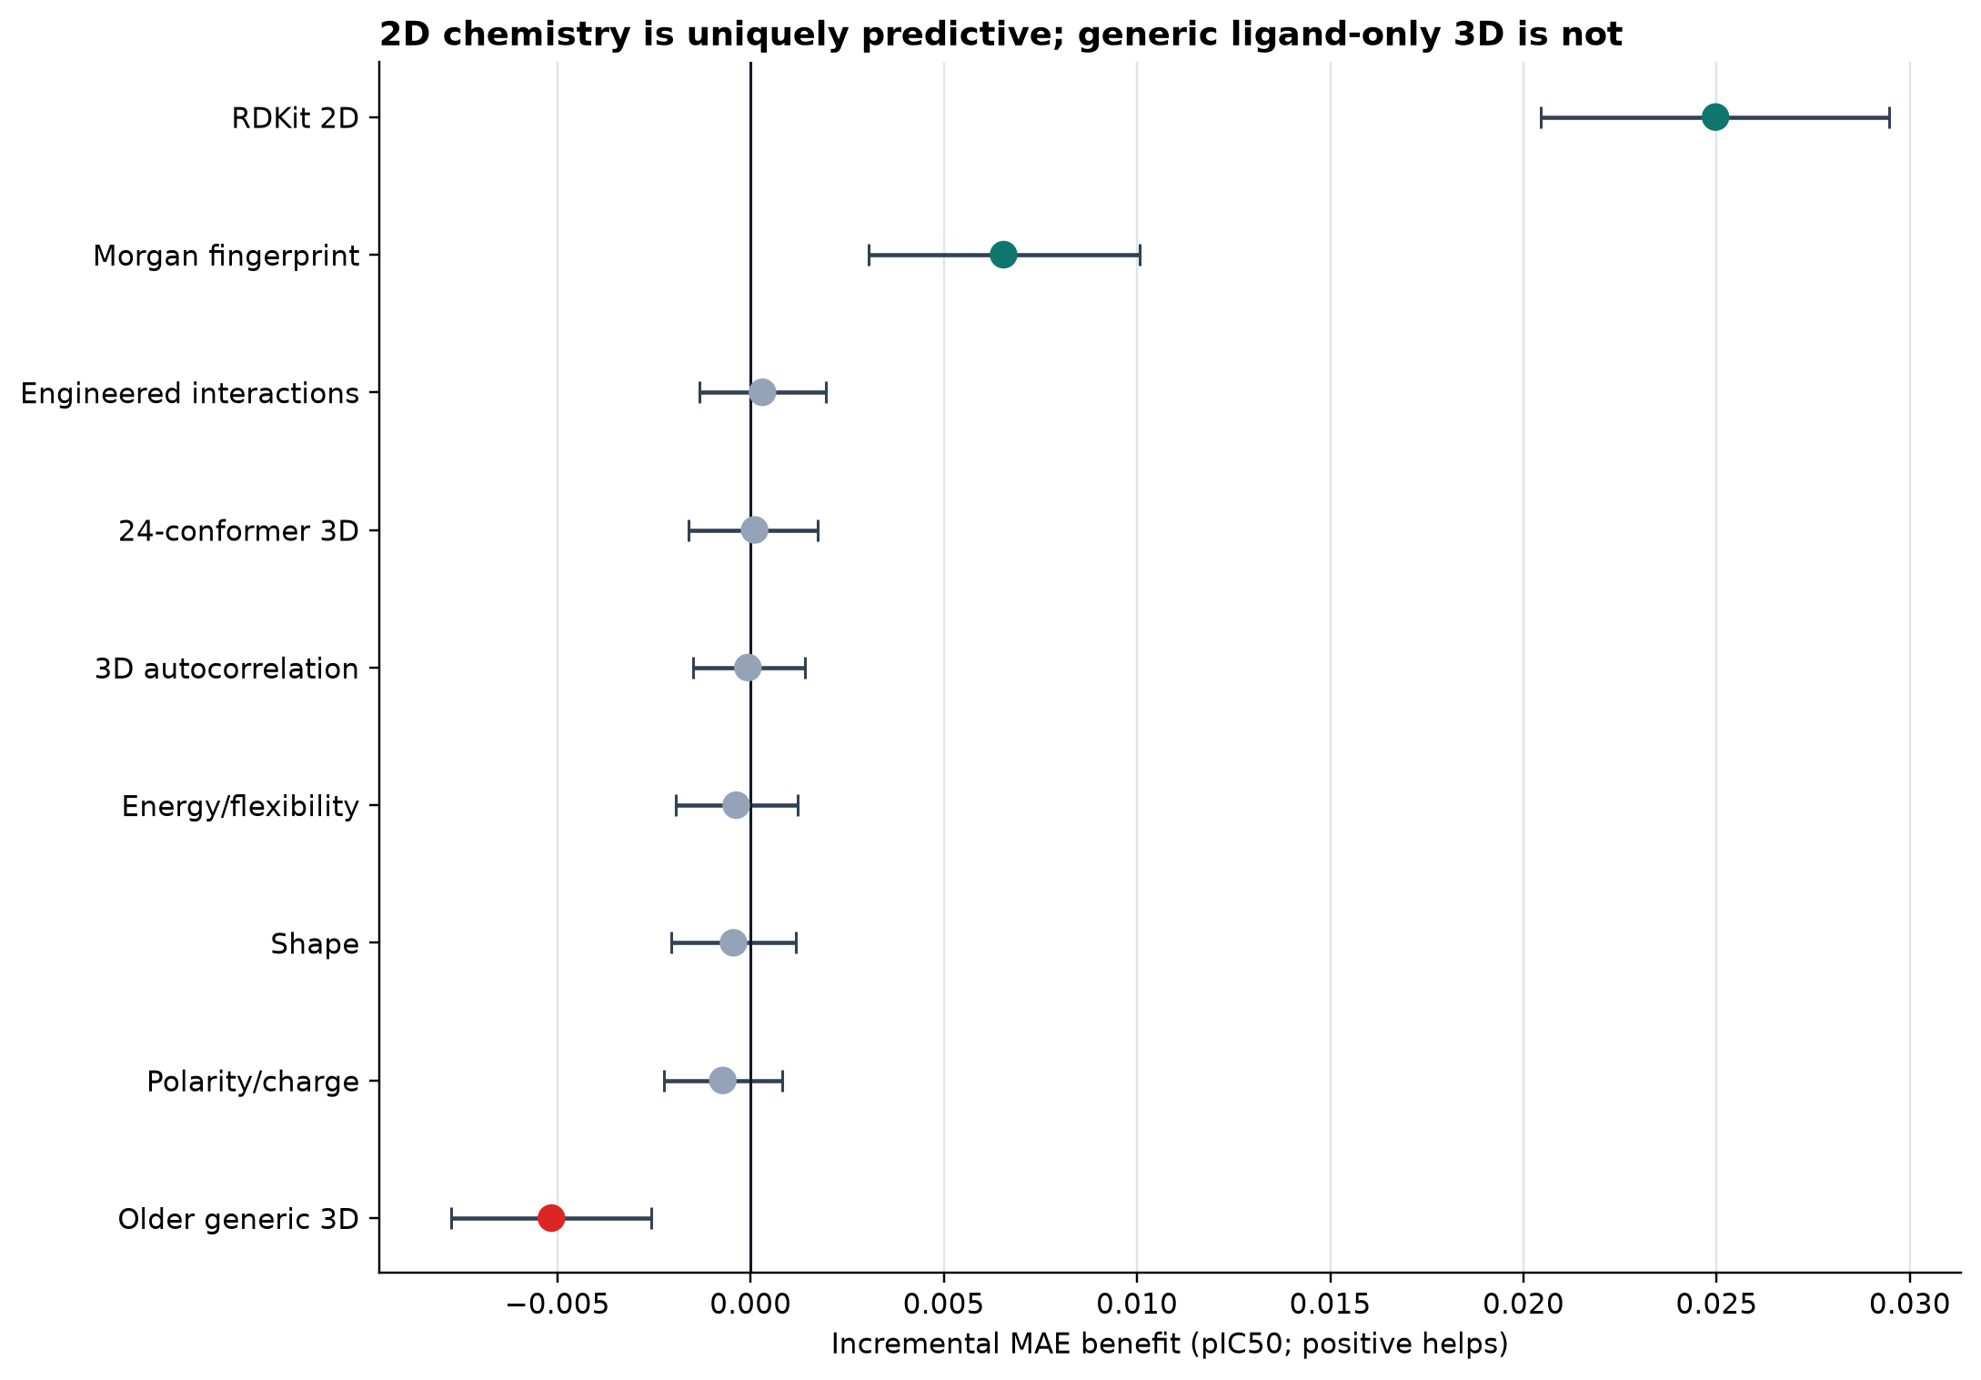
FEATURE-FAMILY EVIDENCE
2D chemistry carries the stable unique signal
+0.0250 MAE
when RDKit2D is removed
+0.0065 MAE
when Morgan fingerprints are removed
Generic ligand-only 3D, shape, WHIM, energy/flexibility, and polarity/charge blocks did not show a stable independent aggregate gain.
Internal analysis | train-only nested scaffold evaluation
04
Notes:
The scientifically useful result is both positive and negative. RDKit2D and Morgan carry reproducible nonredundant signal. The expensive generic conformer features are mostly redundant or noisy after those representations are present. This does not rule out receptor-aware, membrane-aware, or higher-quality microstate physics; those experiments were not performed.
[Sources]
- /Users/shivanshsahni/Downloads/Personal/Wang/Menin/research/reports/platform/herg_meeting_2026_08_18/MEETING_BRIEF.md
- /Users/shivanshsahni/Downloads/Personal/Wang/Menin/research/reports/platform/herg_meeting_2026_08_18/figures/02_feature_family_effects.png
[/Sources]

Slide 5
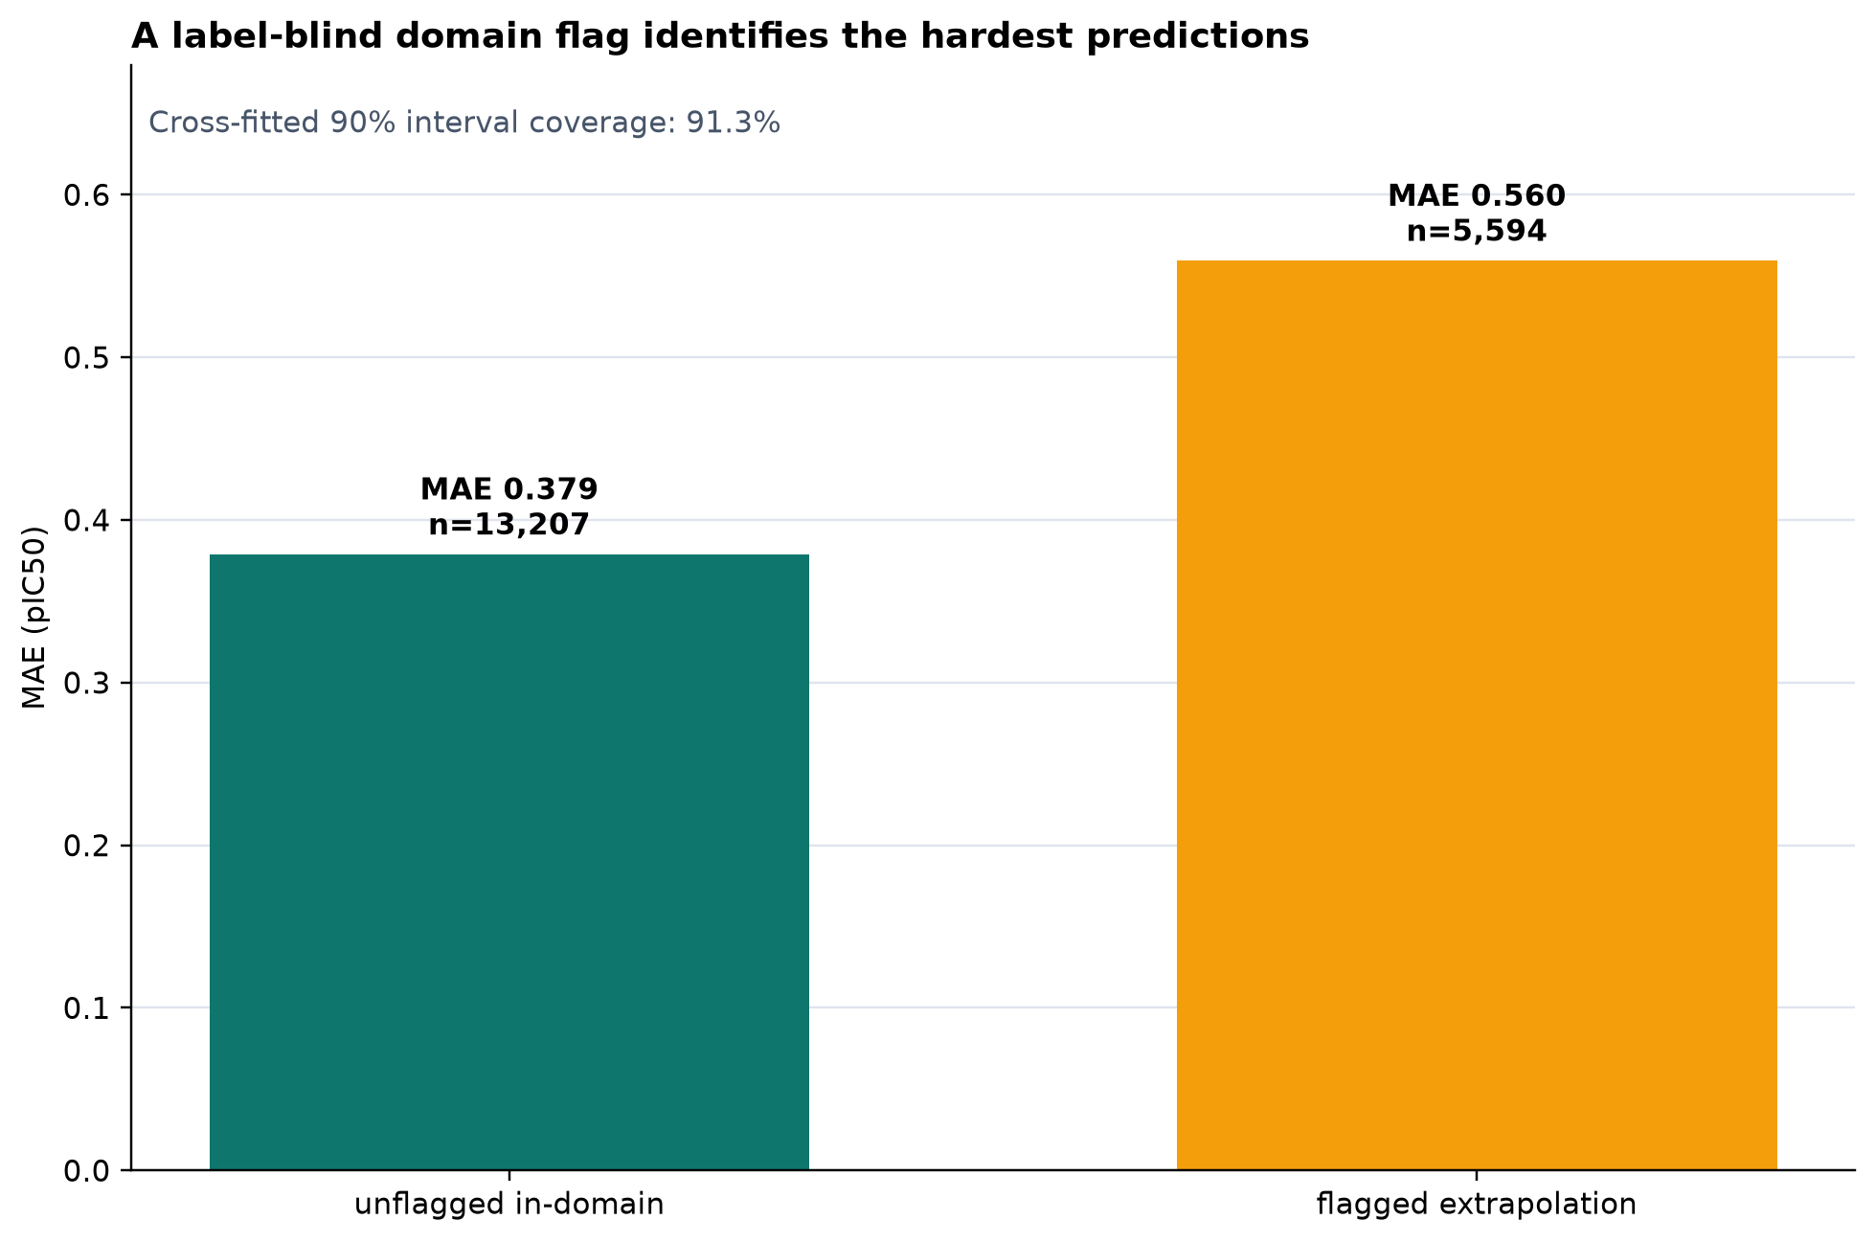
OPERATIONAL RELIABILITY
Confidence is useful when it is tied to domain
0.379
0.560
MAE
in-domain
MAE
flagged
91.3% coverage
for the cross-fitted nominal 90% interval
Negative control: ranking by interval width alone was nearly flat. The label-blind domain flag is the defensible abstention signal.
Internal analysis | train-only nested scaffold evaluation
05
Notes:
Emphasize the distinction between calibrated interval coverage and useful ranking. The interval is calibrated globally, but width alone did not sharply rank errors. The label-blind domain flag—based on novelty and support—is what separates a much harder prediction population.
[Sources]
- /Users/shivanshsahni/Downloads/Personal/Wang/Menin/research/reports/platform/herg_meeting_2026_08_18/MEETING_BRIEF.md
- /Users/shivanshsahni/Downloads/Personal/Wang/Menin/research/reports/platform/herg_meeting_2026_08_18/figures/03_risk_coverage.png
[/Sources]

Slide 6
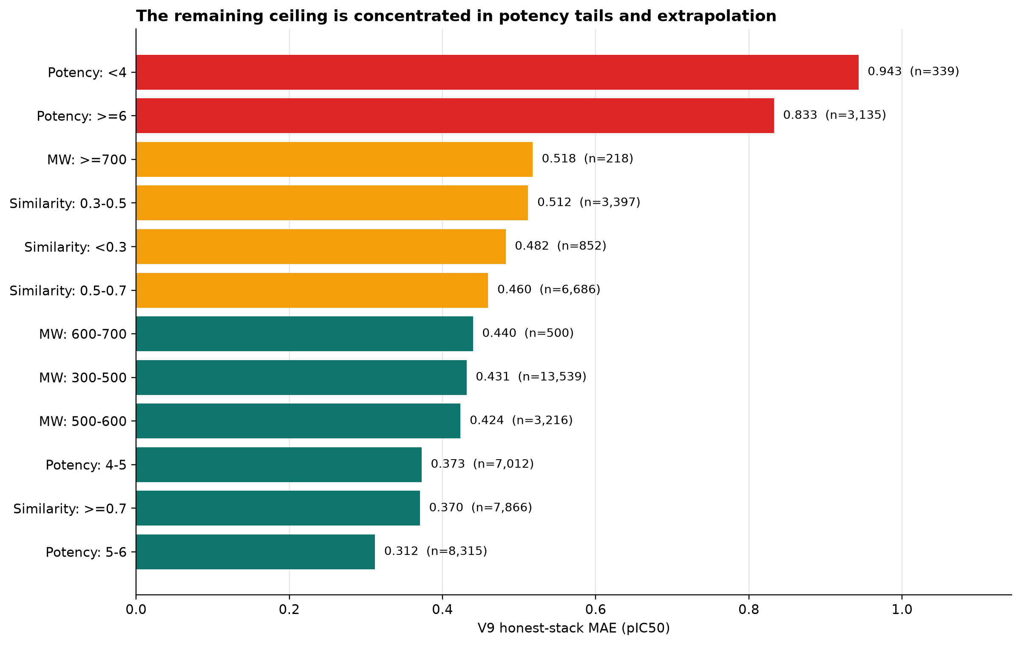
WHERE THE MODEL STILL FAILS
The remaining error ceiling is structured
Label conflict
Replicate spread >1 log: MAE 1.046
Potency tails
Strong regression toward the mean
Low similarity
Error rises outside supported chemistry
Very heavy
>=700 Da: MAE 0.518 (n=218)
Internal analysis | train-only nested scaffold evaluation
06
Notes:
The failure analysis changes the recommended research plan. More generic feature breadth is unlikely to fix measurement disagreement, protocol heterogeneity, or activity cliffs. The >=700 Da result is a warning, not a universal failure claim, because the subgroup is small. The 500–700 Da region remains competitive.
[Sources]
- /Users/shivanshsahni/Downloads/Personal/Wang/Menin/research/reports/platform/herg_meeting_2026_08_18/MEETING_BRIEF.md
- /Users/shivanshsahni/Downloads/Personal/Wang/Menin/research/reports/platform/herg_meeting_2026_08_18/TECHNICAL_QA.md
- /Users/shivanshsahni/Downloads/Personal/Wang/Menin/research/reports/platform/herg_meeting_2026_08_18/figures/04_failure_modes.png
[/Sources]

Slide 7
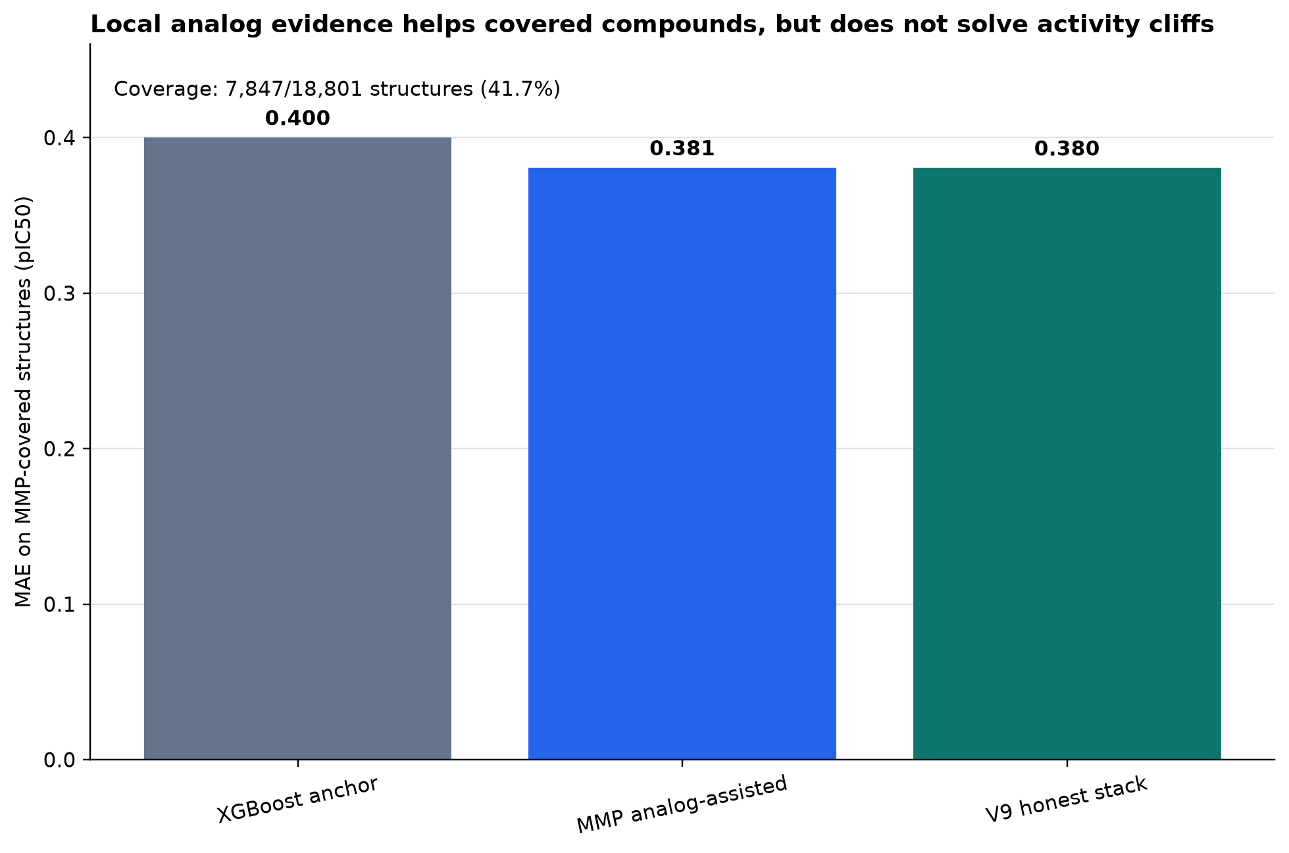
MATCHED-PAIR RESULT
Local analog evidence helps—but only where it exists
41.7%
7,847
of structures have
MMP analog support
supported
structures
0.400 → 0.381 MAE
broad anchor to analog-assisted prediction
But cliff-delta direction remains weak. This supports local-context modeling and targeted matched pairs—not causal transformation rules.
Internal analysis | train-only nested scaffold evaluation
07
Notes:
This is a useful practical insight: local analog context produces meaningful level-prediction improvement on its supported subset. It does not generalize to unsupported structures and it does not yet provide reliable mechanistic direction across activity cliffs.
[Sources]
- /Users/shivanshsahni/Downloads/Personal/Wang/Menin/research/reports/platform/herg_meeting_2026_08_18/MEETING_BRIEF.md
- /Users/shivanshsahni/Downloads/Personal/Wang/Menin/research/reports/platform/herg_meeting_2026_08_18/figures/05_mmp_analog_assistance.png
[/Sources]

Slide 8
ACCURACY VERSUS SAFETY OBJECTIVE
There is no single metric-free definition of “best”
Global accuracy model
Safety / tail-selected model
Best for broad continuous potency prediction
Better balance at potency extremes, worse globally
GLOBAL MAE
TAIL MAE
GLOBAL CHANGE
TAIL MAE
0.433
1.425
+0.011
1.354
Use as the default reported potency model.
Report as a separate operating mode, not a replacement.
Recommendation: report both objectives transparently and choose by use case.
Internal analysis | train-only nested scaffold evaluation
08
Notes:
The safety-oriented objective is a successful sensitivity experiment, not the universally superior model. It materially reduces tail error and potency-bin imbalance, but the cost to average performance is statistically supported. Presenting both modes is more honest than hiding the tradeoff.
[Sources]
- /Users/shivanshsahni/Downloads/Personal/Wang/Menin/research/reports/platform/herg_meeting_2026_08_18/MEETING_BRIEF.md
- /Users/shivanshsahni/Downloads/Personal/Wang/Menin/research/reports/platform/herg_meeting_2026_08_18/TECHNICAL_QA.md
[/Sources]

Slide 9
FAIR COMPARISON RULE
Why published headline metrics can look much better
Common published headline
Our primary evidence
• Binary blocker classification
• Selected potency threshold
• Random or internal split
• Dataset-specific deduplication
• Recall, AUROC, accuracy, or MCC
• Continuous pIC50 regression
• Structure-collapsed targets
• Scaffold-held-out nested selection
• Assay, source, mass, cliff, and disagreement boundaries
• Calibration and applicability domain
These may be valid results—but they answer a different question.
Contribution: broader and more honest measurement—not a copied superiority claim.
Published metrics are not head-to-head without a common frozen benchmark
09
Notes:
If asked why another paper reports a much larger percentage, first identify its endpoint, threshold, split, and dataset. Pred-hERG 5.0 is the closest public regression comparator, but its curation and split differ. HERGAI and HergSPred are primarily classification tools. A fair superiority claim requires replaying all methods on the same frozen structures and endpoints.
[Sources]
- /Users/shivanshsahni/Downloads/Personal/Wang/Menin/research/reports/platform/herg_meeting_2026_08_18/LITERATURE_COMPARABILITY.md
- https://pmc.ncbi.nlm.nih.gov/articles/PMC11187631/
- https://pmc.ncbi.nlm.nih.gov/articles/PMC12291323/
- https://pubs.acs.org/doi/10.1021/acs.jcim.2c00256
- https://doi.org/10.1016/j.compbiomed.2024.109416
- https://pmc.ncbi.nlm.nih.gov/articles/PMC12756696/
- https://pmc.ncbi.nlm.nih.gov/articles/PMC11245006/
[/Sources]

Slide 10
DECISION SLIDE
The next breakthrough requires better evidence, not just more descriptors
1
Freeze an external series
2
Model the measurement
Explicit human-WT functional patch clamp, one-time evaluation, protocol-resolved.
Assay-conditioned or hierarchical model with construct, modality, source, and protocol context.
3
Target activity cliffs
4
Gate receptor physics
Acquire and model matched pairs where the broad model fails; train local-delta specialists.
Prepare receptor states, ligand microstates, membrane environment, and software pins before docking/MD claims.
Meeting ask: prioritize the external series and assay-context adjudication; use those results to decide whether receptor physics is justified.
Internal analysis | train-only nested scaffold evaluation
10
Notes:
This is the decision point. My recommended priority is the explicit human-WT functional external series plus assay-context adjudication. Those measurements address the strongest current uncertainty. Receptor-aware physics becomes valuable only after the receptor, ligand-state, membrane, and environment contracts are actually prepared.
[Sources]
- /Users/shivanshsahni/Downloads/Personal/Wang/Menin/research/reports/platform/herg_meeting_2026_08_18/MEETING_BRIEF.md
- /Users/shivanshsahni/Downloads/Personal/Wang/Menin/research/reports/platform/herg_meeting_2026_08_18/TECHNICAL_QA.md
[/Sources]

Slide 11
APPENDIX A
Threshold views support tool comparisons without changing the primary task
Threshold
Sensitivity
Specificity
Balanced accuracy
20 μM
94.8%
43.0%
68.9%
10 μM
80.2%
68.6%
74.4%
1 μM
43.1%
96.8%
70.0%
These operating points are derived from the continuous model. They are secondary views—not a redefinition of the primary continuous-potency task.
Internal analysis | train-only nested scaffold evaluation
11
Notes:
Use this appendix only when asked for classifier-style numbers. Sensitivity and specificity change substantially with the threshold. Never quote one percentage without naming the threshold and task.
[Sources]
- /Users/shivanshsahni/Downloads/Personal/Wang/Menin/research/reports/platform/herg_meeting_2026_08_18/MEETING_BRIEF.md
- /Users/shivanshsahni/Downloads/Personal/Wang/Menin/research/reports/platform/herg_meeting_2026_08_18/RESULT_TRACEABILITY.csv
[/Sources]

Slide 12
APPENDIX B
What the evidence supports—and what it does not
SUPPORTED
NOT YET SUPPORTED
• Robust internal nested-scaffold improvement
• Stable unique value from RDKit2D and Morgan
• Calibrated cross-fitted intervals
• Label-blind applicability-domain stratification
• Local analog assistance on supported chemistry
• Explicit accuracy–safety tradeoff
• External or prospective superiority
• Fully adjudicated explicit human-WT scope
• Clinical QT-risk prediction
• Causal feature or MMP transformation rules
• Receptor-binding mechanism from ligand-only 3D
• Universal performance above 700 Da
The platform is ready for a decisive external measurement campaign.
Use RESULT_TRACEABILITY.csv and TECHNICAL_QA.md for exact questions
12
Notes:
Close by being precise. The internal result, feature conclusions, uncertainty calibration, and domain boundaries are defensible. External superiority, causal biology, explicit-WT scope, clinical QT risk, and universal heavy-molecule coverage are not yet established. The next meeting outcome should be an agreed external evidence plan.
[Sources]
- /Users/shivanshsahni/Downloads/Personal/Wang/Menin/research/reports/platform/herg_meeting_2026_08_18/MEETING_BRIEF.md
- /Users/shivanshsahni/Downloads/Personal/Wang/Menin/research/reports/platform/herg_meeting_2026_08_18/TECHNICAL_QA.md
- /Users/shivanshsahni/Downloads/Personal/Wang/Menin/research/reports/platform/herg_meeting_2026_08_18/RESULT_TRACEABILITY.csv
[/Sources]

