Slide 1
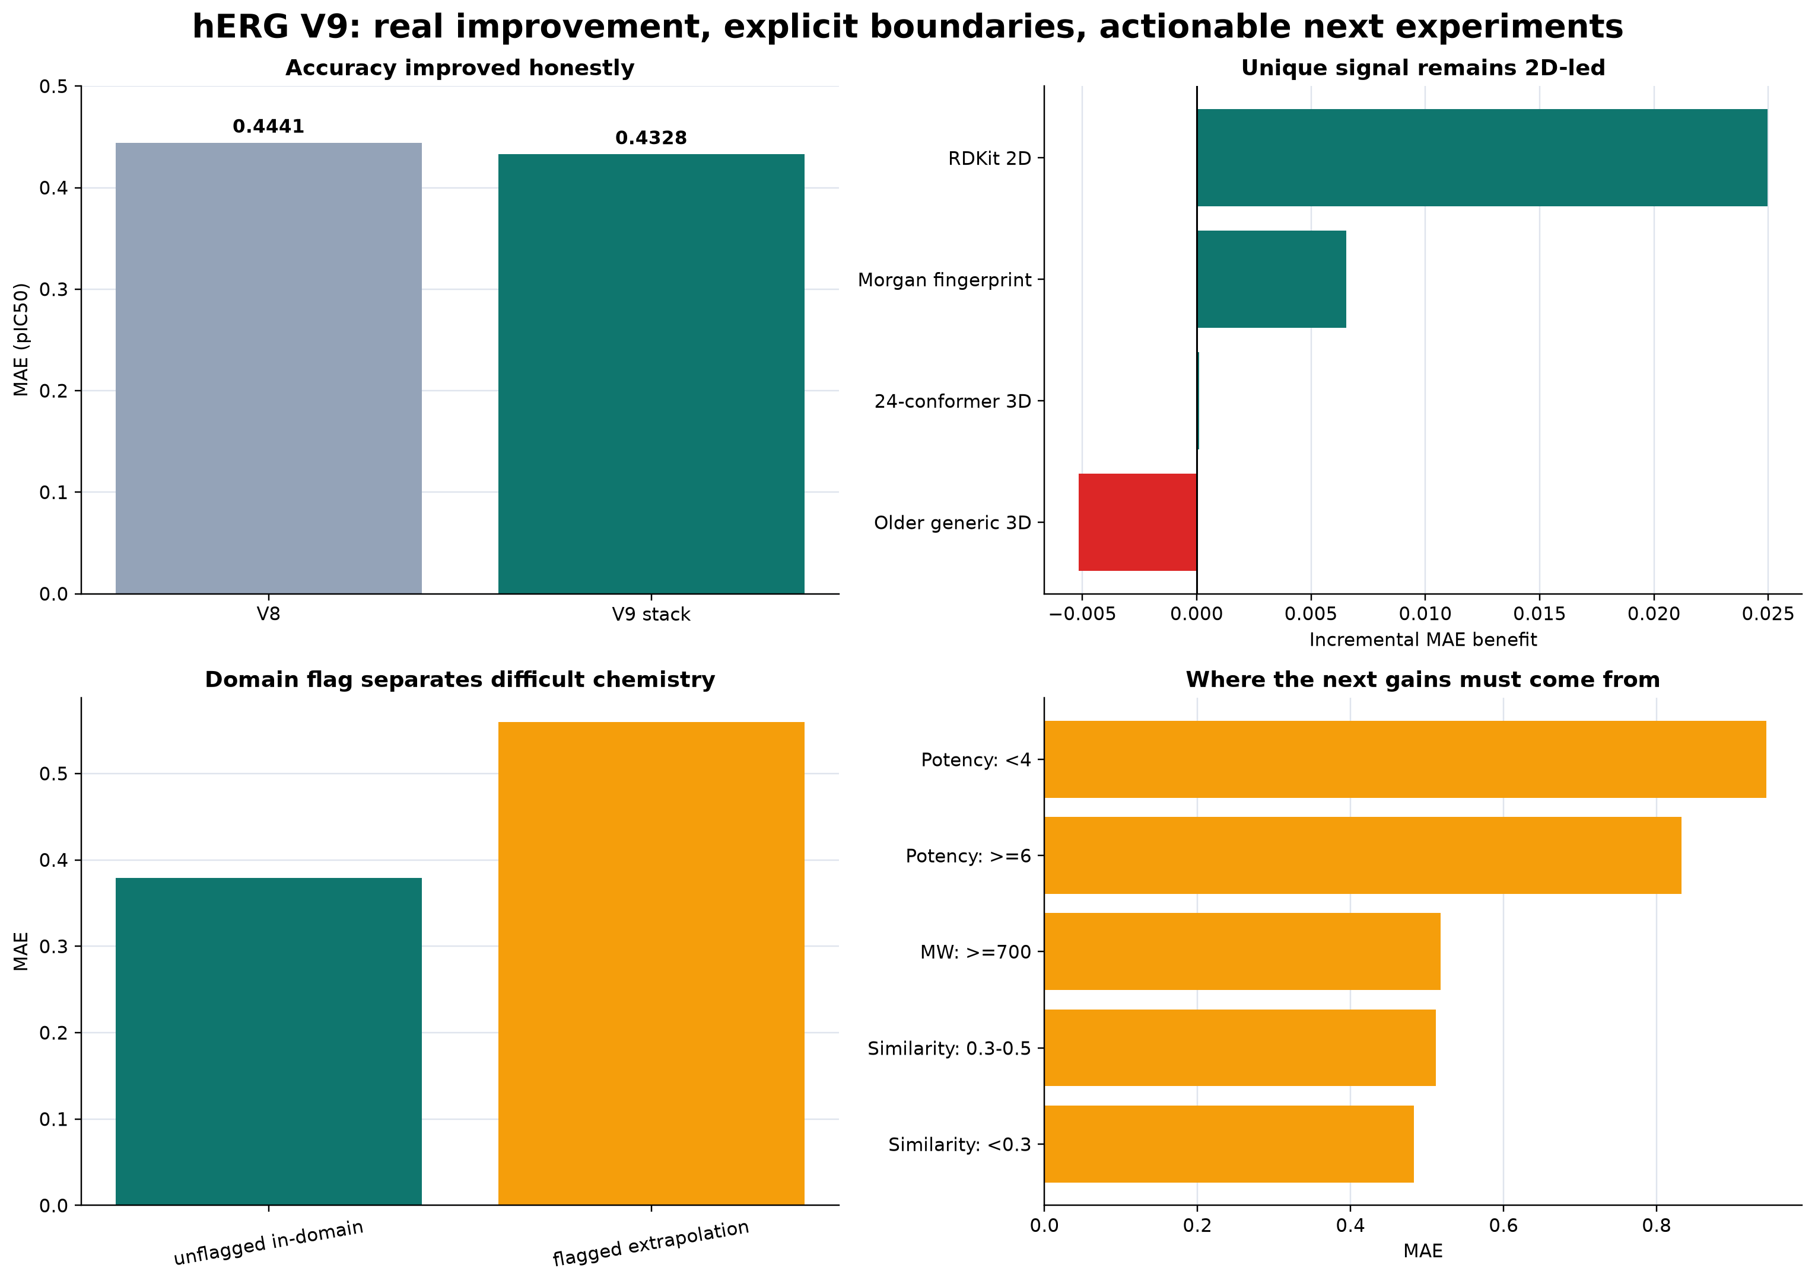
hERG Prediction Platform
Nine Iterations of Honest Model Development
Continuous potency prediction, transparent failure domains, and a clear experimental path
18,801 Structures
8,455 Scaffolds
5 Nested Folds
Notes:
Open with the development arc: the work moved from data governance and 2D baselines through physics, measurement modeling, exhaustive feature combinations, and domain specialists. The core contribution is an honest broad prediction platform with clearly measured limits.
[Sources]
- /Users/shivanshsahni/Downloads/Personal/Wang/Menin/research/reports/platform/herg_meeting_2026_08_18/MEETING_BRIEF.md
- /Users/shivanshsahni/Downloads/Personal/Wang/Menin/research/reports/platform/herg_meeting_2026_08_18/figures/06_graphical_summary.png
[/Sources]

Slide 2
Nine Iterations of Model Development
V1
Dataset Governance
V2
Tuned 2D XGBoost
V3
Broader Model Search
Structure identities, provenance, frozen splits, and leakage controls.
First strong scaffold anchor at approximately 0.446 MAE.
More model families and features did not improve the honest anchor.
V4
24-Conformer Surface
V5
Feature Attribution
V6
Fundamental Optimization
Fresh ligand 3D features generated across 24,901 quantitative structures.
Held-out ablations isolated the unique contribution of each block.
Physics-focused combinations tested redundancy and failure modes.
V7
Measurement Objectives
V8
Feature Lattice
V9
Domain Mixture
Accuracy and safety-tail objectives separated instead of hidden.
2,048 coalitions mapped what works, what fails, and for whom.
Specialists, local analogs, and applicability context reached 0.4328 MAE.
Notes:
Use this as the narrative spine for the meeting. V1 to V3 established the governed baseline. V4 to V6 tested ligand-only physics and feature causality. V7 to V9 focused on measurement heterogeneity, exhaustive combinations, domain specialists, and local evidence.
[Sources]
- /Users/shivanshsahni/Downloads/Personal/Wang/Menin/research/reports/platform/herg_meeting_2026_08_18/MEETING_BRIEF.md
- /Users/shivanshsahni/Downloads/Personal/Wang/Menin/research/local_runs/herg_feature_lattice_analysis_v81_superseded_cross_fold_mmp/ANALYSIS.md
- /Users/shivanshsahni/Downloads/Personal/Wang/Menin/research/local_runs/herg_honest_measurement_campaign_v7_1/analysis.json
[/Sources]

Slide 3
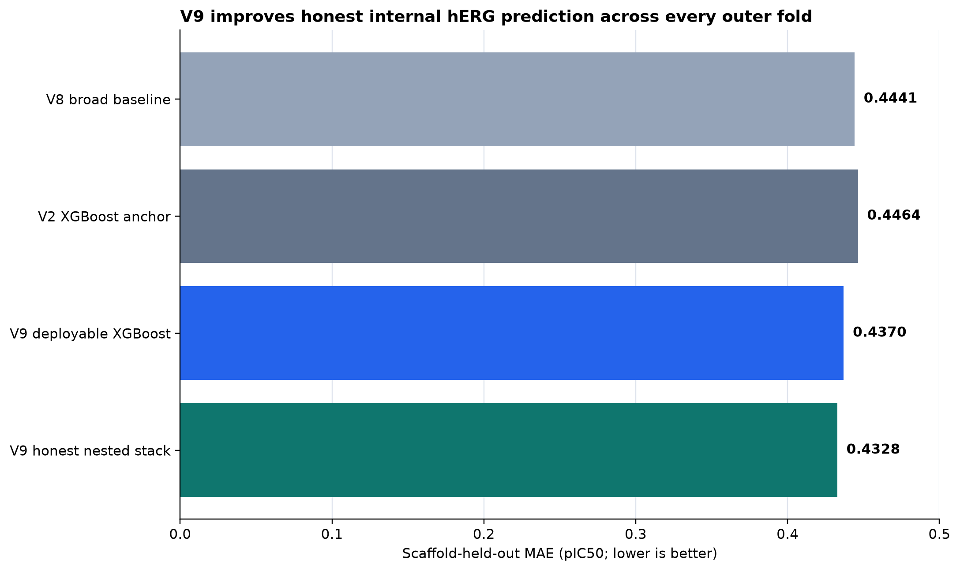
Best Honest Internal Performance
0.4328
91.8%
Nested Stack MAE
Within 1.0 Log
69.8%
0.4370
Within 0.5 Log
Deployable XGBoost MAE
0.0114 MAE Improvement
V9 versus V8; 95% scaffold CI 0.0086 to 0.0141. Every outer fold improved.
Notes:
The nested stack is the strongest unbiased internal evidence. The frozen deployable molecular model is a single XGBoost artifact and is slightly weaker. Do not present the stack as an external or prospective result.
[Sources]
- /Users/shivanshsahni/Downloads/Personal/Wang/Menin/research/reports/platform/herg_meeting_2026_08_18/MEETING_BRIEF.md
- /Users/shivanshsahni/Downloads/Personal/Wang/Menin/research/reports/platform/herg_meeting_2026_08_18/RESULT_TRACEABILITY.csv
- /Users/shivanshsahni/Downloads/Personal/Wang/Menin/research/reports/platform/herg_meeting_2026_08_18/figures/01_model_progress.png
[/Sources]

Slide 4
Evaluation Designed to Resist Leakage
18,801
8,455
5
0
Exact Training Structures
Scaffold Groups
Nested Outer Folds
Validation Or Test Labels Opened
1
2
3
4
Structure Collapse
Scaffold Separation
Inner Selection
Single Outer Prediction
Replicate observations become one structure-level target.
Related chemotypes stay together in a single held-out fold.
Features, parameters, and mixtures are chosen without outer labels.
Every structure is evaluated once in its untouched scaffold context.
Notes:
This design deliberately produces harder and more transferable estimates than random splitting. It prevents replicated measurements and close scaffold relatives from appearing as independent evidence.
[Sources]
- /Users/shivanshsahni/Downloads/Personal/Wang/Menin/research/reports/platform/herg_meeting_2026_08_18/TECHNICAL_QA.md
- /Users/shivanshsahni/Downloads/Personal/Wang/Menin/research/reports/platform/herg_meeting_2026_08_18/MEETING_BRIEF.md
[/Sources]

Slide 5
Feature Families Ranked by Unique Held-Out Impact
Feature Test
MAE Change
95% Scaffold CI
Evidence
What We Learn
Remove RDKit2D
+0.0250
+0.0204 to +0.0295
Reliable In 5 Of 5 Folds
Global physicochemical structure is the strongest unique foundation.
Remove Morgan
+0.0065
+0.0031 to +0.0101
Reliable In 4 Of 5 Folds
Local substructure context adds independent scaffold-transfer signal.
Add Old Ligand 3D
-0.0052
-0.0078 to -0.0026
Reliable Deterioration
Generic or unstable 3D can actively dilute a strong 2D model.
Add Polarity and Contacts
-0.0007
-0.0022 to +0.0008
No Stable Gain
These ligand-only physics proxies are mostly redundant after 2D chemistry.
Add Energy and Flexibility
-0.0004
-0.0019 to +0.0012
No Stable Gain
Force-field summaries do not improve broad aggregate transfer.
Add Selected Interactions
+0.0003
-0.0013 to +0.0020
No Stable Gain
Interaction hypotheses may matter locally, not as a global block.
Notes:
Positive MAE change means prediction worsened when an included block was removed or improved when an omitted block was added, depending on the named test. The decisive positive evidence is RDKit2D and Morgan. The generic 3D and physics blocks did not show broad independent value.
[Sources]
- /Users/shivanshsahni/Downloads/Personal/Wang/Menin/research/reports/platform/herg_meeting_2026_08_18/tables/feature_family_effects.csv
- /Users/shivanshsahni/Downloads/Personal/Wang/Menin/research/reports/platform/herg_meeting_2026_08_18/MEETING_BRIEF.md
[/Sources]

Slide 6
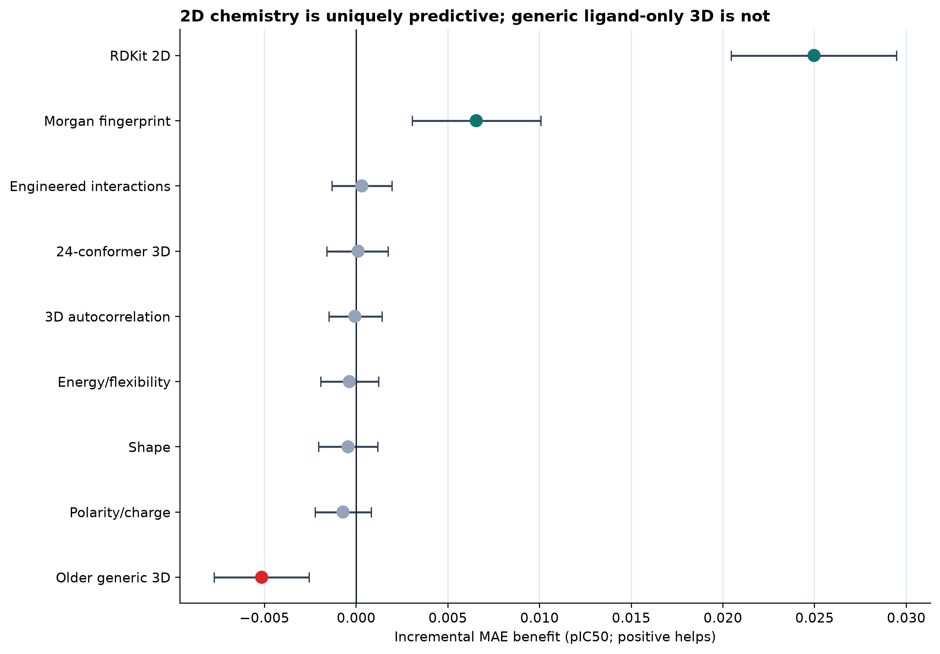
What Ligand-Only Physics Added
24 Conformers
Fresh conformer surface across 24,901 quantitative structures
No Aggregate Gain
Shape, WHIM, energy, flexibility, and charge-contact blocks were unstable or redundant
Scientific Interpretation
The negative result narrows the next experiment: improve microstate, receptor-state, membrane, and assay context instead of adding more generic ligand descriptors.
Notes:
This is not evidence that physics is unimportant. It is evidence that generic ligand-only conformer summaries do not add stable global information after strong 2D representations. Receptor-aware and microstate-aware physics remain untested because preparation and environment contracts were not yet satisfied.
[Sources]
- /Users/shivanshsahni/Downloads/Personal/Wang/Menin/research/reports/platform/herg_meeting_2026_08_18/MEETING_BRIEF.md
- /Users/shivanshsahni/Downloads/Personal/Wang/Menin/research/reports/platform/herg_meeting_2026_08_18/tables/feature_family_effects.csv
- /Users/shivanshsahni/Downloads/Personal/Wang/Menin/research/local_runs/herg_quantitative_24conformer_v4/manifest.json
- /Users/shivanshsahni/Downloads/Personal/Wang/Menin/research/reports/platform/herg_meeting_2026_08_18/figures/02_feature_family_effects.png
[/Sources]

Slide 7
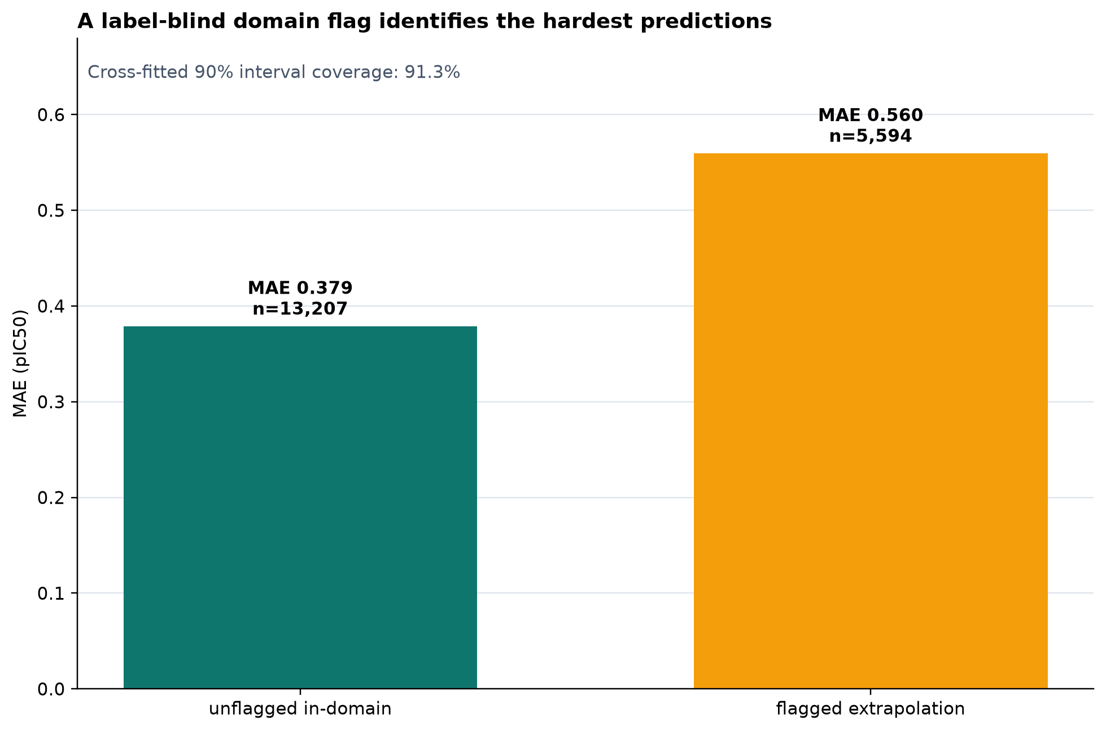
Applicability Domain Defines Reliability
0.379
0.560
In-Domain MAE
Flagged MAE
91.3%
Coverage of the Nominal 90% Interval
Operational Rule
Report the prediction together with the label-blind domain flag. Interval width alone was not a useful error ranking.
Notes:
The domain flag is label blind and operationally meaningful. It identifies a 0.181 MAE gap between supported and extrapolative predictions. Global interval coverage is calibrated, but interval width alone does not rank errors well.
[Sources]
- /Users/shivanshsahni/Downloads/Personal/Wang/Menin/research/reports/platform/herg_meeting_2026_08_18/tables/domain_flag_performance.csv
- /Users/shivanshsahni/Downloads/Personal/Wang/Menin/research/reports/platform/herg_meeting_2026_08_18/tables/risk_coverage.csv
- /Users/shivanshsahni/Downloads/Personal/Wang/Menin/research/reports/platform/herg_meeting_2026_08_18/figures/03_risk_coverage.png
[/Sources]

Slide 8
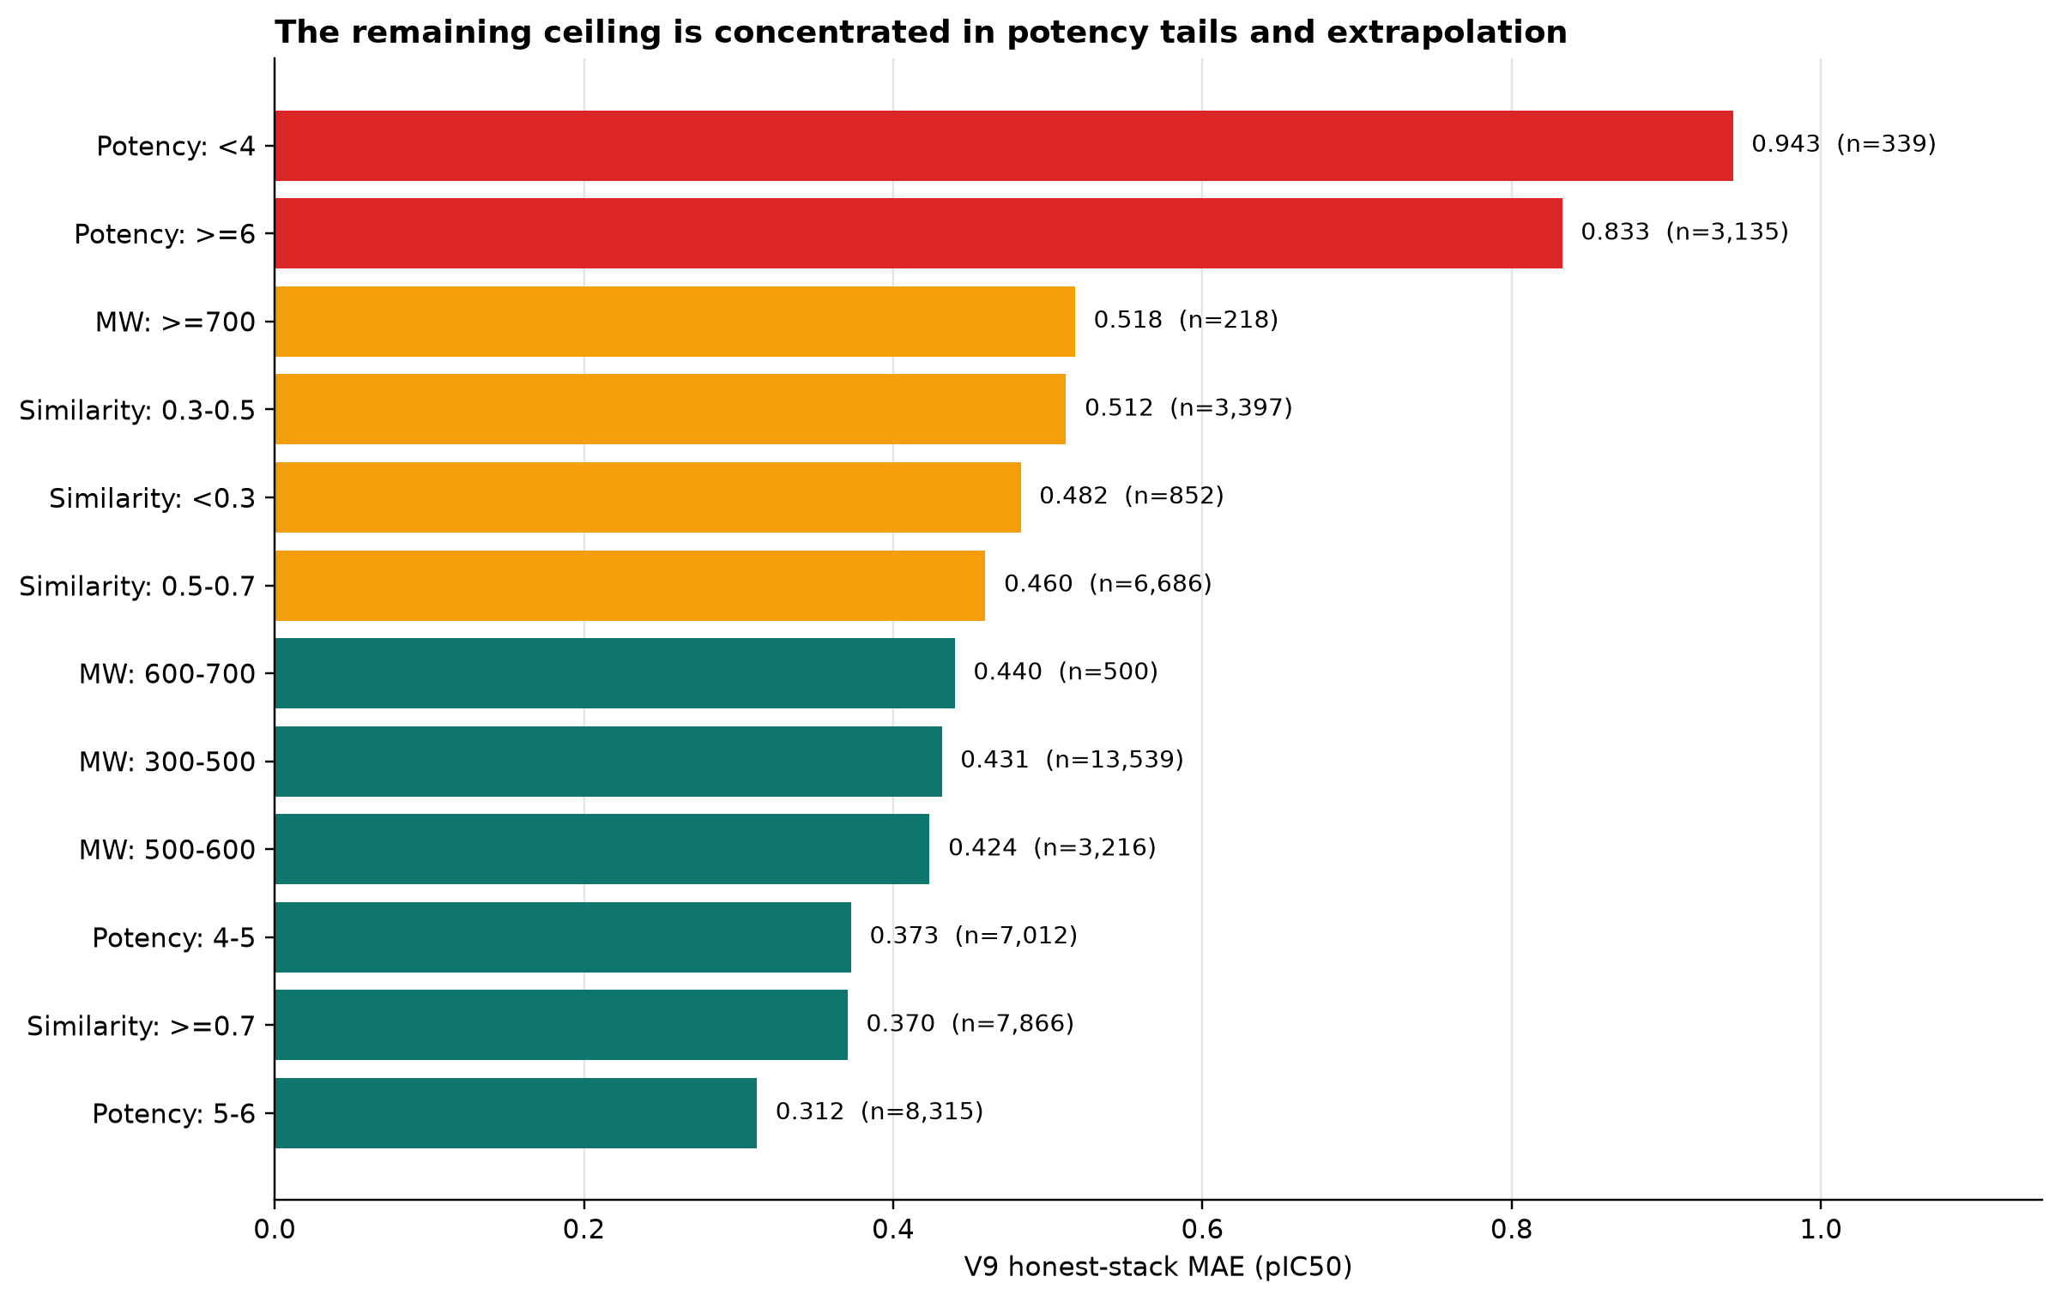
Remaining Errors Are Structured
1.046
MAE With Replicate Spread Above 1 Log
0.518
MAE At 700 Da Or Higher
0.560
MAE In Flagged Extrapolation
500 To 700 Da Remains Competitive
Notes:
The largest errors are not random. Label disagreement, potency extremes, lower similarity, flexibility, and the very heavy tail dominate. Performance through 500 to 700 Da remains credible; the 700 Da and higher subgroup is small and should be reported with uncertainty.
[Sources]
- /Users/shivanshsahni/Downloads/Personal/Wang/Menin/research/reports/platform/herg_meeting_2026_08_18/tables/label_disagreement_summary.csv
- /Users/shivanshsahni/Downloads/Personal/Wang/Menin/research/reports/platform/herg_meeting_2026_08_18/tables/subgroup_sensitivity.csv
- /Users/shivanshsahni/Downloads/Personal/Wang/Menin/research/local_runs/herg_heavy_compound_sidecar_v9/HEAVY_COMPOUND_REPORT.md
- /Users/shivanshsahni/Downloads/Personal/Wang/Menin/research/reports/platform/herg_meeting_2026_08_18/figures/04_failure_modes.png
[/Sources]

Slide 9
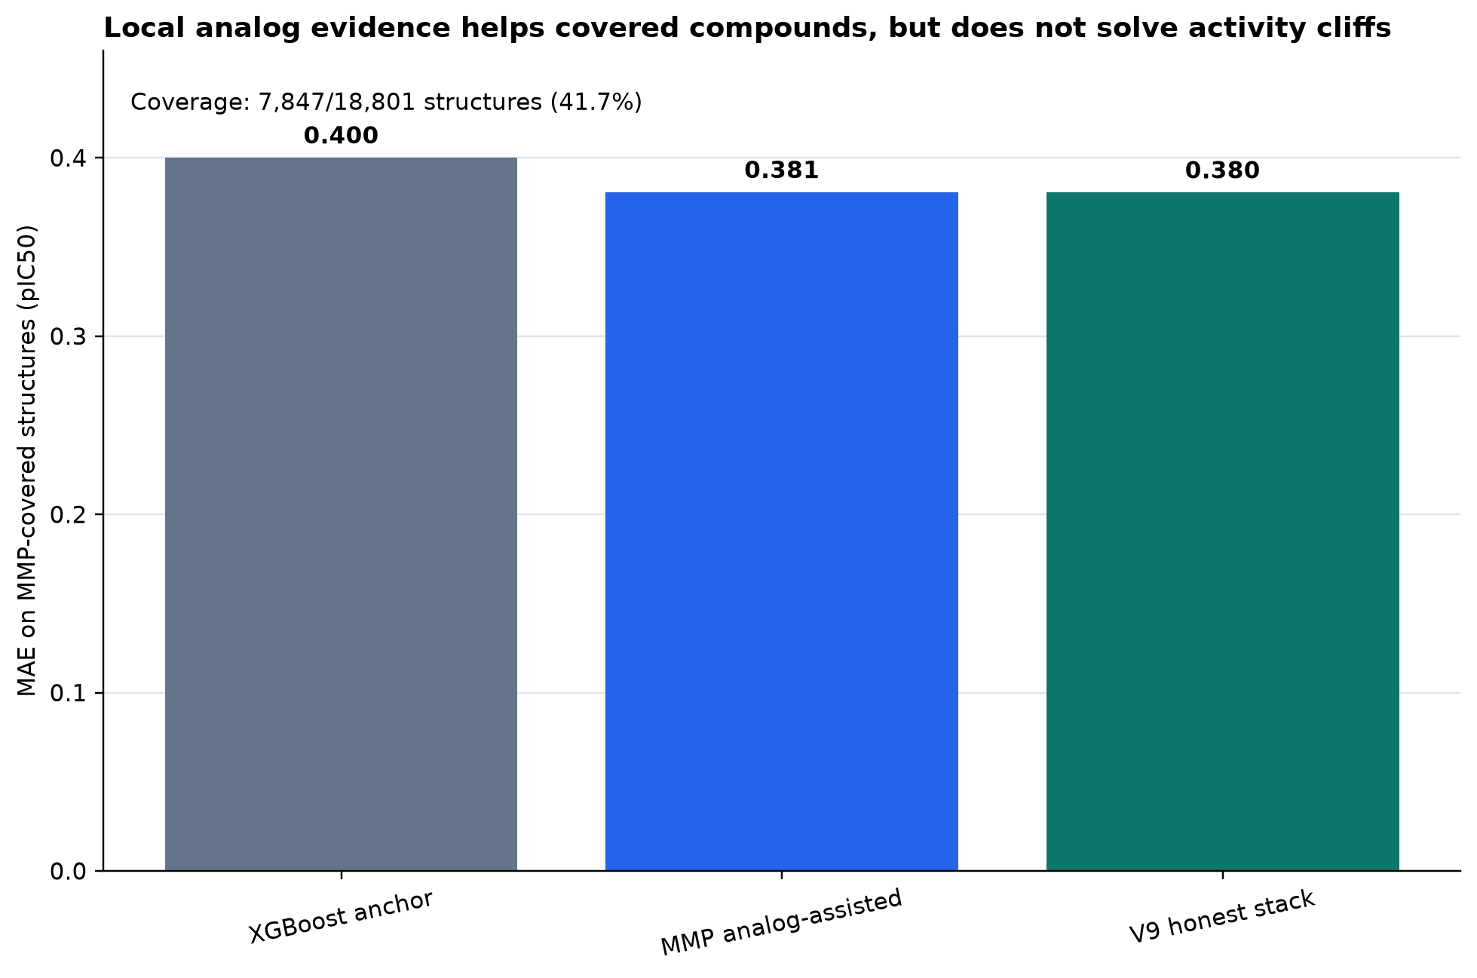
Local Analogs Improve Covered Chemistry
41.7%
7,847
Structures With Analog Support
Supported Structures
0.400 To 0.381 MAE
Broad anchor to analog-assisted prediction on supported structures
Activity-Cliff Direction Remains Weak
Use local analogs as a supported specialist, not as causal transformation rules.
Notes:
Analog support produces a useful local prediction improvement, but only on 41.7 percent of the structures. The remaining transformation-direction results are not strong enough for causal medicinal chemistry rules.
[Sources]
- /Users/shivanshsahni/Downloads/Personal/Wang/Menin/research/reports/platform/herg_meeting_2026_08_18/tables/mmp_covered_structure_performance.csv
- /Users/shivanshsahni/Downloads/Personal/Wang/Menin/research/reports/platform/herg_meeting_2026_08_18/figures/05_mmp_analog_assistance.png
[/Sources]

Slide 10
Published Competitors Use Different Evidence Surfaces
Tool and Task
Labeled Data
Publicized Result
Benchmark Tailoring
Features
Real-World Limitation
Our Platform
Continuous pIC50
18,801
structures
0.4328 MAE
Nested scaffold
Low
Structure collapse; sealed outcomes
RDKit2D, Morgan, specialists, domain flag
Internal only; WT-or-unspecified; external series still needed
Sun et al. 2026
Regression
7,772 train
1,097 external unique
0.383 internal MAE
0.50 corrected external
High
Random split; 10 external values corrected
Atom-type counts, correction factors, RBF-SVR
MW 200–600; external conflicts; incomplete feature generator
Pred-hERG 5.0
Regression
7,609
records
0.35 MAE
0.44 RMSE
High
Task curation; random 80/20 split
ECFP, FCFP, SVM, consensus
Random split; pooled assay types; current repository lacks full assets
hERGBoost
Regression
10,798
molecules
0.438 MAE
External n=706
Moderate
External set; grouping policy unclear
Descriptors, fingerprints, XGBoost
External R2 0.394; extreme-potency RMSE 1.154
HERGAI
Binary at 20 µM
299,927
0.65% active
86.4% recall
AUC 0.863
High
Extreme imbalance; pose selection
Docking PLEC, RF, XGB, DNN stack
Binary screening task; asymmetric active and negative evidence
XGB-ISE
Binary at 10 µM
290,731
molecules
MCC 0.72
Selected strata
Very High
Best result covers 64% of external set
Selected descriptors, balanced XGB ensemble
Coverage selection and pooled HTS labels limit broad deployment
Notes:
Benchmark tailoring is a neutral description of how much the reported result depends on curation, split choice, thresholding, selective coverage, or class construction. It is not an accusation of misconduct. Use the exact published task beside every number.
[Sources]
- /Users/shivanshsahni/Downloads/Personal/Wang/Menin/research/reports/platform/herg_meeting_2026_08_18/LITERATURE_COMPARABILITY.md
- /Users/shivanshsahni/Downloads/Personal/Wang/Menin/research/reports/platform/herg_paper/model_landscape_v2/model_comparison_matrix.csv
- https://pmc.ncbi.nlm.nih.gov/articles/PMC11187631/
- https://doi.org/10.1016/j.compbiomed.2024.109416
- https://doi.org/10.1186/s13321-025-01063-8
- https://doi.org/10.1038/s41598-025-99766-3
- Sun, Wang, and Shen (2026), Modeling hERG Channel Liability, DOI: https://doi.org/10.1021/acs.jcim.6c00163
- Local evidence audit: /Users/shivanshsahni/Downloads/Personal/Wang/Menin/research/literature/herg/predictive_modeling/2026_sun_wang_shen_jcim_6c00163/evidence_review.md
[/Sources]

Slide 11
Accuracy and Safety Require Separate Operating Modes
Global Accuracy Model
Safety and Tail Model
0.433
1.425
+0.011
1.354
Global MAE
Tail MAE
Global MAE Cost
Tail MAE
Best default for broad continuous potency prediction
Better balance at potency extremes; worse average error
Notes:
The safety-selected objective improves the potency tails but pays a statistically supported global cost. The defensible product design is two transparent modes rather than one hidden objective.
[Sources]
- /Users/shivanshsahni/Downloads/Personal/Wang/Menin/research/reports/platform/herg_meeting_2026_08_18/tables/safety_objective_tradeoff.csv
- /Users/shivanshsahni/Downloads/Personal/Wang/Menin/research/reports/platform/herg_meeting_2026_08_18/MEETING_BRIEF.md
[/Sources]

Slide 12
Recommended Next Experiments
1
External Functional Series
Tests real-world transfer and ends the internal-metric debate.
Freeze an explicit human-WT patch-clamp series and evaluate once.
2
Measurement Model
Separates chemistry error from assay and label error.
Adjudicate construct, modality, source, cell system, and protocol context.
3
Activity-Cliff Specialist
Targets the 41.7% analog-supported domain where local models already help.
Acquire matched pairs in the highest-error and highest-value chemical series.
4
Receptor and Microstate Physics
Tests physics that the ligand-only conformer campaign could not represent.
Prepare receptor states, ligand microstates, membrane context, and pinned software.
Notes:
Close with an explicit decision request. The first two experiments address the largest evidence gaps. Activity-cliff modeling builds on the successful local-analog signal. Receptor physics should start only after receptor, microstate, membrane, and environment preparation is complete.
[Sources]
- /Users/shivanshsahni/Downloads/Personal/Wang/Menin/research/reports/platform/herg_meeting_2026_08_18/MEETING_BRIEF.md
- /Users/shivanshsahni/Downloads/Personal/Wang/Menin/research/reports/platform/herg_meeting_2026_08_18/TECHNICAL_QA.md
[/Sources]

