Slide 1
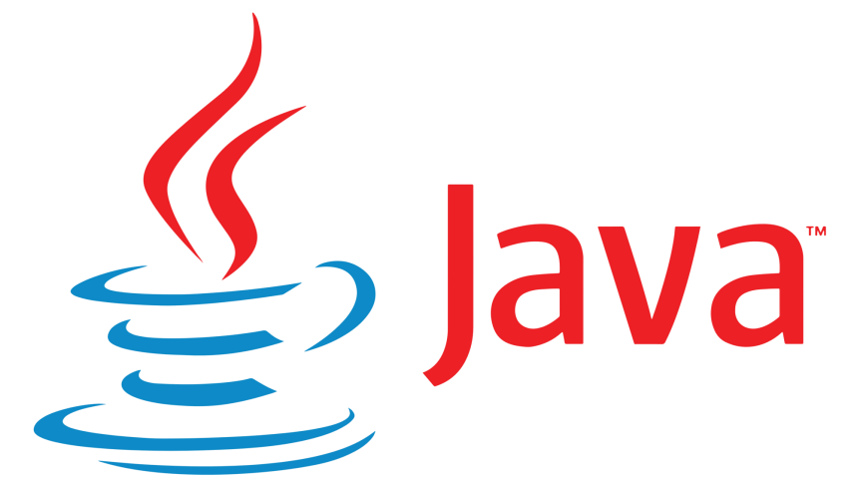
Summer Training Project
Othello Game in Java
Submitted by : Shivansh Rastogi
B.Tech (IT), 5th Semester 02915003116
1

Slide 2
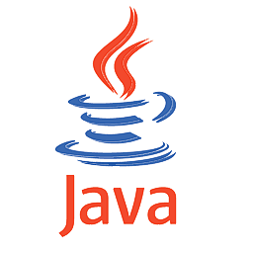
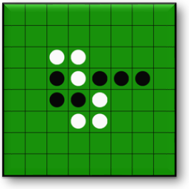
OTHELLO GAME IN JAVA

Slide 3
Objective of Training
To learn object oriented skills and Java programming concepts.
Creating Java programs using object-oriented features like encapsulations, inheritance, and polymorphism. To be able to explain the internal architecture of Java Language, its working through Java virtual machine, and various security models.
To be able to use object oriented concepts, wrapper classes in writing java programs using simple data structures like arrays and strings.
Handling error scenarios in applications to create robust code.
To create small applications by using applets, multithreading and event handling concepts.

Slide 4

Technology Used.
Java SE 10.0.2.
Eclipse Photon IDE for Java Developers
About Eclipse IDE:
In the context of computing, Eclipse is an integrated development environment (IDE) for developing applications using the Java programming language and other programming languages such as C/C++, Python, PERL, Ruby etc.

Slide 5
What is Java?
Java is a general-purpose computer-programming language that is concurrent, class-based ,object-oriented, and specifically designed to have as few implementation dependencies as possible. It is intended to let application developers "write once, run anywhere" (WORA), meaning that compiled Java code can run on all platforms that support Java without the need for recompilation.
Java is really “C++ -- ++ “
HISTORY :
Java is the new programming language developed by Sun Microsystems in 1991.
Firstly, it was called "Green-talk" by James Gosling, one of the inventors of the Java Language. and file extension was .gt.
After that, it was called Oak and was developed as a part of the Green project.
In 1995, Oak was renamed as "Java" because it was already a trademark by Oak Technologies.
The current release of Java is Java SE 10 released on 20th March 2018

Slide 6
Features of Java
Java Is Simple : no pointers, automatic garbage collection
Java Is Object-Oriented : Object-oriented programming provides great flexibility, modularity, clarity, and reusability through encapsulation, inheritance, and polymorphism.
Java Is Distributed : Distributed computing involves several computers working together on a network. Java is designed to make distributed computing easy
Java Is Interpreted : The programs are compiled into the JVM code called bytecode. The bytecode is machine-independent and can run on any machine that has a Java interpreter, which is part of the JVM.
Java Is Robust : Java has a runtime exception-handling feature to provide programming support for robustness.
Java Is Secure : access restrictions are forced (private, public)
Java Is Portable : Java is architecture neutral, Java programs are portable. They can be run on any platform without being recompiled.
Java Is Multithreaded : Multithread programming is smoothly integrated in Java, whereas in other languages you have to call procedures

Slide 7
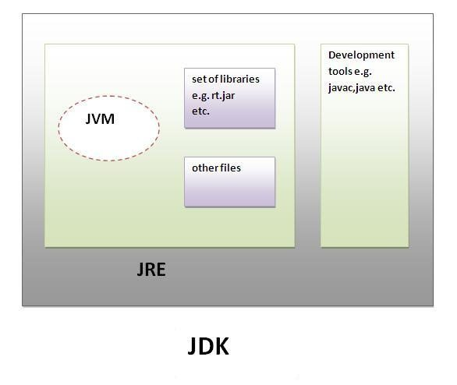
JVM vs. JRE vs. JDK
JDK
The Java Development Kit (JDK) is a software development environment used for developing Java applications and applets. It includes the Java Runtime Environment (JRE), an interpreter/loader (Java), a compiler (javac), an archiver (jar), a documentation generator (Javadoc) and other tools needed in Java development.
JRE
JRE stands for “Java Runtime Environment” and may also be written as “Java RTE.” The Java Runtime Environment provides the minimum requirements for executing a Java application; it consists of the Java Virtual Machine (JVM), core classes, and supporting files.
JVM
It is a specification where working of Java Virtual Machine is specified. But implementation provider is independent to choose the algorithm. Its implementation has been provided by Sun and other companies. It is an implementation is a computer program that meets the requirements of the JVM specification. An Runtime Instance Whenever you write java command on the command prompt to run the java class, an instance of JVM is created.

Slide 8
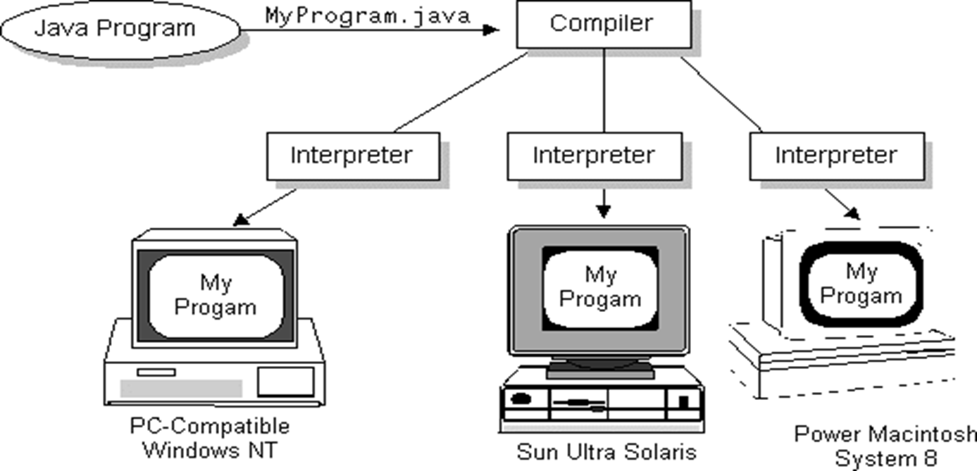
Write Once, Run Anywhere

Slide 9
Programming Concepts
Section | Description
Documentation Section | You can write a comment in this section. Comments are beneficial for the programmer because they help them understand the code..
Package statement | You can create a package with any name. A package is a group of classes that are defined by a name.
Import statements | This line indicates that if you want to use a class of another package, then you can do this by importing it directly into your program. Example: import calc.add;
Interface statement | Interfaces are just like classes that include a group of method declarations. It's an optional section and can be used when we want to implement multiple inheritances within a program.
Class Definition | A Java program may contain several class definitions. Classes are the main and essential elements of any Java program.

Slide 10
Example : Hello,World!
Since Java is object-oriented, programs are organized into modules called classes, which may have data in variables and subroutines called methods.
main() is the first method that is run.
Each program is enclosed in a class definition.
class HelloWorld
{ public static void main (String[] args)
{ System.out.println(“Hello World!”);
}
}
The notation class.method or package.class.method is how to refer to a public method (with some exceptions).
Syntax is similar to C - braces for blocks, semicolon after each statement. One difference: upper and lower case matter!
Notes:
32

Slide 11
Java useful keywords.
Final : The final keyword in java is used to restrict the user.
Variable: If you make any variable as final, you cannot change the value of final variable
Method: If you make any method as final, you cannot override it.
Class: If you make any class as final, you cannot extend it.
Static : The static keyword in Java is used for memory management mainly. The static keyword belongs to the class than an instance of the class.
Variable (class variable): If you declare any variable as static, it is known as a static variable. The static variable can be used to refer to the common property of all objects. The static variable gets memory only once in the class area at the time of class loading.
Method (class method); If you apply static keyword with any method, it is known as static method. Static method belongs to the class rather than the object of a class. Static method can be invoked without the need for creating an instance of class. Static method can access static data member & can change the value of it.
Block: Is used to initialize the static data member. It is executed before the main method at the time of class-loading. So, we can write statements which we want to execute before main.
This : In java, this is a reference variable that refers to the current object.
this can be used to refer current class instance variable. If there is ambiguity between the instance variables and parameters, this keyword resolves the problem of ambiguity.
this can passed as argument in method call. It is mainly used in the event handling.
this can be passed as argument in the constructor call.
this can be used to return the current class instance from the method.

Slide 12
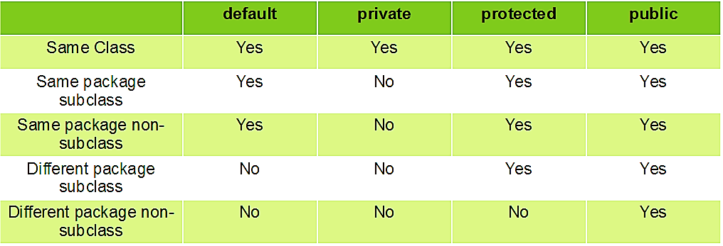
Access Modifiers
As the name suggests access modifiers in Java helps to restrict the scope of a class, constructor, variable, and method or data member. There are four types of access modifiers available in java:
Default
Public
Private
Protected

Slide 13
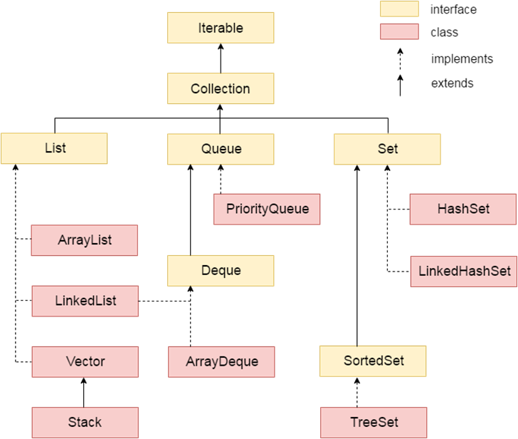
Collection in Java
The Collection in Java is a framework that provides an architecture to store and manipulate the group of objects. All the operations that you perform on a data such as searching, sorting, insertion, manipulation, deletion, etc. can be achieved by Java Collections. Java Collection means a single unit of objects. Java Collection framework provides many interfaces and classes.

Slide 14
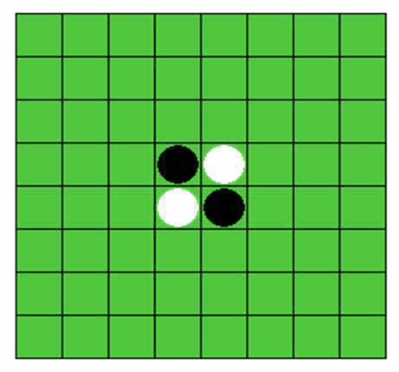
Othello Game in Java
Othello is a classic board game and can only be played by 2 players just like chess, checkers and go. The game board is made up of 8 rows and 8 columns. The board must be populated with 64 discs. They are coloured black on one side and white on the other. This way, they can be flipped to the other colour easily. One player plays discs black side up, the other white side up. After the first 4 initial discs are placed, black open the game. You can play a disc when you flank one or more opponent’s discs between your new disc and any other of your own discs, in the same horizontal, vertical or diagonal line. The opponent's discs that are flanked will be turned upside-down and change colour. When there is no possible legal move, the turn is given back to the opponent. When both players need to pass because there is no legal move left, the game has ended. The discs are counted. Whoever has the most discs wins the board game.
Motto
"a minute to learn, a lifetime to master".

Slide 15
Classes and Description
Player Class
Data members
•Name of players: name (String)
•Symbol used by the players: symbol (char)
•Count of win games. winGame (int)
Member Functions
•Default Constructor: Player()
•Parameterised Constructor: public Player(String name, char symbol)
•Function to set name: public void setName(String name)
•Function to set symbol: public void setSymbol(char symbol)
•Function to get name: public String getName()
•Function to get symbol: public char getSymbol()
•Function to set count of win games: setWinGames()
•Function to get count of win games: getWinGames()

Slide 16
Board Class:
Data members:
Board 2D array to hold the game: board[][] (char)
Size of board: BOARD_SIZE = 8 (final int)
Symbol of both the players: p1Symbol, p2Symbol (char)
Count for Total Moves: private totalMoves (int)
Member Functions:
public int noOfValidMoves(char symbol): Calculating number of Valid Movespublic
Board(char p1Symbol, char p2Symbol): Constructor Othello Board.
public void printBoard(): Displaying Current Board. It is used to print the current status of the board.
public boolean checkMove (char symbol, int x, int y): helper function to generate list of Valid Moves.
public Array List<Pair<Integer, Integer>> validMoves(char symbol). This function will return a ArrayList of pair of points giving a location on board.
public boolean move(char symbol,int x, int y) Check location can hold valid move
public boolean completeGame(). Check that the board is full or not.
public int countSymbol(char symbol). This functions will return the total count of the symbols which is needed to decide which player wins the game.

Slide 17
Othello Class:
Data members:
Object of Board class for conducting Othello: Board board
Objects of Player class to play: player1, player2
Check for new game: boolean anotherGame = true
Count for Total Number of Games: No_of_Games (static int)
Count for Number of Draw Games: Draw
Member Functions:
public void startGame(): It will first make 2 new objects of Player class and then take their information and call create_Board() for conducting the game.
private Player take_player_info(int n): Taking the private information for the Players such as name symbol etc.
public void create_Board() : Create a new board object to play a new game.
Private void printScoreBoard(): Used for displaying the score of both the plaers after the game is end.
private void printHint(ArrayList<Pair<Integer, Integer>> validMoves): Used to printing the calculated valid moves for the required Player

Slide 18
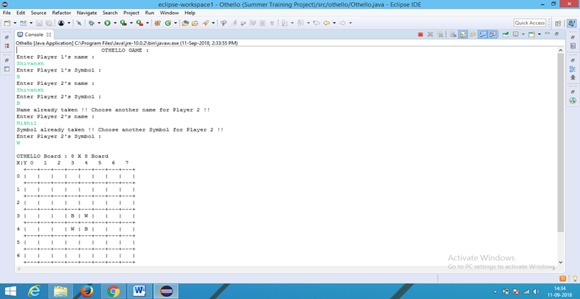
Screenshots
Taking Player info in Othello

Slide 19
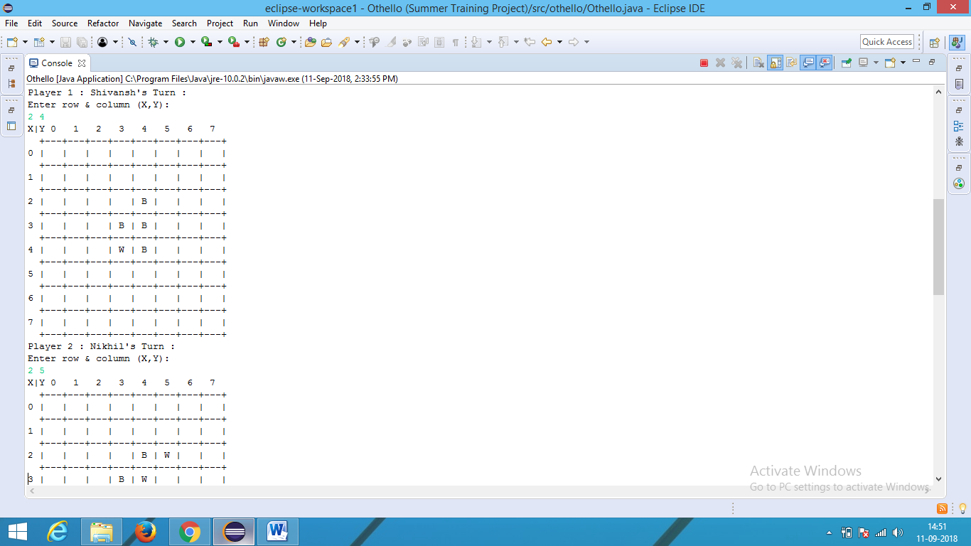
Screenshots
Taking Move one by one

Slide 20
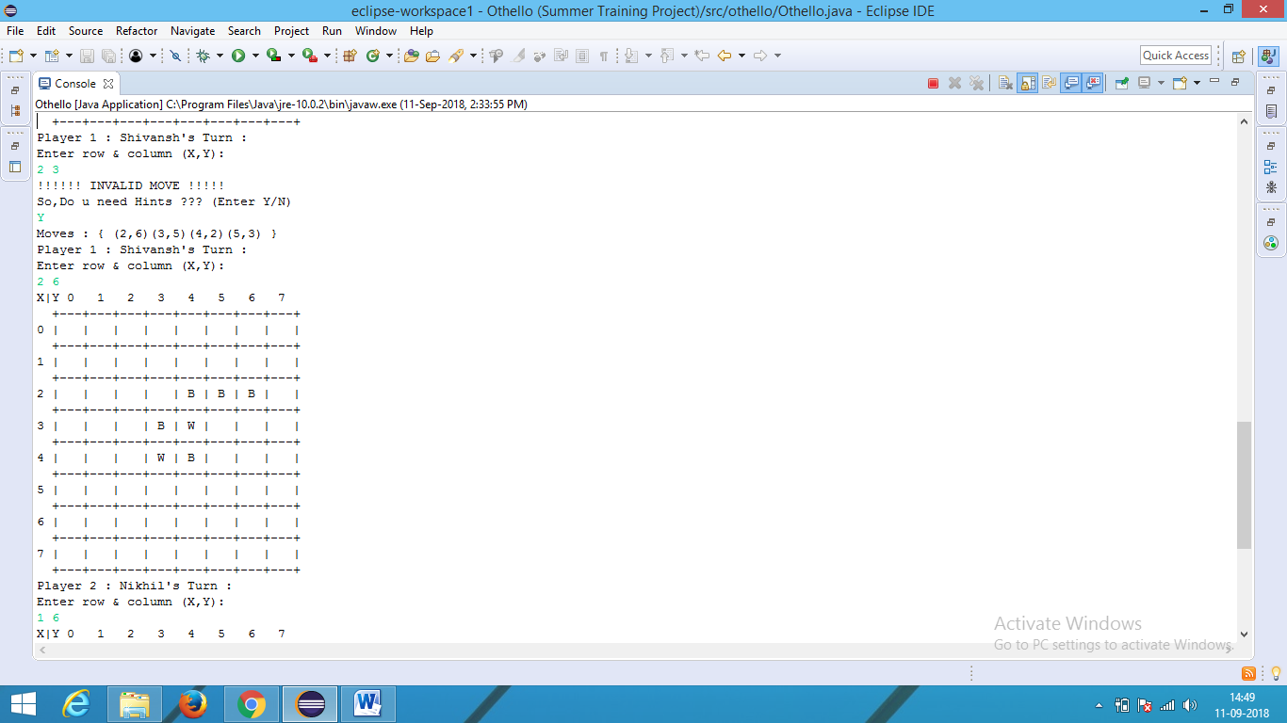
Screenshots
Taking help when you have invalid move

Slide 21
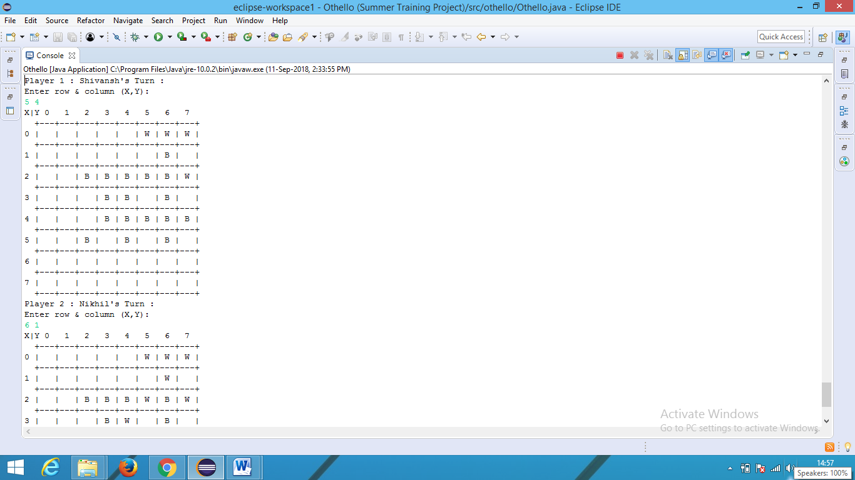
Screenshots
Continuing game

Slide 22
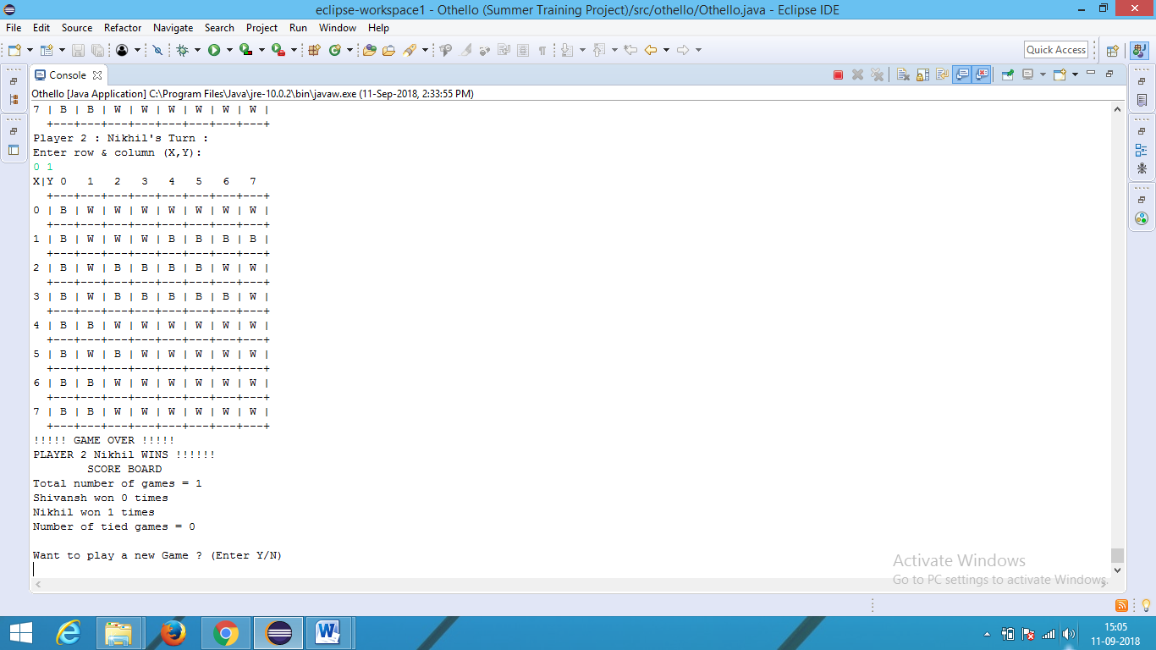
Screenshots
Game over and Display score board.

Slide 23
References
https://www.tutorialspoint.com
https://www.javatpoint.com
https://www.codingninjas.in
https://www.stackoverflow.com
https://www.geeksforgeeks.org
https://github.com
https://youtube.com
https://google.com

Slide 24
THANK YOU

