Slide 1

ALGORITHMS · 01
Binary
Search
Efficient Searching in Sorted Arrays
Presenter Name · Shivansh Tiwari

Slide 2
02
Introduction to Searching
Searching asks one simple question:
Where is the
target?
UNSORTED → no safe elimination
40
10
70
20
60
30
Binary Search answers efficiently—but only when the data is sorted. Order lets every comparison discard an entire half of the remaining search space.
SORTED → eliminate ½
10
20
30
40
60
70
BINARY SEARCH / SORTED ARRAYS
02

Slide 3
03
Divide and Conquer
low and high bound the active search space. mid tests its center.
low = 0
mid = 4
high = 8
10
20
30
40
50
60
70
80
90
Compare target with arr[mid]
equal → found
smaller → keep left half
larger → keep right half
9 → 4 → 2 → 1
SEARCH SPACE SHRINKS
BINARY SEARCH / SORTED ARRAYS
03

Slide 4
04
Algorithm + Pseudocode
low ← 0
high ← n − 1
while low ≤ high
mid ← low + (high − low) / 2
if arr[mid] = target
return mid
else if arr[mid] < target
low ← mid + 1
else
high ← mid − 1
return −1
01 INITIALIZE
Set the active range from 0 to n−1.
02 COMPARE
Test arr[mid] against the target.
03 DISCARD HALF
Move low or high. Stop when found—or when low > high.
BINARY SEARCH / SORTED ARRAYS
04

Slide 5
05
Dry Run · target = 70
STEP 1
mid = 4 → 50 < 70 → low = 5
10
20
30
40
50
60
70
80
90
eliminated
STEP 2
mid = 6 → 70 = 70 → FOUND
10
20
30
40
50
60
70
80
90
Found at index 6
BINARY SEARCH / SORTED ARRAYS
05

Slide 6
06
Binary Search in C
● ● ●
Iterative · returns index or −1
#include <stdio.h>
int binarySearch(int a[], int n, int target) {
int low = 0, high = n - 1;
while (low <= high) {
int mid = low + (high - low) / 2;
if (a[mid] == target) return mid;
if (a[mid] < target) low = mid + 1;
else high = mid - 1;
}
return -1;
}
int main(void) {
int n, target, a[100];
scanf("%d", &n);
for (int i=0; i<n; i++) scanf("%d", &a[i]);
scanf("%d", &target);
int index = binarySearch(a, n, target);
if (index >= 0) printf("Element found at index %d\n", index);
else printf("Element not found\n");
return 0;
}
BINARY SEARCH / SORTED ARRAYS
06

Slide 7
07
Sample Terminal Execution
$ ./binary_search
Enter array size: 9
Enter 9 sorted elements:
10 20 30 40 50 60 70 80 90
Enter element to search: 70
Element found at index 6
input
One run. Two comparisons.
BINARY SEARCH / SORTED ARRAYS
07

Slide 8

08
Analogy · A Dictionary
01
Open near the middle
The middle page acts like mid.
02
Compare the word
Alphabetical order tells you before or after.
03
Discard half
Repeat with new low and high bounds.
BINARY SEARCH / SORTED ARRAYS
08

Slide 9
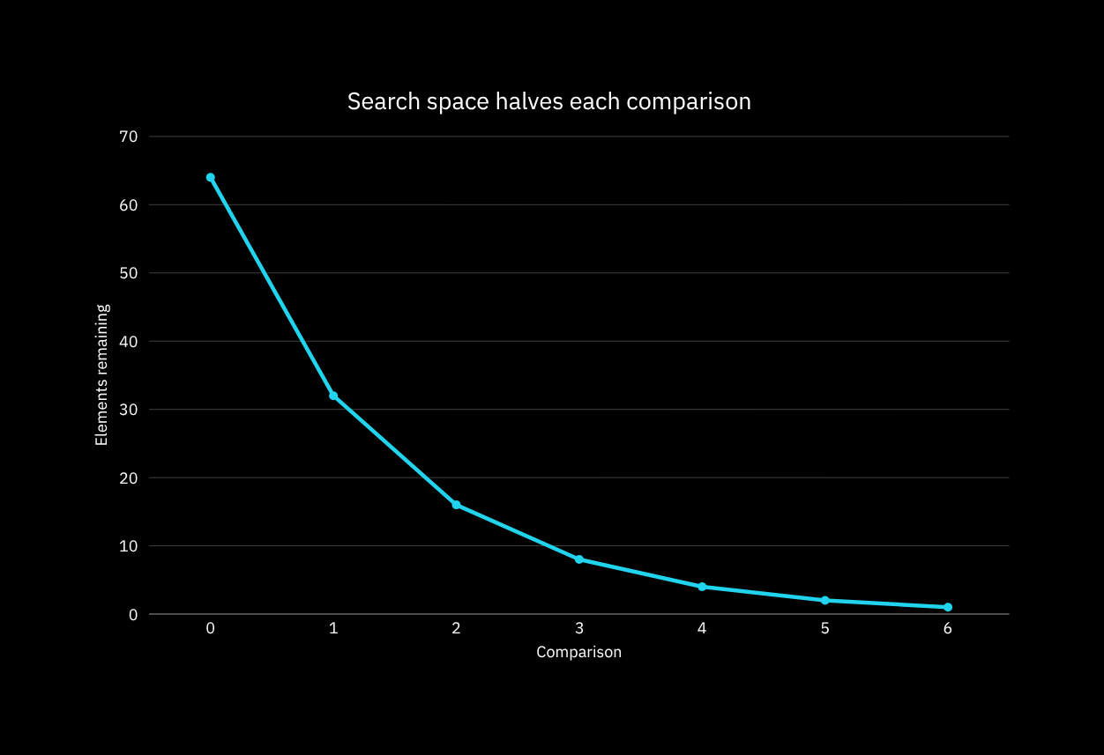
09
Time Complexity
BEST
O(1)
Target is the first mid.
AVERAGE + WORST
O(log n)
Every step halves the remaining candidates.
BINARY SEARCH / SORTED ARRAYS
09

Slide 10
10
Space Complexity
ITERATIVE
RECURSIVE
O(1)
O(log n)
Only low, high, and mid are stored. Memory stays constant as n grows.
Each recursive call adds a stack frame until the search range reaches one element.
call 5
call 4
call 3
call 2
call 1
call stack depth
BINARY SEARCH / SORTED ARRAYS
10

Slide 11
11
Binary Search vs Linear Search
BINARY SEARCH
LINEAR SEARCH
APPROACH
Divide & conquer
Sequential scan
SORTED DATA
Required
Not required
BEST
O(1)
O(1)
AVERAGE
O(log n)
O(n)
WORST
O(log n)
O(n)
SPACE
O(1) iterative
O(1)
BEST FOR
Large sorted arrays
Small / unsorted data
BINARY SEARCH / SORTED ARRAYS
11

Slide 12
12
Advantages + Limitations
ADVANTAGES
LIMITATIONS
Fast at scale
Order has a cost
  O(log n) performance
  O(1) iterative auxiliary space
  Predictable comparisons
  Requires sorted data
  Sorting updates add overhead
  Poor fit without random access
Use it when order is stable and access is direct.
BINARY SEARCH / SORTED ARRAYS
12

Slide 13
13
Applications
01
02
Sorted databases
Lookup systems
Locate keys and records quickly.
Dictionaries, catalogs, indexes.
03
04
Boundary finding
Problem solving
First/last valid position in algorithms.
Core pattern in programming contests and production code.
BINARY SEARCH / SORTED ARRAYS
13

Slide 14
14
Key Takeaways
O(log n)
01 SORT FIRST
Binary Search depends on ordered data.
The payoff of halving.
02 HALVE REPEATEDLY
Compare at mid; discard one side.
03 STAY LEAN
1,024 → 512 → 256 → 128 → 64 → 32 → 16 → 8 → 4 → 2 → 1
Iterative search uses O(1) extra space.
BINARY SEARCH / SORTED ARRAYS
14

Slide 15
END OF SEARCH
Thank
You!
return found;
Made with Canva
15

