Slide 1
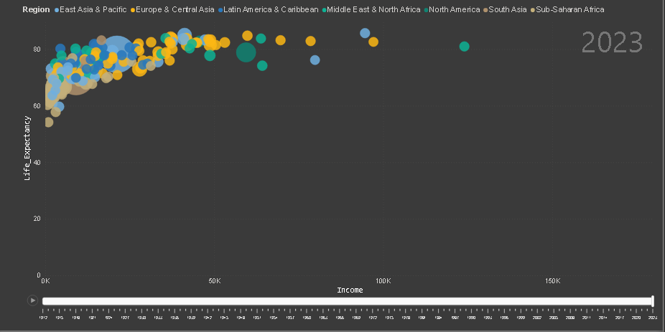
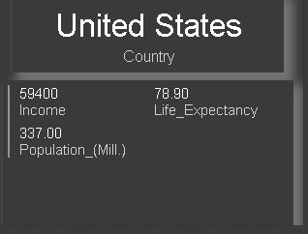

Relation of Income with Life_expectancy
Each Bubble is a country.
Color represents region
Size of the bubble represents population

