Slide 1

Privofy: Privacy Decoded, Risks Revealed
Privofy is designed to decode complex privacy policies and reveal potential risks associated with online services. Many users don't read or understand these policies, leading to exploitation of their data. Privofy aims to bridge this gap by providing easy-to-understand insights and safety scores for privacy policies, empowering users to make informed decisions about their data.
By: Shivansh Mathur

Slide 2
The Problem: Data Exploitation and Lack of Understanding
Exploitation
Companies exploit user data due to users approving privacy policies without understanding them, leading to data leaks and spam calls.
Fear vs. Understanding
60% of Indian adults and 85% of adults worldwide fear unauthorized data access, yet only 11% understand privacy policies.
https://economictimes.indiatimes.com/small-biz/policy-trends/60-online-users-fear-unauthorised-data-collection-only-11-users-read-privacy-policies-survey/articleshow/68355981.cms?from=mdr
https://explodingtopics.com/blog/data-privacy-stats

Slide 3




Privofy's Solution: AI-Powered Privacy Policy Analyzer
Upload or Search
AI Analysis
Users can upload or search company privacy policies on the website.
An AI model analyzes the policy, providing a layman's explanation, legal concerns, and a safety score.
Translation & Audio
Insights can be translated and listened to in the user's preferred language.
The site is hosted at: https://privofy.netlify.app

Slide 4
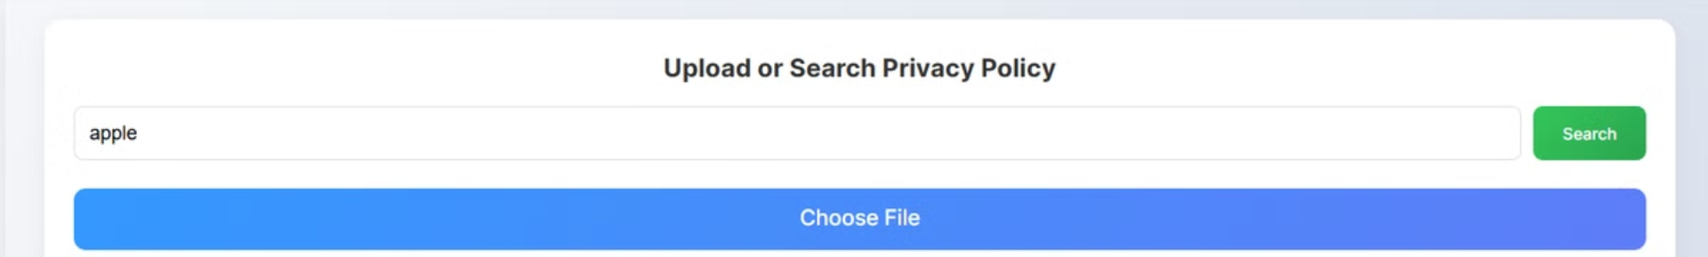




Implementation: How Privofy Works
Dashboard Access
Users log in and access the dashboard with main features.
Policy Input
Users search the site's database or upload a privacy policy. This is sent to the backend
AI Analysis
At the backend, the AI model generates insights: summary, data usage, key takeaways, and safety score.
Language Options
Insights are translated and available in audio format.

Slide 5
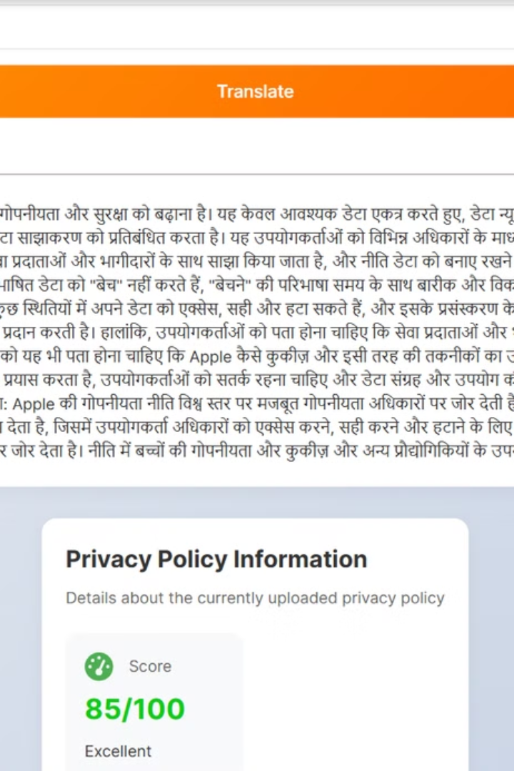
Key Features: Simplifying Privacy
Easy to Use
Simple-to-use website for uploading privacy policies.
Large Database
Searchable database of privacy policies and terms & conditions.
Easy to Understand
AI explains policies in easy-to-understand language with a safety score.
Translation
Text translation and audio in multiple languages.

Slide 6
Impact and Scalability: Empowering Users Worldwide
Broad Impact
Increase transparency – holding companies accountable for their data practices.
Reduce privacy violations – empowering users to make better choices.
Push for better policies – encouraging businesses to adopt fairer, more user-friendly policies.

Slide 7

Conclusion: Solving a
Critical Problem
Privofy stands out with its comprehensive features, automating the analysis of complex privacy policies. Unlike hiring lawyers, Privofy offers an accessible solution, freeing up legal professionals for other cases. This project addresses data security, leaks, and spam calls, aligning with SDG-16, making it a valuable and impactful tool.
Join us at https://privofy.netlify.app in making the internet a safer place. Because your data belongs to you!

