Slide 1

Idea Concept Submission
Made In 3D: Seed The Future Entrepreneurs
Program Season 2024-25
Note: This review submission is mandatory to release the Seed Funding to schools

Slide 2

Student Startup Team Introduction
School ID | 174388337
Name of School | D.A.V. PUBLIC SCHOOL
Names of students who are part of team | 1. Shivansh Mathur 2. Saksham Mehta 3. Revansh Adlakha 4.Yatharth Srivastava 5. Abhinav Chutani 6. Chirag Kharb
Name of Teacher | Ms. Dipali Mathur, Ms. Swati Singh
Name of School Champion / Mentor | Mr. Ankit Patware

Slide 3
Sr No. | Name of Parameter | Milestone | Yes/No (To be filled by teams)
1 | Identification of an Idea (Problem statement) | As per the themes of this year. Team should be able to justify the above to the School Champion. There is mapping of: Only 1 Theme All 3 Core requirements At least 1 Aspect
2 | Plagiarism free | Startup idea selected is not a viz-a-viz copy of existing product picked from Google search. Note: Existing products with enhancements are OK. Copy past not allowed! | Yes
3 | Start-up Name & Logo | Name & logo selected is suitable for the product posted on the respective community of school. | Yes
4 | Manufacturability | Is it possible to manufacture this product using platform? They have to use xDesign && 3D Printing (at least 1 part or whole) Product should be manufacturable in the allocated budget & time-frame of 6 months. | Yes
5 | Onboarding process, Credentials , Access to Community | Your onboarding is completed and you are able to access the platform with your credentials and have access to the respective community | Yes
6 | Whatsapp group creation | There is a whatsapp group created with the teacher, students and school champions in it | Yes
7 | Idea Funnel post | School champion has updated the school details in the Idea funnel on the Volunteer's community. (Please verify with School champion
To release seed funding, all answers should be “Yes”
Coordinate with your School champion or Mentor to convert the “No” to “Yes” by completing the milestone

Slide 4
Short Description of your product/ startup
This innovative project addresses the communication challenges faced by deaf children aged 5-17. The solution is a pair of lightweight, compact glasses made from biodegradable and recycled materials, ensuring both comfort and sustainability. Equipped with a small camera, the glasses feature intuitive blink-detection technology that allows users to interact by simply blinking twice. The glasses also convert spoken language into real-time text, which is displayed on a transparent screen positioned just above the user’s line of sight. This design ensures seamless communication and accessibility, empowering children to actively participate in classroom activities, engage socially, and overcome daily barriers. By combining cutting-edge technology with sustainability, the project offers an affordable, portable, and user-friendly alternative to existing tools, which are often bulky and expensive. This innovative approach aims to bridge communication gaps, enhance learning opportunities, and foster inclusion, ultimately contributing to a more accessible and connected world for deaf children.

Slide 5
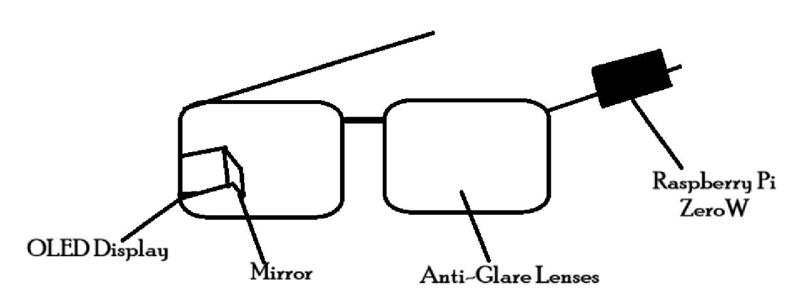
Block diagram(rough)

Slide 6
Plan of Action (Mapping of Who is responsible for What within your team)
Roles & responsibilities allocation within the team members. What is the expected outcome from each member. Make a post of this on the community
*Some examples of Roles that you can mention above>
Head of Marketing, Head of R&D, Head of Mechanical Design, Head of Electronics, Head of Manufacturing, Head of Finance, Chief Executive Officer (CEO), etc. You are free to invent a new role if required ☺
Sr. no. | Name (to be filled by team) | Responsibility/ Role* (to be filled by team)
1 | Shivansh Mathur | Chief Technical Officer (CTO)
2 | Saksham Mehta | Head of Mechanical Design
3 | Revansh Adlakha | Chief Marketing Officer (CMO)
4 | Yatharth Srivastava | Chief Financial Officer (CFO)
5 | Abhinav Chutani | Chief Executive Officer (CEO)
6 | Chirag Kharb | Chief Design Officer (CDO)

