Slide 1
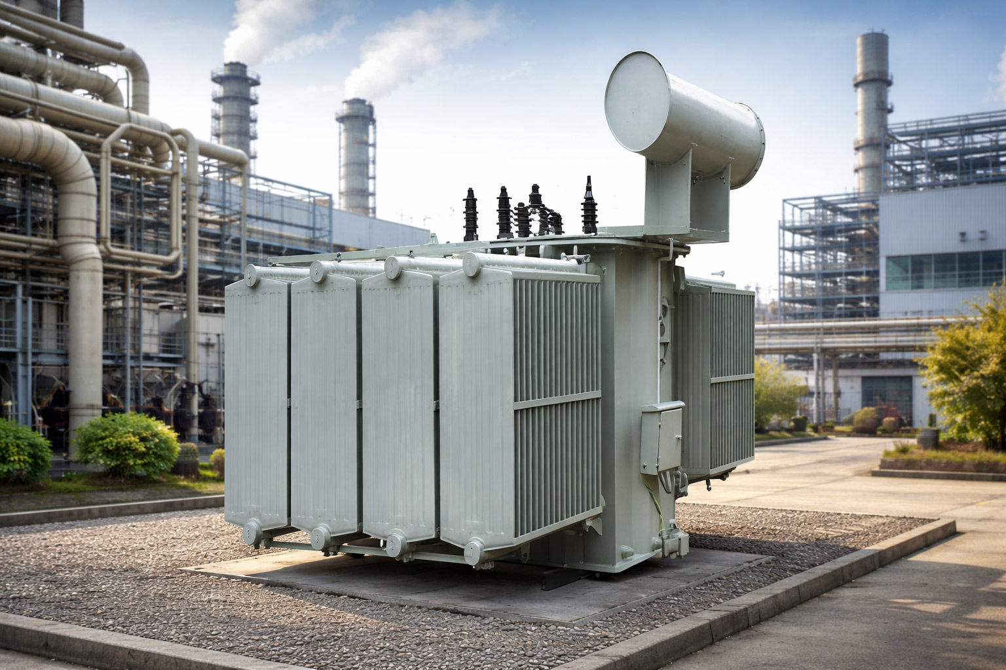
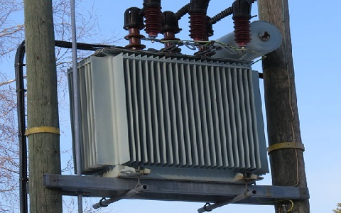
GRIDPULSE
POWERNext-AI 2026 · Track 2 · 10–11 Oct 2026
01
GridPulse
Distribution Transformer
Digital Twin
The Last Mile of the Power Grid
Distribution transformers are critical grid assets that step down medium-voltage electricity to low voltage
for delivery to homes, businesses, and industries. They form the final transformation stage between the
distribution network and end consumers.
Why they matter
Essential infrastructure: Enable reliable electricity delivery across urban and rural India.
High deployment scale: India's distribution network relies on a vast, geographically dispersed fleet of transformers.
Continuous operating stress: Loading variations, ambient temperature, voltage imbalance, and changing demand
affect operating conditions.
The challenge
Overloading and thermal stress can accelerate insulation ageing.
Phase imbalance, abnormal voltage, and oil-related issues can indicate deteriorating conditions.
Limited continuous monitoring makes early detection and condition assessment difficult.
Reactive maintenance can mean faults are discovered only after service is affected.
The need: Move from reactive maintenance towards data-driven, continuous transformer condition monitoring.
Notes:
Supporting detail
Physics-Informed Condition Monitoring and Evidence-Driven Maintenance Decision Support
Track 2: Digital Twin for Intelligent Health Monitoring and Predictive Maintenance of Distribution Transformers
A distribution transformer steps medium voltage (11 kV in the studied assets) down to the
433 V / 250 V supply consumers use.
WHY OPERATING CONTEXT MATTERS
• Load: resistive loss grows with current squared, so heating rises faster than load.
• Temperature: oil temperature lags load by hours; fitted time constants are about 2–3 h in
our synthetic benchmarks; loading guides model insulation ageing as
temperature-dependent [R1][R2].
• Electrical imbalance: unequal phase currents and neutral current heat the unit unevenly.
• History: today's temperature depends on recent loading.
The challenge: isolated readings and periodic inspections cannot show whether a reading is
normal for the present load and recent history. Fixed-interval maintenance can lead to
unexpected transformer failures, increased maintenance costs, power interruptions and
reduced asset life [R23].
Scale: condition monitoring must work across many assets in India's expanding distribution
network.
[INSERT REAL DISTRIBUTION TRANSFORMER PHOTOGRAPH]
[INSERT OFFICIALLY SOURCED INDIA
DISTRIBUTION-INFRASTRUCTURE GROWTH GRAPH WITH UNITS,
YEARS AND CITATION]
[INSERT VERIFIED GLOBAL AND INDIA FAILURE STATISTICS — ONLY
IF ORIGINAL SOURCES AND DEFINITIONS ARE VERIFIED]
The challenge is not merely to collect transformer data; it is to interpret it in the context of electrical and thermal
behaviour.
[TEAM NAME] · [MEMBER 1] ... [MEMBER N] · Manipal Institute of Technology, Bengaluru · POWERNext-AI 2026 · Citations: [R1][R2][R23]
10–11 Oct 2026 · 24-hour hackathon by CPRI (R&D Management Dept, Bengaluru)

Slide 2
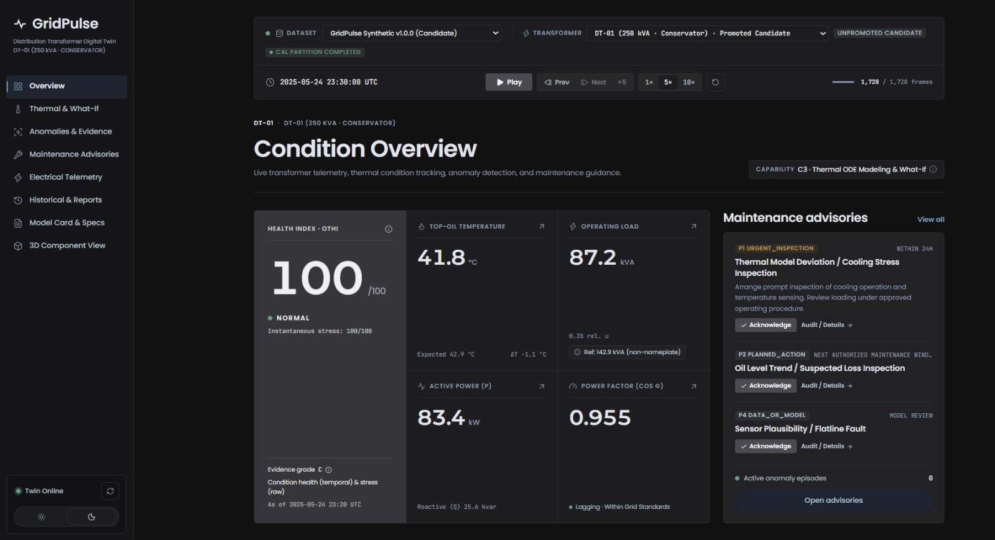
GRIDPULSE
02
How the twin supports a decision
Telemetry Ingestion — Ingest transformer data through the appropriate dataset adapter.
Validation & Normalization — Validate and standardize measurements.
Capability Assessment — Determine which models and analytical capabilities are usable.
Thermal Modeling & Anomaly Detection — Run physics-based thermal estimation and anomaly detectors.
Evidence Evaluation — Convert eligible findings into domain-level severities.
Health Scoring (OTHI) — Aggregate domain severities into the overall transformer health index.
Protection Logic — Apply critical protection-state rules and trip-latch handling.
Visualization & Advisories — Display OTHI, supporting evidence, and maintenance advisories.
Notes:
Plain language: a raw top-oil reading means little without the load and the recent history behind it. GridPulse keeps a chronological state for each asset, validates every input, derives electrical features, compares behaviour with engineering checks and, only for qualified models, with expected thermal behaviour. Persistent evidence is then turned into a maintenance advisory with a priority and an action window. / Assumptions: the prototype replays datasets through the same canonical path that REST ingestion uses; it is not a live sensor deployment. Thresholds and action windows are configured defaults awaiting utility approval. / Limitation: the official statement lists fault prediction and remaining useful life as typical analytics modules. We deliberately offer neither as a number, because no supplied dataset has degradation history or dissolved-gas data. We give a conditional 2-hour projection for promoted models, observed thermal exposure and evidence-linked advisories instead. / Likely judge question: Why no remaining useful life? Answer: no supplied dataset has longitudinal degradation or dissolved-gas data, so any RUL number would be unsupported.
Supporting detail
Official problem statement: “Digital Twin of a Distribution Transformer for Condition Monitoring and Predictive Maintenance” [R23]
1 Raw measurements alone cannot say
whether the transformer behaves as
expected.
2 The twin keeps a chronological, stateful
picture of operating condition.
3 Inputs are validated for timestamps,
units, quality and provenance.
4 Electrical features are derived.
5 Behaviour is compared with engineering
checks and, where qualified, with expected
thermal behaviour.
6 Persistent abnormal evidence is tracked.
7 A gated OTHI and a deterministic
maintenance policy turn evidence into
traceable advice.
8 The dashboard and reports keep
measurements, derived features, model
estimates and recommendations visibly
distinct.
[INSERT ACTUAL MAIN DASHBOARD
SCREENSHOT]
1 Simulate behaviour from operational data — ● IMPLEMENTED · VERIFIED
— Fitted grey-box thermal model; what-if only for PROMOTED models (C3)
2 Monitor electrical and thermal parameters — ● IMPLEMENTED · VERIFIED
— Phase V and I, neutral I, P, Q, PF, frequency, top-oil, ambient, load index
3 Estimate health conditions — ● IMPLEMENTED · VERIFIED — OTHI_V2:
five domains with evidence grade A/B/C/U (operational index)
4 Detect abnormal operating conditions — ● IMPLEMENTED · VERIFIED —
Deterministic detectors; episodes for electrical, power-quality, protection
5 Statistical drift and leak trends — ● GATED · DESCRIPTIVE ONLY — Thermal
CUSUM drift and oil-leak trend: visible evidence, zero weight in OTHI
6 Predictive maintenance recommendations — ● IMPLEMENTED · VERIFIED
— Versioned advisories P0–P4 with action windows; no numeric RUL
7 Interactive dashboard and reports — ● IMPLEMENTED — screenshots to be supplied —
React dashboard; JSON, CSV, PDF exports returned HTTP 200 on the running build
WHAT IT IS
A stateful, chronological replay of datasets through the same canonical path
that REST ingestion uses; not a live sensor deployment.
WHAT IT DOES NOT DO
Numeric RUL or failure probability; autonomous control or relay replacement; claims
of field validation. No supplied dataset has degradation history or dissolved-gas data.
[R8][R15][R23]

Slide 3
GRIDPULSE
03
System architecture
01
02
03
04
05
06
Raw telemetry
Source
adapters
Canonical
quality
Electrical
features
TwinState
Thermal model
→
→
→
→
→
CSV / canonical
REST
Keep datasets
separate
Units, UTC,
provenance
S, PF, load,
imbalance
Chronological state
Predictive only if
promoted
07
08
09
10
11
Residual
evidence
OTHI
Maintenance
policy
FactBundle
Dashboard /
reports
→
→
→
→
CUSUM and oil
trend gated
Freshness and trip
override
Based on fixed set of
rules
One source for UI /
reports
React, JSON, CSV,
PDF
Four rules that hold throughout the pipeline
Missing data stays unknown.
Unqualified models stay descriptive.
Gated detectors carry zero score weight.
A verified trip overrides all evidence.
Notes:
Plain language: telemetry enters through source adapters into one canonical contract with UCUM units, UTC time and a quality flag modelled on OPC UA status semantics. Electrical quantities are derived, then a chronological TwinState with a state hash is updated; late events never rewind it. The grey-box thermal model feeds residuals and detectors, OTHI_V2 aggregates the evidence, and a deterministic, versioned policy produces advisories. One FactBundle feeds both the dashboard and the reports, so the screens and the PDF cannot disagree. / Assumptions: thresholds, detector severities and action windows are configured engineering defaults, not standards limits. / Limitation: only the CSV and canonical REST paths are implemented; MQTT, OPC UA and Modbus are planned. / Four rules to say aloud: missing data never silently becomes a healthy value; an unqualified model cannot produce an authoritative prediction; gated detectors cannot change the health score; a verified trip overrides everything. / Likely judge question: How is OTHI built and where do its numbers come from? Answer: max-plus-compounding of five domain severities; the severities, thresholds and the 0.25 coefficient are configured product-policy defaults that need equipment-specific limits.
Supporting detail
1 Raw telemetry — CSV
exports; canonical REST
ingestion — ●
IMPLEMENTED ·
MEASURED
→
2 Source adapter —
Tripura CSV,
CPRI-schema, GridPulse
synthetic — ●
IMPLEMENTED · VERIFIED
→
3 Canonical data and quality
— UCUM units [R21]; UTC
time; phase mapping; GOOD
/ UNCERTAIN / BAD quality
modelled on OPC UA status
[R18]; duplicate and gap
handling — ● IMPLEMENTED
· VERIFIED
→
4 Derived electrical
features — S, PF, I_eq,
unbalance, neutral ratio,
relative load u — ●
IMPLEMENTED · DERIVED
→
5 Chronological TwinState
— State hash; late events
never rewind the state —
● IMPLEMENTED ·
VERIFIED
→
6 Grey-box thermal
model — Documented
fallback; predictive use
only when PROMOTED
(est.) — ● IMPLEMENTED
· MODEL est.
7 Residuals and anomaly
evidence — Deterministic
detectors; the CUSUM and
oil-trend branches carry no
score weight — ●
IMPLEMENTED · VERIFIED
and ● GATED ·
DESCRIPTIVE ONLY
→
8 OTHI_V2 — Five
domains, freshness
gates, anti-uplift,
protection override — ●
IMPLEMENTED · VERIFIED
→
9 Deterministic
maintenance policy —
Versioned rules P0–P4
with action windows — ●
IMPLEMENTED ·
ADVISORY
→
10 Authoritative
FactBundle — One
structured source for
both the UI and the
reports — ●
IMPLEMENTED · VERIFIED
→
11 Dashboard and
reports — React
dashboard; JSON, CSV,
PDF exports — ●
IMPLEMENTED
Data classes: MEASURED ·
DERIVED · MODEL ESTIMATE
(cyan fill, est.) · ADVISORY
Provenance and configuration — Source
hash, mapping version, model version, state
hash
Capability gating C0–C4 — Integrity,
electrical, thermal descriptive, predictive,
exposure
Protection precedence — A verified
direct trip outranks all other evidence
Append-only operator ledger — Actor,
reason and event time; evidence is never
rewritten
• Normalise units, timestamps, phases and quality; derive S, PF, I_eq and imbalance only when
compatible signals exist.
• Process data deterministically and chronologically.
• Use the thermal model predictively only when its evidence and calibration gates pass.
• Apply residual analysis and CUSUM only where configured and qualified.
• Issue versioned, auditable recommendations.
• Missing data never silently becomes a healthy value.
• An unqualified model cannot produce an authoritative
prediction.
• Gated detectors cannot change the health score.
• A verified trip overrides everything.
[R7][R10][R18][R21]

Slide 4

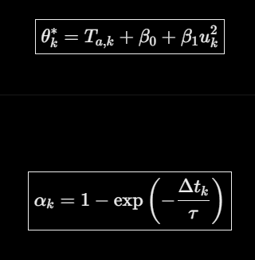
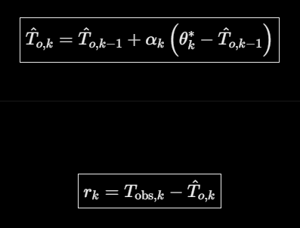










GRIDPULSE
04
The model and its qualification gates
Electrical load
First-order thermal response
The load index provides a physical driver for heating.
All four promotion gates must pass
Health scoring follows evidence
•
Notes:
Plain language: this slide shows the four ideas that make the twin physical rather than a dashboard of thresholds. / Derivation of the thermal update. (1) At steady load the top-oil rise over ambient settles at beta0 + beta1 u squared; the u squared appears because resistive loss scales with current squared. (2) The oil responds as a first-order lag: d theta_o / dt = (1/tau)(beta0 + beta1 u^2 - theta_o). (3) Over a step of length dt with constant ambient and load the exact solution is theta_o(t+dt) = theta* + (theta_o(t) - theta*) exp(-dt/tau). (4) With alpha = 1 - exp(-dt/tau) this becomes T_new = T_old + alpha (theta* - T_old), which handles irregular sampling because dt only enters through alpha. (5) The residual is observed minus expected. / Huber loss is quadratic for small residuals and linear for large ones, so a stuck or spiking sensor cannot drag the fit; delta = 1.345 sigma with a 0.5 C floor for sensor resolution. Bias matters because a positive bias means the model runs cooler than the transformer. / Assumptions: first-order lag; ambient and load held at the forecast origin during evaluation; OTHI severities and the 0.25 coefficient are configured defaults. / Limitation: this is not the IEC equation; the IEC structure is shown for context only. / Likely judge question: why a first-order model rather than the full IEC or a hot-spot model? Answer: it is identifiable from top-oil, load and ambient only; hot-spot and ageing need winding temperature and a verified insulation class, so C4 is gated.
Supporting detail
4A Electrical derivations — ● IMPLEMENTED · DERIVED
S = √(P² + Q²) [kVA] PF = P / S
|Q| = √(max(0, S² − P²)) when only P and S exist
I_eq = √((I_L1² + I_L2² + I_L3²) / 3) [A]
Unbalance % = 100 · max_k |X_k − X̄| / X̄
Neutral ratio = |I_N| / max(I_eq, 0.1 A)
u = S / S_base (relative load index)
P kW, Q kvar, S kVA, I A, V V. |Q| is a magnitude only; the sign is never fabricated. I_eq
is a load proxy, not a rating or a percentage of nameplate. X = the three phase
currents or voltages, X̄ their mean (NEMA-style; 0.1 A floor). S_base = rated kVA when
the profile is verified. Reference: P = √3 · V_L · I_L · PF for a balanced, sinusoidal load.
P–Q–S inconsistency ≥ 0.10 is data-quality evidence, not a fault.
4B First-order grey-box thermal model — ● IMPLEMENTED · MODEL ESTIMATE (est.)
θ*_k = T_a,k + β₀ + β₁ · u_k²
α_k = 1 − exp(−Δt_k / τ)
T̂_o,k = T̂_o,k−1 + α_k · (θ*_k − T̂_o,k−1)
r_k = T_obs,k − T̂_o,k
dθ_o/dt = (1/τ) · (β₀ + β₁u² − θ_o)
θ_o ≡ T_o − T_a is the top-oil RISE over ambient. The code carries absolute T̂_o with T_a inside θ*; the two forms
agree over a step with ambient held constant. u dimensionless relative load; τ [h]; β₀ ≥ 0 [°C] load-independent
rise; β₁ ≥ 0 [°C] load-related rise at u = 1; Δt irregular (Δt = 0 leaves the state unchanged). u² because resistive
loss scales with I²: a reduced-order approximation, not a multiphysics model.
[INSERT REAL UI SCREENSHOT OF THERMAL EQUATION, TEMPERATURE TRAJECTORY AND CONDITIONAL
PROJECTION]
IEC 60076-7 structure, context only [R3][R6]: τ_o · dθ_o/dt = Δθ_or · [(1 + R·K²)/(1 + R)]^x − θ_o. Not
implemented; not identical to the fitted form.
4C Robust fitting and qualification — ● IMPLEMENTED · VERIFIED
Huber: L_δ(r) = ½r² if |r| ≤ δ; δ(|r| − ½δ) otherwise
δ = 1.345 · σ_fit; σ_fit = max(0.5 °C, 1.4826 · MAD)
MAE = (1/N) Σ |y_i − ŷ_i| Bias = (1/N) Σ (y_i − ŷ_i)
Bias > 0: the model UNDER-predicts (transformer warmer)
Baseline: persistence T̂(t+h) = T(t), 2 h open-loop rollout
LOCKED PROMOTION GATES (project policy, not a standard)
1 MAE ≤ 0.95 × persistence MAE, or ≥ 5%
better
2 |bias| ≤ |persistence bias| + 0.10 °C
3 Marginal 90% band coverage from 80% to
98%
4 Identifiable: no parameter on its bound
All four must pass for PROMOTED. MAE alone never promotes a model; a model that is not
promoted stays descriptive (no 2-hour projection, no what-if). Worked result: Slide 5.
4D OTHI_V2 and CUSUM
● IMPLEMENTED · VERIFIED — OTHI_V2
base = max_d s_d compound = 1 − Π_(d≠base) (1 − s_d)
secondary = 0.25 · (1 − base) · compound
OTHI = round(100 · (1 − min(1, base + secondary)))
Worked example: s_thermal = 0.40, s_loading = 0.20 → base 0.40, compound 0.20, secondary 0.25 × 0.60 ×
0.20 = 0.030, OTHI = 57 (one 0.40 domain alone gives 60). Invariants (500-case property test): score within
0–100; raising a severity never raises the score; a latched trip gives 0; deterministic tie-breaking. An operational
index: not insulation health, failure probability or RUL.
● GATED · DESCRIPTIVE ONLY — CUSUM
z_k = (r_k − m_cal) / max(s_cal, 0.5 °C)
C⁺_k = max(0, C⁺_k−1 + z_k − k) C⁻_k = max(0, C⁻_k−1 − z_k − k)
alarm when C⁺ or C⁻ ≥ h; k = 0.5, h = 4.5
Why gated: residual lag-1 autocorrelation 0.95–0.97 breaks the standardised-data assumption; it alarmed on
about 88–93% of normal frames, so it carries zero weight in OTHI. The code stores the lower sum as a
non-positive value (mirror image).
[R3][R4][R6] why fit per asset · [R5] model lineage · [R8][R9] index to action · [R11][R12] CUSUM · [R13][R14] intervals

Slide 5
GRIDPULSE
05
Dataset evaluation
Four datasets, kept separate
Approach Used :
Synthetic Data: A Controlled Testing Approach
Enables reproducible testing across normal operation and controlled fault scenarios.
Supports evaluation when comprehensive, labelled real-world fault data is limited.
Allows systematic testing of detector responses and system behavior.
Limitation: Synthetic results alone cannot establish real-world performance; validation against field data remains essential.
References: Transformer fault identification using synthetic data, IEEE TDEI (2025); Krishnan et al. (2020), Validation of Synthetic U.S. Electric Power Distribution System Data Sets.
Tripura development telemetry
Real telemetry. TEST is a development set.
CPRI-schema v3.0.2
Synthetic benchmark. 8 assets, 360 injected events.
GridPulse synthetic v1
4 assets, 37 scenarios and 5 protection events.
Backup story set
Synthetic demo only. An adapter is still needed.
FIT → CALIBRATION → FREEZE → TEST
Oracle labels stay outside the runtime.
Notes:
Plain language: we use data to calibrate and test a physically interpretable model, not to replace physical reasoning. Parameters and the load driver are chosen on FIT, uncertainty and thresholds on CAL, then the candidate and policy are frozen and bound to their test reports by SHA-256 before TEST is evaluated once. / Results, all synthetic. TX_250_MIX: grey-box MAE 1.035 C against persistence 1.355 C, a 23.58% improvement, yet NOT PROMOTED because its signed bias of +0.260 C exceeds the bias gate. TX_1000_COMM passes all four gates. Across the eight CPRI-schema candidates, MAE beats persistence for every asset (8.6% to 59.9%) but seven fail the bias gate with +0.12 to +0.28 C; only TX_1000_COMM is promoted. On GridPulse synthetic v1, MAE is 46.6% to 61.8% below persistence; DT-01 is promoted, and DT-02, DT-03 and DT-04 miss only because their interval coverage is above 98% (98.11%, 98.49%, 98.10%). Gating stopped unqualified models from producing authoritative projections. / Assumptions: evaluation holds ambient and load at their forecast-origin values over a 2-hour open-loop rollout. / Limitation: Tripura TEST is a development set, not an untouched lockbox; none of this is field validation. / Likely judge question: why did only 1 of 8 pass? Answer: seven show a positive bias of +0.12 to +0.28 C, meaning the model runs cooler than observed; the gate exists to stop a biased model from issuing projections even though its MAE beats persistence.
Supporting detail
We use data to calibrate and test a physically interpretable model; we do not use data as a substitute for physical reasoning.
Tripura development telemetry (real): Five raw CSV exports;
18,324 common timestamps, 2019-06-25 to 2020-04-14;
nominal 15 min (about 81%), irregular intervals, 102
segments, conflicting duplicate timestamps; top-oil quantised
near 1 °C. Chronological 60/20/20 FIT/CAL/TEST with a 2 h
embargo. Role: development and calibration. TEST is a
development set, not an untouched lockbox.
CPRI-schema synthetic benchmark v3.0.2: Its own
methodology: not Tripura, CPRI, utility or field data. 8 assets
(100–1000 kVA), 30 min, 280,182 rows; FIT 2024, CAL
2025-01-01 to 07-02, TEST 2025-07-03 to 12-31; 12 fault
classes, 360 injected events. The twin replays CAL; TEST is
reserved; oracle labels are stripped.
GridPulse synthetic v1: Physics generator v1.0.0: 4 assets
(160–500 kVA; conservator and sealed), 11 kV / 433 V, ONAN;
30 min, 2025-01-01 to 06-29; FIT days 0–107, CAL 108–143,
TEST 144–179; 37 scenarios and 5 protection events;
parameters labelled SOURCE_DERIVED,
ENGINEERING_ASSUMPTION or SCENARIO_SETTING; labels
stay offline.
Backup story set (demo only): 2 assets, 500 frames each, 30
min, 2025-01-01 to 01-11; DEMO_ONLY with no FIT/CAL/TEST;
its own validator passes 119 of 119 checks. Isolated offline
candidate that needs a small adapter.
Datasets stay separate: statistics are never merged. Tripura is
real development telemetry; the other three are synthetic.
RESEARCH BASIS: [R3][R6] generic parameters err ·
[R13][R14] conformal intervals · [R22] synthetic oil and
pressure envelope
1 DATA AUDIT — Inspect cadence,
gaps, duplicates and units
↓
2 CANONICALIZATION — Adapters map
each source to one canonical contract
↓
3 FIT — Parameters and load driver
chosen on FIT only
↓
4 CALIBRATION — Uncertainty and
thresholds calibrated on CAL
↓
5 FREEZE — Candidate and policy frozen;
bound to test reports by SHA-256
↓
6 TEST — MAE, signed bias, coverage,
identifiability: evaluated once
↓
7 PROMOTION DECISION — A failed
gate keeps predictive capability off
Oracle labels and fault ledgers never
enter the runtime; the twin replays CAL
only. Controlled scenario injection tests
software behaviour, not real-world
detection accuracy.
TX_250_MIX · CPRI-schema synthetic · TEST partition
Grey-box MAE 1.035 °C vs persistence MAE 1.355 °C
Relative MAE improvement 23.58%
Model signed bias +0.260 °C (persistence −0.0047 °C)
NOT PROMOTED — signed-bias gate failed
Report values 1.0351 vs 1.3545 °C; 2 h trajectory; coverage 96.17%
TX_1000_COMM — PROMOTED (all four gates) / MAE 1.2015 vs
2.9984 °C (59.93% better); signed bias +0.0974 °C
TX_250_MIX: 2 h trajectory MAE by horizon (°C)
Grey-box (cyan) / Persistence (grey)
0
1
2
0.5217
0.6284
30 min
0.8249
1.1085
60 min
1.1937
1.5992
90 min
1.5999
2.0818
120 min
All eight CPRI-schema candidates: grey-box MAE beats persistence (8.6%
to 59.9%), yet only 1 of 8 is PROMOTED; 7 fail the signed-bias gate (+0.12
to +0.28 °C). GridPulse v1: MAE 46.6–61.8% below persistence; 1 of 4
promoted; 3 held back only by over-wide intervals.
Performance on supplied or synthetic data is not equivalent to independent field validation.

Slide 6
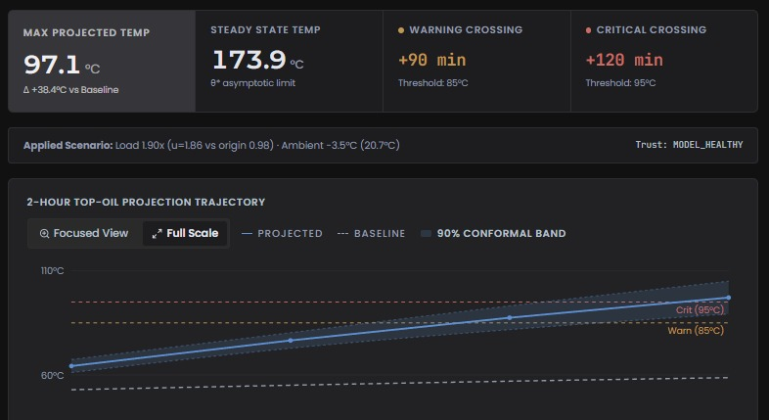
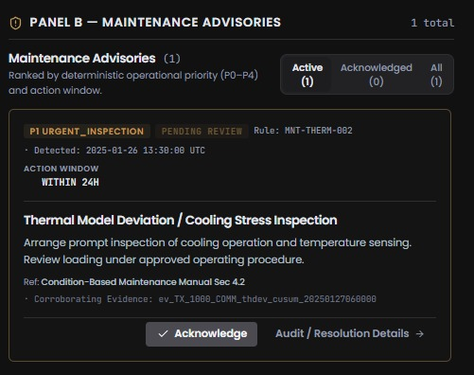
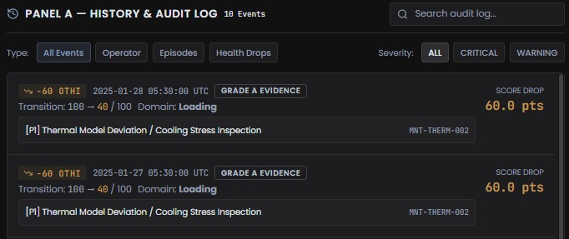
GRIDPULSE
06
Scenario testing and maintenance
What-if scenarios
Maintenance advisory
History and audit
[INSERT ACTUAL WHAT-IF
SCREENSHOT]
[INSERT ACTUAL MAINTENANCE
ADVISORY SCREENSHOT]
[INSERT ACTUAL HISTORY AND AUDIT
LOG SCREENSHOT]
•
Only PROMOTED models support
what-if.
•
Versioned advice with
evidence-linked reasons.
•
Stable incident identities and
evidence timelines.
•
Test load changes and signal
anomalies.
•
P0–P4 priorities and configured
action windows.
•
Append-only operator actions with
actor, reason and time.
•
[VERIFY in demo: run a what-if and
confirm the live OTHI and state hash
are unchanged]
•
Acknowledgement does not prove
repair.
•
Traceable data, model and rule
versions.
Notes:
Supporting detail
What-if scenario generator — ●
IMPLEMENTED · promoted models only
[INSERT ACTUAL WHAT-IF SCREENSHOT]
• Controlled load changes, spikes, stuck signals,
bias or drift, phase imbalance.
• Compares hypothetical outcomes with the
current state.
• Enabled only for PROMOTED models;
otherwise shown as Gated.
• Hypothetical runs must not change the live
state. [VERIFY in demo: run a what-if and
confirm the live OTHI and state hash are
unchanged]
Maintenance advisory — ● IMPLEMENTED ·
VERIFIED (API)
[INSERT ACTUAL MAINTENANCE ADVISORY
SCREENSHOT]
P0 SAFETY /
Immediate
P1 URGENT /
Within 24 h
P2 PLANNED / Next
window
P3 MONITOR /
Watch trend
P4 REVIEW /
Data/model
• Versioned deterministic rules with
evidence-linked reasoning.
• Priorities P0–P4 with action windows
(configured policy defaults awaiting utility
approval).
• Active, Acknowledged and Resolved differ:
acknowledgement is a workflow event, not proof
of repair.
• Advisory only: no switching or control.
History and audit log — ● IMPLEMENTED ·
VERIFIED (API)
[INSERT ACTUAL HISTORY AND AUDIT LOG
SCREENSHOT]
• Stable incident identities; a timeline of state
and evidence changes.
• Episode duration, severity and supporting
observations.
• Operator actions with actor, reason and event
time in an append-only ledger.
• Review cards show supporting evidence as a
collapsible count.
• Traceable to configuration, model and rule
version and source data.
If a screenshot shows an advisory “Ref:” line, caption it “illustrative policy reference — not a cited utility document” or crop it. Citation: [R8]

Slide 7
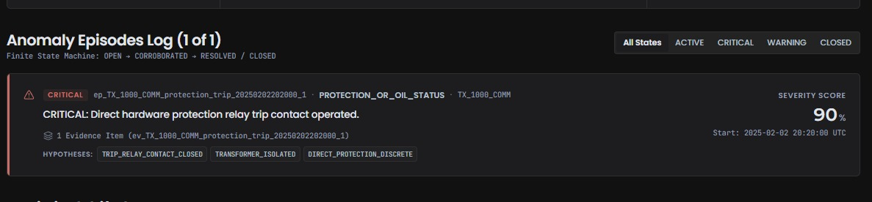
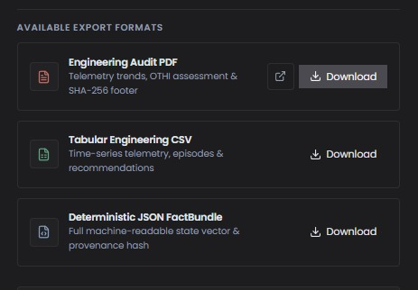
GRIDPULSE
07
Anomalies, reports and protection
Persistent anomaly episodes
Reproducible reports
One identity as evidence evolves. Explicit persistence,
recovery and missing-data handling.
Dashboard and JSON / CSV / PDF share one
FactBundle. Sensor quality stays separate from dataset
partition.
[INSERT ACTUAL ANOMALY TIMELINE SCREENSHOT]
Recorded protection-trip replay
07:30
08:00 · TRIP
Operator ACK
10:30 · Reclose
Authorised resolution
Next frame
OTHI 19
OTHI 0
OTHI stays 0
OTHI stays 0
RESOLVE
OTHI 100
Overload evidence
OTI trip, breaker open
Latch stays active
Load returns, still
latched
Documented reason
code
Health recovers
DT-02 · GridPulse synthetic v1 · CAL · scripted authorised resolution. Synthetic data.
Notes:
Plain language: anomaly episodes separate a transient spike from a persistent condition and keep one stable identity while evidence evolves, using persistence, corroboration, hysteresis and recovery. Today they cover current and voltage imbalance, neutral ratio, low power factor, P-Q-S inconsistency and protection trips; thermal, oil and pressure conditions raise evidence and advisories but not yet episodes. Reports are generated from the same FactBundle as the dashboard, so JSON, CSV and PDF cannot disagree with the screens; the exports returned HTTP 200 on the running build. / Protection semantics: a latched direct trip sets the protection domain to full severity, so OTHI is 0 and the status is CRITICAL. Acknowledging, resumed healthy telemetry, or resolving an unrelated advisory does not clear it. Only an authorised RESOLVE or DISMISS of MNT-PROT-001 with a documented reason code, recorded after the trip, clears it; health then recovers on the next processed frame. / Assumption and limitation: this is a recorded offline replay on synthetic data with a scripted resolution; injected test events are labelled OPERATOR_INJECTED; no physical trip command is issued and this does not replace protection relays. / Likely judge question: how does a trip clear? Answer: only an authorised resolution with a documented reason code; acknowledgement and resumed telemetry do not.
Supporting detail
1 Stateful anomaly episodes — ● IMPLEMENTED
· VERIFIED
• Separates transient spikes from persistent
conditions.
• Stable identity as evidence evolves; no new
episode per frame.
• Persistence, corroboration, hysteresis and
recovery; explicit missing and stale data
handling.
• Covers current and voltage imbalance, neutral
ratio, low PF, P–Q–S inconsistency and
protection trips.
• Thermal, oil and pressure raise evidence and
advisories only (episodes planned).
[INSERT ACTUAL ANOMALY
TIMELINE SCREENSHOT]
[INSERT PHYSICAL-DOMAIN
PANEL SCREENSHOT]
2 Historical performance and reporting — ●
IMPLEMENTED · VERIFIED (exports returned
HTTP 200)
• Electrical and thermal trends; time in
temperature bands and observed thermal
exposure.
• Qualified expected-behaviour comparison
where available.
• JSON, CSV and PDF exports from the same
FactBundle as the dashboard.
• Telemetry log shows Sensor Quality separate
from Dataset Partition.
• Unsupported sensors read “Unavailable / Not
Supported” and are never scored.
[INSERT ACTUAL HISTORICAL
PERFORMANCE OR GENERATED
REPORT SCREENSHOT]
[INSERT TELEMETRY LOG
SCREENSHOT: SENSOR QUALITY
vs DATASET PARTITION]
3 Protection-trip demonstration — ● IMPLEMENTED · VERIFIED (recorded offline replay)
07:30
OTHI 19
Overload evidence
→
08:00 · TRIP
OTHI 0 CRITICAL
OTI trip, breaker open,
phase current exactly 0 A;
P0 advisory
→
Operator ACK
OTHI stays 0
Acknowledgement does not
clear the latch
→
10:30 · Reclose
OTHI stays 0
Breaker recloses and load
returns; still latched
→
Authorised resolution
RESOLVE
Documented reason code,
recorded after the trip
→
Next frame
OTHI 100 NORMAL
Health recovers on the next
processed frame
Recorded offline replay of DT-02, GridPulse synthetic v1, CAL partition, with a scripted authorised resolution. Synthetic data. Injected test events are
labelled.
• A verified direct trip outranks accumulated anomaly evidence.
• Only RESOLVE or DISMISS of the protection advisory MNT-PROT-001 with a documented reason code clears the latch; acknowledgement and resumed telemetry do not.
• No physical trip commands are issued; this does not replace protection relays.
[INSERT ACTUAL PROTECTION-TRIP TEST
SCREENSHOT]

Slide 8
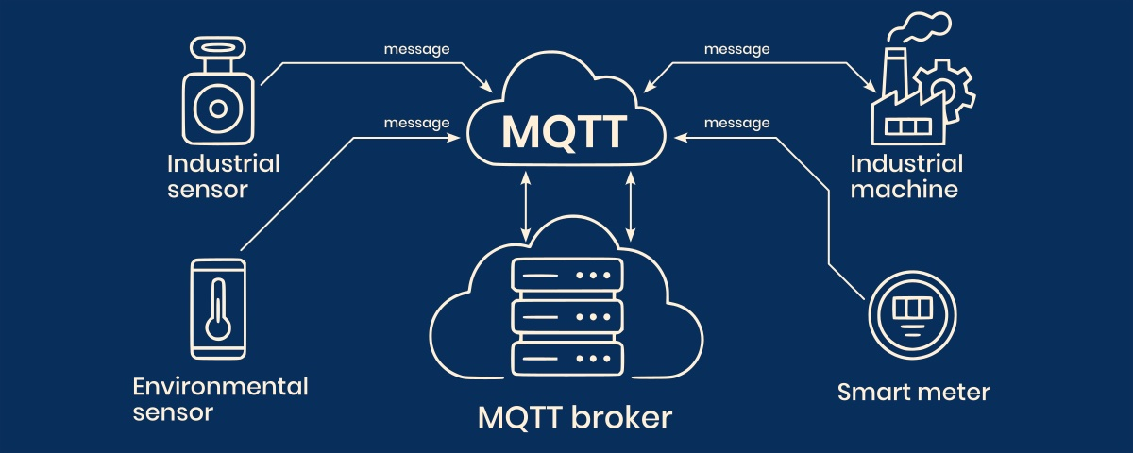
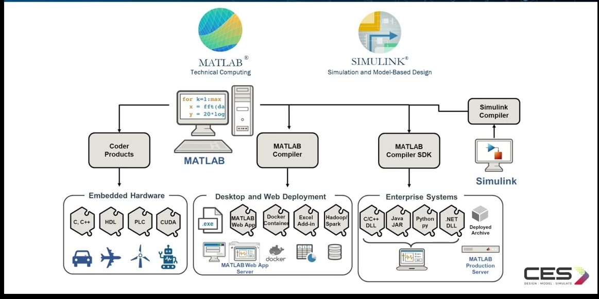
GRIDPULSE
08
Roadmap to operational use
Industrial sources
Independent verification
Detector requalification
PROPOSED / FUTURE
PROPOSED / FUTURE
PROPOSED / FUTURE
•
MQTT, OPC UA and Modbus
source adapters.
•
A MATLAB / Simulink reference
model.
•
CUSUM on prewhitened residuals.
•
Temperature-corrected oil-leak
trends.
•
SCADA and edge gateways feed
the canonical contract.
[R17][R18][R19][R20]
•
Compare identical load and
ambient profiles, transients and
steady-state rise.
•
Thermal, oil and pressure
episodes.
Notes:
Plain language: everything on this slide is a plan except CSV and canonical REST ingestion. Industrial protocols (MQTT, OPC UA, Modbus) and SCADA or edge gateways would feed the existing canonical telemetry contract through source adapters, so the analytics do not change when the transport does. A MATLAB/Simulink model would be an independent first-order reference: identical ambient and load profiles, then a comparison of time constants, transients and steady-state rise, including load steps and changing ambient, with documented sensitivity. It is a verification plan, not a result. / Requalification: CUSUM on prewhitened or one-step residuals; a bulk-oil-temperature-corrected multi-day leak estimator; episodes for thermal, oil and pressure conditions; thermal ageing only with a credible hot-spot temperature and a verified insulation class; an adapter for the backup story dataset. / Considered and deferred: Kalman state estimation on physical states and a machine-learning shadow comparator, because instability came from detector design and state handling rather than noise, and synthetic noise cannot validate the filter parameters. This needs explicit team sign-off before any work. / Likely judge question: what is the path to real deployment? Answer: adapters into the existing canonical contract, equipment-specific limits, a Simulink cross-check of the thermal model, and validation on real telemetry.
Supporting detail
IoT and industrial
communications — ┄ PROPOSED /
FUTURE
MQTT [R19]
OPC UA [R18]
Modbus [R20]
SCADA / edge
↓
Source adapters feed the canonical
telemetry contract
● IMPLEMENTED today: CSV and REST only
• MQTT, OPC UA, Modbus, SCADA
and edge gateways as upstream
sources.
• All feed the canonical telemetry
contract through source adapters, so
the analytics stay
transport-independent.
• Precedent: IEEE C57.91 thermal
monitoring on an automation
controller [R17].
MATLAB / Simulink verification —
┄ PROPOSED / FUTURE — a plan,
not a result
[INSERT MATLAB/SIMULINK BLOCK
DIAGRAM OR REFERENCE-MODEL
COMPARISON]
• Build an independent first-order
reference model.
• Feed identical ambient and load
profiles.
• Compare time constants, transients
and steady-state rise.
• Test load steps and changing
ambient; document sensitivity.
Requalification roadmap — ┄
PROPOSED / FUTURE
TODAY — Thermal CUSUM,
oil-leak trend and C4 ageing are
GATED · DESCRIPTIVE ONLY:
visible evidence, zero weight in
OTHI.
• CUSUM on prewhitened or one-step
residuals.
• Bulk-oil-corrected multi-day leak
estimator.
• Episodes for thermal, oil and pressure
conditions.
• C4 only with a credible hot-spot
temperature and a verified insulation
class.
• Adapter for the backup story dataset.
Considered and deferred — ○
EVALUATED, NOT BUILT
CONSIDERED, NOT BUILT —
Kalman state estimation on
physical states / Machine-learning
shadow comparator
• Instability came from detector design and
state handling, not sensor noise.
• Filtering OTHI would delay alarms and
recovery and could hide evidence bugs;
missing data would drift a filter toward a
healthy prior.
• Synthetic noise cannot validate the filter
parameters. Needs explicit team sign-off.
• GridPulse keeps physics-residual evidence
as the authority, unlike black-box detectors
[R16]; no RUL without data prerequisites
[R15].
Implemented today: CSV and canonical REST ingestion only. MQTT, OPC UA and Modbus are planned. Citations: [R15][R16][R17][R18][R19][R20]

Slide 9
GRIDPULSE
09
References and evidence boundaries
Thermal physics
Assessment / statistics
Integration / context
[R1] IEC 60076-7:2018 loading guide
[R7] CIGRE TB 995, transformer twins,
2026
[R16] Ramesh et al., transformer load ML
[R2] IEEE C57.91-2025 loading guide
[R17] Castillo et al., monitoring controller
[R8] CIGRE TB 761, condition assessment
[R3] Najar et al., thermal estimation, 2017
[R18] OPC Foundation, OPC UA
[R9] Zahra et al., health-index review, 2025
[R4] Wang et al., oil time constant, 2020
[R19] OASIS, MQTT Version 5.0
[R10] NIST IR 8356, digital-twin trust
[R5] Djamali & Tenbohlen, thermal models,
2017
[R20] Modbus Organization, specifications
[R11] NIST, CUSUM control charts
[R21] UCUM, units of measure
[R6] Tembo et al., top-oil estimation, 2025
[R12] Page, continuous inspection, 1954
[R22] KSEB, distribution-transformer
specification
[R13] Chernozhukov et al., conformal
inference
[R23] CPRI, POWERNext-AI 2026
[R14] Vovk et al., algorithmic learning
[R15] ISO 13381-1:2025 prognostics
Evidence boundaries
Citations provide engineering context. They do not imply compliance or certification.
Notes:
Full reference list with identifiers (bibliographic data checked 2026-10-11).
R1 https://webstore.iec.ch/en/publication/34351 (text not inspected)
R2 https://standards.ieee.org/ieee/C57.91/7163/ (approved 2025-09-10; supersedes C57.91-2011; text not inspected)
R6 https://arxiv.org/abs/2501.16831
R7 https://electra.cigre.org/347-august-2026/technical-brochures/digital-twins-for-power-transformers-concept-and-future-perspectives.html
R8 https://www.e-cigre.org/publications/detail/761-condition-assessment-of-power-transformers.html
R11 https://www.itl.nist.gov/div898/handbook/pmc/section3/pmc323.htm
R13 https://proceedings.mlr.press/v75/chernozhukov18a.html
R15 https://www.iso.org/standard/88029.html (public scope only)
R18 https://reference.opcfoundation.org/specs/OPC-10000-1/full
R19 https://docs.oasis-open.org/mqtt/mqtt/v5.0/mqtt-v5.0.html
R20 https://modbus.org/modbus-specifications
R21 https://ucum.org/ucum
R23 https://cpri.res.in/en/content/powernext-ai-2026-24-hour-hackathon-undergraduate-engineering-students-karnataka-manipal-0
(R3, R4, R5, R9, R10, R16, R17 are identified by the DOIs shown on the slide.) [R16] is not claimed as the source of the project datasets.
Supporting detail
THERMAL PHYSICS AND LOADING (R1–R6)
[R1] IEC 60076-7:2018, “Power transformers – Part 7: Loading
guide for mineral-oil-immersed power transformers,” Ed. 2.0,
IEC, 2018.
[R2] IEEE Std C57.91-2025, “IEEE Guide for Loading
Mineral-Oil-Immersed Transformers and Step-Voltage
Regulators,” 2025 (supersedes C57.91-2011).
[R3] S. Najar, J.-F. Tissier, S. Cauet and E. Etien, “Improving
thermal model for oil temperature estimation in power
distribution transformers,” Applied Thermal Engineering, vol.
119, pp. 73–78, 2017.
doi:10.1016/j.applthermaleng.2017.03.061
[R4] L. Wang, X. Zhang, R. Villarroel, Q. Liu, Z. Wang and L.
Zhou, “Top-oil temperature modelling by calibrating oil time
constant for an oil natural air natural distribution transformer,”
IET Gener. Transm. Distrib., vol. 14, no. 20, pp. 4452–4458,
2020. doi:10.1049/iet-gtd.2020.0155
[R5] M. Djamali and S. Tenbohlen, “Hundred years of
experience in the dynamic thermal modelling of power
transformers,” IET Gener. Transm. Distrib., vol. 11, no. 11, pp.
2731–2739, 2017. doi:10.1049/iet-gtd.2016.1321
[R6] F. Tembo, F. Bragone, T. Laneryd, M. Barreau and K.
Morozovska, “Data-Driven vs Traditional Approaches to Power
Transformer’s Top-Oil Temperature Estimation,”
arXiv:2501.16831, Jan. 2025 (preprint).
CONDITION ASSESSMENT, TWINS, STATISTICS (R7–R15)
[R7] CIGRE JWG A2/D2.65, “Digital twins for power transformers –
Concept and future perspectives,” Technical Brochure 995, Electra
no. 347, Aug. 2026.
[R8] CIGRE WG A2.49, “Condition assessment of power
transformers,” Technical Brochure 761, 2019.
[R9] S. T. Zahra, S. K. Imdad, S. Khan, S. Khalid and N. A. Baig,
“Power transformer health index and life span assessment: A
comprehensive review of conventional and machine learning
based approaches,” Eng. Appl. Artif. Intell., vol. 139, art. 109474,
2025. doi:10.1016/j.engappai.2024.109474
[R10] J. Voas, P. Mell, P. Laplante and V. Piroumian, “Security and
Trust Considerations for Digital Twin Technology,” NIST IR 8356,
Feb. 2025. doi:10.6028/NIST.IR.8356
[R11] NIST/SEMATECH e-Handbook of Statistical Methods, Sec.
6.3.2.3 “CUSUM Control Charts.”
[R12] E. S. Page, “Continuous inspection schemes,” Biometrika,
vol. 41, no. 1–2, pp. 100–115, 1954.
[R13] V. Chernozhukov, K. Wüthrich and Y. Zhu, “Exact and Robust
Conformal Inference Methods for Predictive Machine Learning with
Dependent Data,” Proc. COLT, PMLR vol. 75, pp. 732–749, 2018.
[R14] V. Vovk, A. Gammerman and G. Shafer, Algorithmic Learning
in a Random World, Springer, 2005.
[R15] ISO 13381-1:2025, “Condition monitoring and diagnostics of
machine systems – Prognostics – Part 1: General guidelines and
requirements,” Ed. 3, 2025 (public scope only).
DATA, INTEGRATION, EVENTS (R16–R23)
[R16] J. Ramesh, S. Shahriar, A. R. Al-Ali, A. Osman and M. F.
Shaaban, “Machine Learning Approach for Smart Distribution
Transformers Load Monitoring and Management System,”
Energies, vol. 15, no. 21, art. 7981, 2022.
doi:10.3390/en15217981
[R17] W. A. Castillo, R. T. Jagaduri and P. K. Muralimanohar,
“Implementation of a transformer monitoring solution per IEEE
C57.91-1995 using an automation controller,” 65th Annu.
Conf. for Protective Relay Engineers, 2012.
doi:10.1109/CPRE.2012.6201252
[R18] OPC Foundation, “OPC UA Part 1: Overview and
concepts” and “Part 4, Sec. 7.11: DataValue and StatusCode.”
[R19] OASIS, “MQTT Version 5.0,” 2019.
[R20] Modbus Organization, “Modbus specifications.”
[R21] UCUM Organization, “Unified Code for Units of Measure.”
[R22] Kerala State Electricity Board Ltd., Supply Chain
Management, “Technical Specification: Distribution
Transformer 11 kV/433 V, 100, 160, 250 & 500 kVA,”
SCM-SPEC/XD/DT2 Rev 0.2, effective 17-11-2021.
[R23] CPRI, “POWERNext-AI 2026” event notice and problem
statement “Digital Twin of a Distribution Transformer for
Condition Monitoring and Predictive Maintenance.”
P1 Final Architecture Decisions · P2 Critical Decisions · P3 Tripura Dataset Audit · P4 CPRI-schema v3.0.2 methodology · P5 GridPulse synthetic v1 methodology and sources · P6 frozen
TEST evaluation reports · P7 verification reports and the backup-dataset validation report
[R22] full text read earlier by the team; [R4], [R6], [R10], [R13], [R16] abstract-level; [R7], [R8], [R15] public scope pages only; [R1], [R2] standard text not inspected; [R5], [R9]
bibliographic data verified, findings not inspected.
Citing a standard or guide does not imply compliance or certification. Where a standard’s text was not inspected, only public scope or secondary descriptions were used.

