Slide 1

S&P GLOBAL & CRISIL CAMPUS HACKATHON
Trading Wens
CANDIDATE
Shivansh
Dwivedi
From live market evidence to position-aware risk
A paper-trading intelligence workspace that connects provider data, trained financial sentiment, directional signals, and portfolio exposure without hiding uncertainty.
COLLEGE / CAMPUS
Pending candidate confirmation
LIVE MARKET CONTEXT
TRAINED FINBERT
PAPER EXECUTION
SUBMISSION 2026
01 / 07
Notes:
Open with the decision problem: traders must connect market movement, news evidence, and their actual position before acting.
Trading Wens is a research and paper-trading aid, not an investment recommendation.
Background media supplied by the candidate: https://d33g0704mc6hny.cloudfront.net/technology_page_banner_video.mp4

Slide 2
02
PROBLEM AND APPROACH
Four disconnected views. One decision loop.
The project treats news sentiment as evidence, then asks whether it matters to the position the user actually holds.
1
2
3
4
Market
News
Position
Decision
Price, range, volume, and current session movement
Authenticated and public headlines with trained sentiment
Live quantity, side, market value, and unrealized P/L
Movement label, confidence, and adverse exposure
THE CORE RULE
LONG + DOWNSIDE
LONG + UPSIDE
Risk depends on direction × position
RISK
ALIGNED
A predicted fall raises risk for a long position but reduces directional risk for a short position. A sideways label means the combined evidence does not clear the directional threshold.
TRADING WENS • 2 / 7
Notes:
Problem framing and implemented approach are based on the repository architecture and frontend risk logic.
Clarify confidence: sentiment-class confidence and directional price confidence are distinct outputs. Sideways can coexist with high confidence in a neutral class.

Slide 3
03
SYSTEM DESIGN
A bounded, traceable path from source to screen.
Provider-specific payloads stop at the API boundary. Every downstream view consumes normalized contracts.
Alpaca
FinBERT service
Market · account · orders
Go API
Bounded batch inference
Model + version metadata
React workspace
Session gate
Normalization
Deduplication
Paper execution
PostgreSQL persistence
Overview
Live trading
Risk feed
Portfolio status
Evidence drill-down
GDELT
Public company coverage
Shared signal layer
Movement direction
Position-aware risk
Bluesky
Public social context
AUTHENTICATED
POSITION-AWARE
MODEL-TRACEABLE
TRADING WENS • 3 / 7
Notes:
Source: repository docs/architecture.md and docs/api-v1.yaml.
Alpaca documentation: https://docs.alpaca.markets/
GDELT DOC 2.0: https://blog.gdeltproject.org/gdelt-doc-2-0-api-debuts/
Bluesky HTTP reference: https://docs.bsky.app/docs/category/http-reference

Slide 4
04
IMPLEMENTATION HIGHLIGHTS
Built for evidence, not theatre.
The strongest engineering decisions are the ones that prevent a polished dashboard from making an unsupported claim.
Truthful data states
Model traceability
Execution auditability
Live provider data remains authenticated. Public demo fixtures stay labelled synthetic. Missing model output remains unavailable.
FinBERT loads once, accepts bounded batches, returns calibrated confidence, uncertainty, labels, and model version.
Paper orders require confirmation. Orders, fills, audit events, account snapshots, and sentiment evidence are persisted.
NO FABRICATED FALLBACK
BATCH ≤ 16 HEADLINES
PAPER ENDPOINT ONLY
REACT 19
GO
POSTGRESQL
PYTORCH
ALPACA + GDELT
Authenticated UI
API + domain
Durable ledger
FinBERT inference
Market + news
TRADING WENS • 4 / 7
Notes:
Implementation claims are based on src/backend, src/frontend, src/ml, and the database migrations in this repository.
The paper-trading endpoint is deliberately restricted to https://paper-api.alpaca.markets.

Slide 5
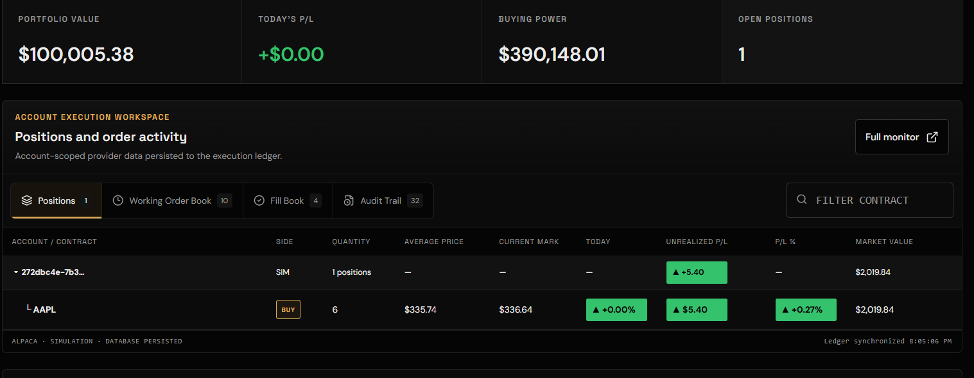
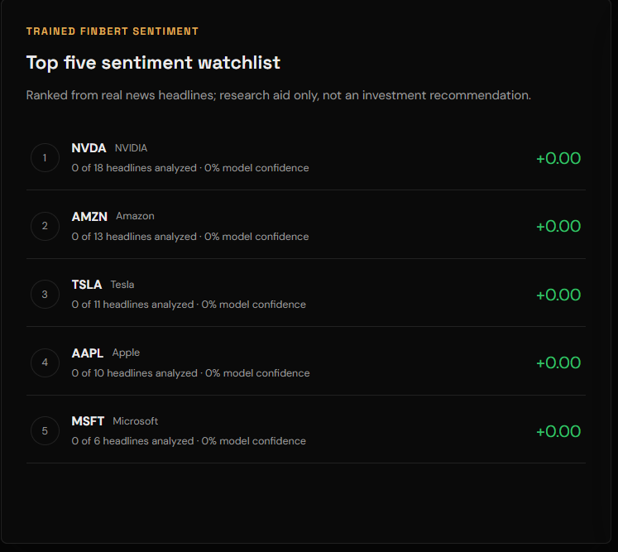
05
KEY RESULTS
One account view, refreshed after every trade.
The implementation now connects real positions to trained headline analysis and the same directional signal used across the workspace.
30
50
16
27
1
MAINTAINED LARGE-CAP STOCKS
MAXIMUM AGGREGATED ARTICLES
HEADLINES PER MODEL BATCH
FRONTEND TESTS PASSING
SHARED MOVEMENT PREDICTION
TRADING WENS • 5 / 7
Notes:
Screenshots were captured from the Trading Wens application supplied with this submission.
Figures are implementation bounds or verified test counts, not trading-performance claims.

Slide 6
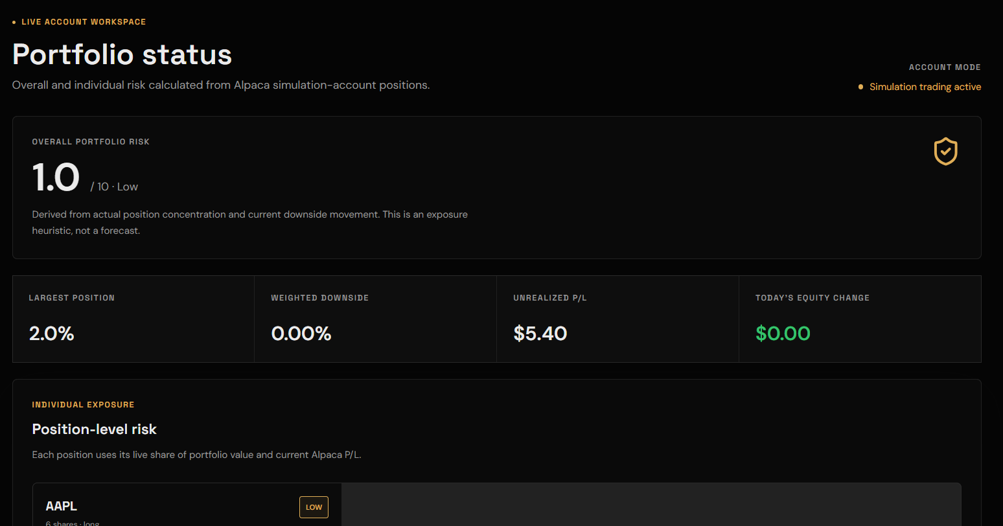
06
DOMAIN IMPACT
A clearer bridge from event intelligence to exposure.
For financial research teams, speed matters only when the evidence and the affected position remain visible together.
WHY THIS MATTERS
Surveillance
Rank issuer events by evidence, direction, and exposure instead of headline volume alone.
Explainability
Keep source URLs, model identity, confidence, current mark, and position side in the review path.
Portfolio context
Aggregate individual adverse exposure into one interpretable portfolio signal without losing symbol-level detail.
Extendable to issuer monitoring, credit events, and index constituents
TRADING WENS • 6 / 7
Notes:
The screenshot uses Alpaca simulation-account positions and the application risk heuristic.
Potential S&P Global and Crisil use cases are proposed extensions, not claims of deployment inside either organization.

Slide 7
07
LIMITATIONS AND NEXT STEPS
Keep the signal honest. Make the evidence stronger.
The current system is a working decision-support prototype. The next phase is disciplined validation, not a larger promise.
CURRENT LIMITS
NEXT THREE RELEASES
No price guarantee
Direction is a thresholded signal, not a forecast contract or investment recommendation.
01
02
03
Provider dependence
Calibrate
Cluster
Monitor
Coverage and freshness depend on entitlement, publication latency, and source availability.
Walk-forward evaluation and neutral thresholds
Group repeated coverage into one event
WebSockets, drift, latency, and provider health
Heuristic portfolio risk
The score is interpretable exposure, not full VaR, stress loss, or regulatory capital.
Trading Wens
Evidence first. Position aware. Explicitly uncertain.
TRADING WENS • 7 / 7
Notes:
Close by naming limits before ambition. The project should be judged as a traceable prototype, not a claim of profitable forecasting.
Add the confirmed college identity and unlisted demo video link before final submission.

