Slide 1
A Mechanism for Screening Individuals Vulnerable to Depression using Speech
09-04-26

Slide 2
DAIC (Distress Analysis Interview Corpus) Dataset
Train set consist of 107 interviews -
30 depressed
77 non-depressed
Dev set consist of 35 interviews-
12 depressed
23 non-depressed
Test set consist of 47 interviews-
14 depressed
33 non-depressed

Slide 3
Methodology
Pre-processed the audio sample by extracting participant’s speech data and silence removal.
Used TSFEL library to extract 156 features per segment. Then we vertically stacked 4 different aggregations(mean, max, min, std). So, total 156*4 = 624 features per segment.
Further used random forest classifier with 200 decision trees to train the model.

Slide 4
Results (each segment is treated as a single sample)
Threshold : 0.3
Segment Length | Train F1 Score | Dev F1 Score | Test F1 Score
3 sec | 0.728 | 0.270 | 0.321
5 sec | 0.790 | 0.231 | 0.322
7 sec | 0.833 | 0.244 | 0.332
9 sec | 0.853 | 0.238 | 0.325
11 sec | 0.863 | 0.220 | 0.334

Slide 5
Results (each segment is treated as a single sample)
Threshold : 0.4
Segment Length | Train F1 Score | Dev F1 Score | Test F1 Score
3 sec | 0.893 | 0.201 | 0.336
5 sec | 0.932 | 0.174 | 0.339
7 sec | 0.954 | 0.165 | 0.344
9 sec | 0.957 | 0.174 | 0.377
11 sec | 0.966 | 0.147 | 0.353

Slide 6
Results (each segment is treated as a single sample)
Threshold : 0.5
Segment Length | Train F1 Score | Dev F1 Score | Test F1 Score
3 sec | 0.924 | 0.140 | 0.286
5 sec | 0.954 | 0.114 | 0.304
7 sec | 0.972 | 0.113 | 0.307
9 sec | 0.980 | 0.081 | 0.329
11 sec | 0.983 | 0.070 | 0.324

Slide 7
Results (each segment is treated as a single sample)
Threshold : 0.6
Segment Length | Train F1 Score | Dev F1 Score | Test F1 Score
3 sec | 0.830 | 0.103 | 0.177
5 sec | 0.868 | 0.070 | 0.210
7 sec | 0.905 | 0.091 | 0.191
9 sec | 0.920 | 0.052 | 0.201
11 sec | 0.942 | 0.033 | 0.219

Slide 8
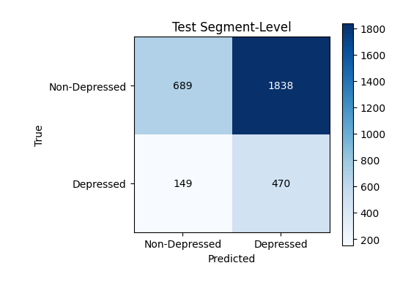
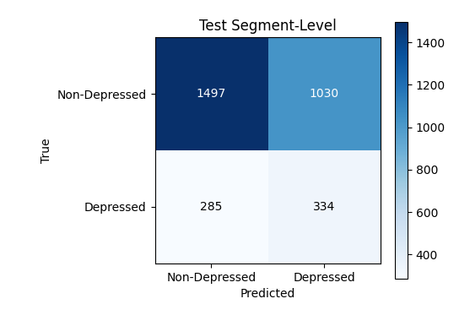
Results (seg length = 3sec)
Threshold : 0.3, F1: 0.321
Threshold : 0.4, F1: 0.336

Slide 9
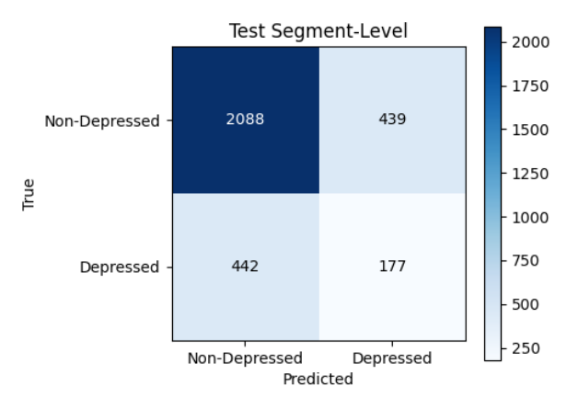
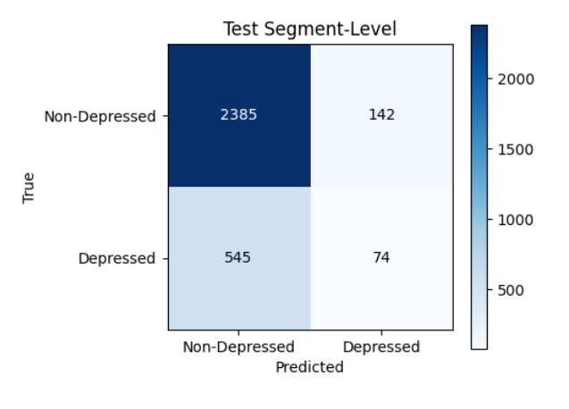
Results (seg length = 3sec)
Threshold : 0.5, F1: 0.286
Threshold : 0.6, F1: 0.177

Slide 10
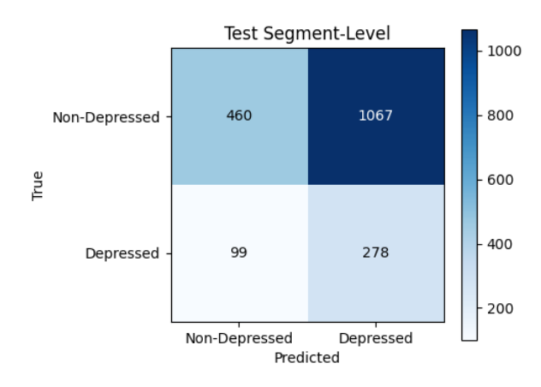
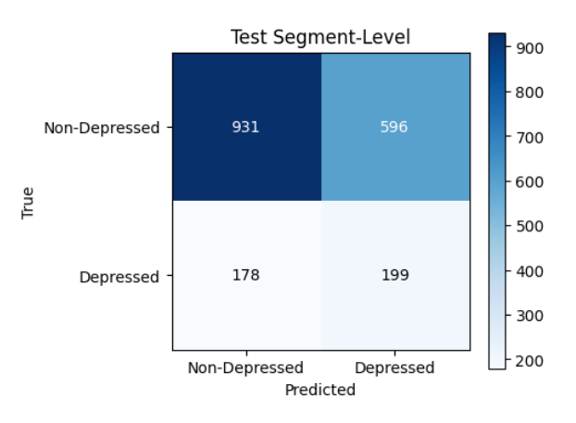
Results (seg length = 5sec)
Threshold : 0.3, F1: 0.322
Threshold : 0.4, F1: 0.339

Slide 11
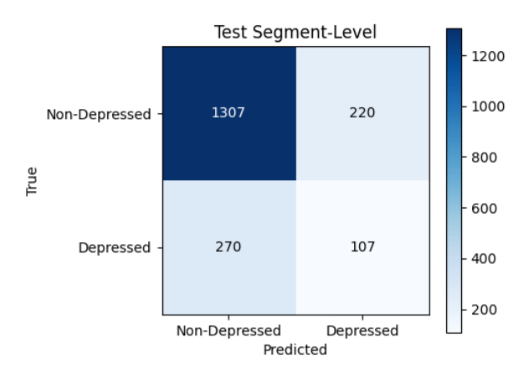
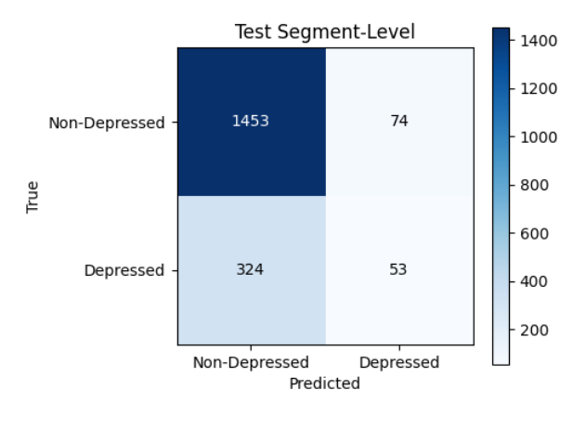
Results (seg length = 5sec)
Threshold : 0.5, F1: 0.304
Threshold : 0.6, F1: 0.210

Slide 12
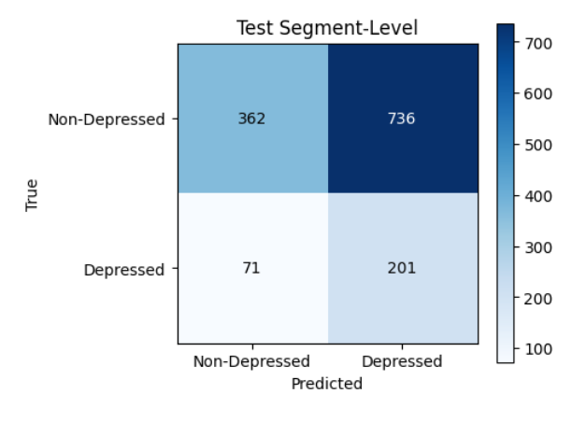
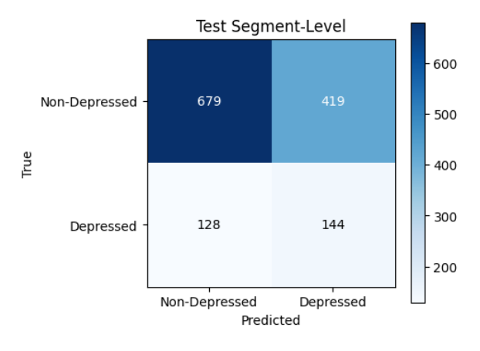
Results (seg length = 7sec)
Threshold : 0.3, F1: 0.332
Threshold : 0.4, F1: 0.344

Slide 13
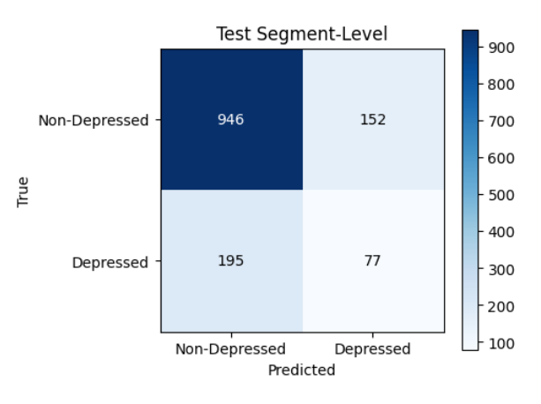
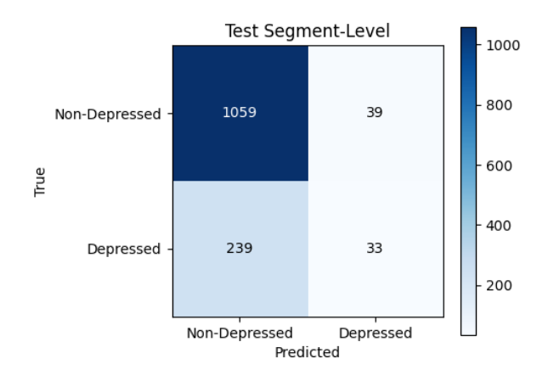
Results (seg length = 7sec)
Threshold : 0.5, F1: 0.307
Threshold : 0.6, F1: 0.191

Slide 14
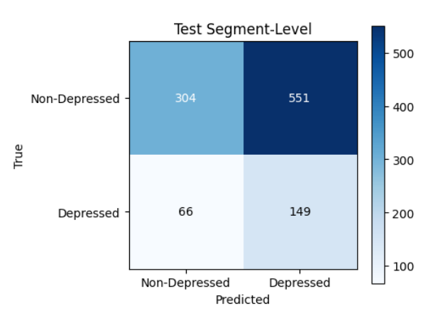
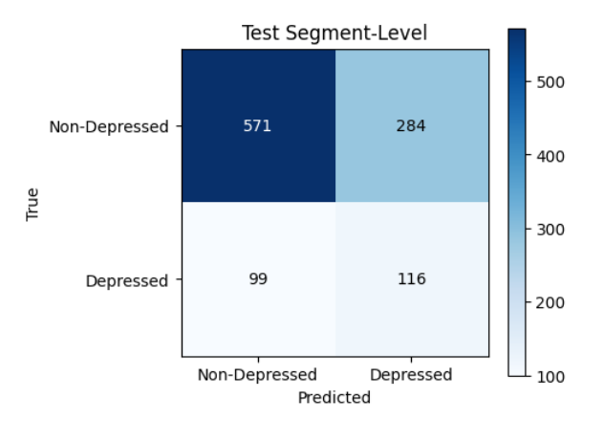
Results (seg length = 9sec)
Threshold : 0.3, F1: 0.325
Threshold : 0.4, F1: 0.377

Slide 15
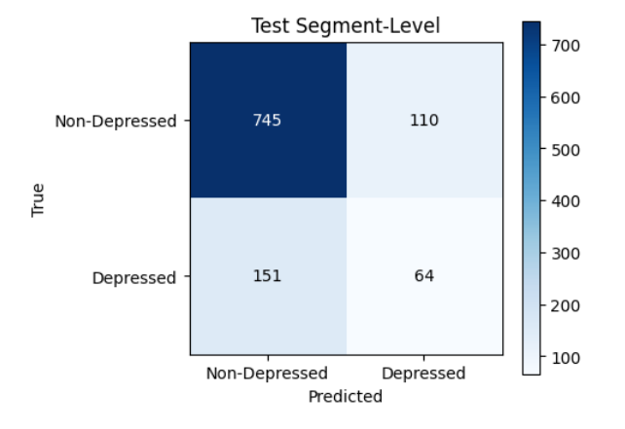
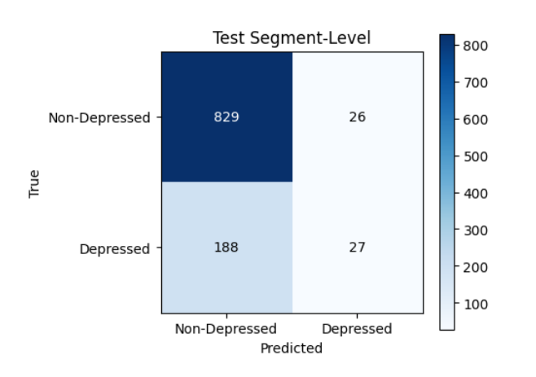
Results (seg length = 9sec)
Threshold : 0.5, F1: 0.329
Threshold : 0.6, F1: 0.201

Slide 16
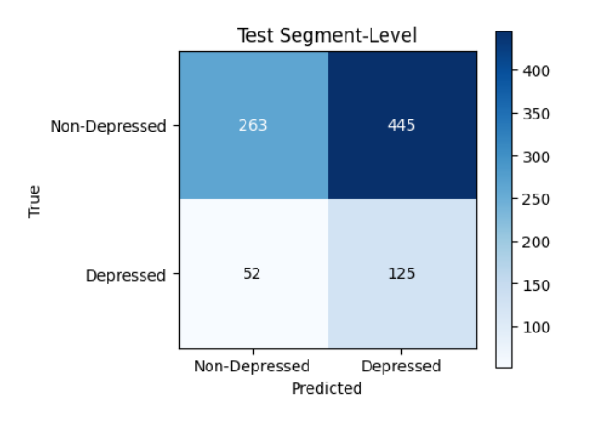
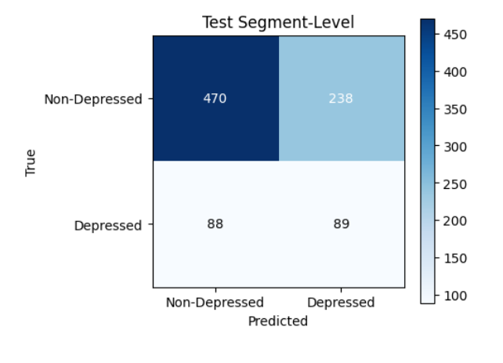
Results (seg length = 11sec)
Threshold : 0.3, F1: 0.334
Threshold : 0.4, F1: 0.353

Slide 17
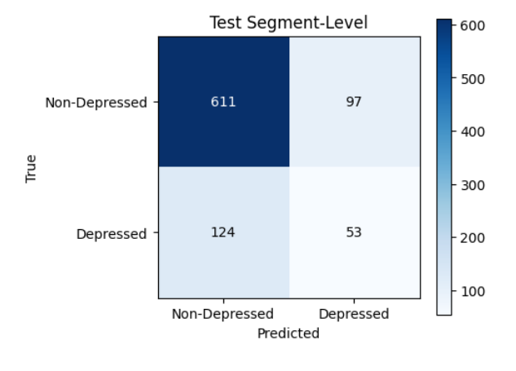
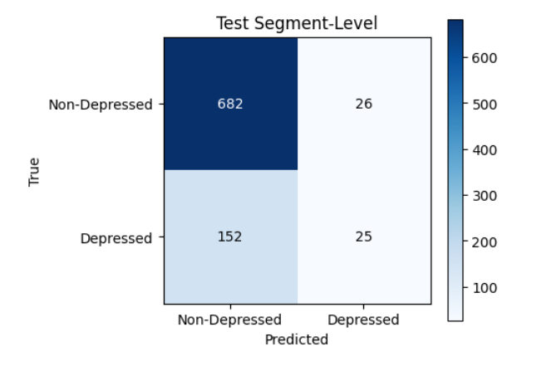
Results (seg length = 11sec)
Threshold : 0.5, F1: 0.324
Threshold : 0.6, F1: 0.219

Slide 18
Thanks

