Slide 1

DepreechX
Towards Interactive Systems for Interpretable Depression Screening via Speech
12 June, 2025

Slide 2
Feature Set
#10 features from the pause histogram
#10 MFCC features
#20 features per frame

Slide 3
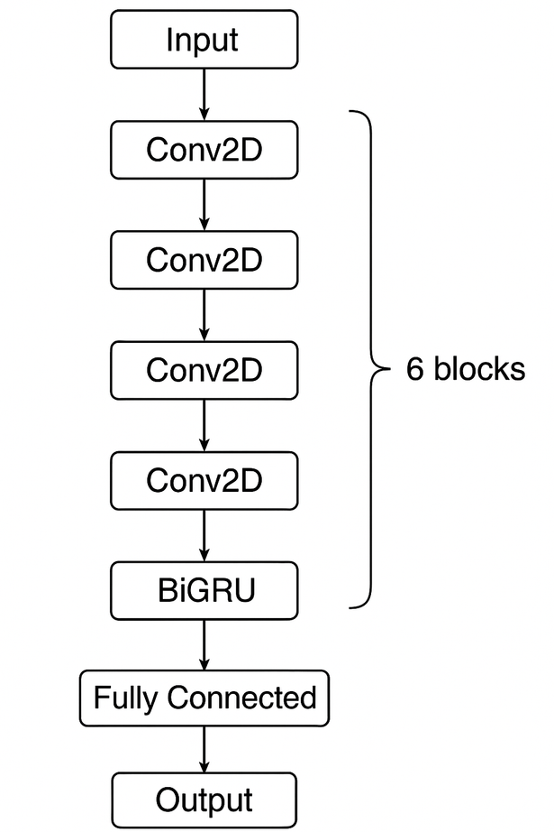
Model Architecture
#6 2D-convolutional layers
Followed by 1 Layer BiGRU.

Slide 4
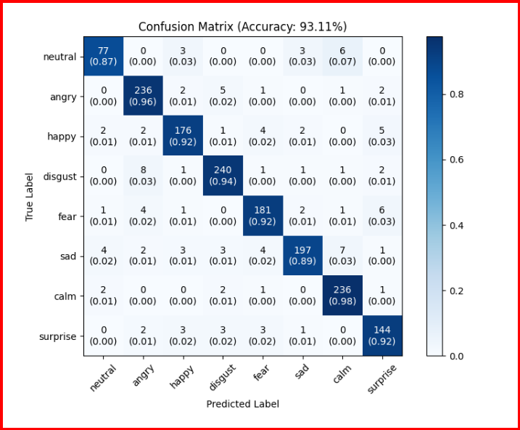
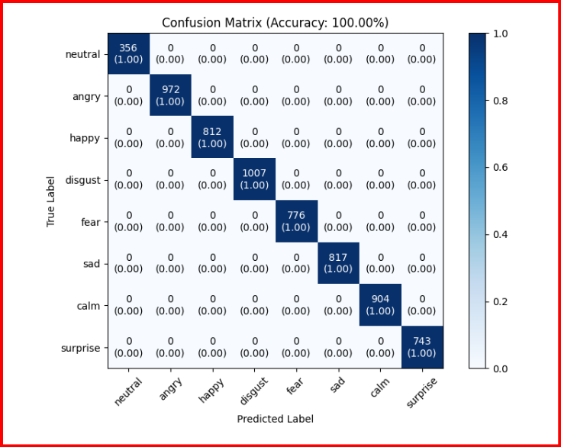
2DCNN + 1-layer-BiGRU model - Confusion Matrix
Validation Set
Training Set

Slide 5
Testing on YouTube Audio Clips
#5 samples from each of the 5 speakers under one emotion category.
#25 samples per emotion class
For #3 emotion classes - [Happy, Neutral, and Sad]
#75 samples

Slide 6
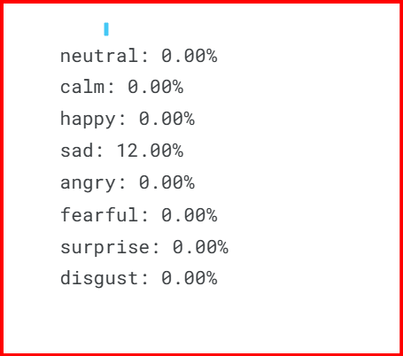
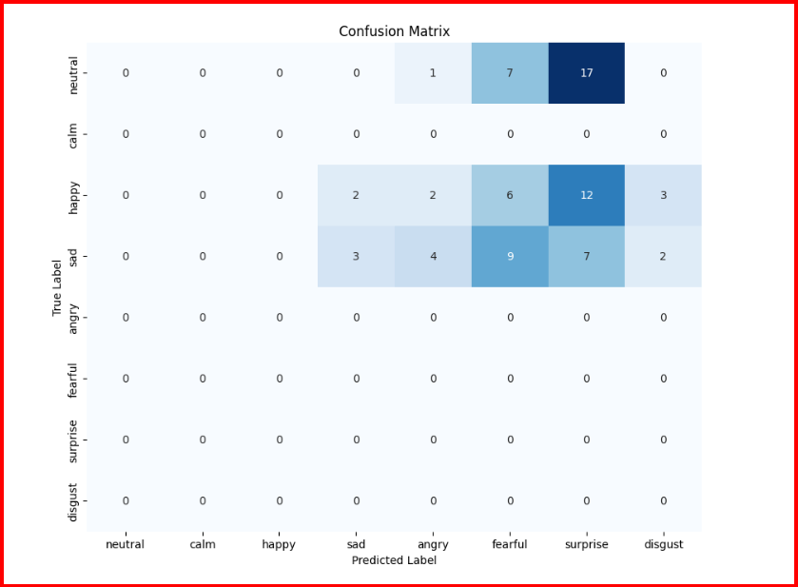
Result on own dataset
Accuracy per class

Slide 7
Paper
Enhanced Speech Emotion Recognition Using Averaged Valence Arousal Dominance Mapping and Deep Neural Networks (25th June 2024)
by Davit Rizhinashvili · Abdallah Hussein Sham · Gholamreza Anbarjafari

Slide 8
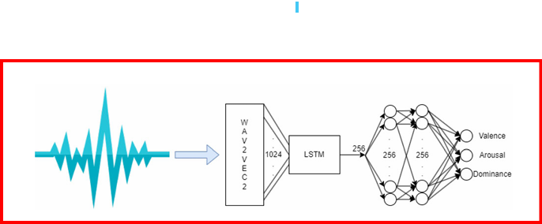
Aim
Development of robust VAD mapping.
The paper introduces a SER model based on pre-trained Wave2Vec 2.0, followed by LSTM networks and linear layers.

Slide 9
Methodology to Generate Reference VAD Embedding
Used three different pre-trained networks for the generation of VAD embedding.
Grouped results based on 8 emotions and averaged them to generate a reference embedding on the RAVDESS dataset.

Slide 10
Datasets
For training purposes: RAVDESS dataset ( 1440 audio files of 24 professional actors (12 female, 12 male)
For testing purposes:
CREMA-D(Crowd-sourced Emotional Multimodal Actors Dataset) is a dataset of 7442 original clips from 91 actors coming from various races and ethnicities.
EMO-DB(Berlin Database of Emotional Speech) is a data set of 535 audio clips from 10 actors (5 male, 5 female) spoken in German.
TESS(Berlin Database of Emotional Speech) is a set of 200 target words by two actresses(aged 26 and 64 years) recording seven emotions. There are #2800 samples in the TESS dataset.

Slide 11
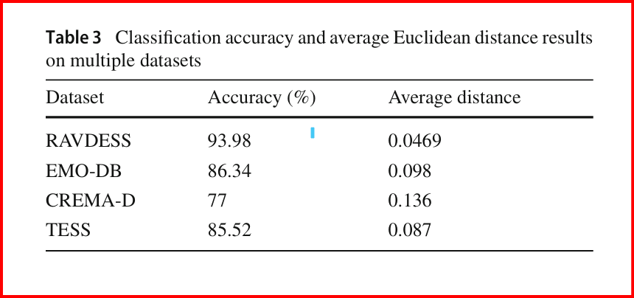
Results

Slide 12
Thank you

