Slide 1

DepreechX
Towards Interactive Systems for Interpretable Depression Screening via Speech
15 May, 2025

Slide 2
Feature Set
#3 features from pause histogram of the frame
Mean Pause Duration
Std. of Pause Durations
Total Pause Count
#2 extra features
RMS value
Std. of Energy
Total #5 features per frame

Slide 3
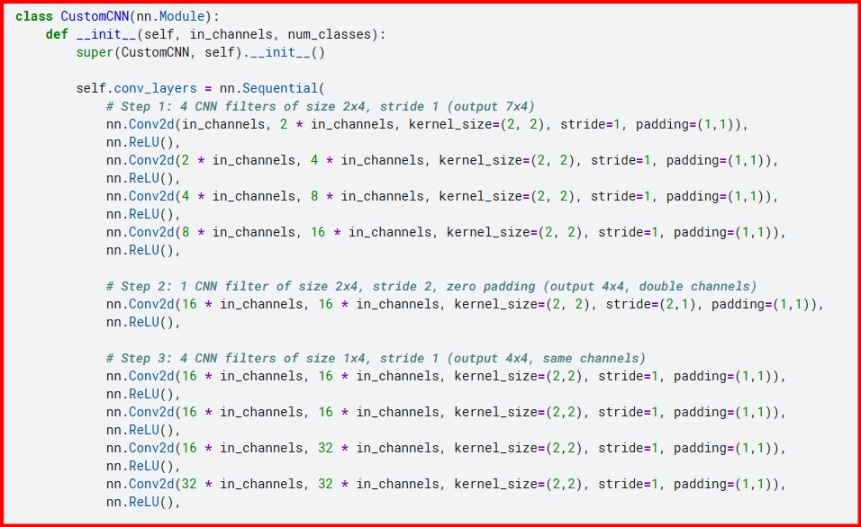
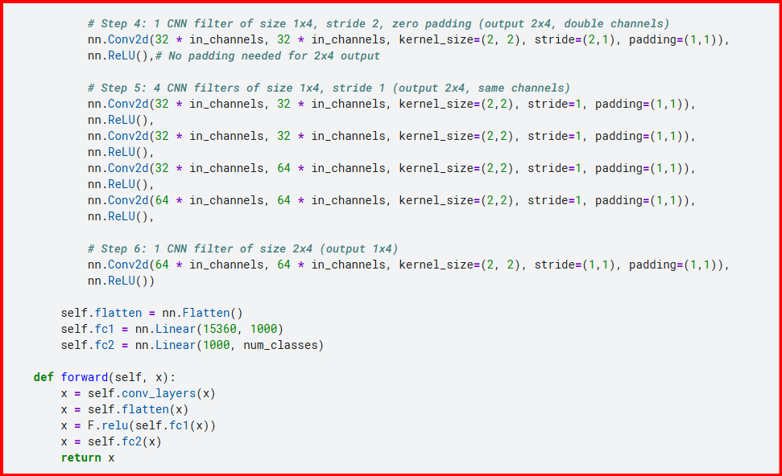
Model 1

Slide 4
Model 1 Results - Comparision between window sizes
Category/Window Size | 20 ms | 60 ms | 80 ms | 300 ms
Accuracy (30 epochs) Test Acc Train Acc | 15.56 15.84 | 16.26 15.08 | 15.56 15.84 | 16.26 15.08

Slide 5
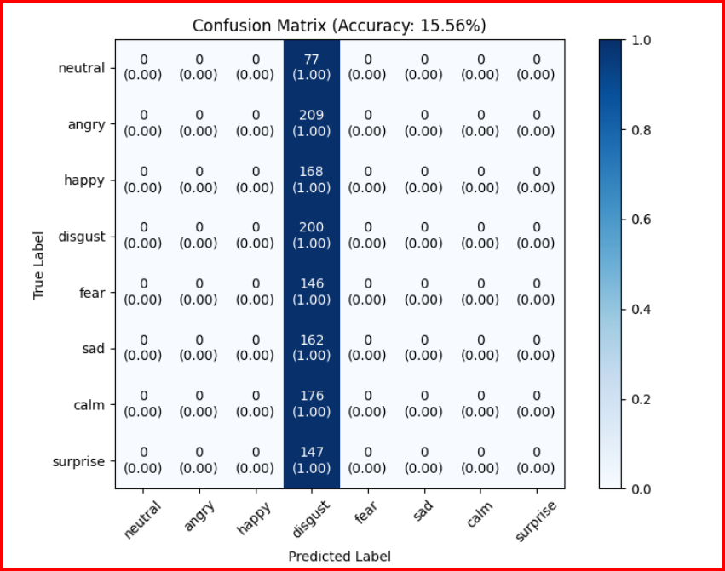
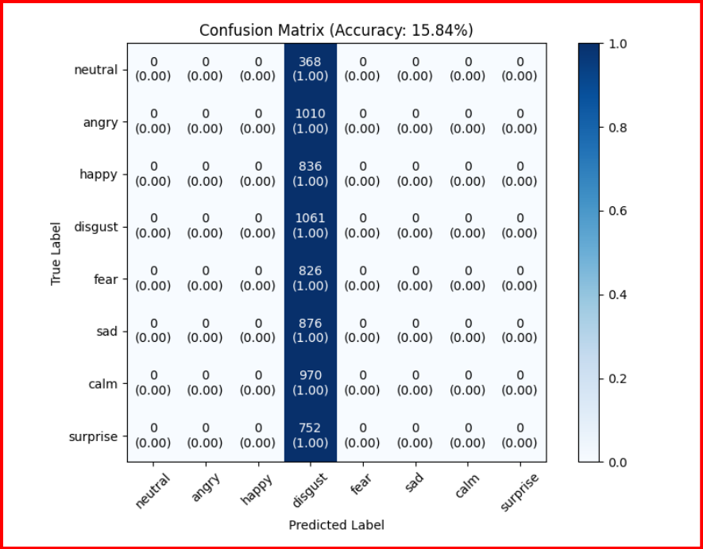
Model 1 Results - Confusion Matrix (20 ms)
Validation Set
Training Set

Slide 6
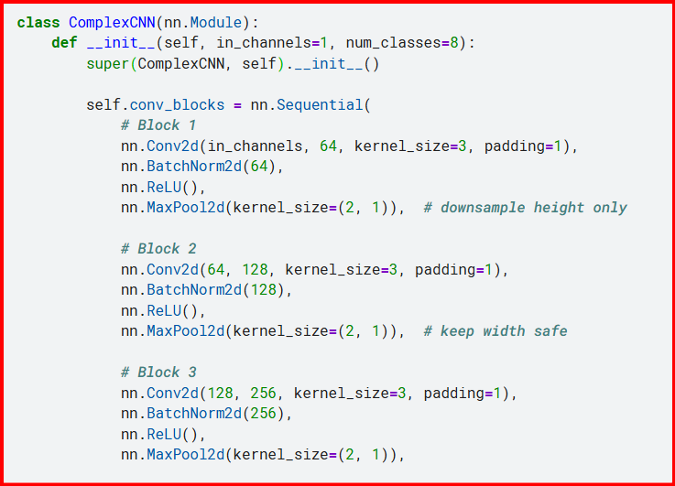
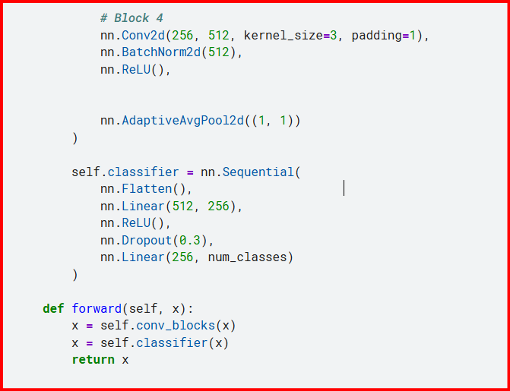
Model 2

Slide 7
Model 2 Results - Comparision between window sizes
Category/Window Size | 300 ms
Accuracy (60 epochs) Test Acc Train Acc | 31.14 43.92
Accuracy (150 epochs) Test Acc Train Acc | 29.71 40.48

Slide 8
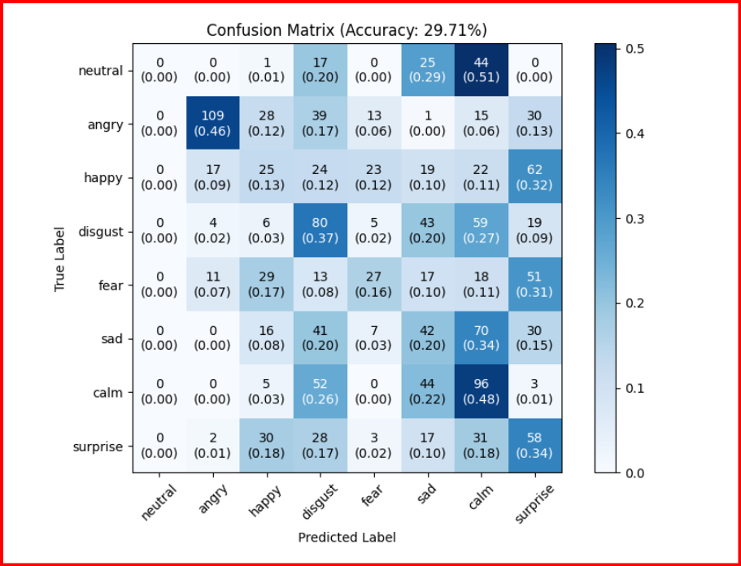
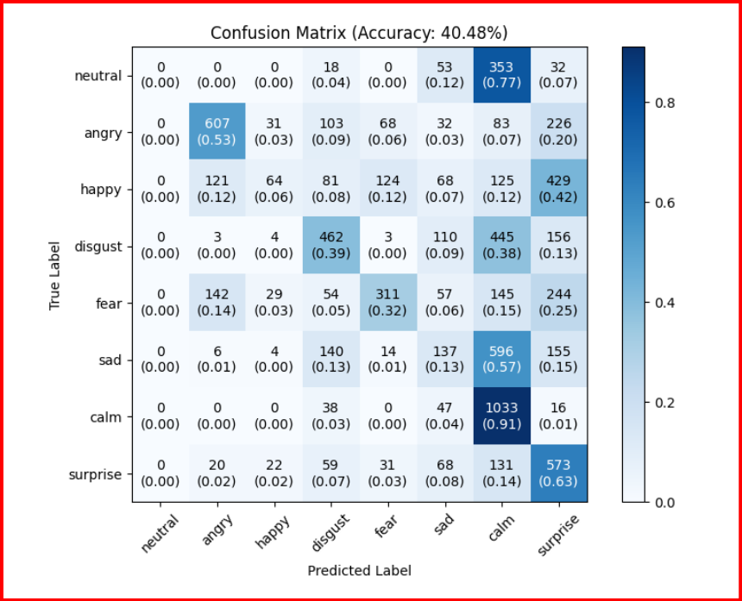
Model 2 Results - Confusion Matrix(150 epochs)
Validation Set
Training Set

Slide 9
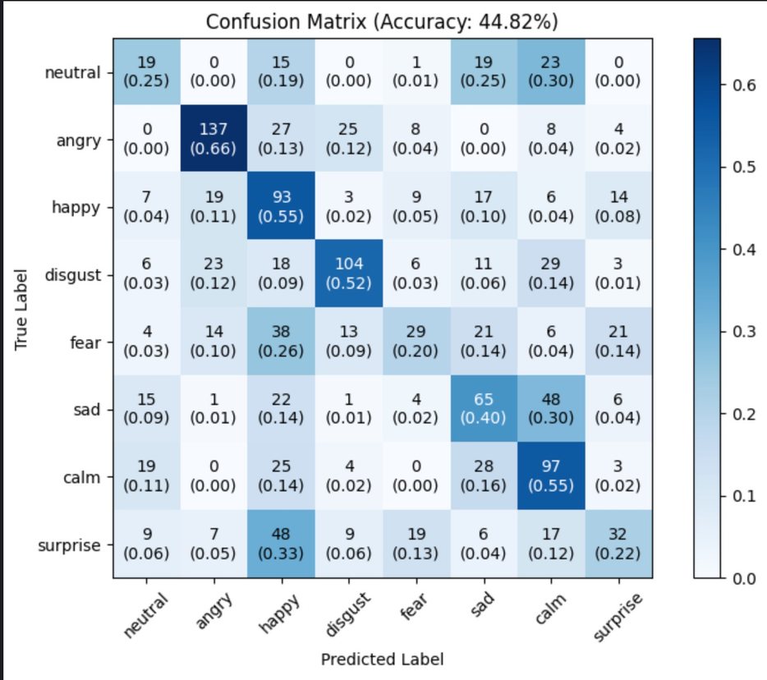
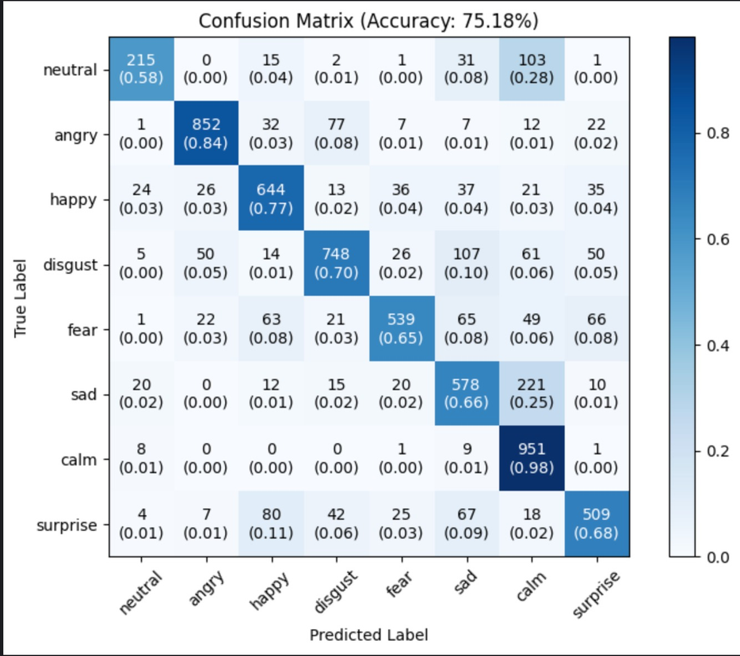
Model -3 (1D Convolutional Neural Network)
Validation Set
Training Set

Slide 10
Thank you

