Slide 1

DepreechX
Towards Interactive Systems for Interpretable Depression Screening via Speech
22 May, 2025

Slide 2
5 - Feature Set
#3 features from pause histogram of the frame
Mean Pause Duration
Std. of Pause Durations
Total Pause Count
#2 extra features
RMS value
Std. of Energy
Total #5 features per frame

Slide 3
20 - Feature Set
10 features from pause histogram
10 features from melspectogram

Slide 4
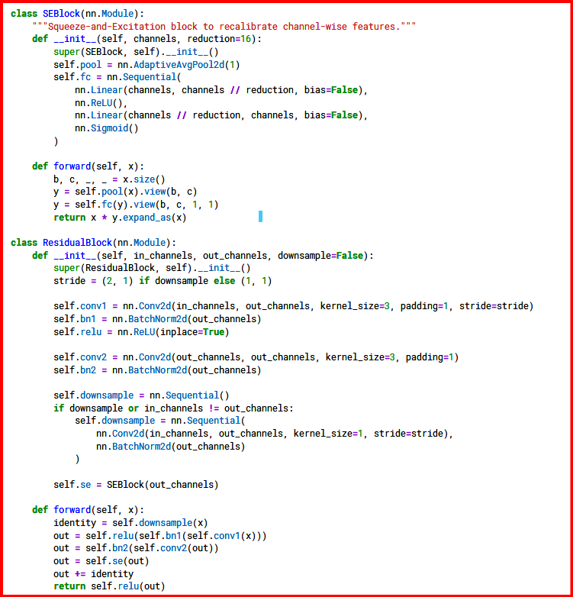
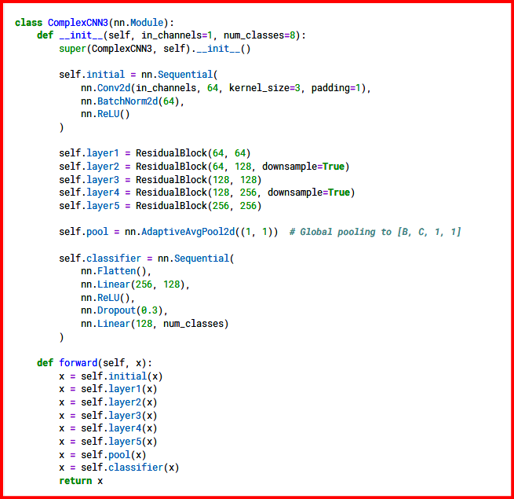
Model - (Squeeze and Excitation + Residual Blocks along with 2D CNN

Slide 5
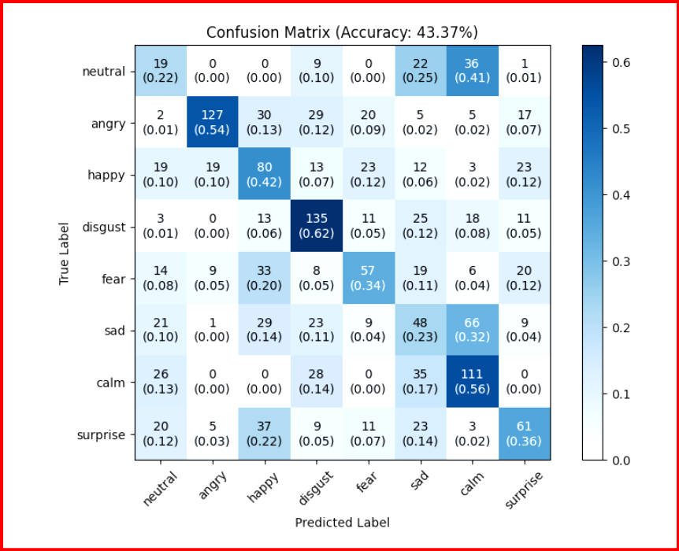
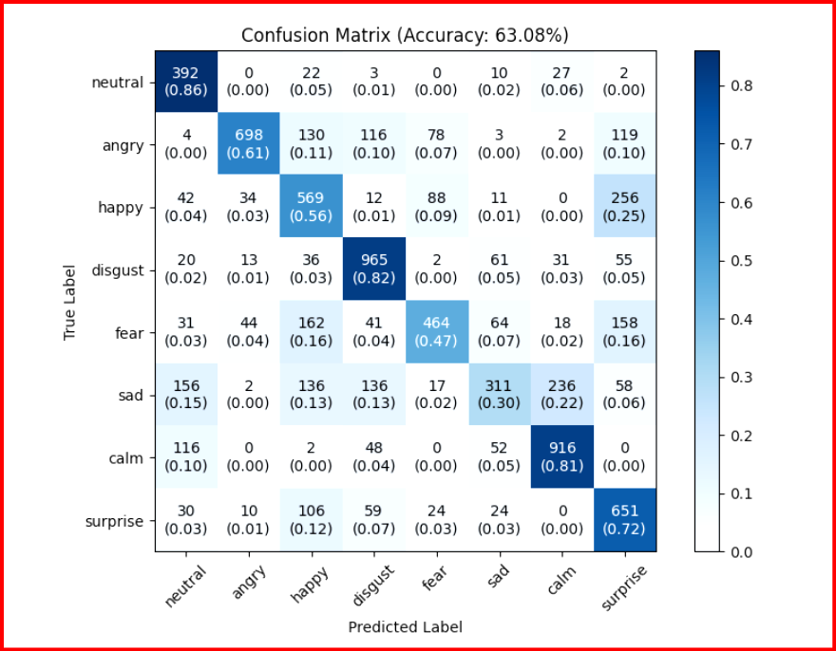
Model Results (window size - 300ms)
Validation Set
Training Set

Slide 6
Model Results - Comparison between window sizes
Category/Window Size | 20 ms | 60 ms | 80 ms | 300 ms
Accuracy (20 feature set) Test Acc Train Acc | 48.47 62.62 | 44.53 57.83 | 45.07 57.44 | 43.37 63.08
Accuracy (5 feature set) Test Acc Train Acc | 32.36 40.42 | 35.42 41.46 | 33.51 41.69 | 29.03 38.02

Slide 7

1D CNN + LSTM Model Architecture
6 1D Convolution Layers
LSTM Layer
FC Layer
Input Waveform
Shape - (1,N)
Intermediate Representation
Shape - (512,N/64)
Final Representation
Shape - (1,512)
Logits
Shape - (1,8)

Slide 8
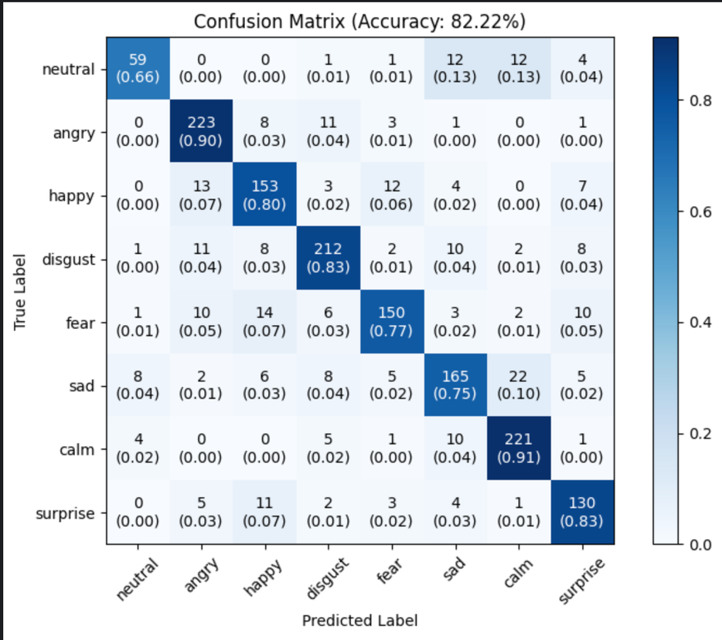
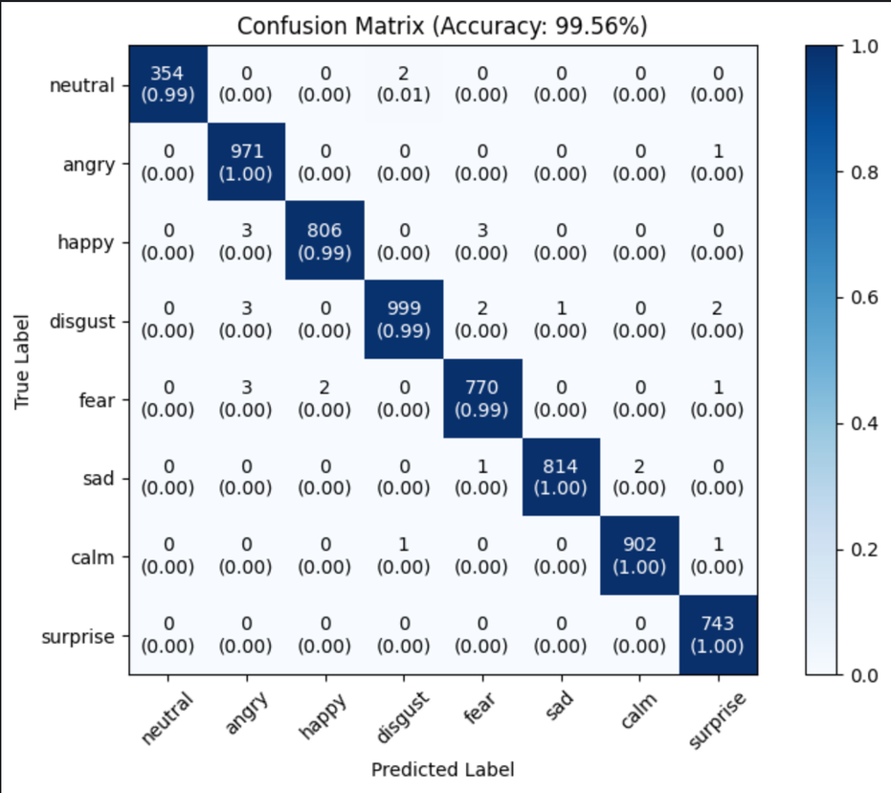
1D CNN + LSTM Model Results
Validation Set
Training Set

Slide 9
Thank you

